Slide 1
Plaintextgen
Klemens Schindler and Eugen Schindler
Text generation using the MPS templates mechanism

Slide 2
“Disclaimer” ☺
Anything that we say is our own personal opinion and in no way represents our employer or any other institutions.

Slide 3
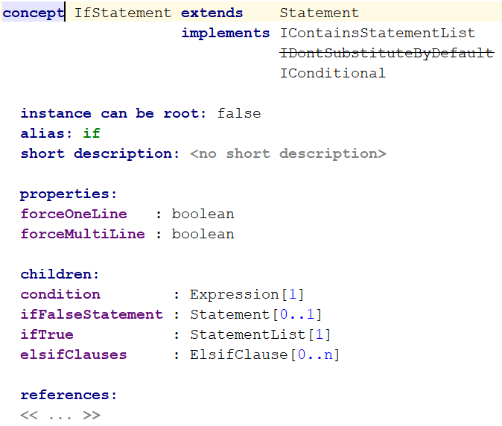
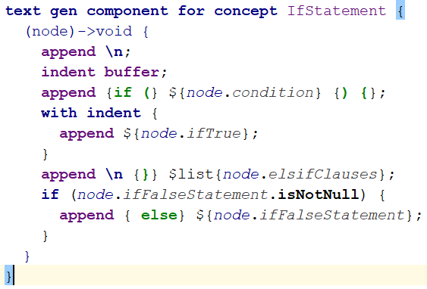

MPS textgen aspect
Simple model-to-text scenarios with small cognitive gap.
Input model fragment:
Notes:
Textgen usually used for very simple model-to-text scenarios where the cognitive gap between the model and the generated text is minimal (preferably cognitive gap is 0, i.e. model and text are 1:1), e.g.: translate a baseLanguage if-statement to a java if-statement or translate an attribute from an XML model to XML text

Slide 4
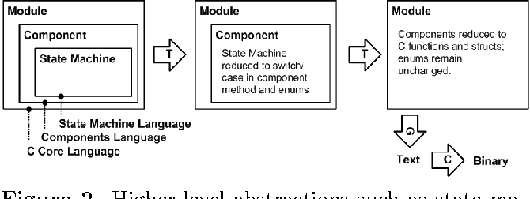
MPS textgen aspect
Often-used approach in MPS for generating to non-fully-supported languages: create a minimum “generation target language” that is easy to textgen.
Harsh reality: often needed text from various abstraction levels and layers in DSLs, especially when kickstarting and during evolution.
Notes:
Java and C are well-modeled in MPS and generation is easy. In 2013 we did a talk called “Model-driven without shortcuts”. JetBrains also told the story of enforcing nice abstraction layers and not breaking them.
Harsh reality we learned: in the beginning, use a lot of workarounds to get results quickly and then incrementally make it “perfect”.
How many “minimum generation target” languages are you going to have and maintain, just to spit out a “stupid textfile”. The picture is from Markus Völter’s explanation of mbeddr.

Slide 5
Plaintextgen history
Enter com.dslfoundry.textgen-multilanguage: using Sascha Lisson’s (now Itemis) richtext to write text and template it, but:
No performance
Difficult to tweak (richtext not meant for generation extensions and manipulating much text)
Enter org.campagnelab.TextOutput: very simple model of words and lines that makes it possible to use the normal reduction rules., but:
Tedious to write bigger templates
Not enough control over layout (grayspacing, horizontal, vertical)
No simple templating from existing text
Enter com.dslfoundry.plaintextgen:

Slide 6
Plaintextgen “principles” & features
Encapsulate textgen aspect & emulate textual-editor appearance (taking editor performance into account)
Model elements of plaintext allowing more maintainable & understandable text generators
Performant, so you don’t need to switch back to textgen
Resemble editor language (textual part) → so one less MPS DSL to learn
Support “classic” text-templating scenarios
Features:
Paste-in support
Word-splitting

Slide 7
Plaintextgen features & usage
Features:
Paste-in support (Remi Bosman †2018)
Powerful layout engine (Remi Bosman †2018)
Word-splitting
Editor-like wrapping intentions
When standard-mechanism not enough → plaintextflow
General advice: always use only plaintextgen and just skip textgen altogether, examples:
For quickly getting text out of any model on any abstraction level
For generating to GPLs or horizontal DSLs (e.g. markup languages) that are not yet fully modeled in MPS
Markus Völter has asked to add plaintextgen to MPS Extensions (maintained by Itemis)
JetBrains uses plaintextgen (gives migration pull-requests to plaintextgen github repo)

Slide 8
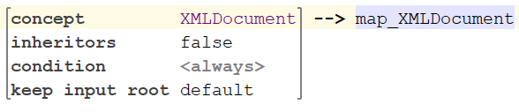
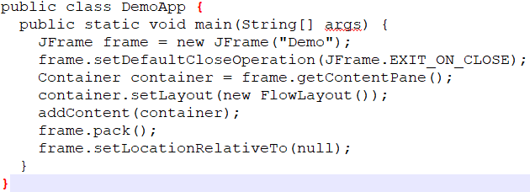
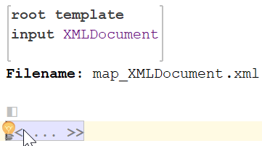
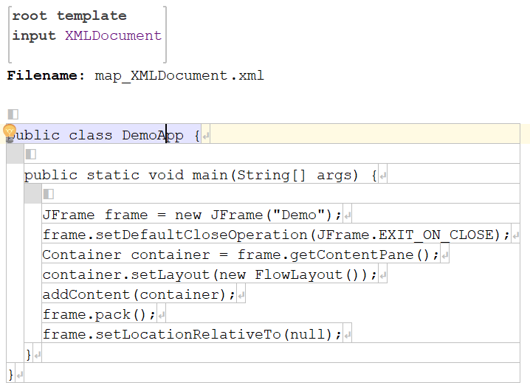
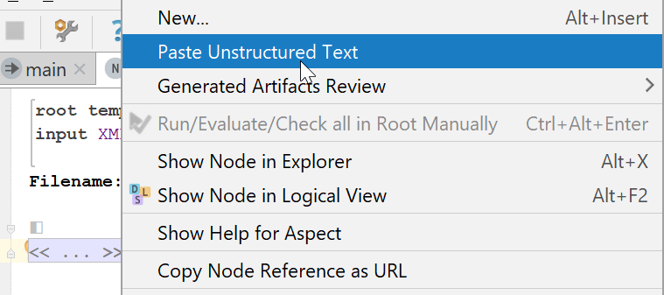
Typical plaintextgen scenarios
Create textual template
Paste into analyzer
Templatize
Demo

Slide 9
Bonus: plaintextflow

Slide 10
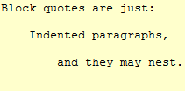
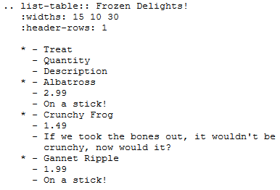
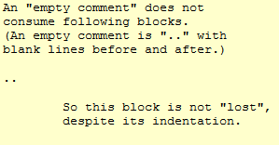
Whitespace-sensitive generation target: reStructuredText

Slide 11

Plaintextgen vs Plaintextflow
Structure is:
VerticalLines/IndentedText
Line
Word
Similar to an MPS editor or a “div” in HTML
Newline in Word should not be used by design, but behaves as hard wrap (reset to text column 0)
Newline provided by Line is always a soft wrap (respects indentation)
For introducing newlines, the structure has to be decided up-front
Indentation symbols may only consist of whitespace and not extra symbols

Slide 12
Plaintextgen vs Plaintextflow
Structure is:
Flow
FlowWord
HardWrap/SoftWrap
Similar to a “stream of words” or a “span” in HTML
Nesting between concepts is flexible
No newlines are inserted by structure unless explicitly inserted
Every Flow can introduce indentation. Indentation symbol is duplicated on each SoftWrap

Slide 13
Future of plaintextgen
Highlights of interesting enhancements in the github issues:
Usability enhancements like context assist
Indenting nlists
Documentation & tutorial
Will become part of MPS Extensions
Gets even more important with generator tests
If you have ideas, bugs, feature requests please submit them as an issue on https://github.com/DSLFoundry/mps-plaintextgen/issues
If you want to help: yes please ☺ It’s only a “hobby project”
Thank you! Any questions left?

