Slide 1
MPS Generators
Eugen Schindler
Inspired by the MPS user manual and the “building maintainable generators” guide from Itemis

Slide 2
Index
What are (MPS) generators?
Model-to-model transformations
Templates
Mapping configurations & generator rules
Mapping labels
Mapping scripts
Generation context
The generator algorithm
Cross-model generation and generation plans
Model-to-text transformations
Common generator patterns (partially inspired by Itemis guide)
Basic dos and don’ts
Further reading

Slide 3
Index
What are (MPS) generators?
Model-to-model transformations
Templates
Mapping configurations & generator rules
Mapping labels
Mapping scripts
Generation context
The generator algorithm
Cross-model generation and generation plans
Model-to-text transformations
Common generator patterns
Basic dos and don’ts
Further reading

Slide 4
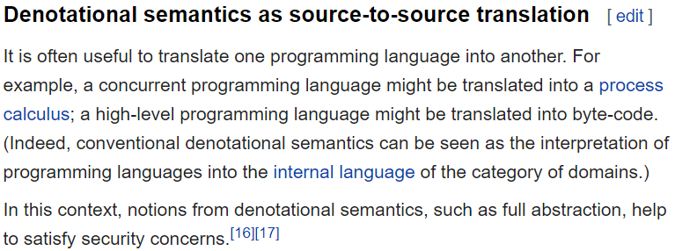
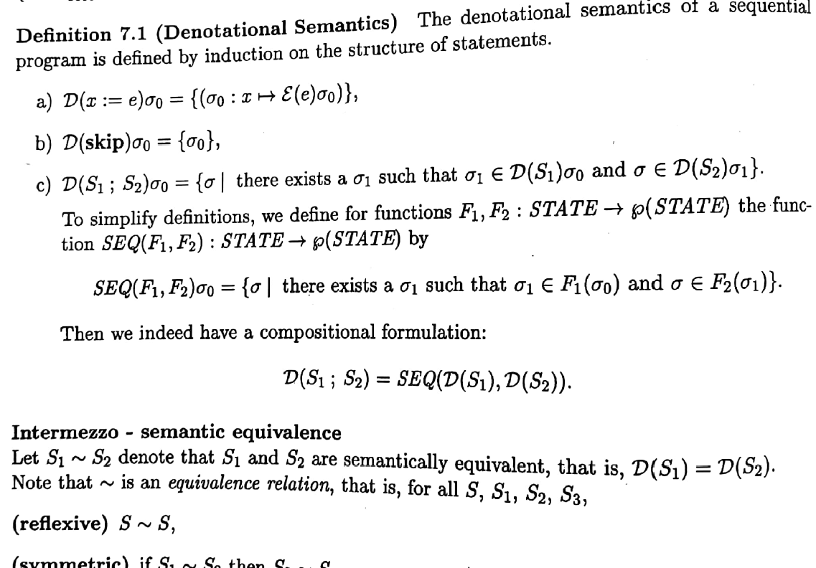
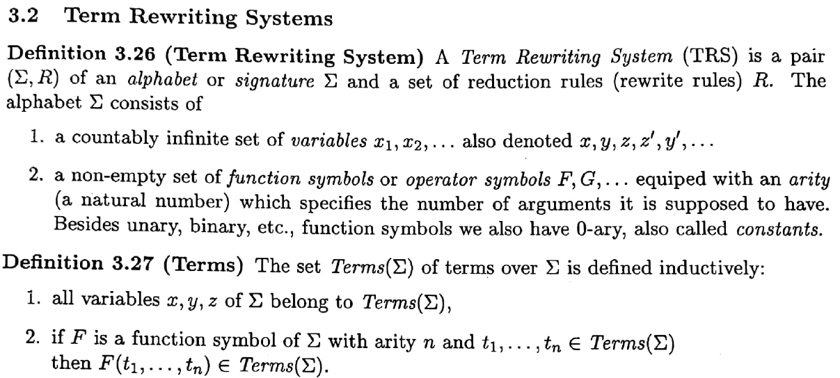
What are (MPS) generators?
Part of a language specification that defines denotational semantics for the concepts of the language
I would say: it’s a specification as you see them typically in term rewrite systems
Wikipedia (2005)
Syllabus “Berekeningsmodellen” TU/e (2002)

Slide 5
What are MPS generators?
Dedicated aspect of a language
Covers all model-to-model transformations
MPS generator engine responsible for performing transformations specified in generators
Model-to-text transformations (usally postponed until the last possible moment) officially covered by another aspect: textgen

Slide 6
Index
What are (MPS) generators?
Model-to-model transformations
Templates
Mapping configurations & generator rules
Mapping labels
Mapping scripts
Generation context
The generator algorithm
Cross-model generation and generation plans
Model-to-text transformations
Common generator patterns
Basic dos and don’ts
Further reading

Slide 7
Model-to-model transformations
Templates
Types of templates & template fragments
Template elements: macros
Mapping configurations & generator rules
Mapping configurations
Types of generator rules
Mapping labels
Generation context
The generator algorithm
Mapping scripts

Slide 8
Model-to-model transformations
Templates
Types of templates & template fragments
Template elements: macros
Mapping configurations & generator rules
Mapping configurations
Types of generator rules
Mapping labels
Generation context
The generator algorithm
Mapping scripts

Slide 9
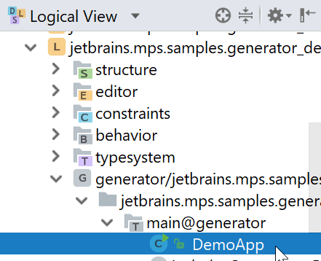
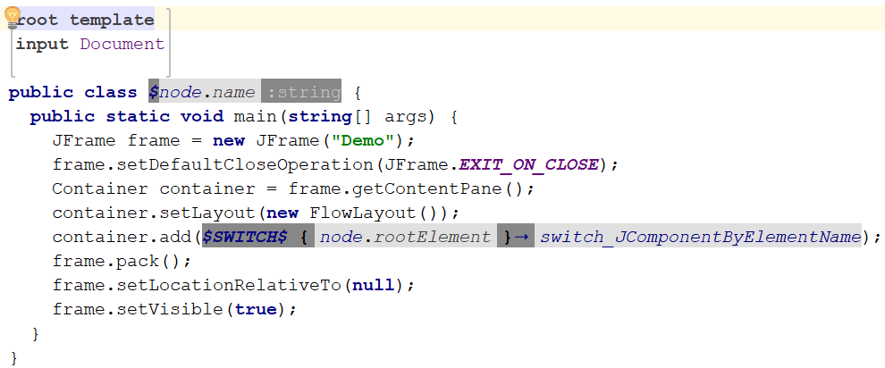
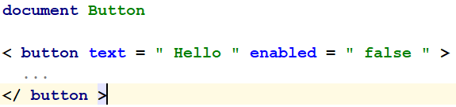
Templates
Input Model
Generator
Output Model
Transformations described by means of templates (in template declarations), which are written in the output language (i.e. the language of the output model)
Applicability of individual templates is defined by generator rules, which are grouped into mapping configurations
Root template (lives in a root node) → for producing a root node:
Root template
Input model
written in: jetbrains.mps.sampleXML
written in (language of output model): jetbrains.mps.baseLanguage (java)

Slide 10
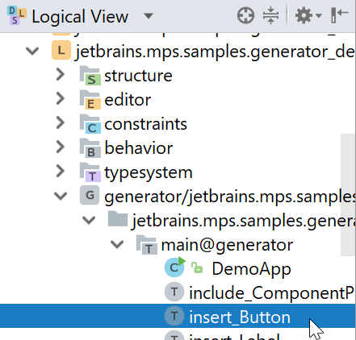
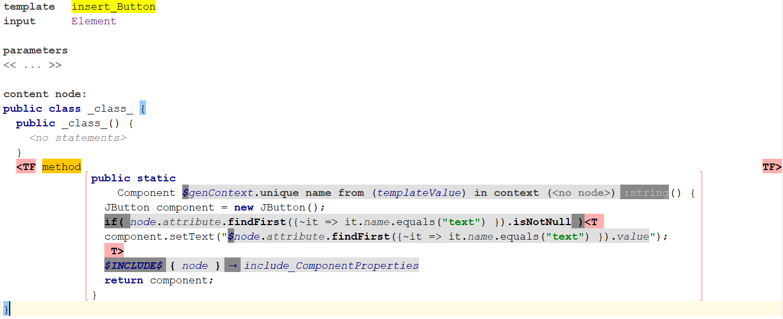
Templates
Input Model
Generator
Output Model
External template (lives in a root node) → for producing a non-root node:
Root template
Input model

Slide 11
Templates
Input Model
Generator
Output Model
Inline template (directly inside a generator rule) → for producing a non-root node:
Input model
Generator rule
Inline template

Slide 12
Templates
The actual template code is 'wrapped' in a template fragment. Any code outside template fragment is not used in transformation and serves as a context (for example you can have a Java class, but export only one of its method as a template).
Fragment

Slide 13
Model-to-model transformations
Templates
Types of templates & template fragments
Template elements: macros
Mapping configurations & generator rules
Mapping configurations
Types of generator rules
Mapping labels
Generation context
The generator algorithm
Mapping scripts

Slide 14
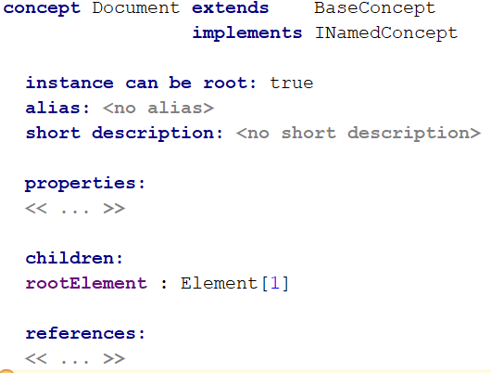
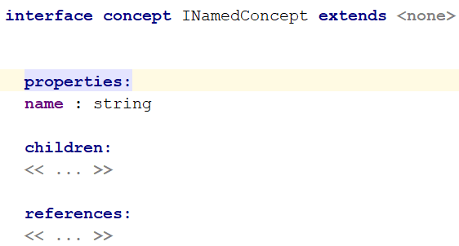
Macros - property
Input model
The code in templates can be parameterized through macros. The generator language defines three kinds of macros:
property macro - computes a property value;
reference macro - computes the target (node) of a reference;
node macro - used to control template filling at generation time. There are several versions of node macro: IF, LOOP, INCLUDE, CALL, SWITCH, COPY-SRC, COPY-SRCL, MAP-SRC, MAP-SRCL, and WEAVE.
Property macro:

Slide 15
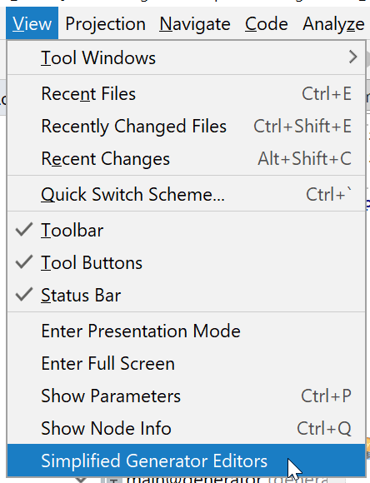
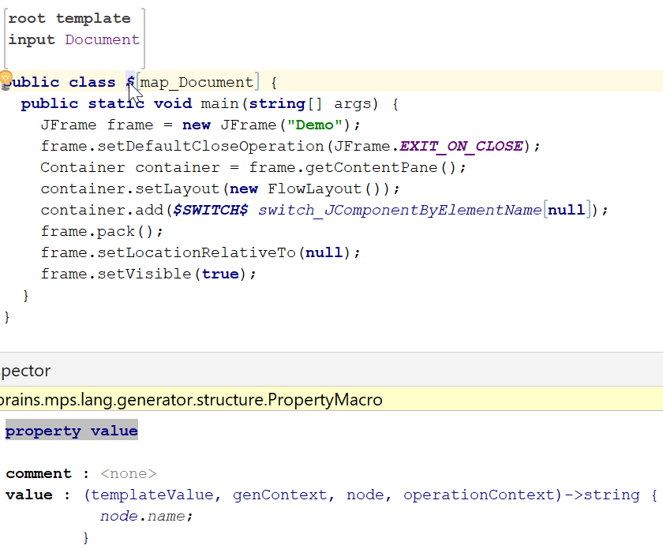
Macros – two views
MPS-specific default notation of macros quite different from many other (especially text-based) notations, using the inspector a lot. For people that don’t like this, there is now a (proof-of-concept) simplified view that makes it more like many others:
We will be using mostly the normal view.
Normal view
Simplified view

Slide 16
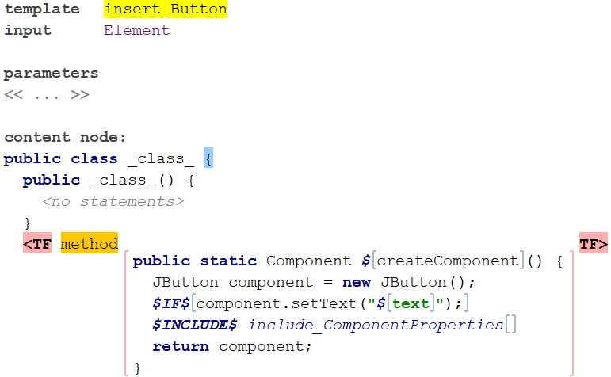
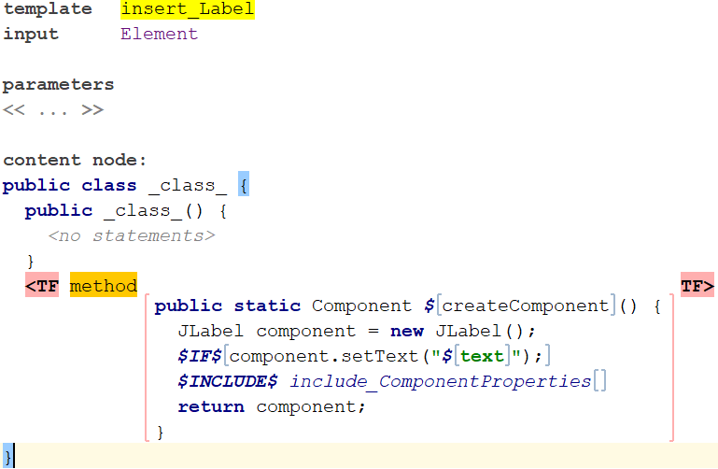
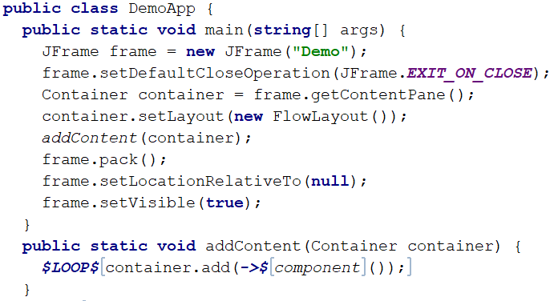
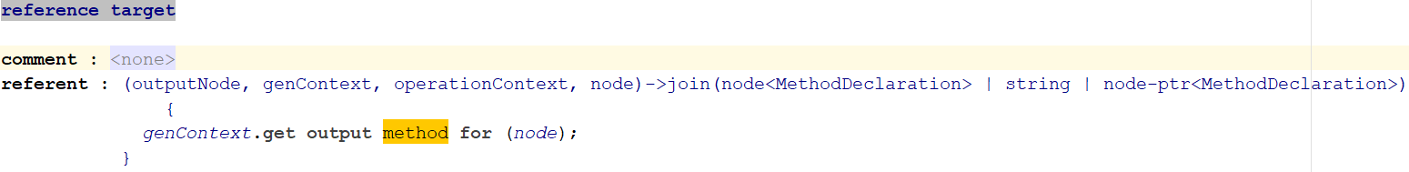
Macros - reference
Input model
Reference macro (very similar to property macro) → computes an actual reference in the output model (used together with mapping labels):
Root template
Inspector of reference macro

Slide 17
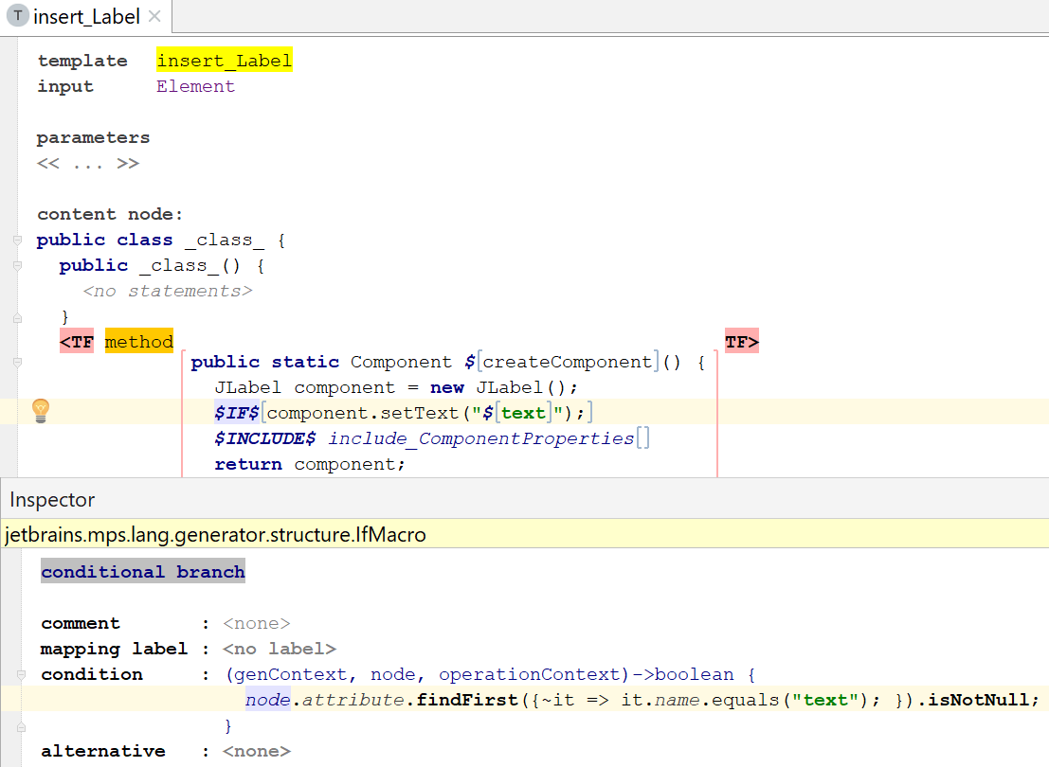
Macros - node
IF macro → The wrapped template code is applied only if the condition is true. Otherwise the template code is ignored and an 'alternative consequence' (if any) is applied:

Slide 18
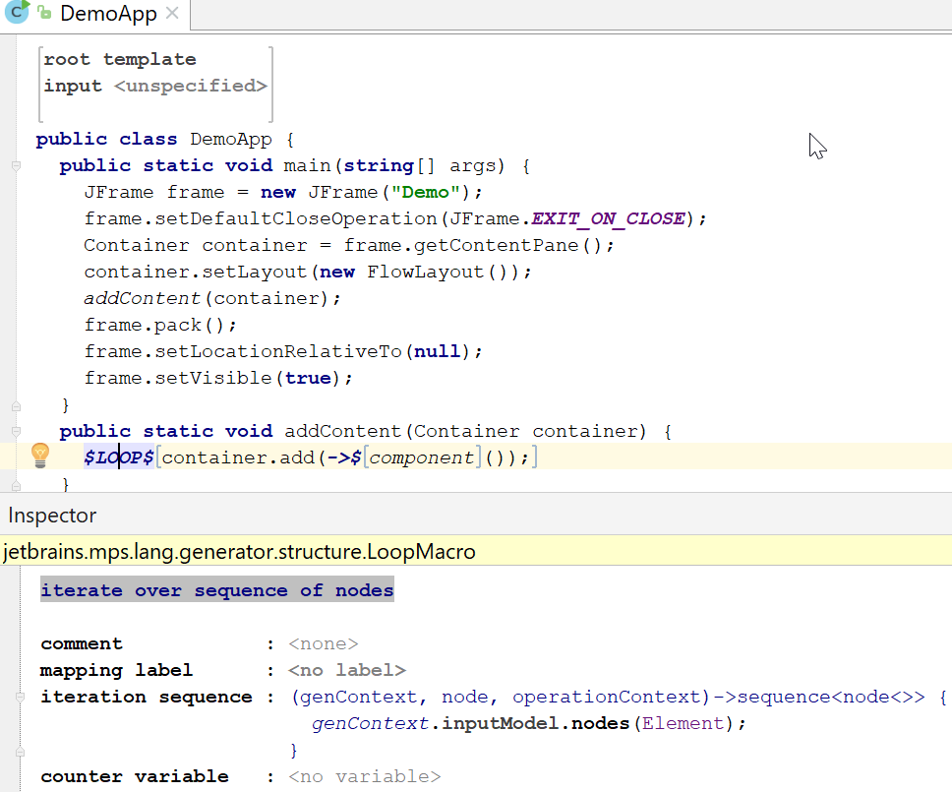
Macros - node
LOOP macro → Computes new input nodes and applies the wrapped template to each of them:

Slide 19
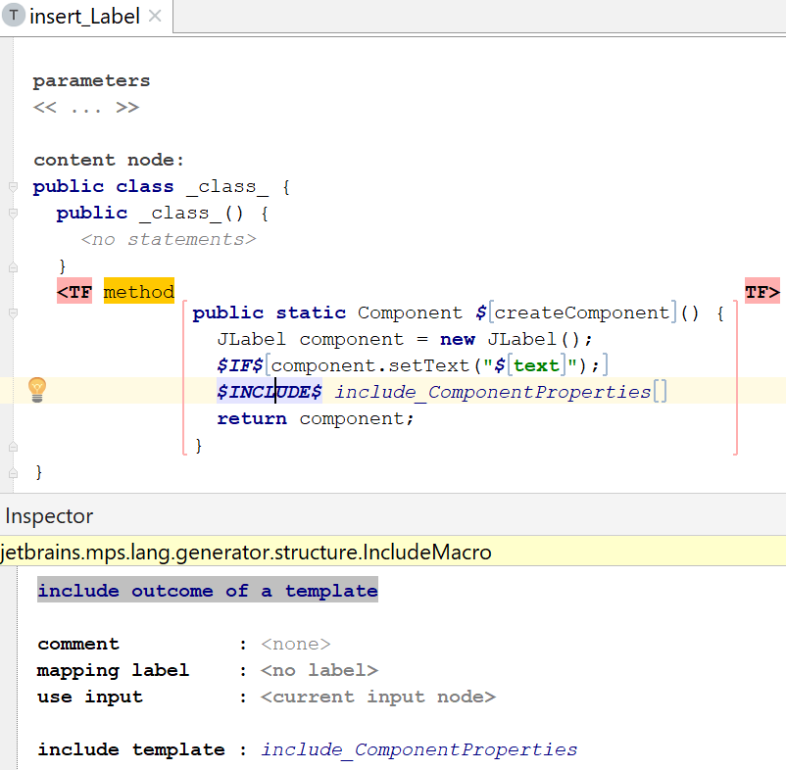
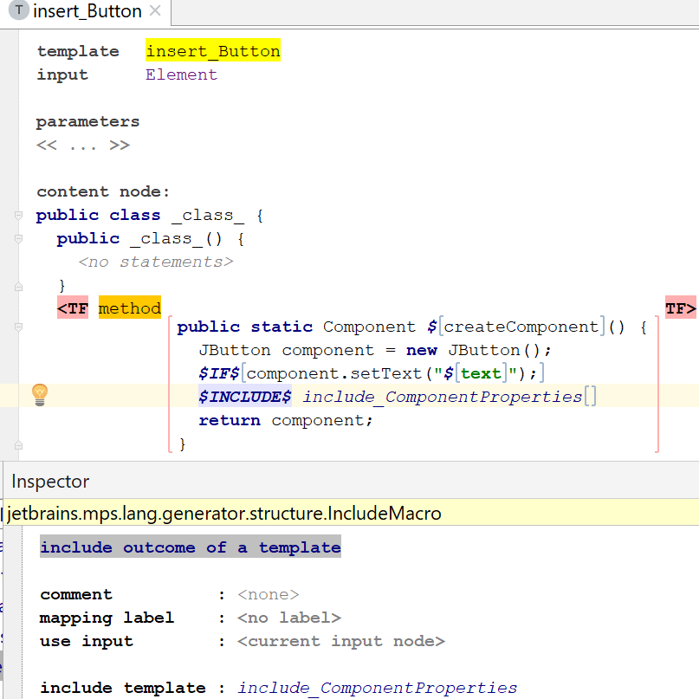
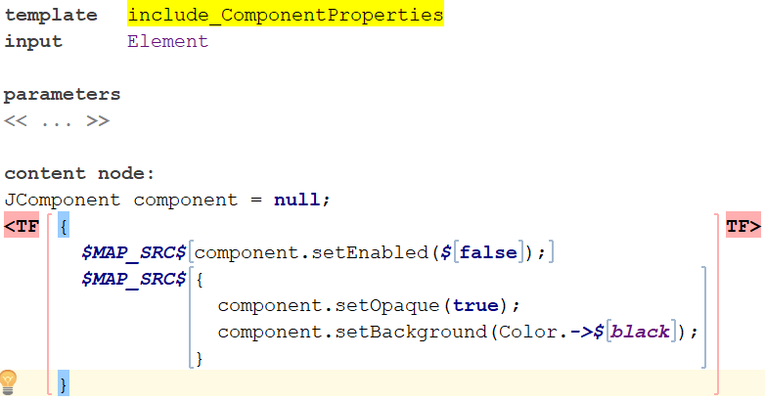
Macros - node
INCLUDE macro → The wrapped template code is ignored (it only serves as an anchor for the INCLUDE-macro), a reusable external template will be used instead:
Null input makes INCLUDE effectively a no-op.

Slide 20
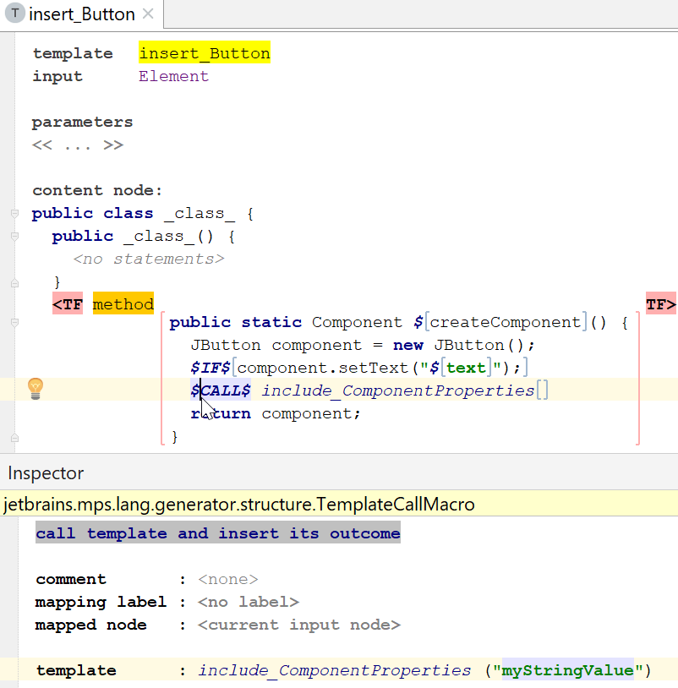
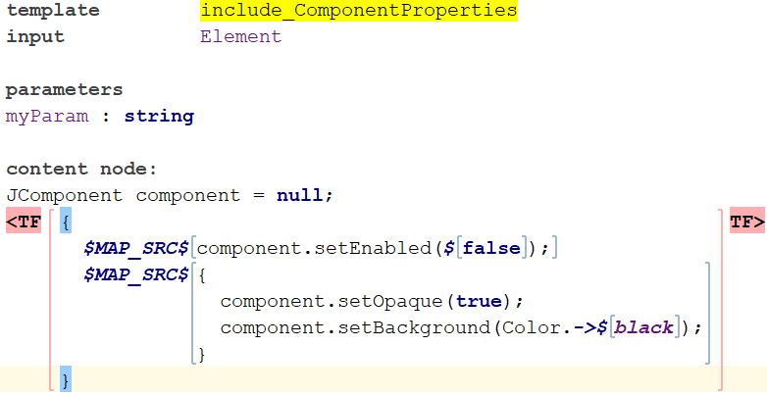
Macros - node
CALL macro → Invokes template and replaces wrapped template code with the result of template invocation. Supports templates with parameters.
Null input node is tolerated, and the template is ignored altogether in this case, i.e. CALL yields empty collection of nodes as a result when input/mapped node is null.

Slide 21
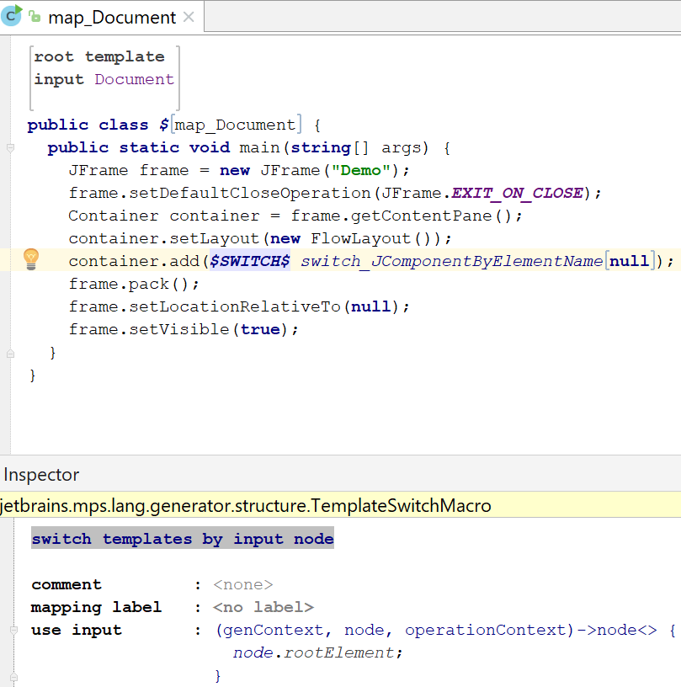
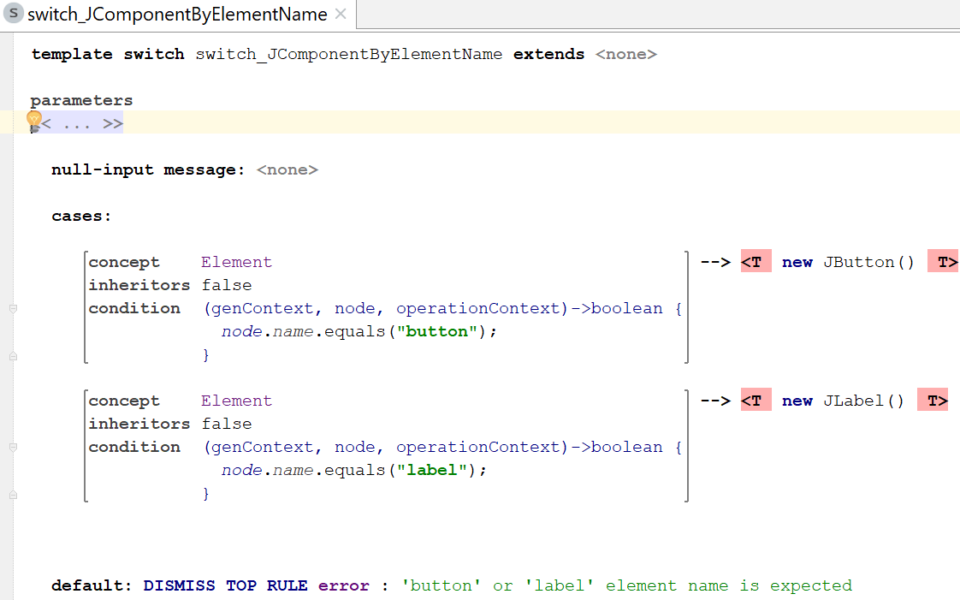
Macros - node
SWITCH macro (used with a template switch) → Provides a way to many alternative transformations in the given place in the template code.
The wrapped template code is applied, if none of switch cases is applicable and no default consequence is specified in template switch.
For null input node, SWITCH may react with a message (specified along with its rules), anchor template node is ignored, and SWITCH macro yields no results.

Slide 22
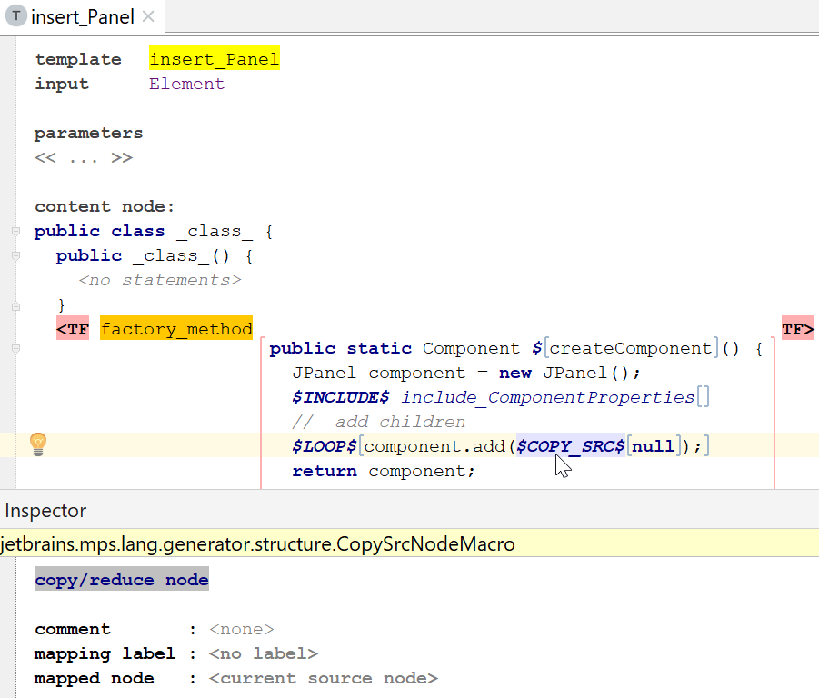
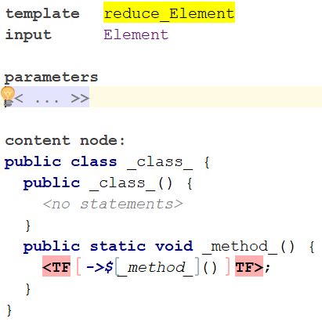
Macros - node
COPY_SRC macro → Copies an input node to the output model. The wrapped template code is ignored.

Slide 23
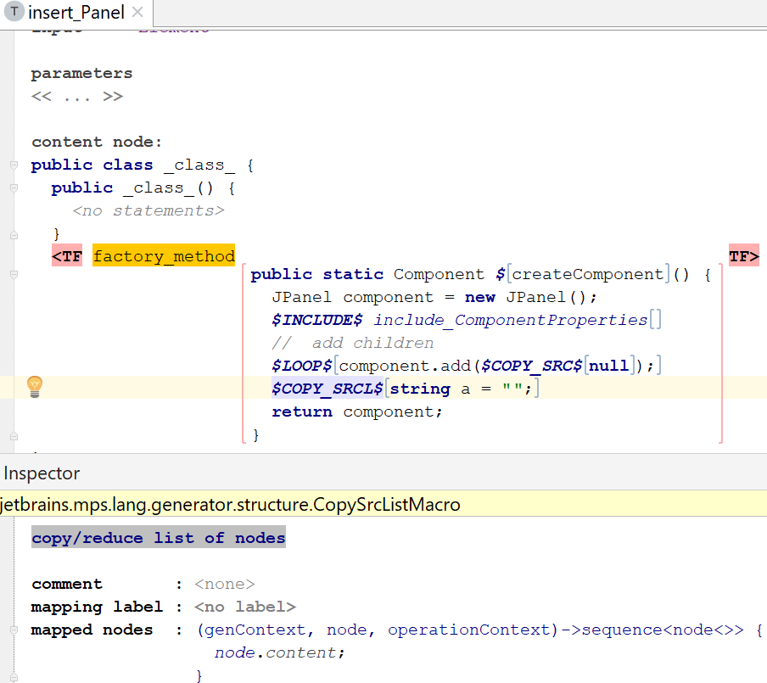
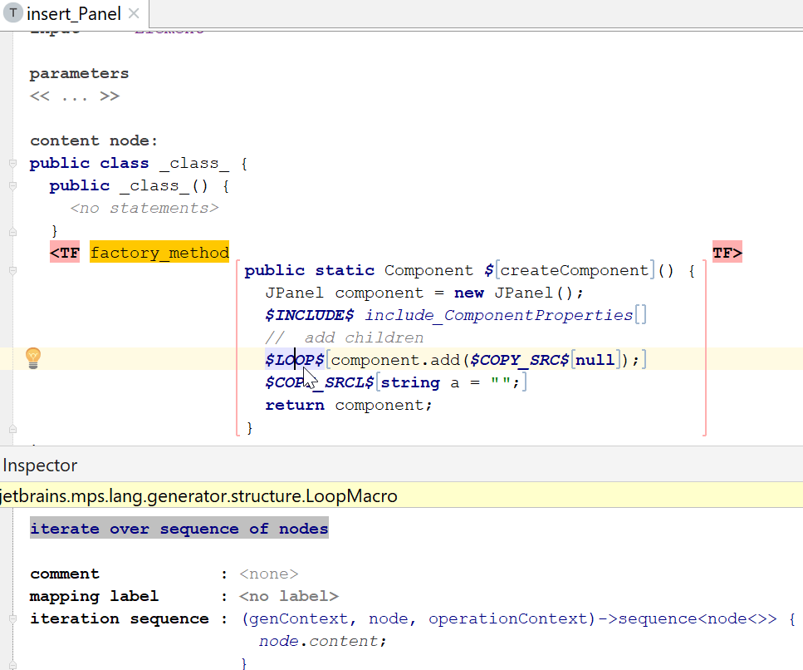
Macros - node
COPY_SRCL macro → same a COPY_SRC, but can be applied to an list of nodes instead of only one node.
$COPY_SRCL[…] can be seen as syntactic sugar for $LOOP[$COPY_SRC[…]]

Slide 24
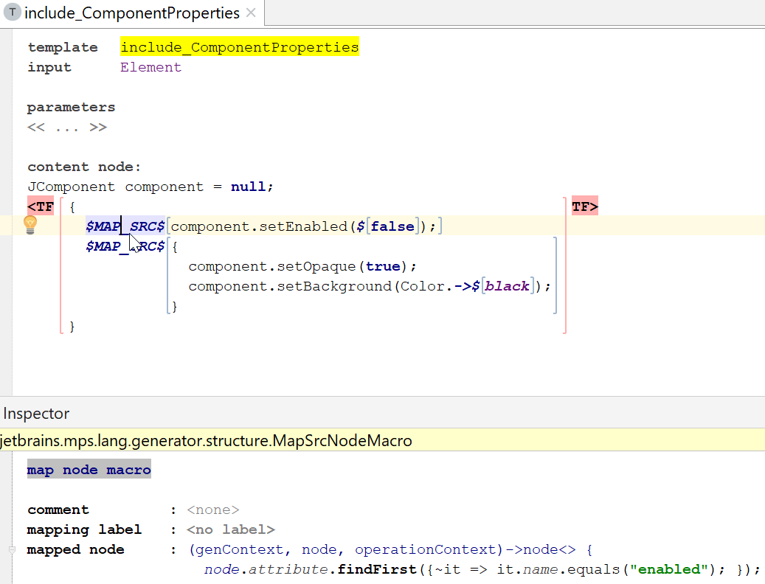
Macros - node
MAP_SRC macro → Multifunctional macro, can be used for:
marking a template code with a mapping label; (note: $LABEL macro can be used for this instead)
replacing the current input node with a new one;
perform a non-template based transformation;
accessing the output node for some reason.
$MAP_SRCL[…] is syntactic sugar for $LOOP[$MAP_SRC[…]]

Slide 25
Macros - node
WEAVE macro → Allows to insert additional child nodes into the output model. The node wrapped in the WEAVE macro (or provided by the use input function) will have the supplied template applied to it and the generated nodes will be inserted.
Invokes a specific weaving rule (generator rules treated at a later point in time)
I couldn’t find any real usages of this macro, it seems people prefer use of weaving rules instead.

Slide 26
Model-to-model transformations
Templates
Types of templates & template fragments
Template elements: macros
Mapping configurations & generator rules
Mapping configurations
Types of generator rules
Mapping labels
Generation context
The generator algorithm
Mapping scripts

Slide 27
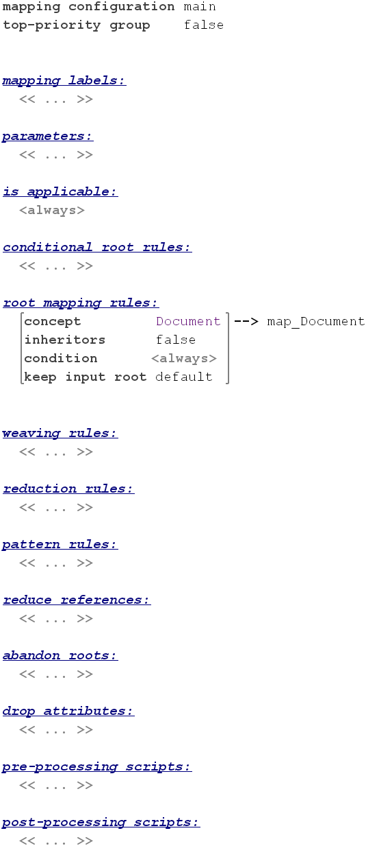
Mapping configurations
Input Model
Generator
Output Model
Applicability of individual templates is defined by generator rules, which are grouped into mapping configurations
A mapping configuration can form a single generation step, contains generator rules, defines mapping labels and may include pre- and postprocessing scripts
Almost each generator rule consists of a premise and a consequence
Nearly all rules contain a reference to the concept of the input node (or just input concept) in its premises. All rule premises also contain an optional condition function.
Rule consequence commonly contains a reference to an external template (declared as a root node in the same or different model) or to an in-line template (conditional root rule and root mapping rule can only have reference to an external template).
There are also several other versions of consequences.

Slide 28
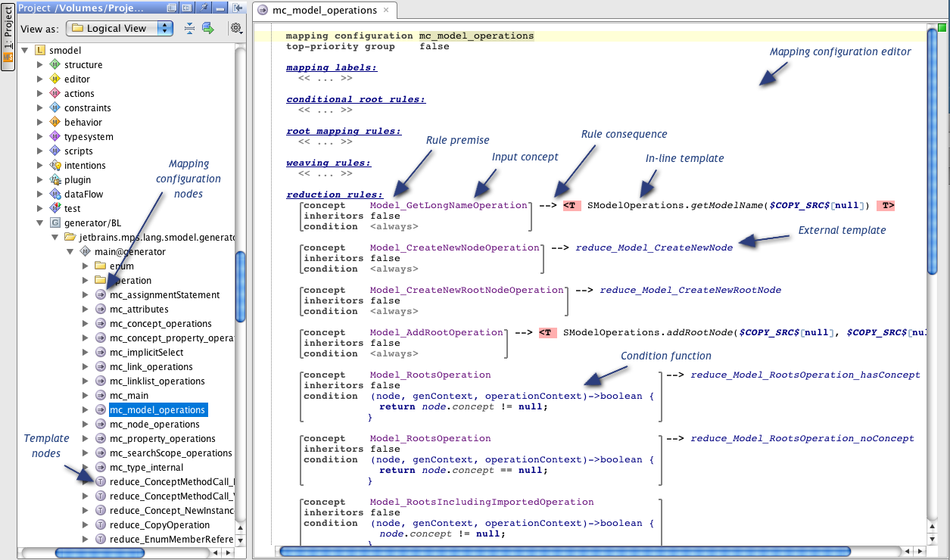
Notes:
This is an example of a generator model and a mapping configuration

Slide 29
Model-to-model transformations
Templates
Types of templates & template fragments
Template elements: macros
Mapping configurations & generator rules
Mapping configurations
Types of generator rules
Mapping labels
Generation context
The generator algorithm
Mapping scripts

Slide 30
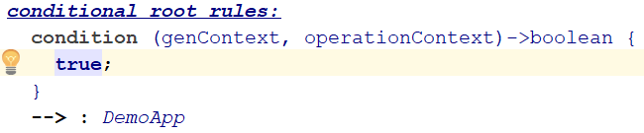

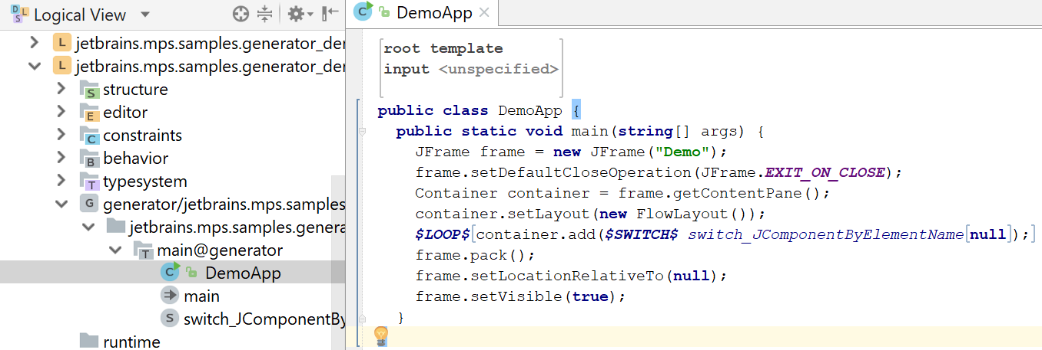
Rules – conditional root
Generates a root node in the output model:
Applied only one time (max) during a single generation step.

Slide 31
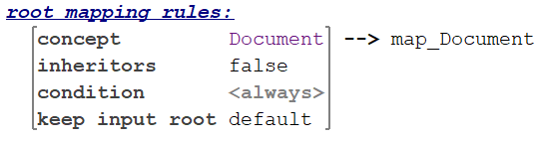
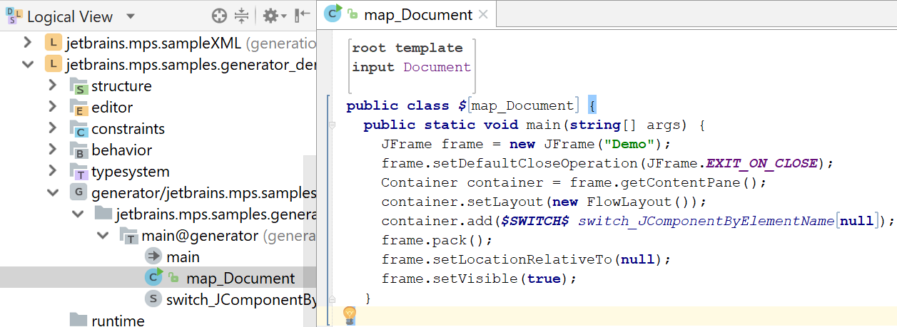
Rules – root mapping
Generates a root node in the output model:

Slide 32
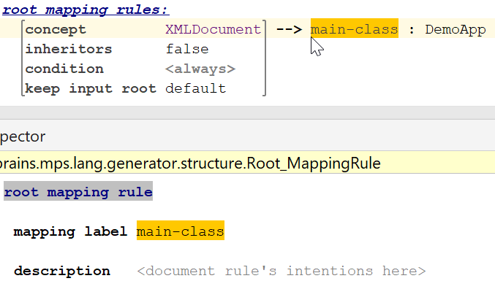
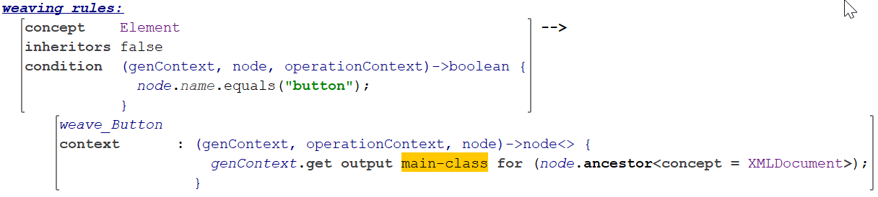
Rules – weaving
Allows to insert additional child nodes into the output model:
The rule is applied on each input node of the specified concept.
The parent node for insertion should be provided by the context function.

Slide 33
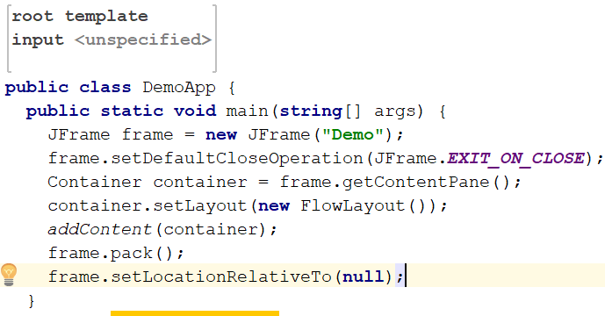
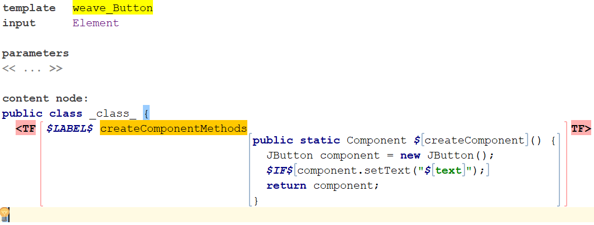
Rules – weaving
Allows to insert additional child nodes into the output model:
The rule is applied on each input node of the specified concept.
The parent node for insertion should be provided by the context function.

Slide 34
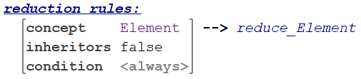
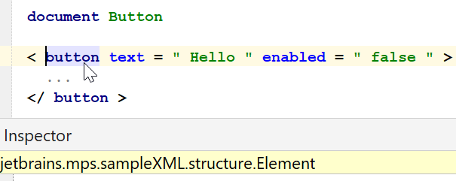
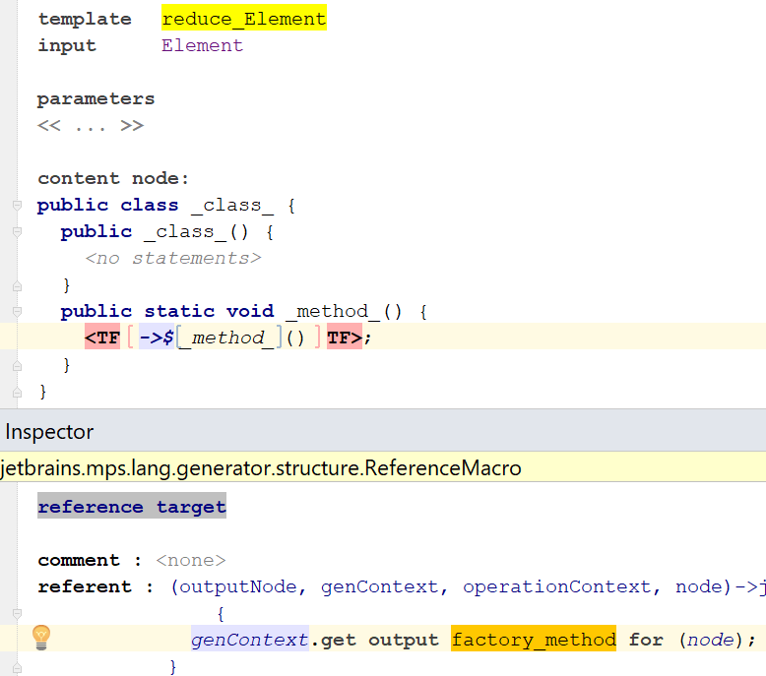
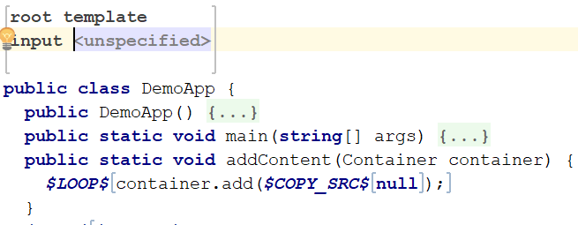
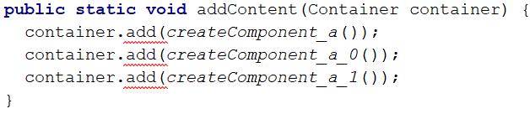
Rules – reduction
Transforms the input node while this node is being copied to the output model:
{

Slide 35
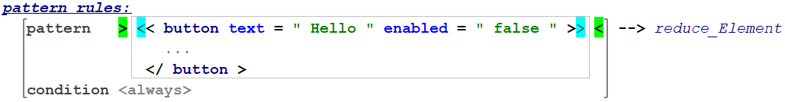
Rules – pattern
Transforms the input node, which matches the pattern:
Similar to reduction rules, but premise is pattern instead of concept.
Patterns are specified in terms of the input language.

Slide 36

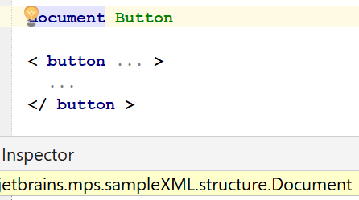
Rules – abandon root
Allows to drop an input root node which otherwise would be copied into the output model:

Slide 37
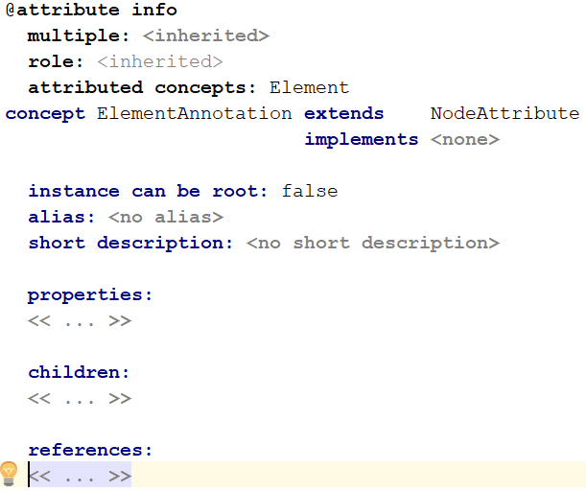
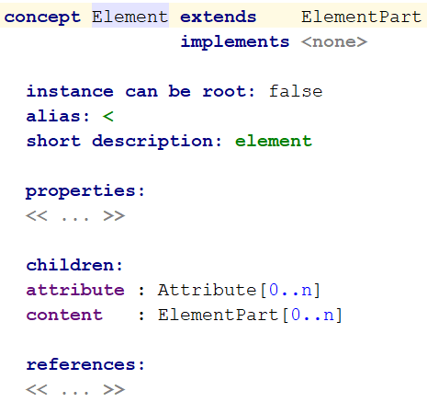

Rules – drop attribute
For a transformed node, controls which attributes get copied from the input node:

Slide 38
Model-to-model transformations
Templates
Types of templates & template fragments
Template elements: macros
Mapping configurations & generator rules
Mapping configurations
Types of generator rules
Mapping labels
Generation context
The generator algorithm
Mapping scripts

Slide 39
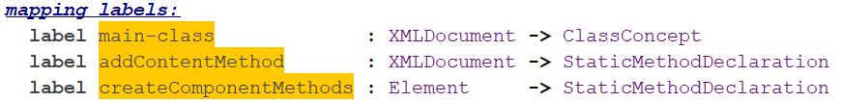



Mapping labels
Mapping Labels are declared in a mapping configuration and references stored to this declaration are used to label generator rules, macros and template fragments. Such marks allow finding of an output node by a known input node.

Slide 40
Model-to-model transformations
Templates
Types of templates & template fragments
Template elements: macros
Mapping configurations & generator rules
Mapping configurations
Types of generator rules
Mapping labels
Generation context
The generator algorithm
Mapping scripts

Slide 41

Generation context
Generation context (the genContext parameter in macro- and rule-functions) allows finding of nodes in the output model, generating unique names and provides other useful functionality.
Generation context can be used not only in the generator models, but also in utility models (i.e. root nodes declared in models outside of the generator model, but used in it) - as a variable of type gencontext.
Operations of genContext are invoked using the familiar dot-notation: genContext.operation. Categories of operations are:
Finding output node: usually on mapping labels and nodes
Generating unique name
Getting contextual info
Transferring user data: transient, step, or session object (see later, generator algorithm).

Slide 42
Model-to-model transformations
Templates
Types of templates & template fragments
Template elements: macros
Mapping configurations & generator rules
Mapping configurations
Types of generator rules
Mapping labels
Generation context
The generator algorithm
Mapping scripts

Slide 43
The generator algorithm
...
Input Model
Transient model 1
Transient model N
Final transient model
Text
Reduction is done in a bunch of transient models, until a fix-point has been reached
The process of generation of target assets from an input model (generation session) includes 5 stages:
Defining all generators that must be involved
Defining the order of priorities of transformations
Step-by-step model transformation
Generating text and saving it to a file (for each root in output model)
Post-processing assets: compiling, etc.
The first 3 stages live in model-to-model “land”, so we will explain them.

Slide 44

Defining generators involved
MPS examines input model & determines which languages are used in it. MPS examines each node in the model and gathers languages that are actually used (so there is no reliance on user-specified language dependencies).
From each 'used language' MPS obtains its generator module. Only 1 generator per module is supported. If any generator in this list depends on other generators (as specified in the 'depends on generators' property), those generators are added to the list as well.
After MPS obtains the initial list of generators, it determines based on generator’s templates what languages will be used in intermediate (transient) models. The languages detected this way are handled in the same manner as the languages used in the original input model. This procedure is repeated until no more 'used languages' can be detected.
Explicit Engagement: In some rare cases, MPS is unable to detect a language whose generator must be involved in the model transformation. This may happen if that language is not used in the input model or in the template code of other (detected) languages. In this case, you can explicitly specify the generator engagement via the Languages Engaged on Generation section in the input model's properties dialog (Advanced tab).

Slide 45

Generator priorities
It is often required that some mappings must be applied before (or not later than, or together with) some other mappings. Priority rules work on the model granularity level.
The language developer specifies such a relationship between mappings by means of mapping constraints in the generator properties dialog.
After MPS builds the list of involved generators, it divides all mappings into groups, according to the mapping priorities specified.
All mappings for which no priority has been specified fall into the last (least-priority) group.
MPS automatically inserts "not later than" rules for all generator models in the source and target languages (languages produced by templates).

Slide 46
Step-by-step model transformation
Each group of mappings is applied in a separate generation step. The entire generation session consists of as many generation steps as there were mapping groups formed during the mapping partitioning. A generation step includes three phases:
Executing pre-mapping scripts
Template-based model transformation
Executing post-mapping scripts

Slide 47
Step-by-step model transformation
The template-based model transformation phase consists of one or more micro-steps. A micro-step is a single-pass model transformation of an input model into a transient (output) model.
Micro-steps are executed according to the following procedure:
Apply conditional root rules (only once - on the 1-st micro-step)
Apply root mapping rules
Copy input roots for which no explicit root mapping is specified (this can be overridden by means of the 'keep input root' option in root mapping rules and by the 'abandon root' rules)
Apply weaving rules
Apply delayed mappings (from MAP_SRC macro)
Revalidate references in the output model (all reference-macro are executed here)

Slide 48
Step-by-step model transformation
There is no separate stage for the application of reduction and pattern rules. Instead, every time MPS copies an input node into the output model, it attempts to find an applicable reduction (or pattern) rule and performs the node copying when it is either copying a root node or executing a COPY_SRC-macro. Therefore, the reduction can occur at either stage of the model transformation.
MPS uses the same rule set (mapping group) for all micro-steps within the generation step.
After a micro-step is completed and some transformations have taken place during its execution, MPS starts the next micro-step and passes the output model of the previous micro-step as input to the next micro-step.
The whole generation step is considered completed if no transformations have occurred during the execution of the last micro-step (fixpoint), that is, when there are no more rules in the current rule set that are applicable to nodes in the current input model.
The next generation step (if any) will receive the output model of previous generation step as its input.

Slide 49
Model-to-model transformations
Templates
Types of templates & template fragments
Template elements: macros
Mapping configurations & generator rules
Mapping configurations
Types of generator rules
Mapping labels
Generation context
The generator algorithm
Mapping scripts

Slide 50



Mapping scripts
A Mapping script is user code, which is executed either before a model transformation (pre-processing script) or after it (post-processing script).
It should be referenced from the mapping configuration to be invoked as a part of it's generation step. Mapping scripts provide the ability to perform non-template based model transformations.
Pre-processing scripts are commonly used for collecting certain information from input model that can be later used in the course of template-based transformation. The information collected by script is saved as a transient-, step- or session-object.

Slide 51
Index
What are (MPS) generators?
Model-to-model transformations
Templates
Mapping configurations & generator rules
Mapping labels
Mapping scripts
Generation context
The generator algorithm
Cross-model generation and generation plans
Model-to-text transformations
Common generator patterns
Basic dos and don’ts
Further reading

Slide 52



Model-to-text transformations
Textgen usually only used for very simple model-to-text scenarios where the cognitive gap between the model and the generated text is minimal (preferably cognitive gap is 0, i.e. model and text are 1:1), e.g.: translate a baseLanguage if-statement to a java if-statement or translate an attribute from an XML model to XML text

Slide 53
Model-to-text transformations & plaintextgen
Textgen usually only used for very simple model-to-text scenarios.
For all other model-to-text scenarios, plaintextgen is recommended. Examples of such scenarios:
For quickly getting text out of any model on any abstraction level
For generating to GPLs or horizontal DSLs (e.g. markup languages) that are not yet fully modeled in MPS
Plaintextgen plugin encapsulates the textgen aspect and emulates textual-editor appearance and models the elements of plaintext in a certain flexible way that allows more maintanable and understandable text generators
General advice: always use only plaintextgen and just skip textgen altogether

Slide 54





Typical plaintextgen scenario
Create textual template
Paste into analyzer
Templatize

Slide 55
Index
What are (MPS) generators?
Model-to-model transformations
Templates
Mapping configurations & generator rules
Mapping labels
Mapping scripts
Generation context
The generator algorithm
Cross-model generation and generation plans
Model-to-text transformations
Common generator patterns
Basic dos and don’ts
Further reading

Slide 56
Common generator patterns
Detecting tests: complex generators depending on some context may need to act differently in tests. Com.mbeddr.mpsutil.blutil.genUtil contains a is-in-tests construct detecting a test.
Preprocessing instead of reductions: when the structures of source and target nodes are too different from each other, it may help to use pre/post processing scripts instead. In some cases, these are also easier to debug than unnecessarily convoluted
Introducing intermediate languages: when the gap between source and target language is too big, it is helpful to introduce an intermediate language to reduce it. This also introduces an extra layer of decoupling, improving maintainability.

Slide 57
Common generator patterns
Error handling: don’t use exceptions (java) for error handling in generators. Instead, use genContext.show error “myErrorMessage”... This makes sure that generation doesn’t stop immediately, improving debugging capabilities tremendously.
Reductions and extensibility: if you need to provide many extension points for your generator, don’t use a LOOP macro or do the transformation in place. Instead, use COPY_SRC/COPY_SRCL or LOOP in combination with a SWITCH macro that delegates to templates. Each of the places where you delegate to a template is a place where extensions can contribute/override with their own reduction rules.

Slide 58
Common generator patterns
SWITCH over IF: When the condition of an IF macro is other than a boolean property, it is usually a smell that this IF should be replaced with a template switch. Using a SWITCH, makes the choice open for extension by the extends relation in each template switch.
(Currently) priority rules over predefined generation plans: If extensibility is important for your generator, then use the priority rule mechanism to specify instead of the generation plan mechanism. When extension is not so important, generator plans can make things easier/faster to build.

Slide 59
Common generator patterns – multiple outputs from a single model
These patterns apply for producing various outputs (e.g. XML, C++ code, java code, etc.) from a single model
Generator configuration: the source model contains the actual contents to be generated, while there is/are (a) model(s) that are dedicated to the configuration of the generation. Example: mbeddr BuildConfiguration. Such dedicated configuration models contain a reference to (part of) the contents-model. The generator of such a configuration model is responsible to copy all contents from the contents-model to the configuration model. This also allows MPS to generate multiple outputs concurrently (as we have a single model per output we want to produce).

Slide 60
Common generator patterns – multiple outputs from a single model
Implementation of multi-output generators: the generator of a dedicated configuration model needs to copy all relevant contents from the content-model. Instead of manually writing a lot of code that copies nodes, use copies = genContext.copy with trace. This makes MPS automatically take care of changing the references in the nodes thare are copied. A big effort-saver.

Slide 61
Common generator patterns – complex multistage generators
When writing large sets of generators and languages that build on top of each other it can be a challenge to understand what is going on during generation. Especially defining generator priorities to order them correctly can get messy quickly.
If not taken care of it can happen that a lot of cross generator dependencies are introduced just for the sake of making sure generators are executed in the correct order.
A pattern to counter this is to define logical barriers in your generator priorities. Priorities are the assigned relative to these barriers. The barriers represent levels of abstraction.
If a generator requires a certain level of abstraction as input, its priorities are defined according to that. It is important a single generator is picked for each of these barriers to have single point where these dependencies are relative to. This makes debugging much easier.
Mbeddr Example: While mbeddr itself uses over 30 generators in total, their priorities are in most cases easy to understand. Most of the generators are isolated and most of them only define that they need to be run before the the modules.gen generator.

Slide 62

Common generator patterns – complex multistage generators
In this example we will look at 3 logical stages of mbeddr all of them on different layers of abstraction. They are explained from the bottom to the top.
mbeddr.modules.gen layer (lowest layer of abstraction): This layer assumes that the input is mbeddr C99 representation, basically a simplified version of C99 without headers and some minor adaptions w.r.t. C99. This generator transforms its input into real C99 code with .c and .h files. If a language extension (e.g. the mbeddr.unittest language ) provides a higher abstraction than this, then it defines its generator priorities relative to this generator.
The middle layer: This layer contains various abstractions on a higher level than C. They are all independent from each other, but at some point they need to generate down to mbeddr C. This needs to happen before the modules.gen generator is executed, because it assumes that the input is C. All of the languages define their priority relative the modules.gen generator. Due to this, debugging if the order is correct is easy. If transformations are not applied correctly, it is easy to check the generation plan for a model to see if all the generators reducing the abstraction to C have been executed before the modules.gen generator.
Higher Level Abstractions: The top layer in our example is a language that integrates state-machines and components. Its priorities are only set relative to the two generators it extends: mbeddr.statemachines and mbeddr.components. Since these generators itself have priorities that require them to be executed before the modules.gen generator is run, no additional priorities are required.

Slide 63
Index
What are (MPS) generators?
Model-to-model transformations
Templates
Mapping configurations & generator rules
Mapping labels
Mapping scripts
Generation context
The generator algorithm
Cross-model generation and generation plans
Model-to-text transformations
Common generator patterns
Basic dos and don’ts
Further reading

Slide 64

Dos and don’ts – good practices
Tool
If you don’t like the default MPS way of displaying, use the simplified MPS generator editors plugin (https://github.com/coolya/mps-generator-editors) → currently only usable as a view, not editor
To avoid any confusion, always follow this rule: after any changes made to the generator model, the model must be re-generated (Shift+F9). Even better is to use Ctrl+F9, which will re-generate all modified models in the generator module.
Use “save transient models” for generator debugging
Use generator trace tooling for debugging
You can check the mapping partitioning for any (input) model by selecting Show Generation Plan action in the model's popup menu.
Method
A very good way to find/extract good examples is from the mbeddr codebase (use Ctrl+N+N to searh for root nodes, explore the mbeddr tutorial, and look in the modules pool for example languages)

Slide 65
Index
What are (MPS) generators?
Model-to-model transformations
Templates
Mapping configurations & generator rules
Mapping labels
Mapping scripts
Generation context
The generator algorithm
Cross-model generation and generation plans
Model-to-text transformations
Common generator patterns
Basic dos and don’ts
Further reading

Slide 66
Further reading
https://confluence.jetbrains.com/display/MPSD20182/Generator
The MPS Language Workbench book (Fabien Campagne)
Itemis guide on maintainable MPS generators: https://coolya.github.io/maintainable-generators/
https://confluence.jetbrains.com/display/MPSD20182/Generator+cookbook
https://confluence.jetbrains.com/display/MPSD20182/Generator+User+Guide+Demo6#GeneratorUserGuideDemo6-savingtransientmodels
https://confluence.jetbrains.com/display/MPSD20182/Generator+User+Guide+Demo6#GeneratorUserGuideDemo6-generationtracertool
https://confluence.jetbrains.com/display/MPSD20182/Generator+Demos
https://confluence.jetbrains.com/download/attachments/85756181/MPS%2B2017.1%2BCookbooks.pdf?version=1&modificationDate=1491299529000&api=v2
mbeddr tutorial, mbeddr languages (node infos?)

