Slide 1
WELCOME TO GAME PROGRAMMING!
DSM GG JUNIOR OT

Slide 2
WHY GAME?

Slide 3
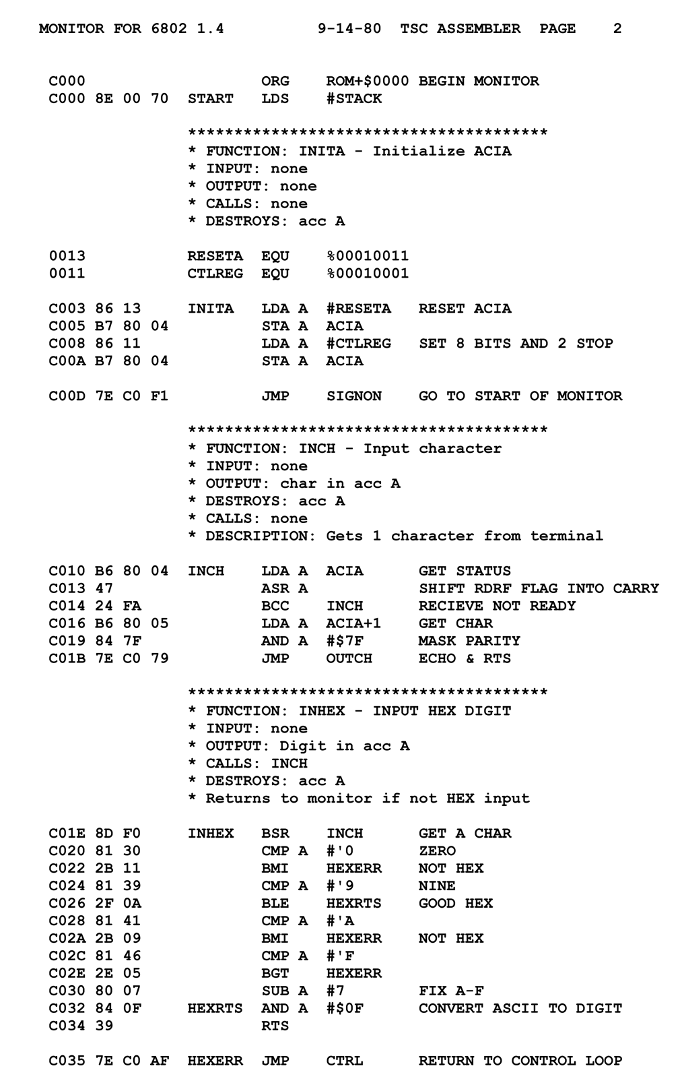
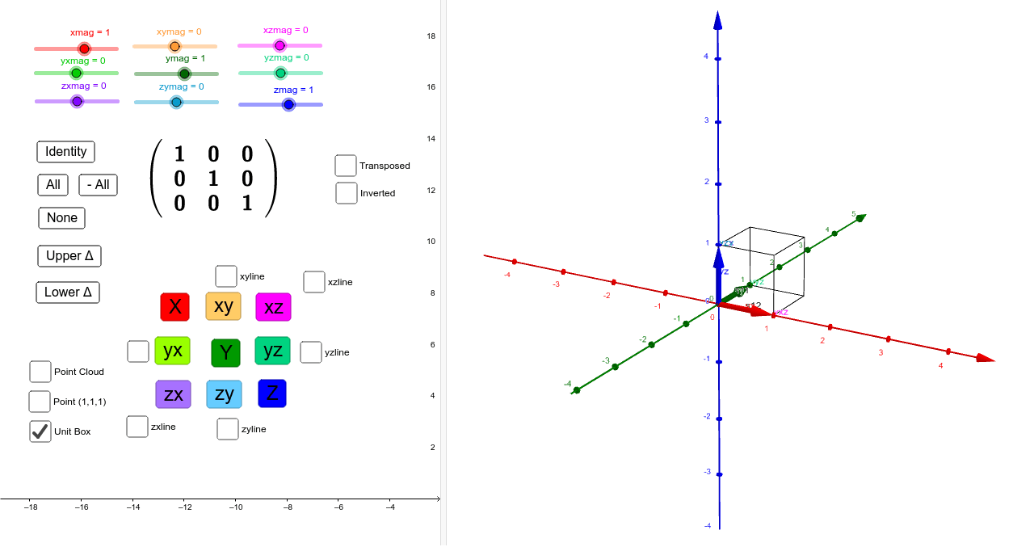
WHAT IS GAME PROGRAMMING?

Slide 4
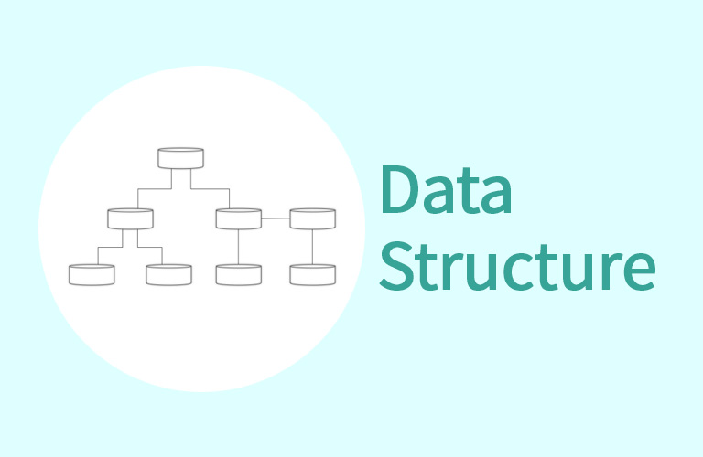


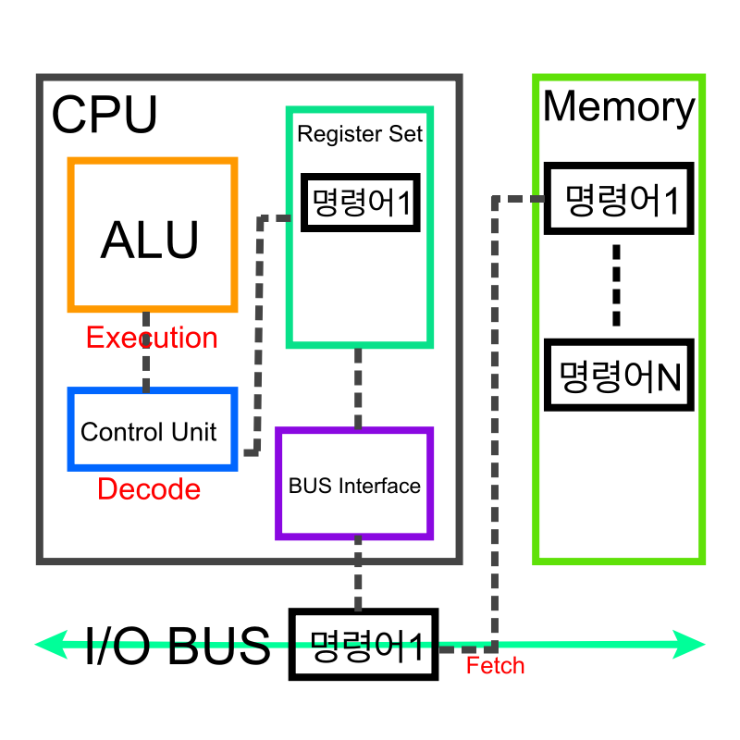



Slide 5
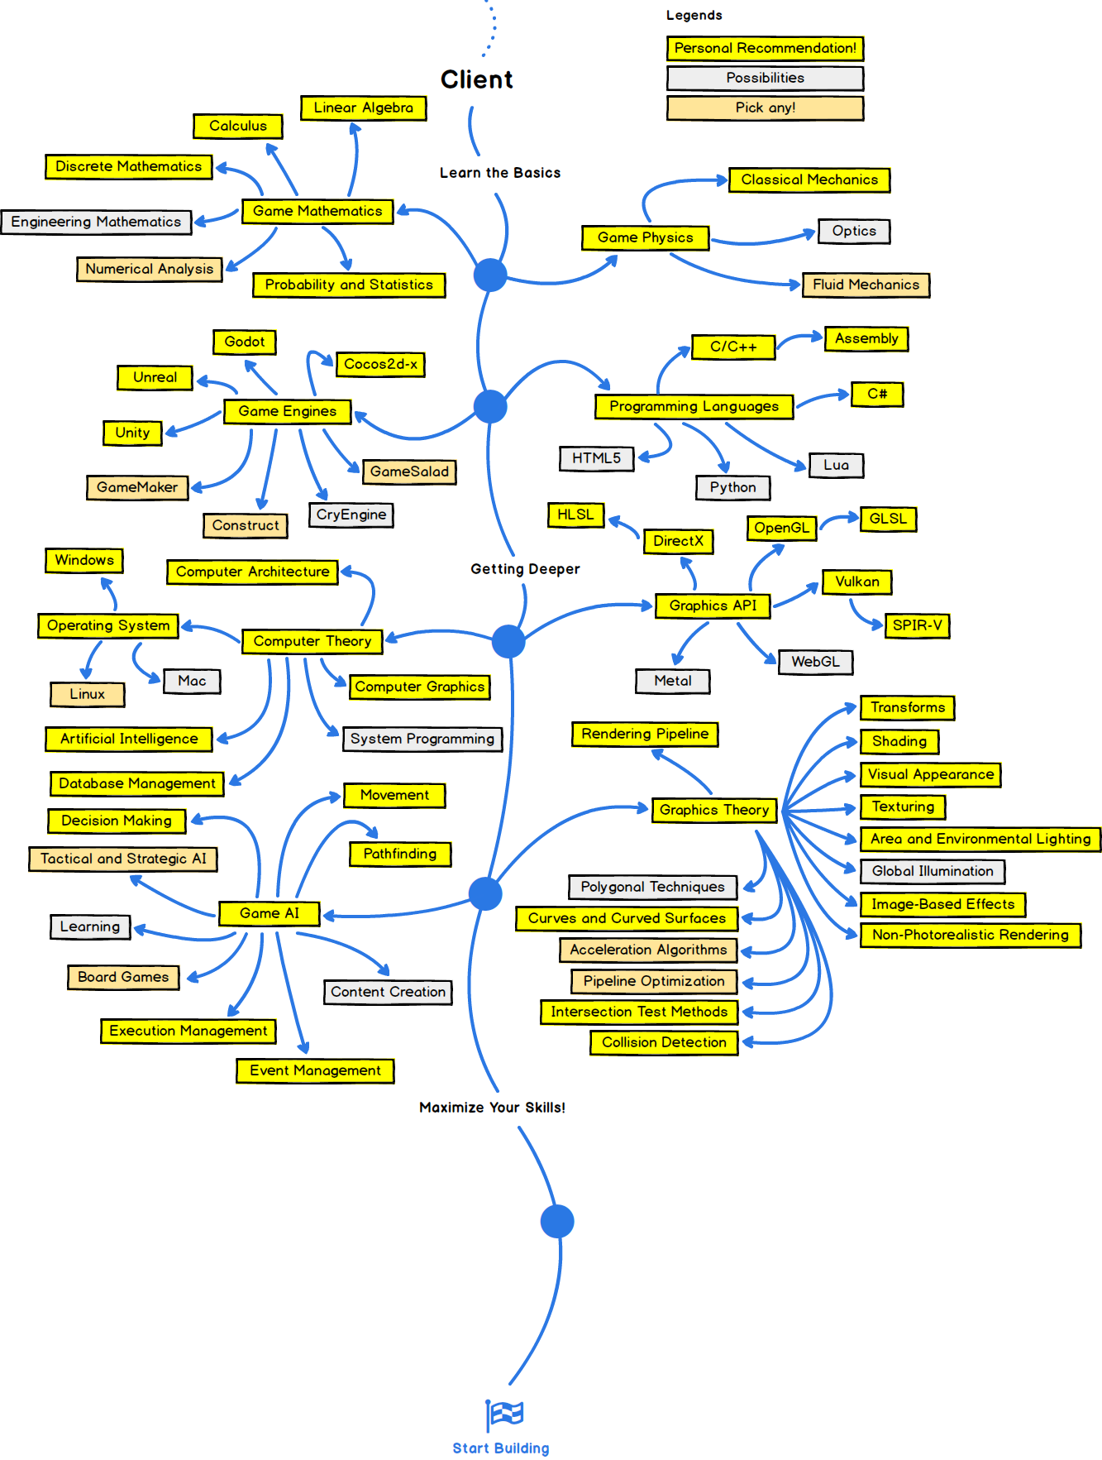

Slide 6





Slide 7


Slide 8
