Slide 1


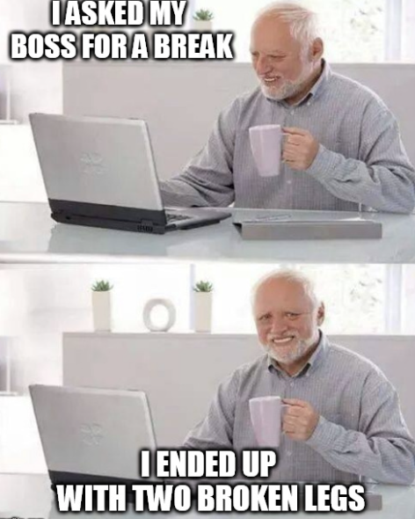

Alexandre, Rodrigo and Lydia
Bone fracture detection Project

Slide 2
Bone Fracture Detection Project Overview
Misdiagnosis of fractures is very common in Emergency Departments. It can have serious consequences like delays in treatment or long-term disabilities.
Past studies focus on the interpretation of the x-rays and the importance of training and supervision of junior doctors.
Hallas et al. Errors in fracture diagnoses in the emergency department. PMID: 16483365

Slide 3
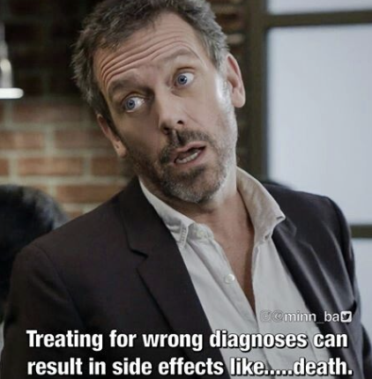
Bone Fracture Detection Project Overview
This project proposal aims to help doctors classify x-rays imagery.
Used in rural zones where there’s no specialist close.

Slide 4
Data preprocessing
Our 5 steps.
1. Loading images
2. Grayscale conversion
3. Resizing to 150x150 with padding to keep the aspect ratio
4. Normalize pixels from [-1 , 1]
5. Data augmentation on the training set only

Slide 5
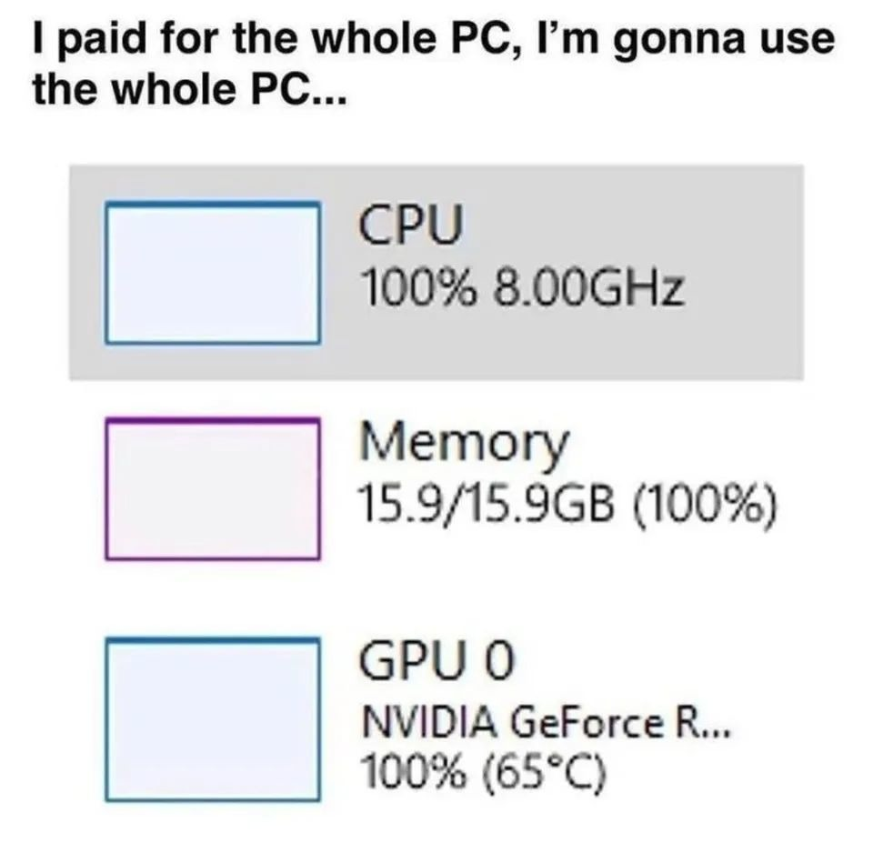
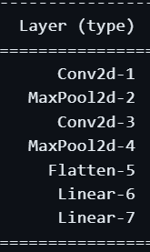
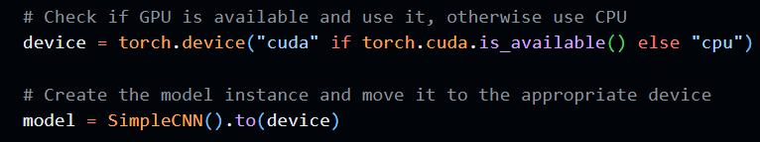
Model development
Pytorch with GPU ( RTX 4060 )
Used convolutional neural networks
Adam optimiser Binary Cross entropy loss function
7 layers
Relu
Relu
Relu
Sigmoid

Slide 6
Model optimisation with threshold
We noticed by increasing epochs and looking at validation loss per epoch that the model was reaching values as low as 0.05 validation loss.
Included a threshold of 0.05 to stop the training and let the model run for 70 epochs max. Took 20-30 mins

Slide 7
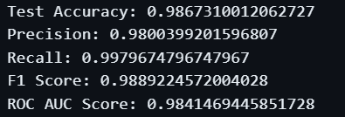
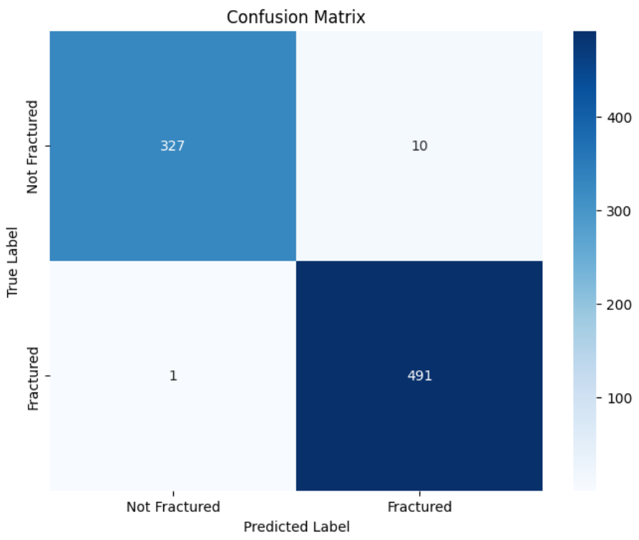
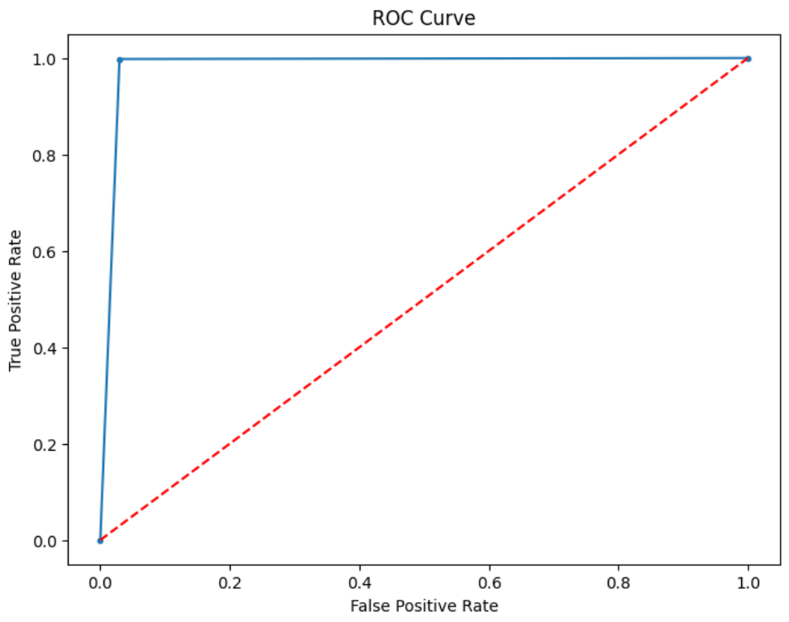
Evaluation metrics

Slide 8
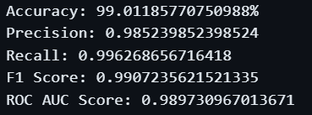
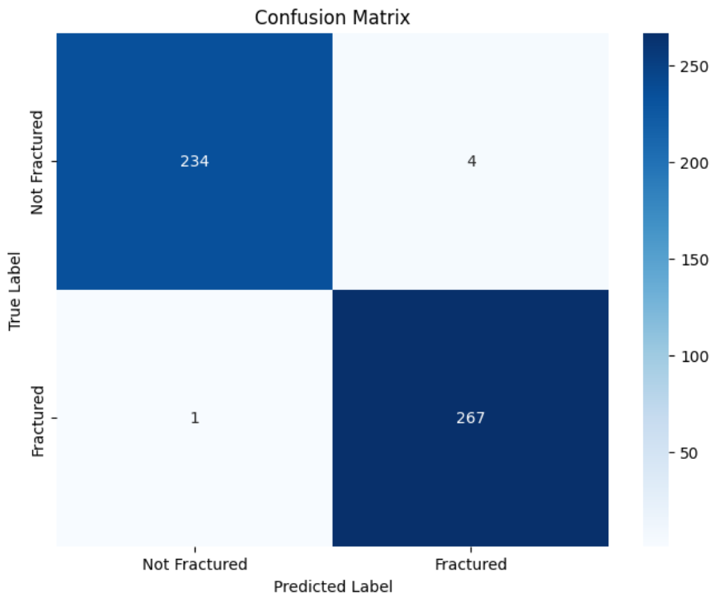

Prediction metrics
Since the predict dataset is also tagged

Slide 9
Conclusions and selling points
Performance:
High accuracy; only 1 misclassified image as not being a broken bone.
Implementing a threshold can maximize recall, ensuring all true broken bones are included.
Trade-off: doctors may review more cases without broken bones.
Limitations:
Model trained only on X-rays; misclassifies non-X-ray images.
Requires diverse, high-quality training data to generalize well.
( probably ) Lower image quality or small fractures reduce prediction accuracy.
Selling Point:
Enhances doctors' ability to identify broken bones if their accuracy is below 99%.
Saves doctors' time by highlighting potential fractures in less than a second.
Allows doctors to catch all patients with fractures if they add their symptoms and pain.

Slide 10
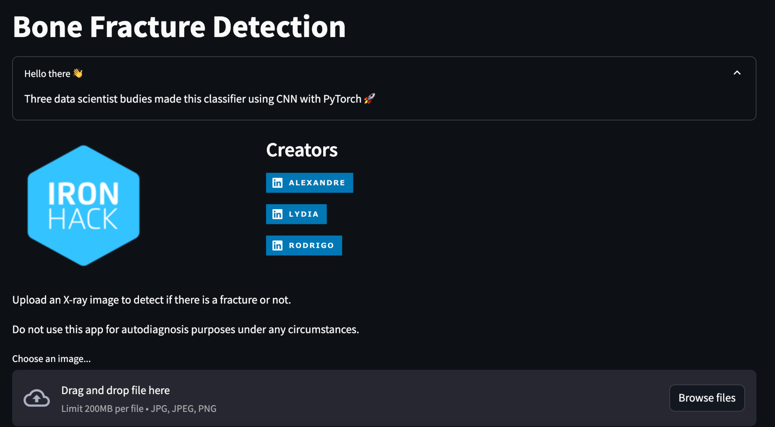
Model deployment using streamlit

Slide 11
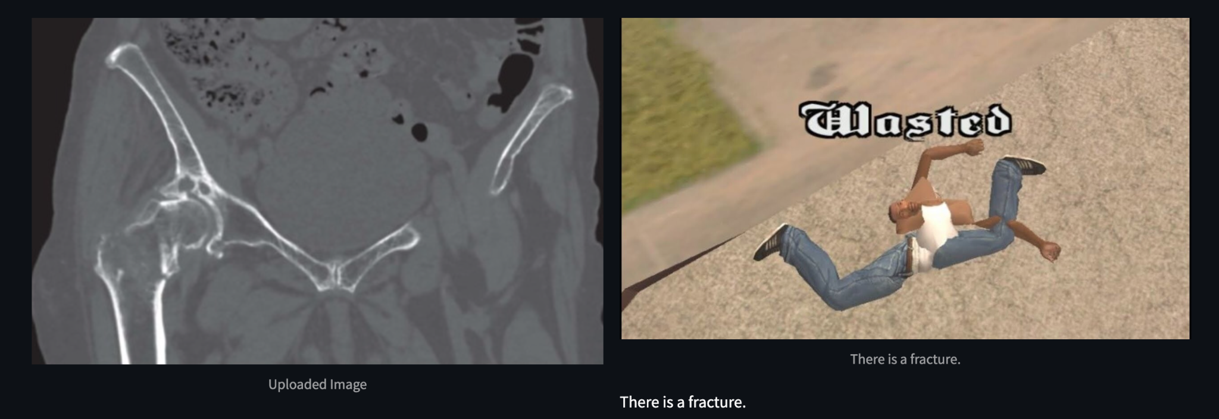
Test the model on streamlit
We used X Ray pictures that were misdiagnosed by doctors. Our model correctly classifies them as a fracture.
(Pinto et al. "Traumatic fractures in adults: missed diagnosis on plain radiographs in the Emergency Department")

