Slide 1
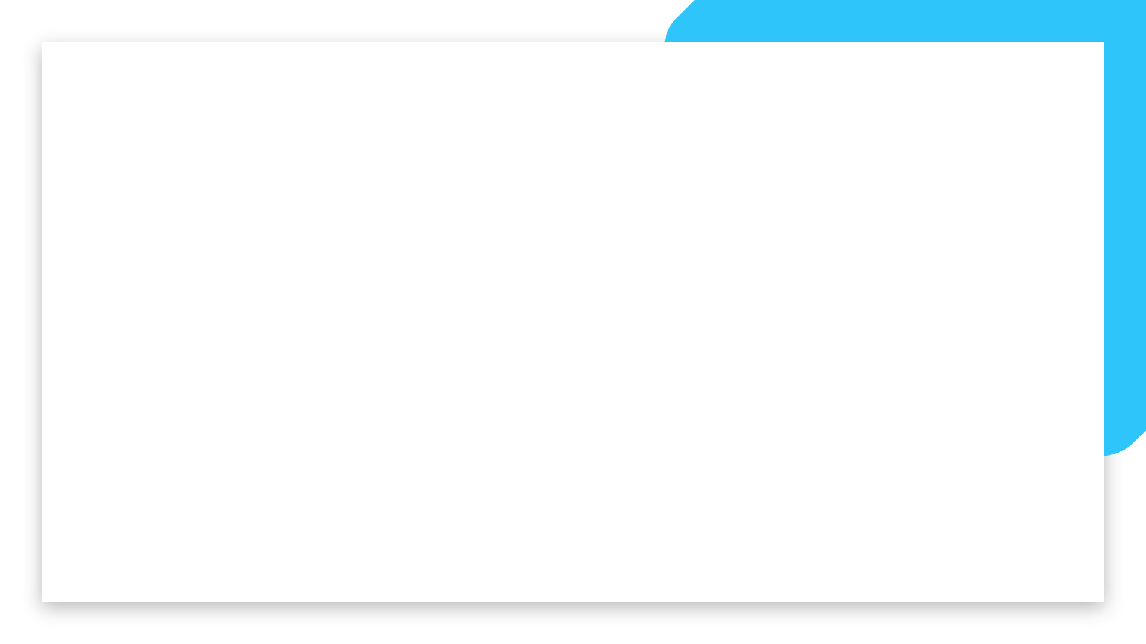


Data Science and Machine Learning
Bootcamp
IRON KAGGLE

Slide 2
Iron Kaggle
LETS COMPETE! Before you jump further, we want you to have an end-to-end experience of solving a Machine Learning problem.
So let’s try and predict the sales of shops, shall we?
You have a dataset containing information on shops’ sales per day (and several characteristics of them) - your goal is to predict the sales!
Welcome

Slide 3
Iron Kaggle
Training data (640841 entries): we will share with you a training set of store sales per day, with bits of information of what happened in that day in that store.
Real-Life Data (+70k entries): we will also share with you entries without the sales. This will be used (on the teachers side) to verify how good your model really is!
Welcome

Slide 4
Iron Kaggle
Expected Deliver:
“Real-life data set” with an extra column called “sales”, with your predictions (in .csv)
An expected value of R2 of performance of your model
A 5’ presentation on the choices you did and the road you took
Welcome

Slide 5
Iron Kaggle
Groups (similar to the room):
G1 – Itua + Emmanuel
G2 – Adriana + Sofia
G3 – Andrei, Gerard, Emin
G4 – Alexandra, Rodrigo, Lydia
G5 – Lili + Aline
Welcome

Slide 6
Iron Kaggle
Schedule:
8am: Introduction, Group organization, framing the problem
8.30am: Development time
1pm: Lunch break
2pm: You will receive the “real-life” data
2pm: Development time + presentation creation
4.30pm: Delivery of the real life data
430pm-5pm: Finish your presentation
5pm: presentations + winner announcement
Welcome

Slide 7
Iron Kaggle
DELIVERABLE:
A .csv file called with your groupd name (e.g, ‘G1.csv’, ‘G2.csv’)
The value of R2 you are expecting to get
Send this in a .zip file containing two elements:
the csv file
a txt file with the R2 score inside
Welcome

Slide 8
Iron Kaggle
Winners:
Winner 1 -> Group with the highest R2 score
Winner 2 -> Group with the most correct prediction of their own R2 score
BOTH CAN BE THE SAME GROUP
Welcome

Slide 9
Iron Kaggle - Results
 | Group 1: | Group 2: | Group 3: | Group 4: | Group 5:
R2 Prediction (how much your thought your model would perform)
R2 Score (how your model performed with real life data provided by Joao)
R2 Difference
Welcome

Slide 10
Good luck
Let’s get started!

