Slide 1
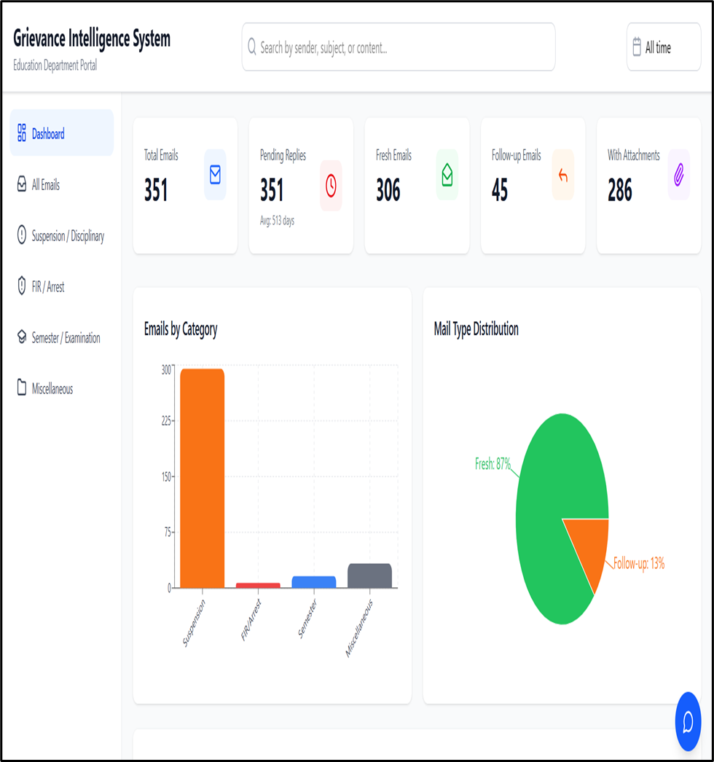
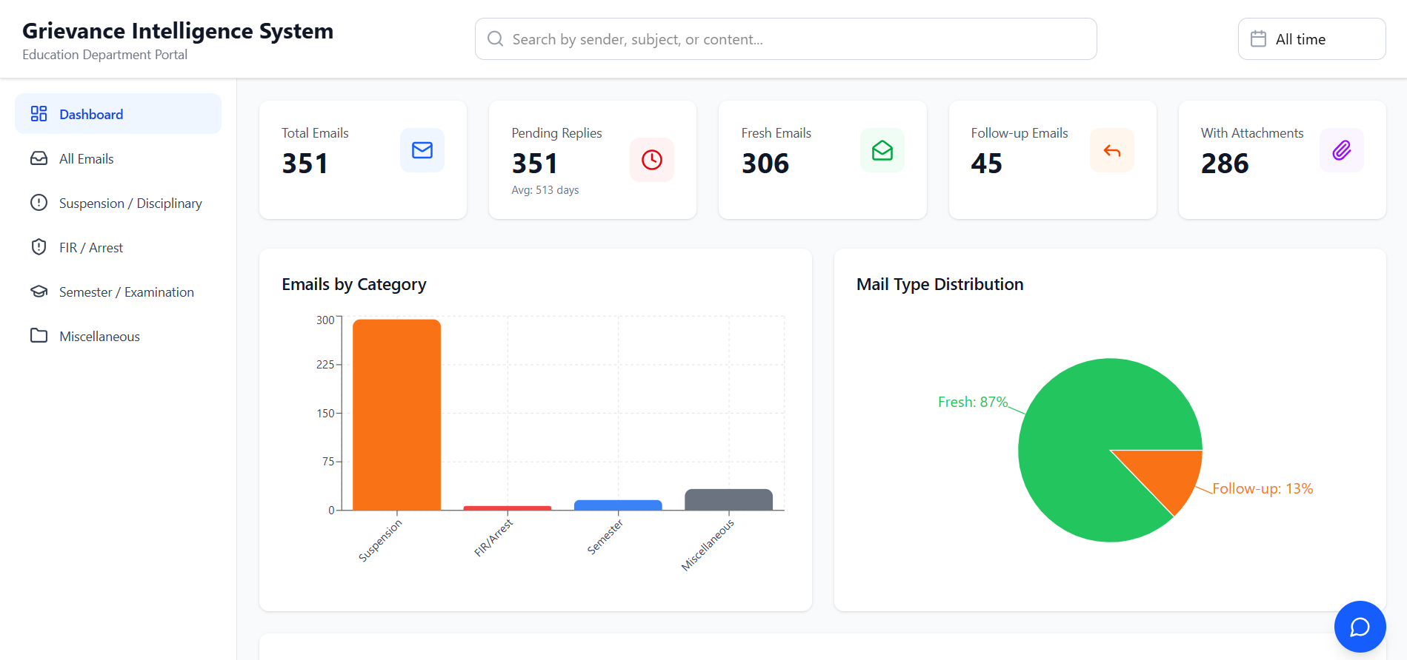
AI-Enabled Email Grievance Management System
An Automated Solution for Processing
Institutional Grievance Emails

Slide 2
Problem Statement
Manual Processing Challenges
Volume Overload
Government-aided colleges submit grievances through unstructured email channels, creating significant operational bottlenecks in the existing manual system.
Large volumes of unstructured emails with attachments require manual parsing, consuming excessive administrative time and resources.
Poor Tracking
Data Fragmentation
Follow-ups lack systematic linkage to original grievances, resulting in lost threads and inconsistent response timelines.
Grievance status information remains scattered across individual emails without consolidated visibility or reporting capability.

Slide 3




Project Objectives
The system addresses operational inefficiencies through targeted automation and intelligent processing capabilities.
Automated Ingestion
Intelligent Classification
Parse archived EML files and extract complete email metadata, body content, and attachment data systematically.
Assign grievances to predefined categories—Suspension, FIR, Examination, Information, or Miscellaneous—for structured routing.
Follow-Up Detection
Structured Output
Identify email threads using sender identity and message headers, maintaining follow-up counts and linkage automatically.
Generate comprehensive Excel-based grievance database enabling filtering, sorting, and consolidated status reporting.

Slide 4
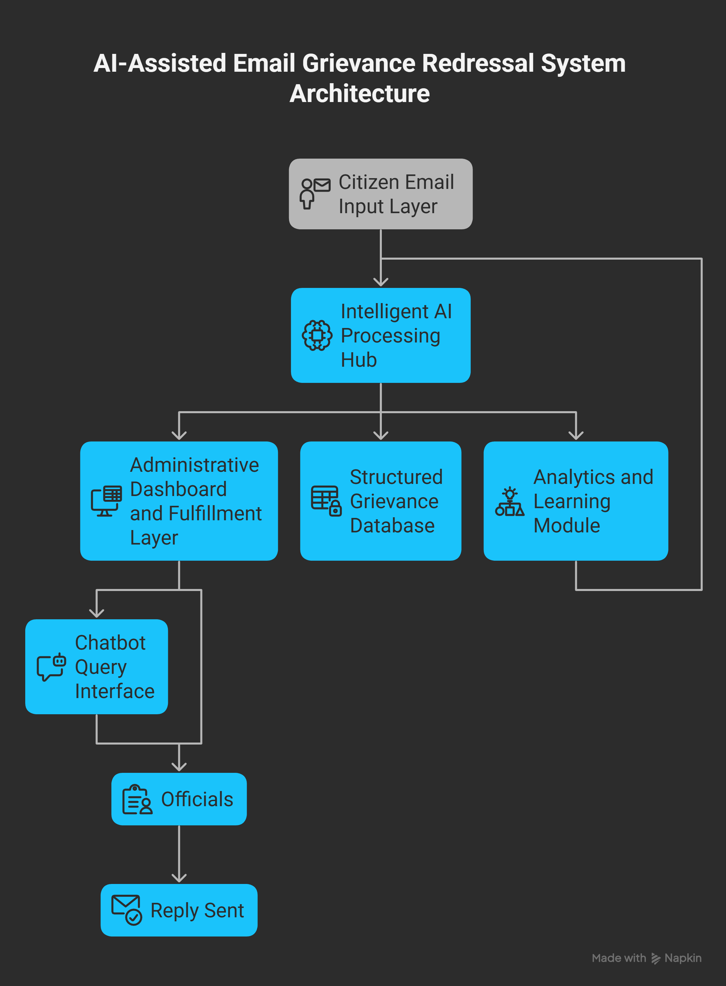
System Architecture:
The system collects citizen grievance emails (including attachments) through an official email inbox.
An AI processing hub reads, extracts, classifies, and analyzes email content using OCR, language processing, and intent detection.
The system identifies fresh and follow-up emails, stores data in a structured grievance database, and generates reply suggestions.
An administrative dashboard allows officials to monitor grievances, track pending cases, view attachments, and send manual replies.
A chatbot and analytics module provide quick insights and continuously improve classification and response assistance.

Slide 5
Grievance Classification Logic
Rule-based categorization ensures consistent grievance routing while maintaining audit trails for all classification decisions.
Suspension/Disciplinary
FIR/Arrest
Actions against employees or staff members requiring administrative intervention.
Police complaints, arrests, or criminal proceedings involving institutional members.
Miscellaneous
Semester/Examination
Reserved strictly for uncategorizable grievances after all classification rules exhausted.
Academic calendar issues, exam schedules, results, or evaluation concerns.

Slide 6
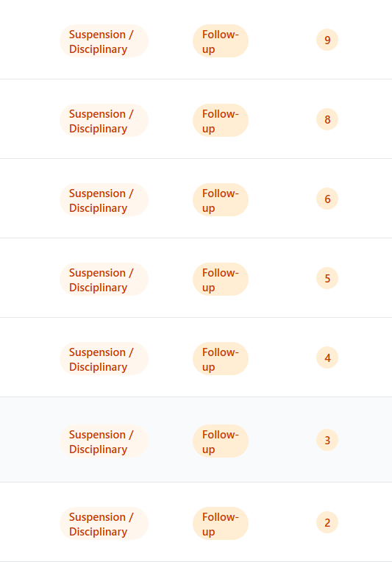
Follow-Up Detection Mechanism
Thread Identification
The system analyzes email headers including Message-ID, In-Reply-To, and References fields to establish conversation threads. Sender email addresses provide additional linkage verification.
State Tracking
Each grievance record maintains follow-up count and freshness status. First email marked as Fresh; subsequent replies automatically flagged as Follow-up with incrementing counter.

Slide 7
Attachment Handling & Data Structuring
01
02
Format Detection
Content Extraction
Identifies PDF, DOCX, XLSX, or TXT file types
before processing
Uses appropriate libraries to extract plain text from
each format
03
04
Error Handling
Text Consolidation
Skips corrupted or oversized files with error
logging for review
Combines email body with attachment content for
unified analysis
Institute Name Resolution
The system employs multi-level lookup: email domain mapping, body content analysis, attachment parsing, and manual fallback to ensure accurate institutional attribution.

Slide 8
Validation & Results
Testing Scope
Performance Metrics
System validated using 350+ real grievance emails collected from government sources, representing diverse grievance types and complexity levels.
Classification accuracy, follow-up detection precision, and attachment handling reliability measured across test dataset.
350+
4
100%
Test Emails
Categories
Thread Detection
Real grievances processed
Classification types tested
Follow-up linkage verified

Slide 9
Conclusion & Future Enhancements
Current Achievement
Immediate Improvements
Long-term Vision
Successfully automated grievance email processing, reducing manual effort while improving tracking accuracy and response timeliness for government institutions.
Integration with email servers for real-time processing, database backend migration from Excel to SQL, and priority escalation workflows.
Natural language processing for semantic classification, sentiment analysis for urgency detection, and automated response generation for routine enquiries.
Recommendation: Deploy pilot implementation in selected government departments to validate operational impact before full-scale rollout across institutional networks.

