Slide 1


AI ENABLED EMAIL GREIVANCE MANAGEMENT SYSTEM
Center of Excellence on Data Science and Machine Learning, Department of IT & Electronics
|
Department of Higher Education, Government of West Bengal
EDUCATION TEAM INTERNS :
1. Anshu Nandi
2. Debajit Guha
3. Aditya Ghosh

Slide 2

Problem Statement
Challenges in the Current Grievance Handling Process
Volume & Routing
Policy Blindness
Large email volumes overwhelm staff. No systematic categorization causes improper routing across grievance types.
All emails treated equally. Urgent and VIP grievances — including Chief Minister directives — go unflagged.
No Structured View
Automation Gaps
Absence of policy-backed auto-replies results in inconsistent, unverified, and non-compliant communication.
No automated reply generation, no NL query interface, and no attachment analysis — driving manual overhead.

Slide 3
Project Timeline
Our project progressed through distinct phases, marked by key meetings, deliverables, and strategic decisions to refine the AI-enabled grievance management system.
Phase 1: Project Handover (March 2026)
Project handed over to Batch-V. Noted basic GUI, but a non-functional RAG pipeline requiring immediate attention.
Phase 2: Initial Setup & Priority (March 2026)
POC demonstrated, established email priority ranks, and agreed on keyword options and weekly meetings for rapid iteration.
Phase 3: Categorization & POC Refinement (April 2026)
Finalized 16 mail categories (CMO, RTI, SVMCM, etc.), set up common email ID, and stressed the need for attachment handling.
Phase 4: Advanced AI Implementation (Late April 2026)
Demonstrated progress to higher education stakeholders. Identified critical tasks: Policy OCR and preventing LLM hallucination.
Phase 5: Testing & Integration (Post-April 2026)
Transitioned to comprehensive testing of 52 emails using local SLMs provided by DTE and prepared a comprehensive evaluation report.

Slide 4
Methodology — 7-Layer Pipeline
A modular, independently scalable architecture ensuring extensibility
1
Ingestion
Secure OAuth 2.0 Gmail connection; auto-fetch every 10 mins with full thread and attachment capture.
2
Storage
MIME parsing and structured SQLite persistence indexed by metadata for reliable retrieval.
3
Attachments
Automated text extraction (PDF/Word/Excel) with Gemini Vision OCR fallback for scanned content.
4
AI Triage
15-category keyword + LLM classification; 7-level priority scoring with auto-escalation on 3+ follow-ups.
5
RAG Reply
FAISS semantic search on policy documents; Gemini-generated replies with mandatory policy clause citations.
6
Chatbot
Tool-calling AI agent supporting read-only SQL queries, policy RAG, and system health summaries.
7
Frontend
React dashboard for analytics charts, filterable tables, reply approvals, and policy management.

Slide 5
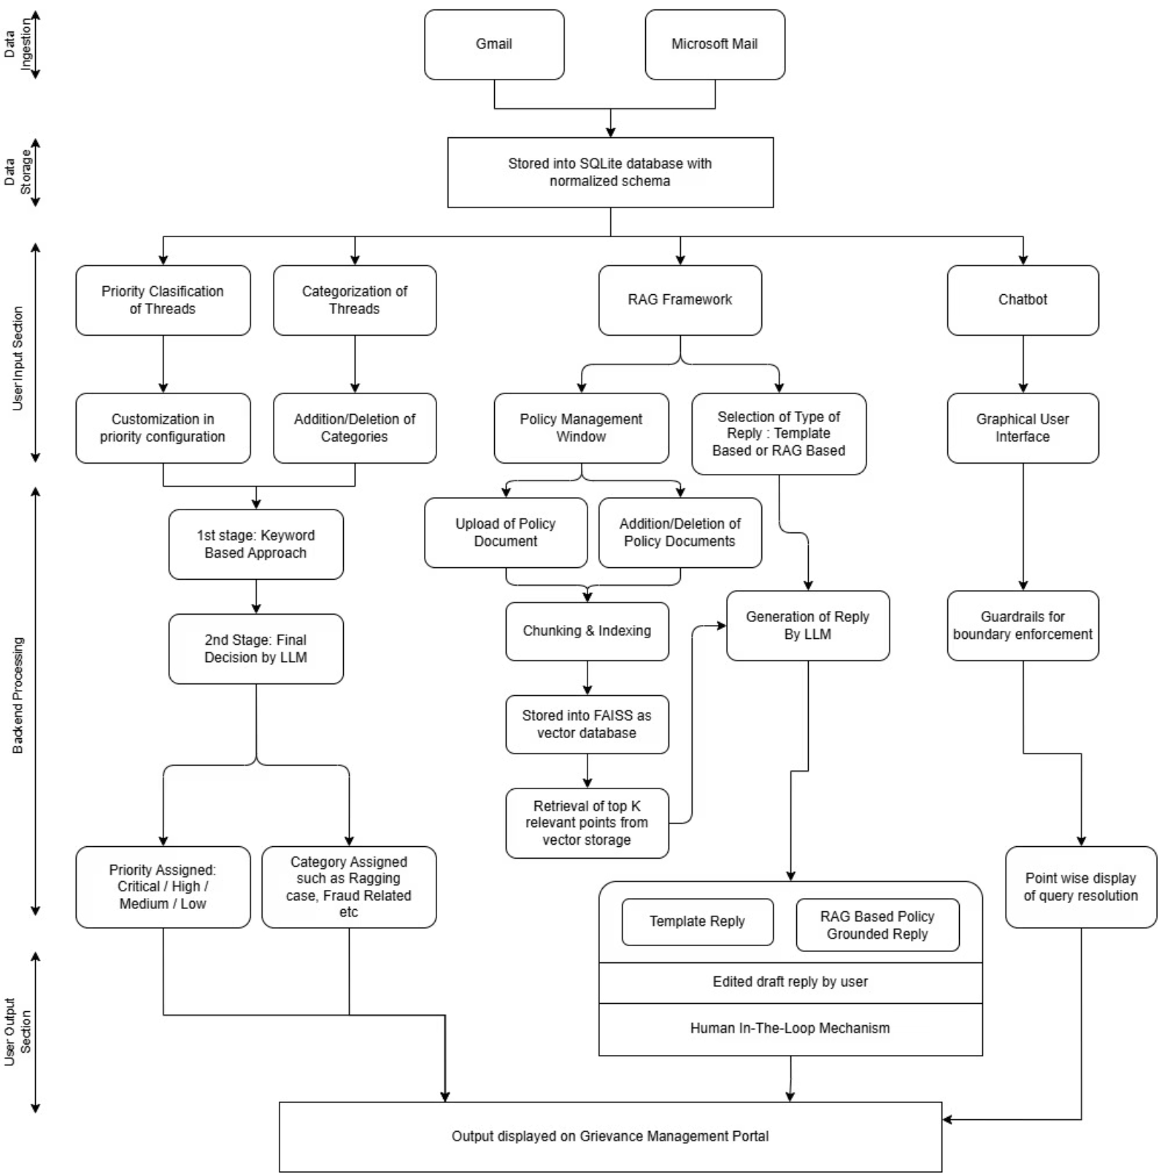
System Architecture

Slide 6



Technology Stack
Roboust, Scalable and AI-Driven Techology Choices
Frontend
Backend
Embeddings & Vector Store
Database
React 18, TypeScript, Recharts, Nginx
FastAPI, Uvicorn
SQLite for structured, multi-tenant data persistence
sentence-transformers (all-MiniLM-L6-v2), FAISS (IndexFlatIP)
AI / LLM
Auth & Security
Google Gemini Flash (Gemma fallback), Gemini Vision API
Google OAuth 2.0, Fernet encryption, PyJWT
Document Parsing
Deployment
pdfplumber, python-docx, openpyxl, pandas
On-premises containerized architecture; zero external cloud storage

Slide 7





Results & Discussion
Delivering a Secure, Intelligent and Scalable Platform
The system delivers measurable improvements across triage accuracy, policy compliance, user experience, and data security.
Intelligent Triage
Policy-Grounded Replies
Live Dashboard
15-category classification and 4-tier priority assignment automated, with dynamic LLM upgrades for urgent or frustrated tones.
RAG engine retrieves policy chunks and generates formally cited responses, eliminating manual PDF searches.
Real-time KPI cards, category charts, and filterable email tables replace previously disorganized shared mailboxes.
NLP Interface
Security Posture
Intelligent Assistant handles grievance counts, status checks, and policy queries via plain language with 5-turn memory.
On-premises data residency, zero external cloud storage, strictly scoped multi-tenant architecture, and robust audit trails.

Slide 8


Priority & Categorization of Emails - Local SLM Evaluation Report
52 official grievance emails evaluated across 5 local SLMs (Qwen 3.5 4B, Llama 3.2 3B, Gemma 3 4B, Phi 4 Mini, Qwen 2.5 3B) on local Ollama for category routing (14 folders) and priority urgency (0–3).
Performance Comparison
Model
Category Acc.
Priority Acc. (Safeguarded)
Avg. Time
Qwen 3.5 4B
82.69%
96.15%
7.62s
Llama 3.2 3B
59.62%
90.38%
4.26s
Gemma 3 4B
67.31%
76.92%
5.08s
Phi 4 Mini
67.31%
69.23%
5.40s
Qwen 2.5 3B
46.15%
82.69%
3.05s
Best Overall
Fastest
Safeguards
Qwen 3.5 4B leads with 80.77% overall accuracy.
Llama 3.2 is fastest (~4.26s) with strong priority accuracy.
Rule-based safeguards boost priority accuracy (Qwen 2.5: +59.62%).
Recommendation: To Deploy Qwen 3.5 4B with safety rules; scale to 17B–31B models for improved routing.

Slide 9





Evaluation Method
Ensuring Accuracy, Security, and Full FRD Traceability
Requirement Traceability
Security Validation
AI Agent Guardrails
End-to-end mapping of all 10 FRD requirements to specific code modules and UI features.
Verified Fernet encryption, HTTP-only signed cookies, and multi-tenant DB isolation against cross-tenant data leakage.
SQL Agent tested for strict read-only enforcement — blocking DELETE, UPDATE, and DROP operations with auto-injected user filters.
RAG Accuracy
Performance & Rate Limits
FAISS semantic relevance evaluated; mandatory policy clause citations (e.g., "As per Clause EXM-01") verified in all generated replies.
Threading locks monitored: 1 Gemini call/min and 50 Gmail calls/min ceiling with background worker concurrency tracking.

Slide 10

Installation & Deployment Process
Complete Setup Guide for Local & Production Environments
01
02
03
System Requirements Check
Configure Cloud Services
Native Installation Setup
Ensure a compatible OS (Windows/Linux/macOS), at least 8 GB RAM, sufficient storage space, optional GPU support, and a stable internet connection.
Set up Google Cloud or Microsoft Azure APIs, generate OAuth 2.0 credentials, create Google Gemini API keys, and configure service account permissions.
Create a Python virtual environment, install dependencies from requirements.txt, configure .env variables with API keys, and optionally set up Ollama for local AI models.
04
05
06
Launch Application Locally
Initialize Semantic Search
Optional Containerized Deployment
Start the backend server with Uvicorn on port 8000, launch the frontend with the Node.js dev server on port 5173, then access the dashboard in your browser.
Build the local FAISS index from policy documents using all-MiniLM-L6-v2 embeddings to enable AI-powered policy retrieval and RAG functionality.
Use Docker Compose to deploy the backend, database, worker, and frontend containers for a production-ready environment.
07
Maintenance & Troubleshooting
Manage database backups, monitor environment variables, resolve OAuth and dependency issues, and maintain FAISS indexes for optimal performance.
Final Outcome: Fully configured AI grievance management system running successfully on local or production infrastructure

Slide 11

Conclusion & Future Work
Conclusion
Roadmap for Expansion
The system transforms the Department of Education's email processing from a manual, unstructured workflow into an automated, secure, and policy-compliant pipeline. Full FRD traceability, multi-tenant isolation, and RAG-powered citations ensure accountability and speed in public grievance redressal.
Plug-and-Play Onboarding
Any government department can onboard via simple Google account connection — zero code changes required.
LLM Interoperability
Integrate government-approved local LLMs for enhanced data privacy and sovereign AI compliance

