Slide 1
Delay-Constrained Network Information Flow
Minghua Chen
School of Data Science, City University of Hong Kong
http://personal.cityu.edu.hk/~mchen88
Joint work with Chih-Chun Wang (Purdue) and Ye Tian (Nanjing U)
Notes:
Good afternoon, everyone. Today I will discuss network communication, in particular, how to maximize throughput subject to delay constraints. This is a joint work with Chih-Chun Wang from Purdue University, and Ye Tian, who was an intern at CUHK and now a PhD student in Purdue University.

Slide 2


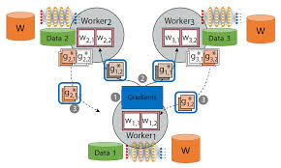
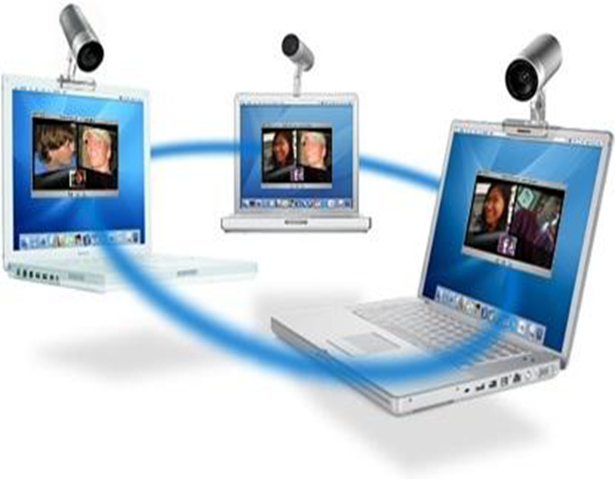


Delay Optimization is the Field with Action
Wireless
networking
Datacenter networking
Delay
Optimization
Deep learning
Real-time
conferencing
E-commerce
VR/AR

Slide 3

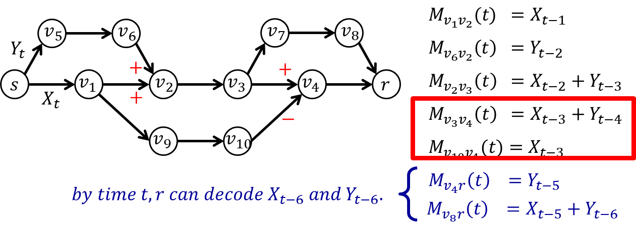
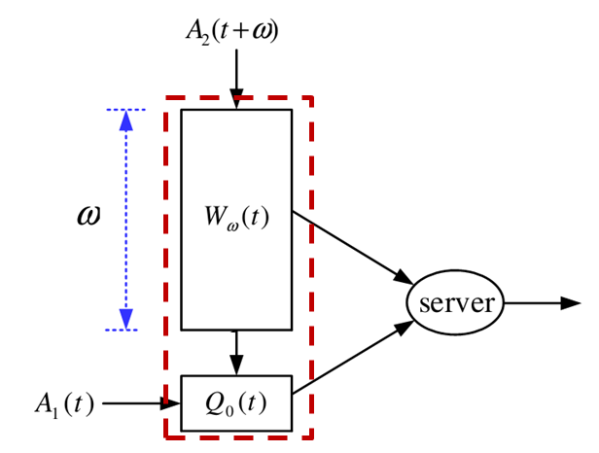
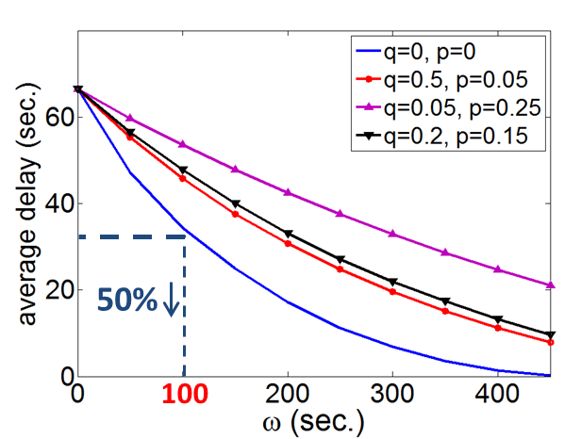
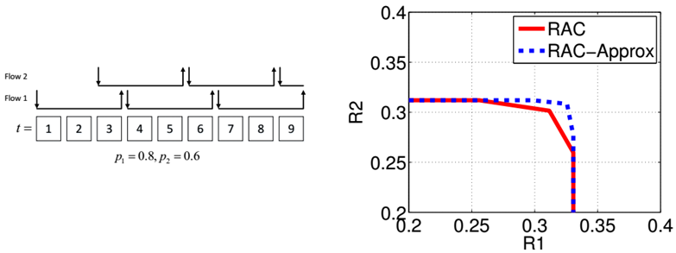
Network Delay Optimization
Delay-constrained network information flow
Delay-constrained wireless scheduling
Flow delay minimization
Proactive serving for reducing user delay
Maximum
delay
Average
delay
IEEE TIT, IEEE/ACM ToN, IEEE JSAC, ACM Multimedia, IEEE INFOCOM, IEEE ISIT

Slide 4












Network Information Flow
$$v_{5}$$
$$v_{6}$$
$$v_{7}$$
$$v_{8}$$
$$s$$
$$v_{1}$$
$$v_{2}$$
$$v_{3}$$
$$v_{4}$$
$$r$$
$$v_{9}$$
$$v_{10}$$
Problem: Given a direct acyclic network, characterize and achieve the capacity from a source to the receiver(s)
A fundamental problem in networked systems
Notes:
In network communication, a key problem is to compute and achieve the communication capacity. In the single-source setting, the capacity is the maximum rate that the source can stream information to its receivers. Given the capacity, one can leverage the rich results from NUM to solve a large number of network design problems, in both wireline and wireless scenarios.

Slide 5
Delay-Unconstrained Network Information Flow: Well-Studied
$$v_{5}$$
$$v_{6}$$
$$v_{7}$$
$$v_{8}$$
$$s$$
$$v_{1}$$
$$v_{2}$$
$$v_{3}$$
$$v_{4}$$
$$r$$
$$v_{9}$$
$$v_{10}$$
Setting: A directed graph, each edge has a unit capacity
Single-Unicast: routing is optimal
  Max-flow = min-cut
  The Ford-Fulkerson algorithm finds a capacity-achieving flow solution in polynomial time
Notes:
Under the classical setting where we only care only about throughput, the problem is well studied. For unicast with one source and one destination, we know that routing is throughput optimal and one can construct a capacity-achieving solution in polynomial time.

Slide 6
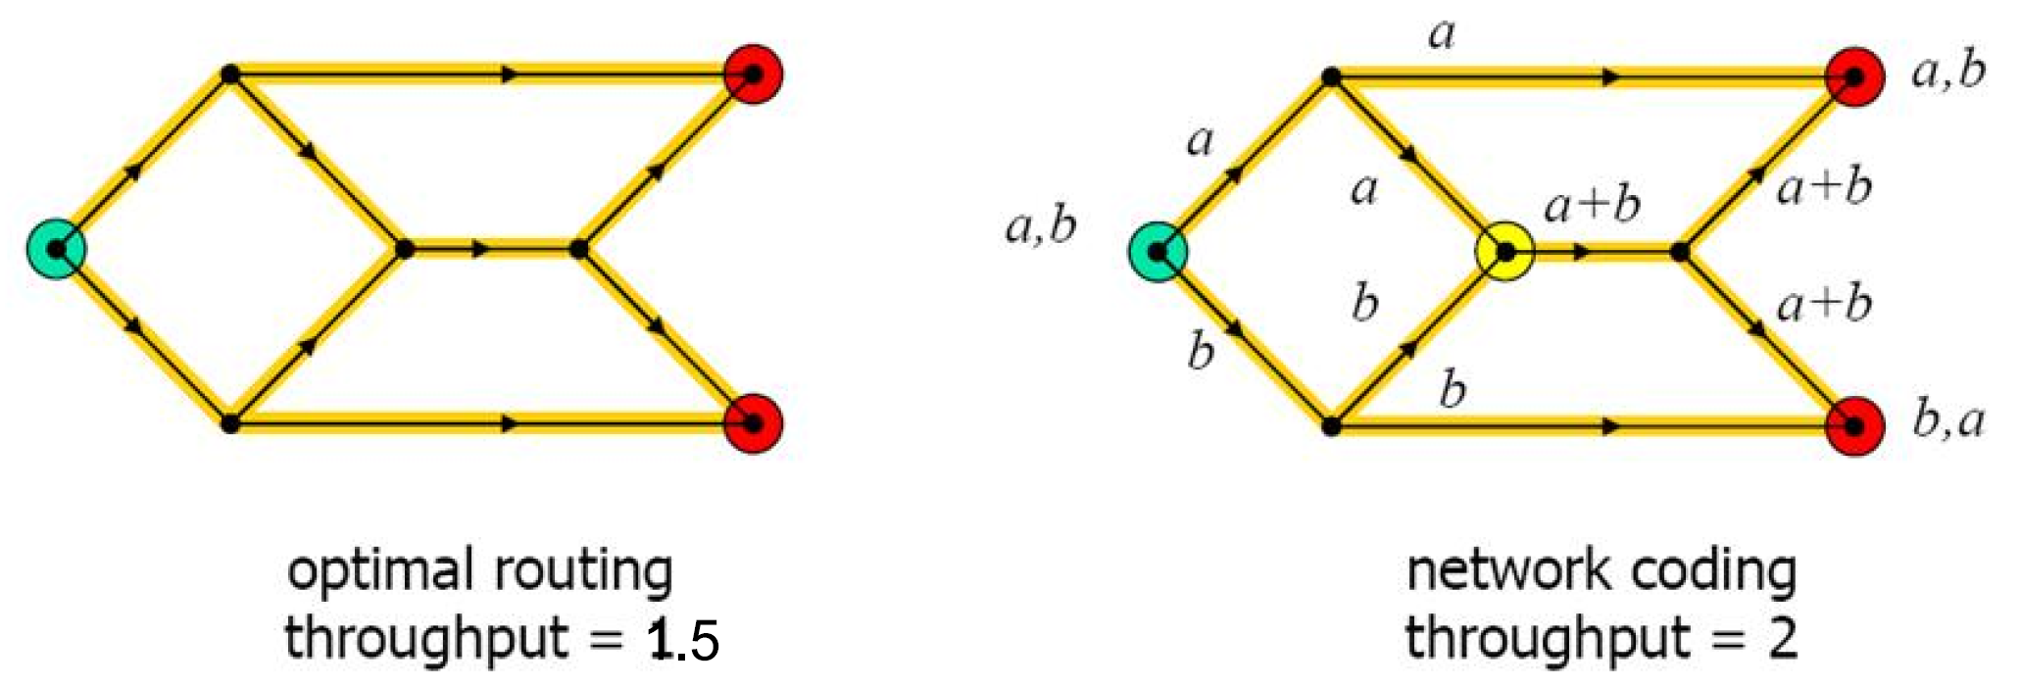
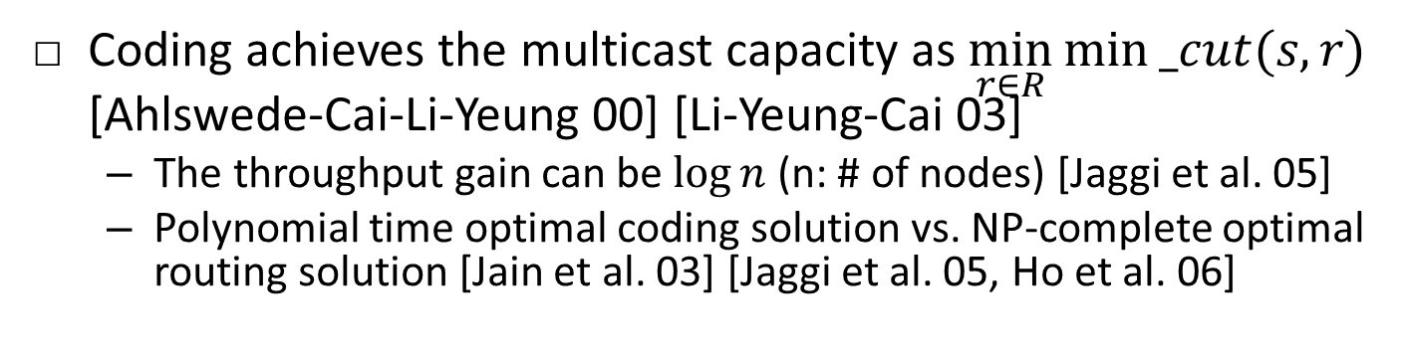
Coding > Routing in Single Multicast
Coding achieves the multicast capacity as $\min_{r∈R}{min⁡_cut(s,r)}$ [Ahlswede-Cai-Li-Yeung 00] [Li-Yeung-Cai 03]
  The throughput gain can be $log⁡n$ (n: # of nodes) [Jaggi et al. 05]
  Polynomial time optimal coding solution vs. NP-complete optimal routing solution [Jain et al. 03] [Jaggi et al. 05, Ho et al. 06]
Notes:
However, for multicast, it turns out just doing routing is not enough. Raymond and Bob from CUHK and their co-authors show that coding can achieve higher throughput than routing. Here, coding means that we mix incoming packets to a node and send out a function of them. In this classic butterfly network example, coding achieves throughput of 2, higher than the 1.5 achieved by routing. The coding gain is 4/3. More general networks, researchers have shown that coding can achieve the multicast capacity, which is the minimum of the mincuts from source s to individual users. The coding gain in terms of throughput can be unbounded, and it is sufficient to consider random linear network coding.

Slide 7


Delay-Constrained Network Information Flow: Under-Explored
Example: D=6, what is
the max throughput
achievable by routing?
Green path incurs an
end-to-end delay 5
Gray path incurs an
end-to-end delay 7
$$v_{5}$$
$$v_{6}$$
$$v_{7}$$
$$v_{8}$$
$$s$$
$$v_{1}$$
$$v_{2}$$
$$v_{3}$$
$$v_{4}$$
$$r$$
$$v_{9}$$
$$v_{10}$$
Question: what is the delay-constrained capacity?
  Each edge has a unit capacity and incurs a unit delay
  Each bit in the s-t flow has an end-to-end deadline D
Notes:
Directed acyclic networks

Slide 8
(Single-Source) Network Information Flow
Delay-Unconstrained:
Well-Studied
Delay-Constrained:
Under-Explored
Unicast capacity is achieved by both routing and network coding
Multicast capacity is achieved by random linear network coding
Network utility maximization as a principled package for wired/wireless network design
This talk: towards filling the blanks on the right

Slide 9
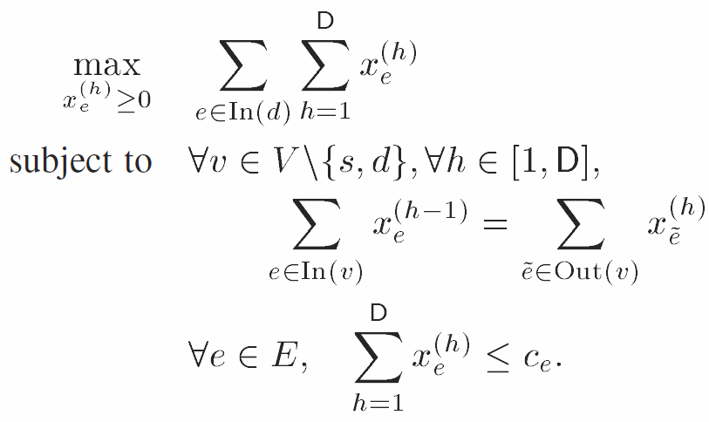
Delay-Constrained Unicast Routing Capacity as an LP
D=6: If only routing is
allowed, the maximum
throughput is 1.5
Each path supports a rate of 0.5
Theorem: The delay-constrained unicast routing capacity can be found by solving an LP.
$$v_{5}$$
$$v_{6}$$
$$v_{7}$$
$$v_{8}$$
$$s$$
$$v_{1}$$
$$v_{2}$$
$$v_{3}$$
$$v_{4}$$
$$r$$
$$v_{9}$$
$$v_{10}$$
L. Ying, S. Shakkottai, A. Reddy, and S. Liu, “On combining shortest path and back-pressure routing over multihop wireless networks,” IEEE ToN 2011
C. Wang and M. Chen, “Sending Perishable Information: Coding Improves Delay-Constrained Throughput Even for Single Unicast”, IEEE ISIT 2014, TIT 2017
Notes:
h: hop
X_e^(h): rate of flow at its h-th hop over edge e
Objective: maximize the total (fractional) capacity subjec
Constraint: capacity constraints.

Slide 10



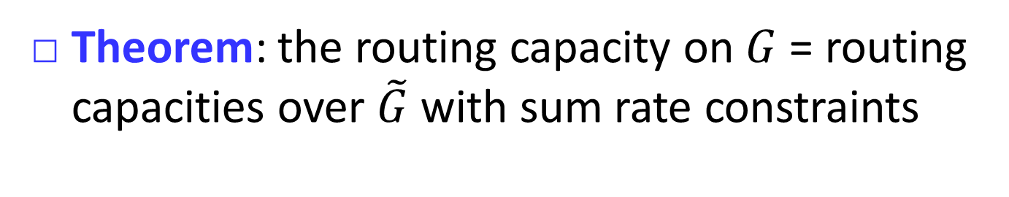















The Idea behind: Hop-Expanded Graph
$$v_{5}^{1}$$
$$v_{6}^{2}$$
sum rate < link capacity
$$v_{7}^{4}$$
$$v_{8}^{5}$$
$$v_{7}^{5}$$
$$v_{8}^{6}$$
$$s^{0}$$
$$v_{1}^{1}$$
$$v_{2}^{2}$$
$$v_{3}^{3}$$
$$v_{4}^{4}$$
$r^{5}$
$$v_{2}^{3}$$
$$v_{3}^{4}$$
$$v_{4}^{5}$$
$r^{6}$
$$v_{9}^{2}$$
$$v_{10}^{3}$$
Theorem: the routing capacity on $G$ = routing capacities over $\tilde{G}$ with sum rate constraints
Notes:
Allow us to track space (for utilizing capacity resource) and time (for ensuring delay) simultaneously
Node $ν→ν^{hop}$; edge $\left(μ,ν\right)→\left(μ^{hop_{u}},ν^{hop_{v}}\right)$, sum
Given a directed acyclic graph G, hop-expanded $\tilde{G}$ can be constructed in polynomial time

Slide 11



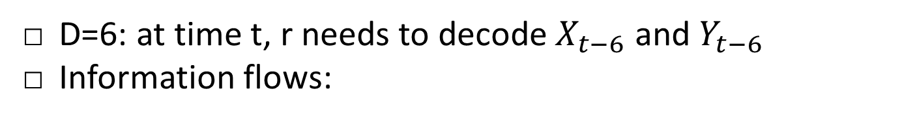





Coding Gain of 4/3 even for Single Unicast
D=6: at time t, r needs to decode $X_{t−6}$ and $Y_{t−6}$
Information flows:
$$v_{5}$$
$$v_{6}$$
$$v_{7}$$
$$v_{8}$$
$$Y_{t}$$
$$Y_{t−7}$$
$$s$$
$$v_{1}$$
$$v_{2}$$
$$v_{3}$$
$$v_{4}$$
$$r$$
$$Y_{t−6}$$
$$v_{9}$$
$$v_{10}$$
$$v_{5}$$
$$v_{6}$$
$$v_{7}$$
$$v_{8}$$
$$X_{t−6}$$
$$s$$
$$v_{1}$$
$$v_{2}$$
$$v_{3}$$
$$v_{4}$$
$$r$$
$$X_{t−5}$$
$$X_{t}$$
$$v_{9}$$
$$v_{10}$$
$$X_{t−5}$$
C. Wang and M. Chen, “Sending Perishable Information: Coding Improves Delay-Constrained Throughput Even for Single Unicast”, IEEE ISIT 2014, TIT 2017

Slide 12



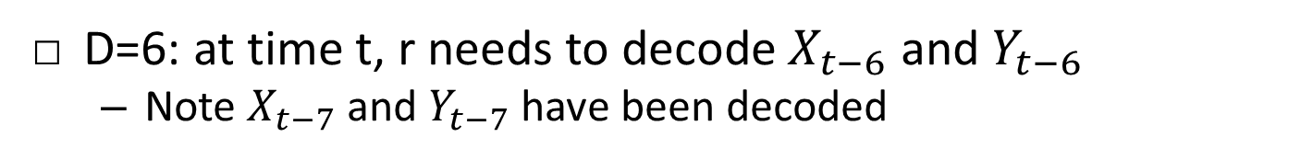






Coding Gain of 4/3 even for Single Unicast
D=6: at time t, r needs to decode $X_{t−6}$ and $Y_{t−6}$
  Note $X_{t−7}$ and $Y_{t−7}$ have been decoded
benign
interference
$$X_{t−3}+Y_{t−4}$$
$$v_{5}$$
$$v_{6}$$
$$+$$
$$v_{7}$$
$$v_{8}$$
$$X_{t−6}+Y_{t−7}$$
$$Y_{t}$$
$$+$$
$$+$$
$$s$$
$$v_{1}$$
$$v_{2}$$
$$v_{3}$$
$$v_{4}$$
$$r$$
$$X_{t}$$
$$+$$
$$2X_{t−5}+Y_{t−6}$$
$$v_{9}$$
$$v_{10}$$
deadline-induced
interference
C. Wang and M. Chen, “Sending Perishable Information: Coding Improves Delay-Constrained Throughput Even for Single Unicast”, IEEE ISIT 2014, TIT 2017

Slide 13



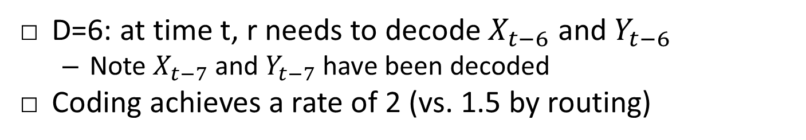






Coding Gain of 4/3 even for Single Unicast
D=6: at time t, r needs to decode $X_{t−6}$ and $Y_{t−6}$
  Note $X_{t−7}$ and $Y_{t−7}$ have been decoded
Coding achieves a rate of 2 (vs. 1.5 by routing)
benign
interference
$$X_{t−3}+Y_{t−4}$$
$$v_{5}$$
$$v_{6}$$
$$+$$
$$v_{7}$$
$$v_{8}$$
$$X_{t−6}+Y_{t−7}$$
$$Y_{t}$$
$$+$$
$$+$$
$$s$$
$$v_{1}$$
$$v_{2}$$
$$v_{3}$$
$$v_{4}$$
$$r$$
$$X_{t}$$
$$−$$
$$Y_{t−6}$$
$$v_{9}$$
$$v_{10}$$
C. Wang and M. Chen, “Sending Perishable Information: Coding Improves Delay-Constrained Throughput Even for Single Unicast”, IEEE ISIT 2014, TIT 2017

Slide 14
Roadmap
The landscape of delay-constrained networking is surprising
  Coding > routing even for single unicast
  Coding gain >= 2
How to compute the coding capacity?
Coding = routing in single unicast, when there is no delay constraint

Slide 15

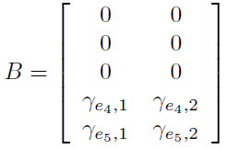
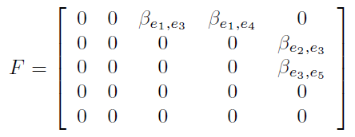







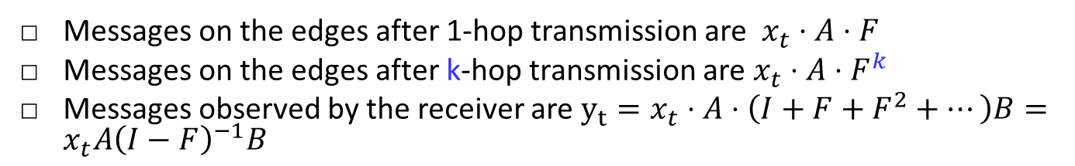
An Algebraic Approach for Linear Network Coding [Li-Yeung-Cai 03, Koetter-Médard 03]
$$e_{1}$$
$$e_{4}$$
$$x_{t}$$
s
$$e_{3}$$
r
$$y_{t}$$
$$e_{2}$$
$$e_{5}$$
Messages on the edges after 1-hop transmission are $x_{t}⋅A⋅F$
Messages on the edges after k-hop transmission are $x_{t}⋅A⋅F^{k}$
Messages observed by the receiver are $y_{t}=x_{t}⋅A⋅\left(I+F+F^{2}+⋯\right)B=x_{t}A{\left(I−F\right)}^{−1}B$

Slide 16
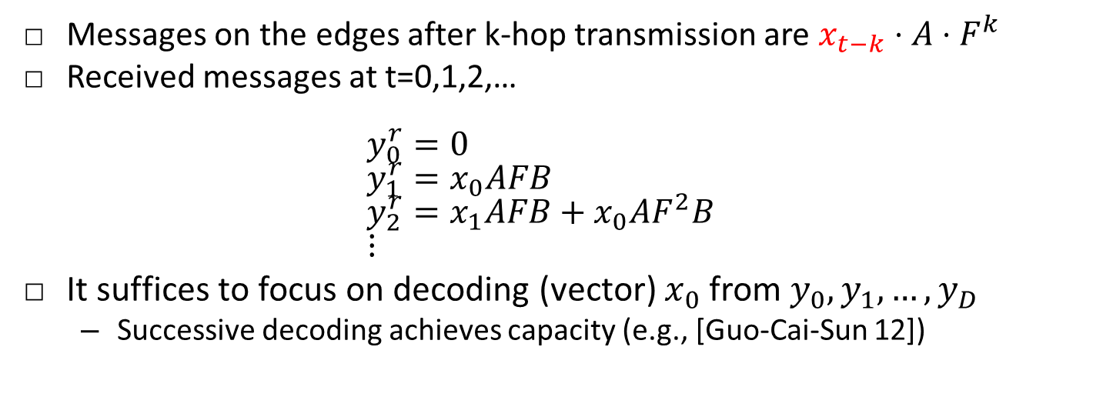
Delay-Constrained Case
$$e_{1}$$
$$e_{4}$$
$$x_{t}$$
s
$$e_{3}$$
r
$$y_{t}$$
$$e_{2}$$
$$e_{5}$$
Messages on the edges after k-hop transmission are $x_{t−k}⋅A⋅F^{k}$
Received messages at t=0,1,2,…
$y_{0}^{r}=0$
$y_{1}^{r}=x_{0}AFB$
$y_{2}^{r}=x_{1}AFB+x_{0}AF^{2}B$
$⋮$
It suffices to focus on decoding (vector) $x_{0}$ from $y_{0},y_{1},…,y_{D}$
  Successive decoding achieves capacity (e.g., [Guo-Cai-Sun 12])
Notes:
Messages on the edges after 1-hop transmission are $x_{t−1}⋅A⋅F$

Slide 17
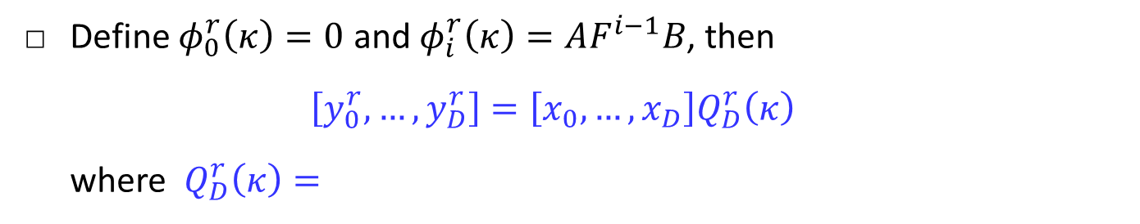
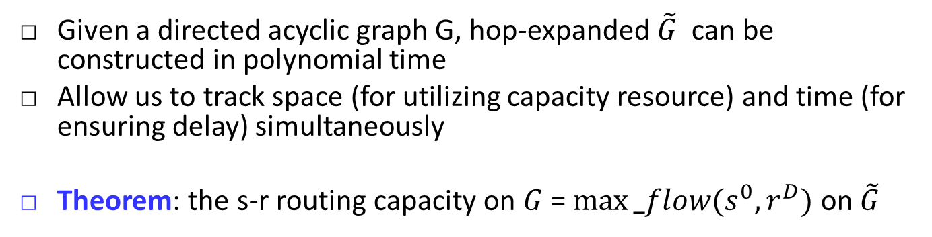
Information/Interference Subspace
$$e_{1}$$
$$e_{4}$$
$$x_{t}$$
s
$$e_{3}$$
r
$$y_{t}$$
$$e_{2}$$
$$e_{5}$$
Define $φ_{0}^{r}\left(κ\right)=0$ and $φ_{i}^{r}\left(κ\right)=AF^{i−1}B$, then
$\left[y_{0}^{r},…,y_{D}^{r}\right]=\left[x_{0},…,x_{D}\right]Q_{D}^{r}\left(κ\right)$
where $Q_{D}^{r}\left(κ\right)=$
$Q_{D}^{r}\left(κ\right)=\left[\begin{matrix}φ_{0}^{r}\left(κ\right) & φ_{1}^{r}\left(κ\right) & ⋯ & φ_{D}^{r}\left(κ\right) \\ & φ_{0}^{r}\left(κ\right) & & φ_{D−1}^{r}\left(κ\right) \\ & & ⋱ & ⋮ \\ 0 & & ⋯ & φ_{0}^{r}\left(κ\right)\end{matrix}\right]$
Information
space observed
$$Q_{D−1}^{r}(κ)$$
Deadline-induced
interference space

Slide 18
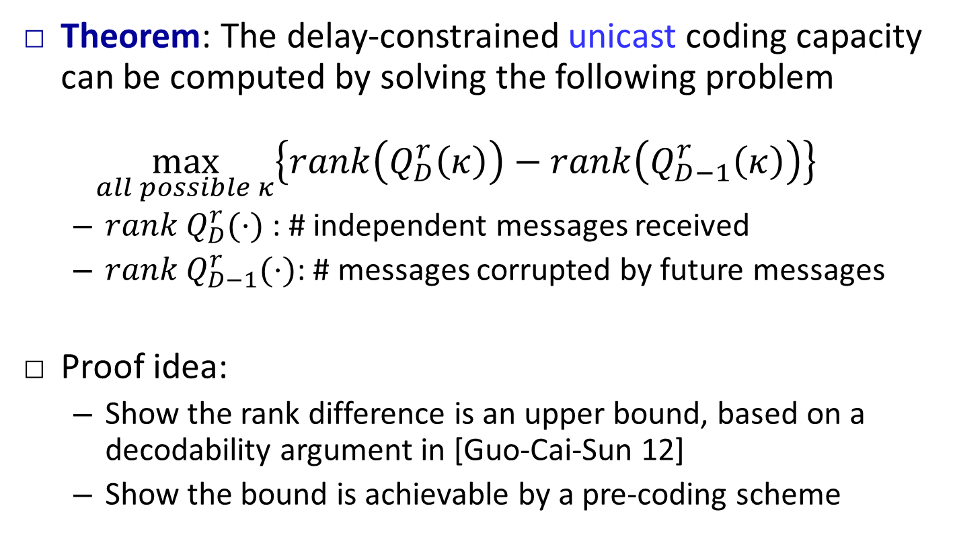
Delay-Constrained Unicast Coding Capacity
Theorem: The delay-constrained unicast coding capacity can be computed by solving the following problem
$\max_{all possible κ}\left\{rank\left(Q_{D}^{r}\left(κ\right)\right)−rank\left(Q_{D−1}^{r}\left(κ\right)\right)\right\}$
  ${rank Q}_{D}^{r}(⋅)$ : # independent messages received
  $rank Q_{D−1}^{r}(⋅)$: # messages corrupted by future messages
Proof idea:
  Show the rank difference is an upper bound, based on a decodability argument in [Guo-Cai-Sun 12]
  Show the bound is achievable by a pre-coding scheme
W. Guo, N. Cai, and Q. T. Sun, “Time-variant decoding of convolutional network codes,” IEEE Communications Letters, vol. 16, no. 10, pp. 1656–1659, 2012.
Notes:
${rank Q}_{D}^{r}(⋅)$ : the number of independent messages received by D
$rank Q_{D−1}^{r}(⋅)$: the number of messages corrupted by future messages
The rank difference represents the number of “corruption-free” messages
$Q_{D}^{r}(⋅)$ captures the aggregate information space observed by r within delay D. Its rank represents the number of independent messages in this space.

Slide 19
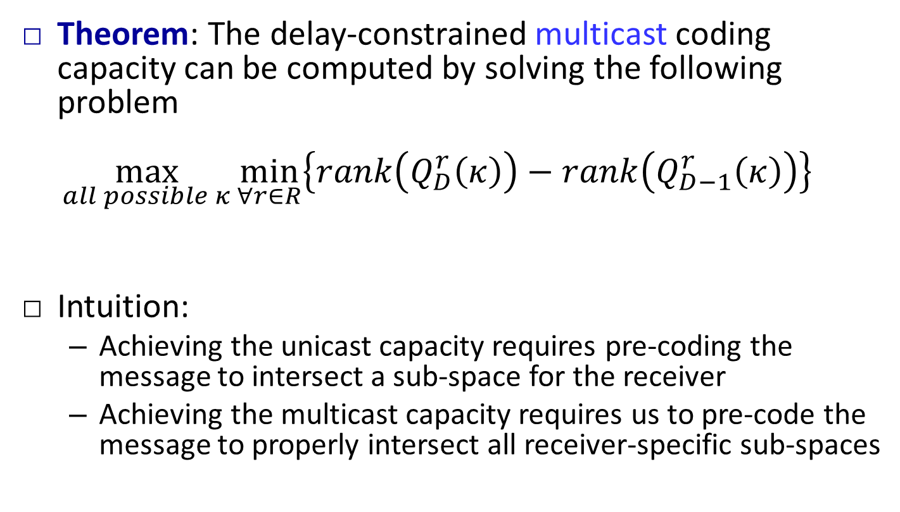
Delay-Constrained Multicast Coding Capacity
Theorem: The delay-constrained multicast coding capacity can be computed by solving the following problem
$\max_{all possible κ}{\min_{∀r∈R}\left\{rank\left(Q_{D}^{r}\left(κ\right)\right)−rank\left(Q_{D−1}^{r}\left(κ\right)\right)\right\}}$
Intuition:
  Achieving the unicast capacity requires pre-coding the message to intersect a sub-space for the receiver
  Achieving the multicast capacity requires us to pre-code the message to properly intersect all receiver-specific sub-spaces
Notes:
Not yet the minimum of individual throughput (possible gap)

Slide 20
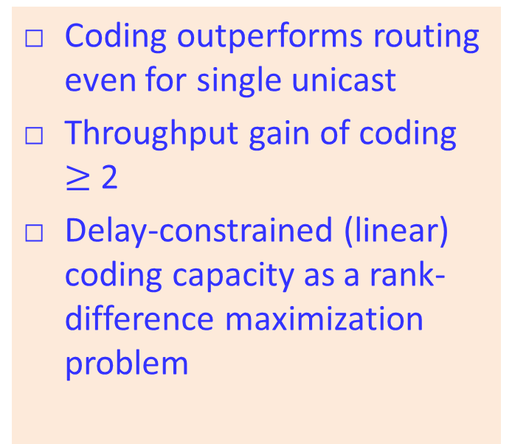
Network Information Flow
Delay-Unconstrained:
Well-Studied
Delay-Constrained:
Under-Explored
Routing is capacity-achieving for unicast
Multicast capacity is achieved by random linear network coding
Network utility maximization as a principled network design package
Coding outperforms routing even for single unicast
Throughput gain of coding $≥$ 2
Delay-constrained (linear) coding capacity as a rank-difference maximization problem
L. Ying, S. Shakkottai, A. Reddy, and S. Liu, “On combining shortest path and back-pressure routing over multihop wireless networks,” ToN 2011
C. Wang and M. Chen, “Sending Perishable Information: Coding Improves Delay-Constrained Throughput Even for Single Unicast”, IEEE ISIT 2014, TIT 17
M. Chen, Y. Tian, and C. Wang, “On Coding Capacity of Delay-constrained Network Information Flow: An Algebraic Approach”, IEEE ISIT 2016
Notes:
Future work: better characterization, exploring max coding gain, …

Slide 21
Fundamental of Network Delay Optimization
Delay-constrained network information flow
Delay-constrained wireless scheduling
Flow delay minimization
Proactive serving for reducing user delay
Maximum
delay
Average
delay
Call for investigation participation
IEEE TIT, IEEE/ACM ToN, IEEE JSAC, ACM Multimedia, IEEE INFOCOM, IEEE ISIT

Slide 22

Thank you!
Minghua Chen (minghua.chen@cityu.edu.hk)
http://personal.cityu.edu.hk/~mchen88

