Slide 1

Energy Efficient Dynamic Provisioning in Data Centers:
The Benefit of Seeing the Future
Minghua Chen
http://www.ie.cuhk.edu.hk/~mchen
Department of Information Engineering The Chinese University of Hong Kong
TexPoint fonts used in EMF.
Read the TexPoint manual before you delete this box.: AAAAAAAAAAA

Slide 2
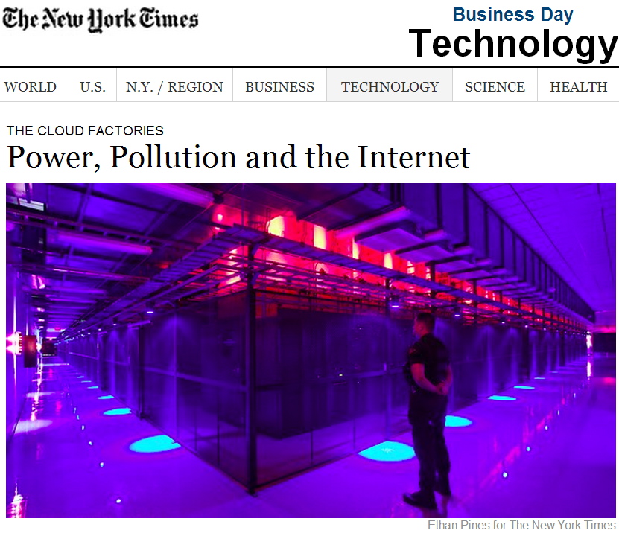
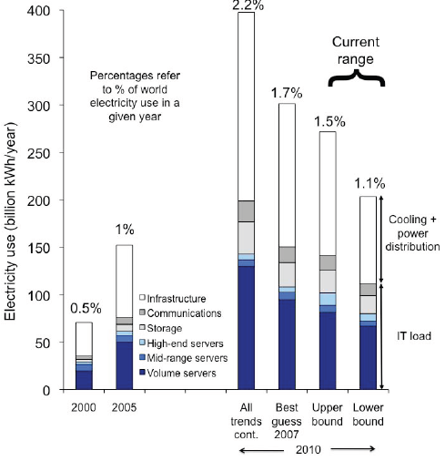
Skyrocketing Data Center Energy Usage
In 2010, it is ~240 Billion kWh, 1.3% of world electricity use.
It can power 5+ Hong Kong, or roughly the entire Spain.
The total bill is ~16 billion USD (~ GDP of New Zealand).
Expected ~ 20% increase in 2012
(Datacenterdynamics 2011)
[Jonathan Koomey 2011]

Slide 3
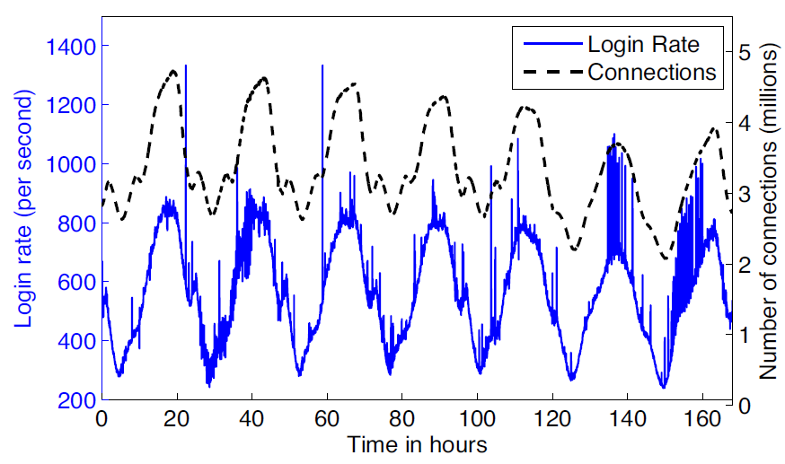
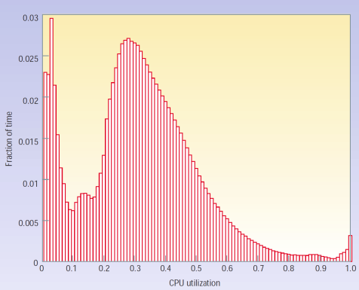
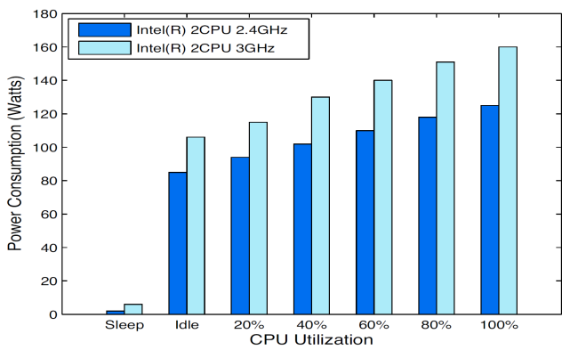
Energy Is Wasted to Power Idle Servers
Workload varies dramatically.
Static provisioning leads to low server utilizations.
  US-wide server utilization: 10-20% (source: NY Times).
Low-utilized servers waste energy.
  Low-utilized server consumes >60% of the peak power.
Notes:
Workload varies dramatically.
Large variation hourly or daily.
Peak-to-Mean ratio: 2-5.
Current practice static-provisioning leads to low-utilized servers.
Google Servers are heavily under-utilized: 30% on average.
Underutilized servers are energy-inefficient.
Low-utilized server consumes 66% of the peak power

Slide 4
Dynamic Provisioning: Save Idling Energy
Dynamically turn servers on/off to meet the demand.
  Save up to 71% energy cost in our case study.
Work Capacity
Static Provisioning
Dynamic Provisioning
Dynamic Load Arrival
Time

Slide 5
Dynamic Provisioning: Challenges
Server on/off is not free: current decision depends on the future workload.
Future workload is unknown.
Dense workload
Time
Dynamic Provisioning
Sparse workload
Dynamic Load Arrival
Time
Notes:
0.5-6 hrs running cost.

Slide 6
Existing Work
System building and feasibility examination (e.g., [Krioukov et al. 2010 GreenNetworking])
  Confirm that big saving is possible.
Algorithm design
  Using optimal control approaches. (e.g., [Chen et al. 2005 SIGMETRICS])
  Using queuing theory approaches. (e.g., [Grandhi et al. 2010 PERFORMANCE])
  Forecast based provisioning (e.g., [Chen et al. 2008 NSDI])
Relying on knowing future workload
to certain extent.
Notes:
Using optimal control approaches. (e.g., [Chen et al. 2005 SIGMETRICS])
No performance guarantee if the prediction model fails.
Using queuing theory approaches. (e.g., [Grandhi et a. 2010 PERFORMANCE])
No performance guarantee if the steady-state model fails.
Forecast based provisioning (e.g., [Chen et al. 2008 NSDI])
No performance guarantee.

Slide 7
Fundamental Questions
Can we achieve close-to-optimal performance, without knowing future workload information?
Can we characterize the beneﬁt of knowing future workload information?
  The value of modeling and prediction.
Notes:
For many modern systems, their short-term future inputs can be predicted by machine learning, time-series analysis, etc.

Slide 8
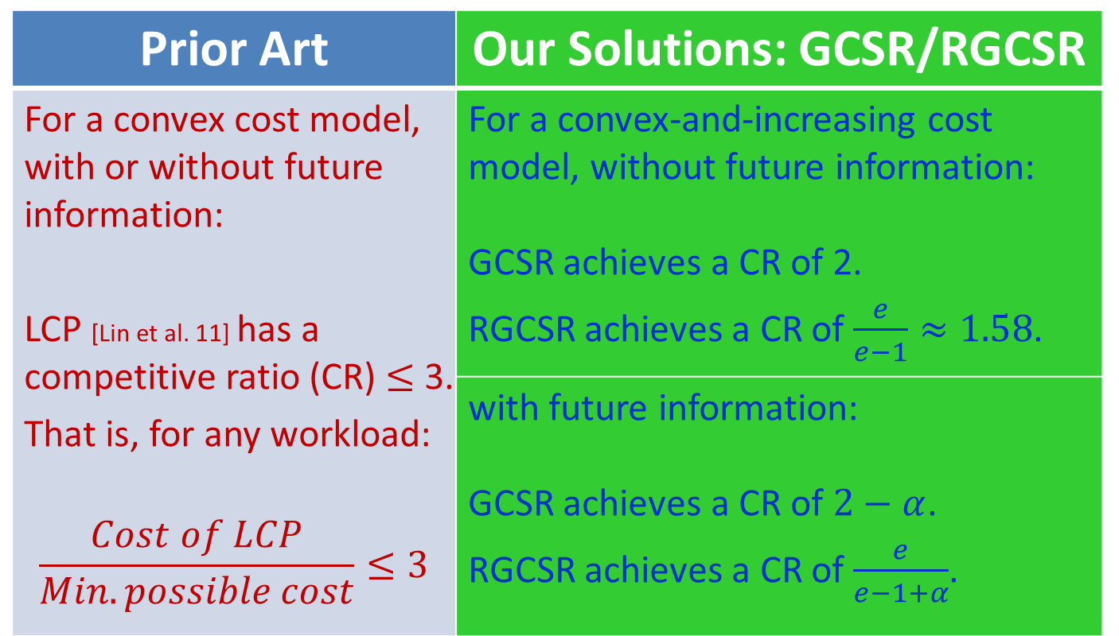
Our Contributions
Prior Art | Our Solutions: GCSR/RGCSR
For a convex cost model, with or without future information: LCP [Lin et al. 11] has a competitive ratio (CR) $≤$ 3. That is, for any workload: $$\frac{Cost of LCP}{Min. possible cost}≤3$$ | For a convex-and-increasing cost model, without future information: GCSR achieves a CR of 2. RGCSR achieves a CR of $\frac{e}{e−1}≈1.58$.
 | with future information: GCSR achieves a CR of $2−α$. RGCSR achieves a CR of $\frac{e}{e−1+α}$.
Notes:
FIXED THE COLOR. USE THE FIGURE.

Slide 9
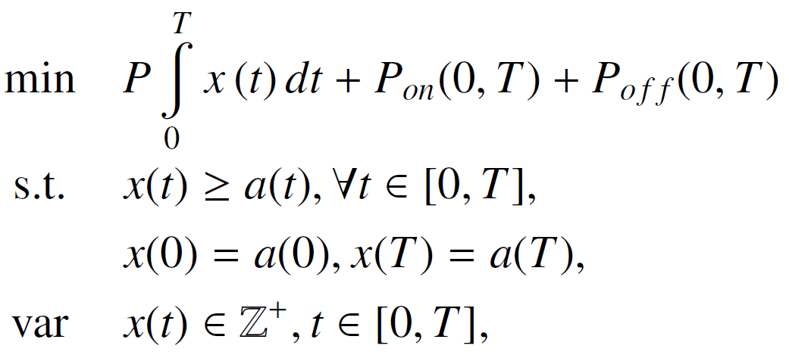
Problem Formulation (Basic Version)
total data center running cost
total server on-off cost
supply-demand constraint
integer variables
Objective: minimize data center operational cost in [0,T].
  Linear cost model.
  Elephant/mice workload model.
  Servers are homogenous and start instantaneously.
Challenge: Need to solve the problem in an online fashion.
Notes:
Challenges: Need to solve the integer problem in an online fashion.
(A1) Linear cost model. (Step function model: different cost for idling and busy.
(A2) Elephant/mice workload model.
(A3) Servers start instantaneously.

Slide 10

A Tom & Jerry Episode
The Idling Cabs

Slide 11


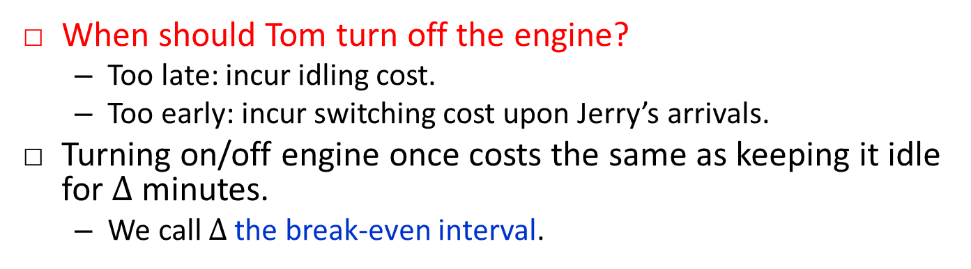
Tom’s Puzzle: Idling-Cab Problem
When should Tom turn off the engine?
  Too late: incur idling cost.
  Too early: incur switching cost upon Jerry’s arrivals.
Turning on/off engine once costs the same as keeping it idle for $Δ$ minutes.
  We call $Δ$ the break-even interval.
Airport
Notes:
A simple variant of the classic Ski-rental problem, by Anna R. Karlin, Mark S. Manasse, Larry Rudolph, and Daniel D. Sleator, “competitive snoopy caching. 1988.
Define break-even point.

Slide 12

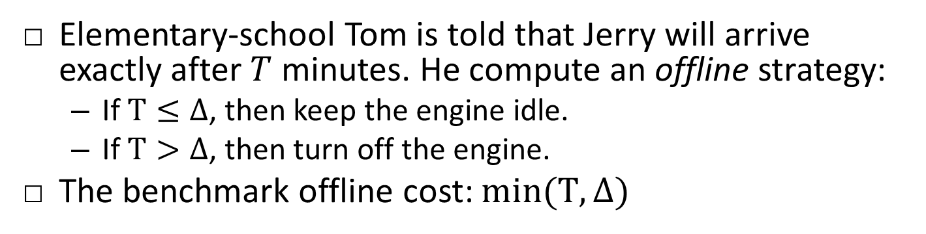



Offline: Knowing the Entire Future
Elementary-school Tom is told that Jerry will arrive exactly after $T$ minutes. He compute an offline strategy:
  If $T≤Δ$, then keep the engine idle.
  If $T>Δ$, then turn off the engine.
The benchmark offline cost: $min(T,Δ)$
$$T$$
time
$$Δ$$
  $Δ$: the break-even interval.
$$T$$
Notes:
The offline strategy is a baseline to compare.

Slide 13

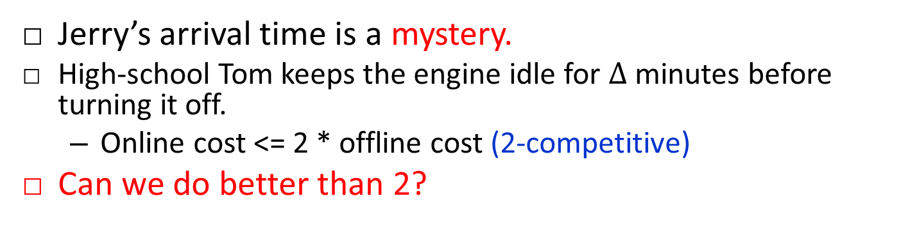
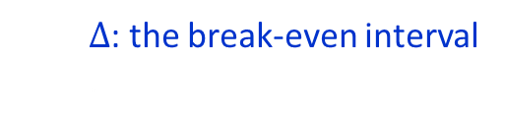
Online: Knowing Zero Future
Jerry’s arrival time is a mystery.
  High-school Tom keeps the engine idle for $Δ$ minutes before turning it off.
  Online cost <= 2 * offline cost (2-competitive)
Can we do better than 2?
online cost = offline cost
online cost = 2*offline cost
time
$$Δ$$
  $Δ$: the break-even interval
  .
Notes:
Put offline and online actions side by side.
This insight was also explored in DELAYEDOFF solution in
Anshul Gandhia, Varun Guptaa, Mor Harchol-Baltera, Michael A. Kozuchb, Optimality Analysis of Energy-Performance Trade-o for Server
Farm Management. Performance 10.

Slide 14

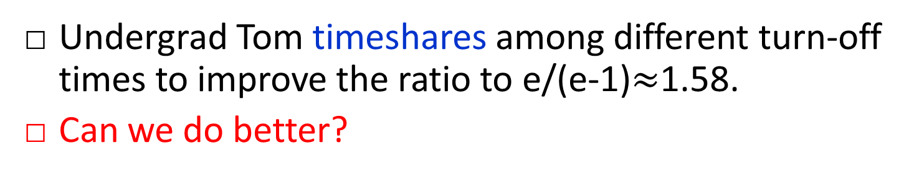


Benefit of Randomization
Undergrad Tom timeshares among different turn-off times to improve the ratio to e/(e-1)$≈$1.58.
Can we do better?
S1 wins.
S2 loses.
S1 loses.
S2 partially wins.
Both S1 and S2 win.
time
$$0.75Δ$$
$$0.25Δ$$
  $Δ$: the break-even interval.
Strategy S2
Strategy S1
Notes:
Observation: Jerry can only pick one arrival-epoch to hurt Tom.
A. R. Karlin, M. S. Manasse, L. A. McGeoch, and S. Owicki. Competitive randomized algorithms for non-uniform problems. In Proceedings of the First Annual ACM-SIAM Symposium on Discrete Algorithms, San Francisco, CA, 22–24 January 1990,

Slide 15


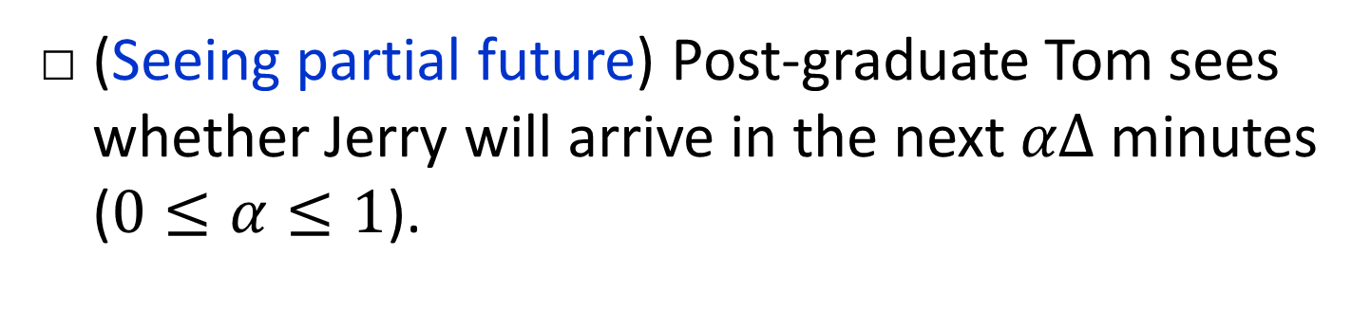

The Benefit of Seeing the Future
(Seeing partial future) Post-graduate Tom sees whether Jerry will arrive in the next $αΔ$ minutes ($0≤α≤1$).
look-ahead window
time
$$t$$
$$t+αΔ$$
  $Δ$: the break-even interval.
Notes:
Worst case: Jerry arrives right after $αΔ$ minutes from the turning off time.

Slide 16
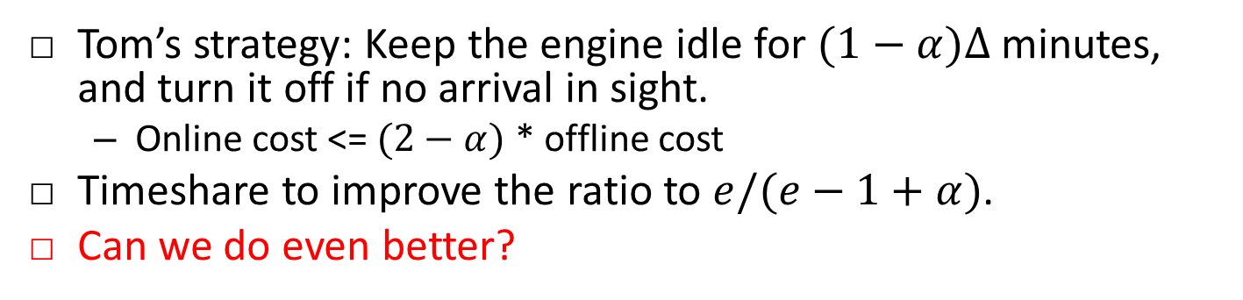


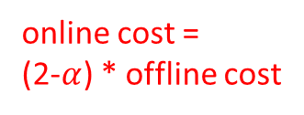
The Benefit of Seeing the Future
Tom’s strategy: Keep the engine idle for $(1−α)Δ$ minutes, and turn it off if no arrival in sight.
  Online cost <= $(2−α)$ * offline cost
Timeshare to improve the ratio to $e/(e−1+α)$.
Can we do even better?
online cost = offline cost
online cost =
(2-$α$) * offline cost
time
$$(1−α)Δ$$
  $Δ$: the break-even interval.
Notes:
Worst case: Jerry arrives right after $αΔ$ minutes from the turning off time.
The competitive ratio is $2−α$.

Slide 17
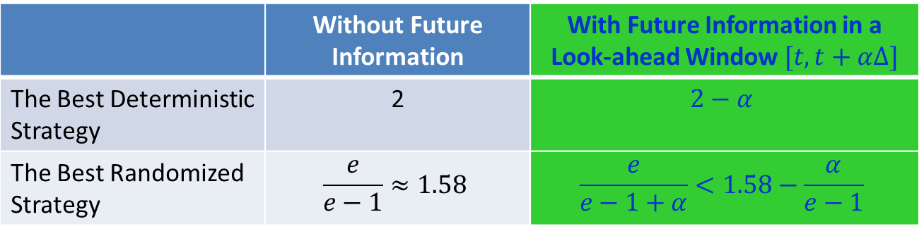
The Idling-Cab Problem: Summary
Tom proves that his strategies are the best possible.
But in practice, there are more than one cab.
 | Without Future Information | With Future Information in a Look-ahead Window $[t, t+αΔ]$
The Best Deterministic Strategy | 2 | $$2−α$$
The Best Randomized Strategy | $$\frac{e}{e−1}≈1.58$$ | $$\frac{e}{e−1+α}<1.58−\frac{α}{e−1}$$

Slide 18
Tom’s Topic: Idling-Cabs Problem (Tough)
How to minimize the aggregate waiting cost?
New key issue: who should serve the next Jerry?
Airport
Notes:
An integer-programming based approach adapted from LCP has a competitive ratio no better than 2.

Slide 19
Who Should Serve the Next Jerry?
fair but energy-wasting..
Hong Kong’s first-in-first-out rule:
Tom’s last-in-first-out rule:
  De-fragment the waiting periods to minimize the on/off times!
energy-efficient.
time
Tom #2
Tom #1
Tom #1 has waited longer than Tom #2.
waiting periods
serving periods

Slide 20
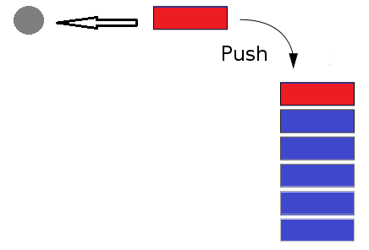
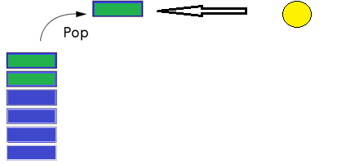


Tom’s Solution for Idling-Cabs Problem
Job-dispatching module: last-in-first-out.
  Easy to implement with a stack.
Individual cabs: solve their own idling-cab problems.
Customer departure
Customer arrival
Departing customer
Arriving customer
Idling cab ID
Off cab ID

Slide 21
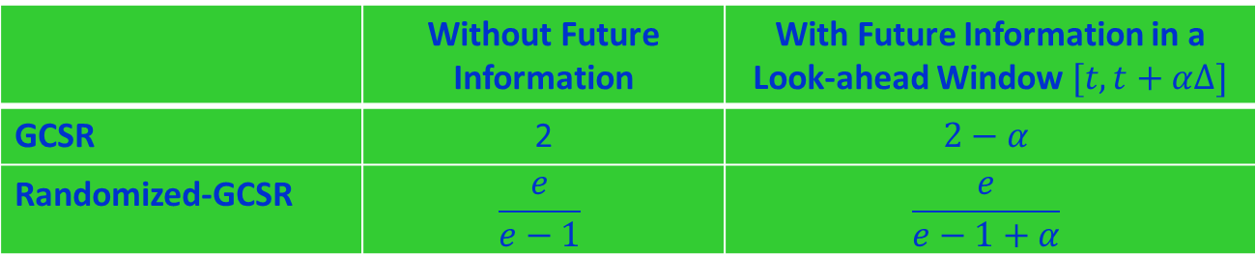

Tom’s MPhil Thesis: the Idling-Cabs Prob.
 | Without Future Information | With Future Information in a Look-ahead Window $[t, t+αΔ]$
GCSR | 2 | $$2−α$$
Randomized-GCSR | $$\frac{e}{e−1}$$ | $$\frac{e}{e−1+α}$$
Observation: Future information beyond $Δ$ will not further improve performance.

Slide 22
Generalize GCSR/RGCSR beyond
The Linear Cost Model
Time-varying single-cab idling cost?
  Break-even idea still works: turn off the engine when the accumulated idling cost reaches the on-off cost.
Convex-and-increasing aggregate cabs waiting cost?
  The “last-in-first-out” job dispatching still gives the optimal (offline) decomposition.
  Each cab still solves its own on-off problem.

Slide 23
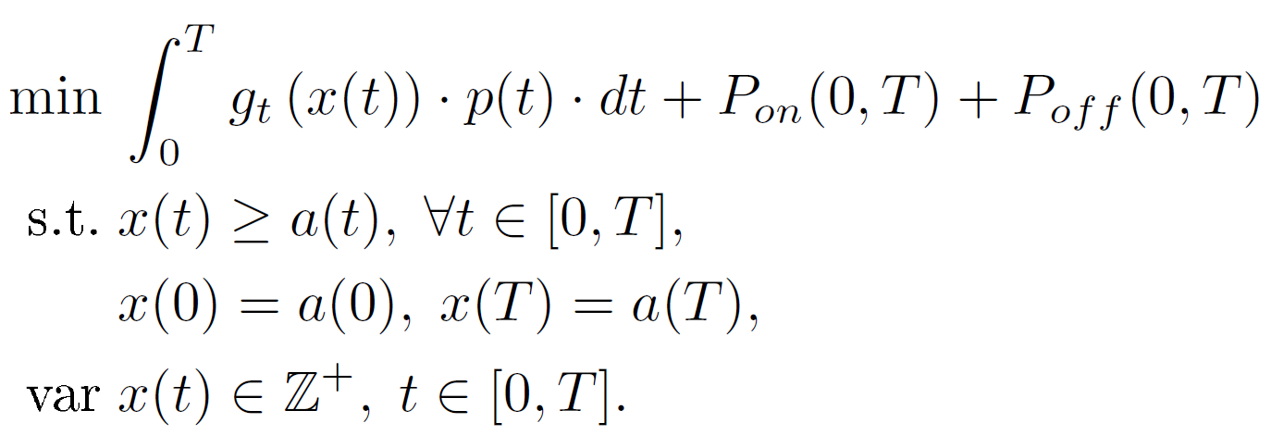
GCSR/RGCSR Are for the General Problem
(nonlinear) data center running cost
total server on-off cost
supply-demand constraint
infinity integer variables
Objective: minimize data center operational cost in [0,T].
  Data center running cost, including server, cooling, and power conditioning, is an increasing and convex function.
  Elephant workload model (solutions also apply to mice model).
  Homogenous servers with zero start-up time.
Challenge: Need to solve the nonlinear problem in an online fashion.

Slide 24


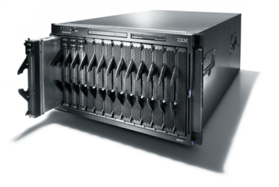

Greening Data Centers
Animal-Intelligent (AI)
…
Servers Cabs Jobs Customers

Slide 25
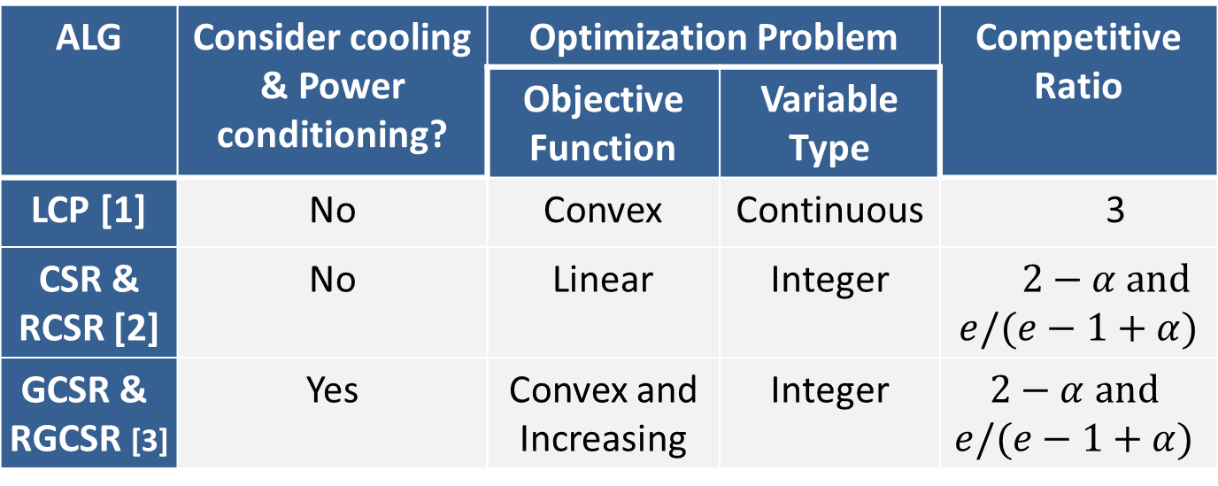
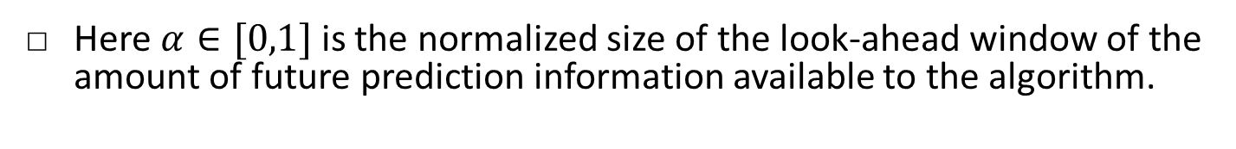
Dynamic Provisioning: Comparison
ALG | Consider cooling & Power conditioning? | Optimization Problem |  | Competitive Ratio
 |  | Objective Function | Variable Type
LCP [1] | No | Convex | Continuous | 3
CSR & RCSR [2] | No | Linear | Integer | $2−α and$ $$e/(e−1+α)$$
GCSR & RGCSR [3] | Yes | Convex and Increasing | Integer | $$2−α and$$ $$e/(e−1+α)$$
Best possible
Here $α∈[0,1]$ is the normalized size of the look-ahead window of the amount of future prediction information available to the algorithm.
[1] M. Lin, A. Wierman, L. Andrew, and E. Thereska. Dynamic right-sizing for power-proportional data centers. In Proc. IEEE INFOCOM, 2011.
[2] T. Lu and M. Chen. Simple and effective dynamic provisioning for power-proportional data centers. In Proc. IEEE CISS, 2012. IEEE TPDS 2013.
[3] J. Tu, L. Lu, M. Chen, and R. Sitaraman. Dynamic Provisioning in Next-Generation Data Centers with On-site Power Production. In Proc. ACM e-Energy, 2013.

Slide 26
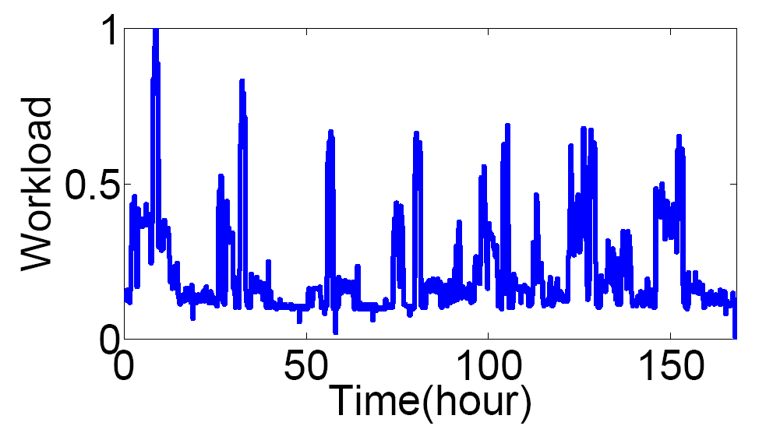
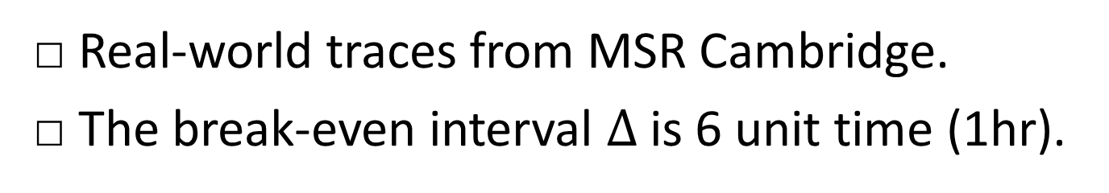
Numerical Results
Real-world traces from MSR Cambridge.
The break-even interval $Δ$is 6 unit time (1hr).

Slide 27
Cost Reduction over Static Provisioning
Save 66-71% energy over static provisioning.
  Achieve the optimal when we look one hour ahead.

Slide 28
CSR/RCSR are Robust to Prediction Error
Zero-mean Gaussian prediction error is added.
  Standard deviation grows from 0 to 50% of the workload

Slide 29
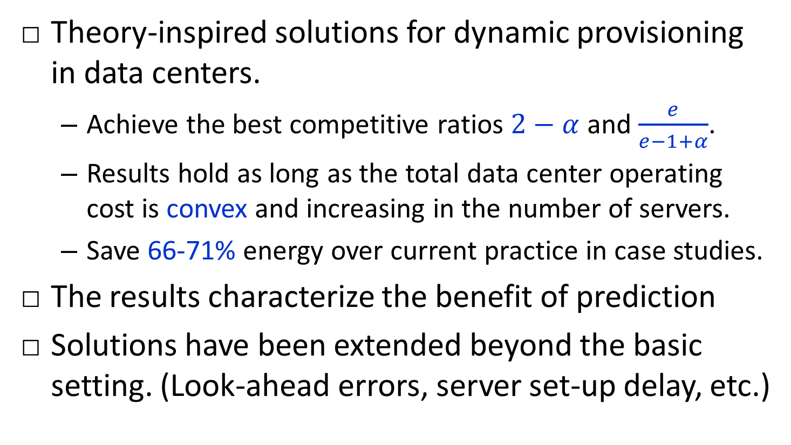
Summary
Theory-inspired solutions for dynamic provisioning in data centers.
  Achieve the best competitive ratios $2−α$ and $\frac{e}{e−1+α}$.
  Results hold as long as the total data center operating cost is convex and increasing in the number of servers.
  Save 66-71% energy over current practice in case studies.
The results characterize the benefit of prediction
Solutions have been extended beyond the basic setting. (Look-ahead errors, server set-up delay, etc.)
Notes:
We are exploring with industry partners to transfer the technology.

Slide 30
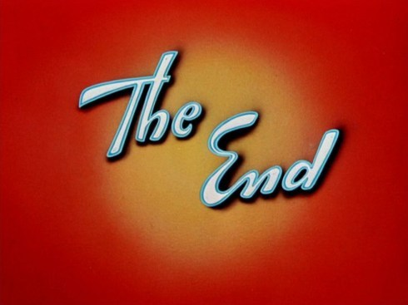
Minghua Chen (minghua@ie.cuhk.edu.hk)
http://www.ie.cuhk.edu.hk/~mhchen
Notes:
More time on revision.
The content of the lecture is quite easy to follow. However, I think the discrete random variable is difficult and I hope for the future lecture, there would be more explanation and examples! Thanks!
Good teaching schedule and the materials are easy to understand.
The course is well prepared and I can follow it. And quiz and problem set is helpful. I’d like more questions in problem set. Sometimes the discussion time is a little long although I know you hope everyone understand it.
熱心教學!
但如運用較多例子(連答案) 會更好!
希望能提供更多練習

