Slide 1
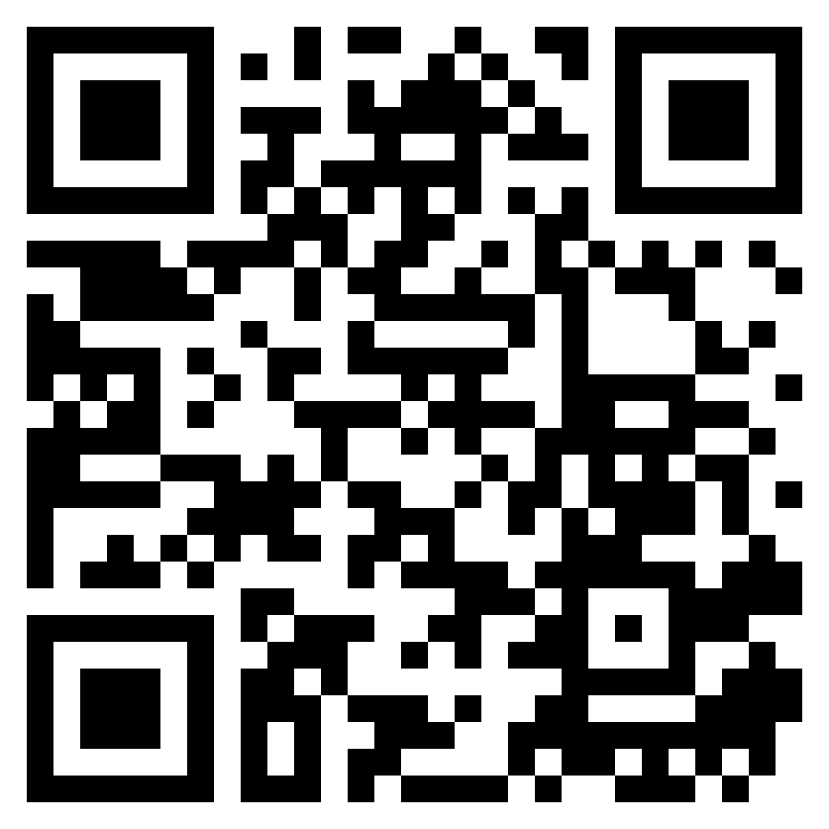
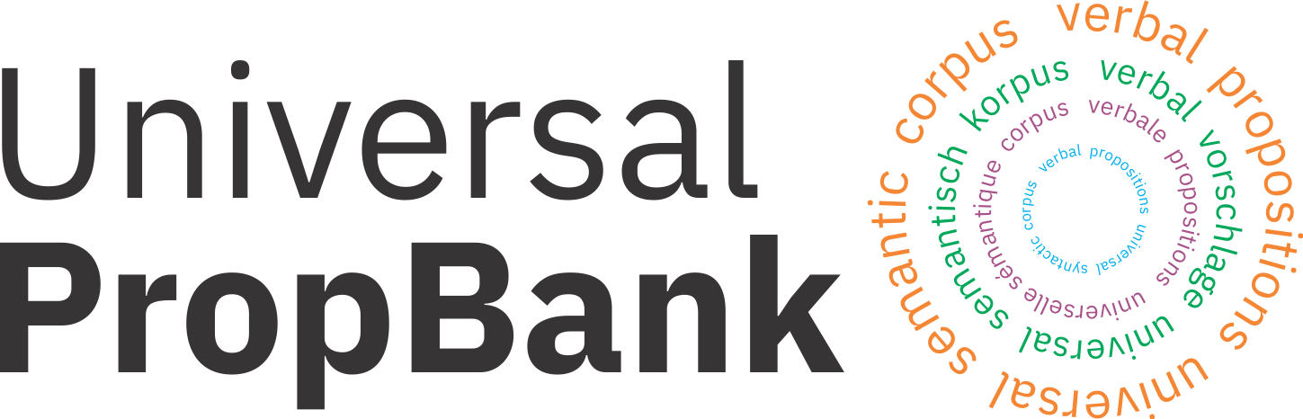



Universal Proposition Bank 2.0 and Beyond
Ishan Jindal, Alexandre Rademaker, Michał Ulewicz, Huyen Nguyen, Linh Ha, Khoi-Nguyen Tran, Huaiyu Zhu, Yunyao Li
Skatje Myers, Martha Palmer
https://universalpropositions.github.io/
IBM Research – Almaden
IBM Research – Brazil
Vietnam National University

Slide 2
Introduction
Multilingual Propbanks
Problems and Challenges
Solution
Universal Representations
Revamped UP
Results
Quality
Improving UP2.0
A case study
Language agnostic post processing
Language specific adaptations
Outline

Slide 3
Semantic Role Labeling (SRL)
Who did what to whom, when, where and how?
(Palmer, 1990; Gildea and Jurafsky, 2000; Màrquez et al., 2008)
2

Slide 4
Semantic Role Labeling (SRL)
Derek
broke
with a hammer
to escape
broke
the window
1
Predicate Identification
Identify all predicates in the sentence
3

Slide 5
Semantic Role Labeling (SRL)
Derek
break.01
with a hammer
to escape
broke
the window
1
Predicate Identification
Identify all predicates in the sentence
2
Sense Disambiguation
Classify sense of each predicate
break.01, break
A0: breaker
A1: thing broken
A2: instrument
A3: pieces
A4: arg1 broken away from what?
English Propbank
Martha Palmer, Daniel Gildea, and Paul Kingsbury. 2005. The proposition bank: An annotated corpus of semantic roles. Comput. Linguist., 31(1):71–106.
4

Slide 6
Semantic Role Labeling (SRL)
Derek
break.01
with a hammer
to escape
broke
the window
1
Predicate Identification
Identify all predicates in the sentence
2
Sense Disambiguation
Classify sense of each predicate
3
Argument Identification
Find all roles of each predicate
Argument identification can either be
Identification of span, (span SRL) OR
Identification of head (dependency SRL)
5

Slide 7
Semantic Role Labeling (SRL)
Derek
broke
the window
with a hammer
to escape
A0: breaker
break.01
A1: thing broken
A2: instrument
AM-PRP: Purpose
1
Predicate Identification
Identify all predicates in the sentence
2
Sense Disambiguation
Classify sense of each predicate
3
Argument Identification
Find all roles of each predicate
4
Argument Classification
Assign semantic label to each role
6

Slide 8
Multilingual SRL
Problems:
Language specific Propbanks
English Propbank
Chinese Propbank
Arabic Propbank
Hindi Propbank
German Propbank ….
Applications must be language specific
Separate text analytics
Do we have Propbank for other languages?
Vietnamese? Polish? Portuguese?.....
break.01
Derek broke the window with a hammer to escape
A0
A1
A2
AM-PRP
Schalgen.9
Derek schlug das Fenster mit einem Hammer ein,
um entkommen
A0
A2
A1
A6
打破.1
Derek
用 锤子
打破
窗户 逃跑
Arg0
Arg1
ArgM-PNC
Same color represents same semantic meaning
7

Slide 9
What we want?
Goal:
A solution that simplifies Multi-lingual information processing.
That can be readily available to any language without much investment
Drawback:
May loose language-specific idiosyncrasies
Beyond:
Use language –specific adaptations.
8

Slide 10
Potential Solution
break.01
Derek broke the window with a hammer to escape
A0
A1
A2
AM-PRP
Universal Meaning Representation
break.01
Schalgen.9 break.01
Derek schlug das Fenster mit einem Hammer ein,
um entkommen
breaker
instrument
A0
A2 A1
A1 A2
thing broken
Derek
A6 AM-PRR
With the Hammer
mit einem Hammer
用 锤子
the Window
das Fenster
窗户
打破.1 break.01
Derek
用 锤子
打破
窗户 逃跑
Arg0
A0
A2
Arg1
A1
ArgM-PNC
AM-PRR
9

Slide 11

Multilingual SRL
Challenge:
break.01
Language–specific formalisms
Derek broke the window with a hammer to escape
break.01
A0: breaker
A1: thing broken
A2: instrument
A3: pieces
A4: arg1 broken away from what?
AM-MNR: Manner
AM-PRR: Purpose
Schalgen.9
A0: Agent
A1: Impactor
A2: Impactee
A3: Impactors
A4: Result
A5: Subregion
A6: Purpose
A7: Period of iteration
A0
A1
A2
AM-PRP
Schalgen.9
(EN)A1 = (DE)A2
Derek schlug das Fenster mit einem Hammer ein,
um entkommen
A0
A2
A1
A6
打破.1
Derek
用 锤子
打破
窗户 逃跑
Arg0
Arg1
ArgM-PNC
10

Slide 12

Multilingual SRL
Challenge:
break.01
Language–specific formalisms
Derek broke the window with a hammer to escape
break.01
A0: breaker
A1: thing broken
A2: instrument
A3: pieces
A4: arg1 broken away from what?
AM-MNR: Manner
AM-PRR: Purpose
Schalgen.9
A0: Agent
A1: Impactor
A2: Impactee
A3: Impactors
A4: Result
A5: Subregion
A6: Purpose
A7: Period of iteration
A0
A1
A2
AM-PRP
Schalgen.9
Derek schlug das Fenster mit einem Hammer ein,
um entkommen
A0
A2
A1
A6
Limited Coverage
break.01
A0: breaker
A1: thing broken
A2: instrument
A3: pieces
A4: arg1 broken away from what?
AM-MNR: Manner
AM-PRR: Purpose
打破.1
Arg0: Agent, causer
Arg1: Theme
ArgM-PNC: Purpose
打破.1
Derek
用 锤子
打破
窗户 逃跑
Arg0
Arg1
ArgM-PNC
11

Slide 13
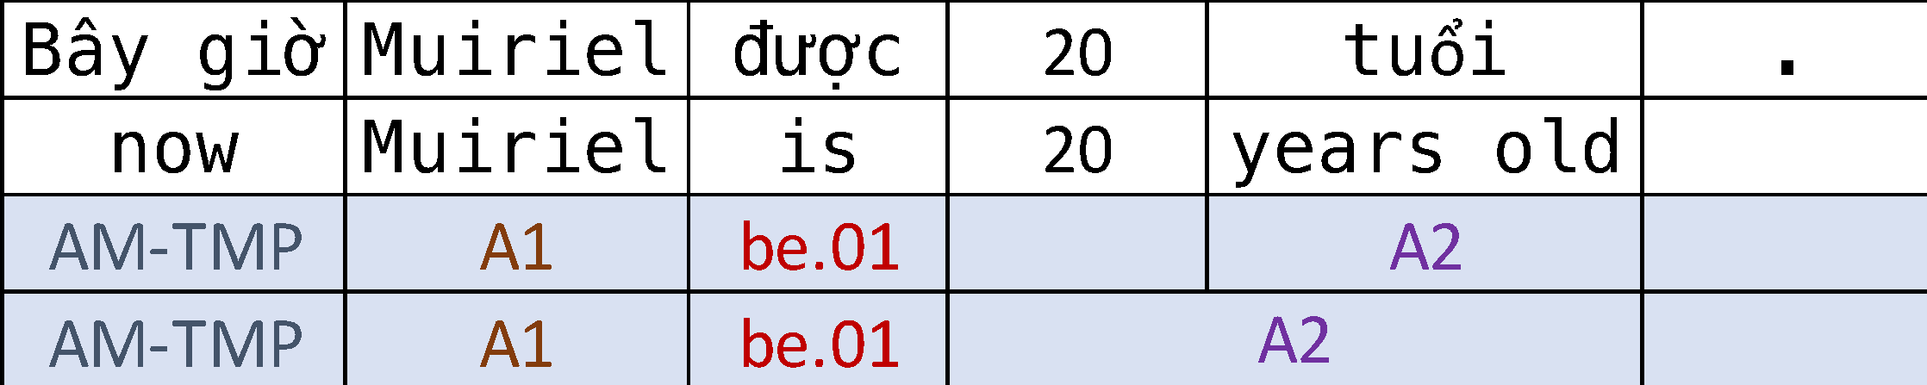
Universal Representation via Annotation Projection
UP1.0
Project English Propbank SRL labels to target languages
[ACL 2015] Generating high quality proposition banks for multilingual semantic role labeling
https://github.com/System-T/UniversalPropositions
7 languages: DE, ES, FI, FR, IT, PT, ZH
Released in 2016 and 2017.
12

Slide 14


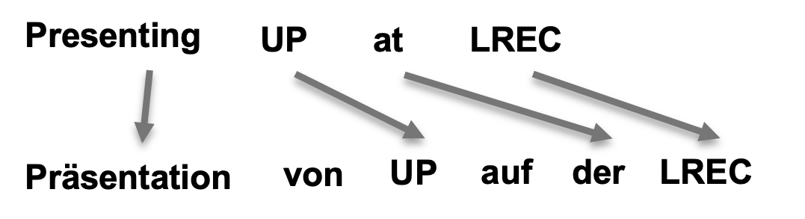
Automatic Data Generation
Syntactic Parsing
TL Parse Tree
Word Aligner
Annotation Projection
TL
Bitext (EN-TL)
TL Predicate-Argument
Structures
Syntactic Parsing
EN Semantic Role Labeler
EN
EN Parse Tree
EN Predicate-Argument
Structures
Bitext (EN-TL)
Europarl
Tatoeba
Opensubtitles
UN
Syntactic Parser
MATE
STANFORD
Stanza
Spacy
UDPipe
Word Aligner
Berkeley Aligner
Simalign
Awesome Align
EN SRL Model
ClearNLP
MATE-SRL
Neural SRL
Span- and dependency-based SRL
13

Slide 15
Universal PropBank via Annotation Projection
Issues with UP1.0
Quality: Released in 2016 and 2017.
SRL model
Parser model
Word aligner model
Language coverage: Only 7 languages from 2 language families.
SRL representations: Only dependency based SRL
Gold labels: no language with gold SRL labels
Better models became available
2016 → 2022
Feature based SRL → NNSRL
~ 7F1 points better is performance
Statistical Parser → Neural Parser
>10F1 points better
Statistical Aligner → Neural Aligner
>10F1 points better
14

Slide 16
Universal PropBank via Annotation Projection
Issues with UP1.0
Quality: Released in 2016 and 2017.
SRL model
Parser model
Word aligner model
Language coverage: Only 7 languages from 2 language families.
SRL representations: Only dependency based SRL
Gold labels: no language with gold SRL labels
Deep learning models cover more languages
Multilingual Language Models
Trained on 100+ languages.
7,102 known languages
23 most spoken languages
15

Slide 17
Universal PropBank via Annotation Projection
Issues with UP1.0
Quality: Released in 2016 and 2017.
SRL model
Parser model
Word aligner model
Language coverage: Only 7 languages from 2 language families.
SRL representations: Only dependency based SRL
Gold labels: no language with gold SRL labels
Need for SPAN based SRL
Head annotation is insufficient to compute the span annotation.
Needs high quality syntactic parser
If exists, Not always correct
Decoupling of syntactic analysis
Train syntax-agnostic SRL models
16

Slide 18
Universal PropBank via Annotation Projection
Issues with UP1.0
Quality: Released in 2016 and 2017.
SRL model
Parser model
Word aligner model
Language coverage: Only 7 languages from 2 language families.
SRL representations: Only dependency based SRL
Gold labels: no language with gold SRL labels
Enabling the research community to perform fair evaluation of their multilingual and cross-lingual SRL systems
17

Slide 19
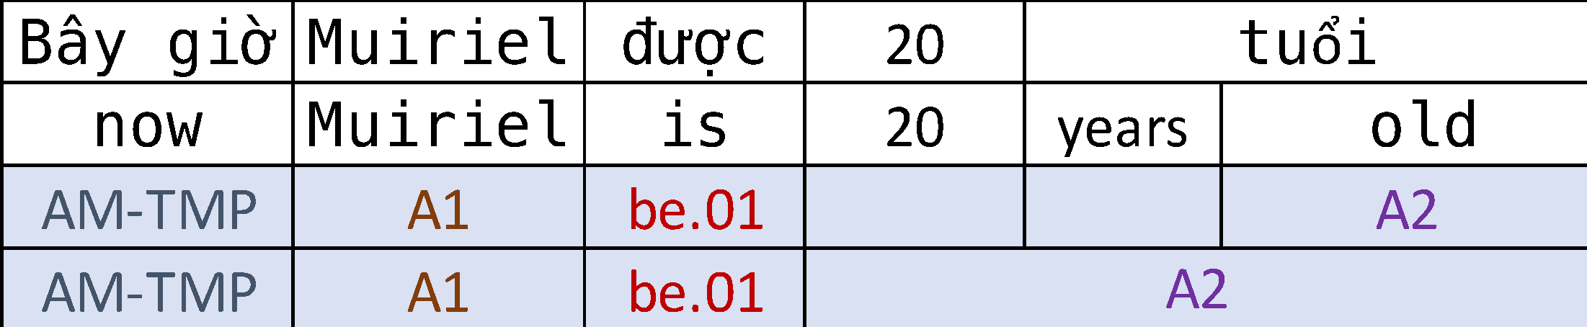
Universal PropBank Revamp
UP2.0
Significant update to UP-1.0
[High Quality] ~10 F1 points quality improvement over UP-1.0
[Language Expansion] 7 → 23 languages from 8 language families:
CS, DE, EL, EN, ES, FI, FR, HI, HU, ID, IT, JA, KO, MR, NL, PL, PT, RO, RU, TA, TE, UK, VI, ZH
[Span Annotations] Head only → both span- and head-based SRL
[Gold Data] Gold data in EN, PT, PL, VI languages
18

Slide 20


Automatic Data Generation
How we revamp?
Syntactic Parsing
TL Parse Tree
Word Aligner
Annotation Projection
TL
Bitext (EN-TL)
TL Predicate-Argument
Structures
Syntactic Parsing
EN Semantic Role Labeler
EN
EN Parse Tree
EN Predicate-Argument
Structures
R1) Component Selection
Bitext (EN-TL)
Europarl
Tatoeba
Opensubtitles
Syntactic Parser
MATE
STANFORD
Stanza
Spacy
UDPipe
Word Aligner
Berkeley Aligner
Simalign
Awesome Align
EN SRL Model
ClearNLP
MATE-SRL
Neural SRL
Span- and dependency-based SRL
UP1.0
UP2.0
19

Slide 21
Automatic Data Generation
How we revamp?
Syntactic Parsing
TL Parse Tree
Word Aligner
Annotation Projection
TL
Bitext (EN-TL)
TL Predicate-Argument
Structures
Syntactic Parsing
EN Semantic Role Labeler
EN
EN Parse Tree
EN Predicate-Argument
Structures
R1) Component Selection
Bitext (EN-TL)
Europarl
Tatoeba
Opensubtitles
Syntactic Parser
MATE
STANFORD
Stanza
Spacy
UDPipe
Word Aligner
Berkeley Aligner
Simalign
Awesome Align
EN SRL Model
ClearNLP
MATE-SRL
Neural SRL
Span- and dependency-based SRL
UP1.0
UP2.0
20

Slide 22

Annotation Projection
How we revamp?
We follow the same two-stage process in UP-1.0.
Apply a filtered annotation projection to parallel corpora to achieve annotations with high precision for target-language.
Then we bootstrap and retrain the TL SRL to iteratively improve recall without reducing precision.
EN-NNSRL
Semantic labels
(Predicates + Arguments)
Semantic labels
(Predicates + Arguments)
Syntactic labels
EN-SRL
Input
TL
Filtered
Projection
Filtered
Projection
TL-NNSRL
Semantic labels
(Predicates + Arguments)
Semantic labels
(Predicates + Arguments)
TL-SRL
Hybrid Projection
Hybrid
TL
Semantic labels
(Predicates + Arguments)
Check Completeness
TL
TL
Incomplete
Semantic labels
Predicate Complete
Semantic labels
Argument Complete
Semantic labels
TL
Bootstrapped Learning
Polyglot
Training
NNSRL Model
EN-SRL: EN SRL labels using SRL model from UP1.0 EN-NNSRL: EN SRL labels using SRL model from UP2.0
21

Slide 23

Results: Overall Performance
> 10 points F1 on predicates and arguments
22

Slide 24
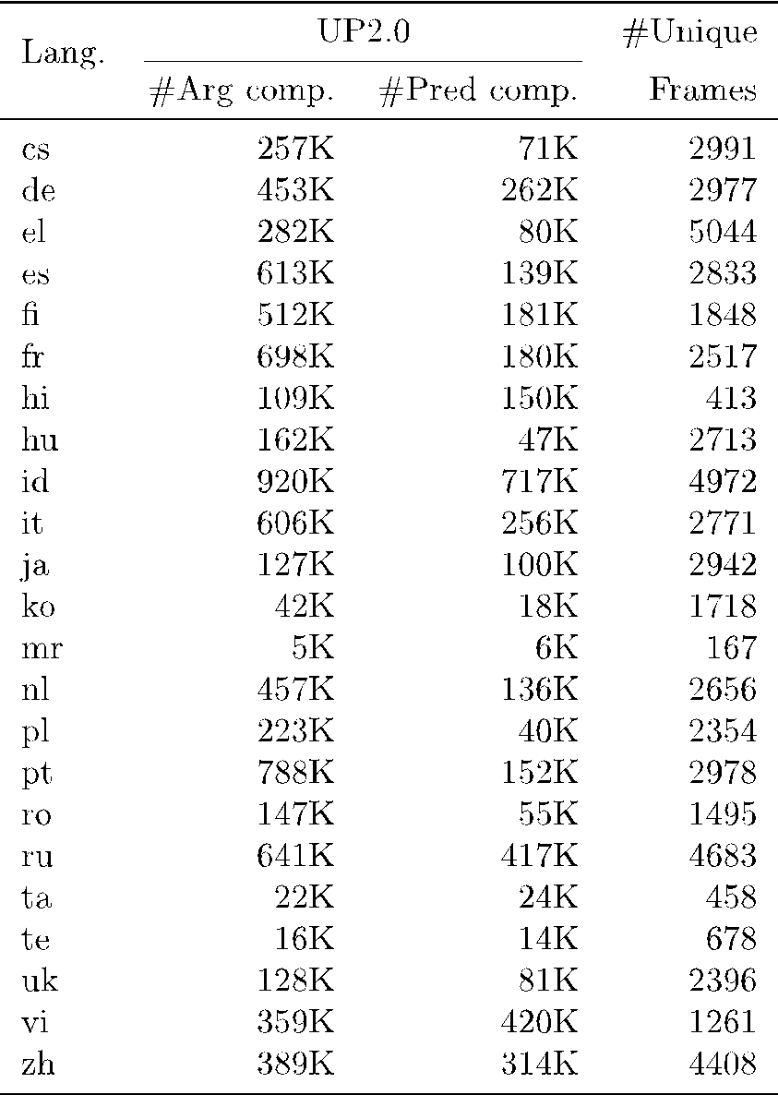
Propbank Data
What we generate?
Propbank data for 23 languages
A UP release contains treebanks of the corresponding UD release.
To differentiate Gold from UP data we use the following conventions:
UP_<language>-<corpus>
GOLD_<language>-<corpus>
In addition, each language has a folder with verb overview files (produced from the frame files) in HTML format. These files can be viewed in a browser and give an overview of all English frames that each target language verb can evoke.
https://github.com/UniversalPropositions
23

Slide 25
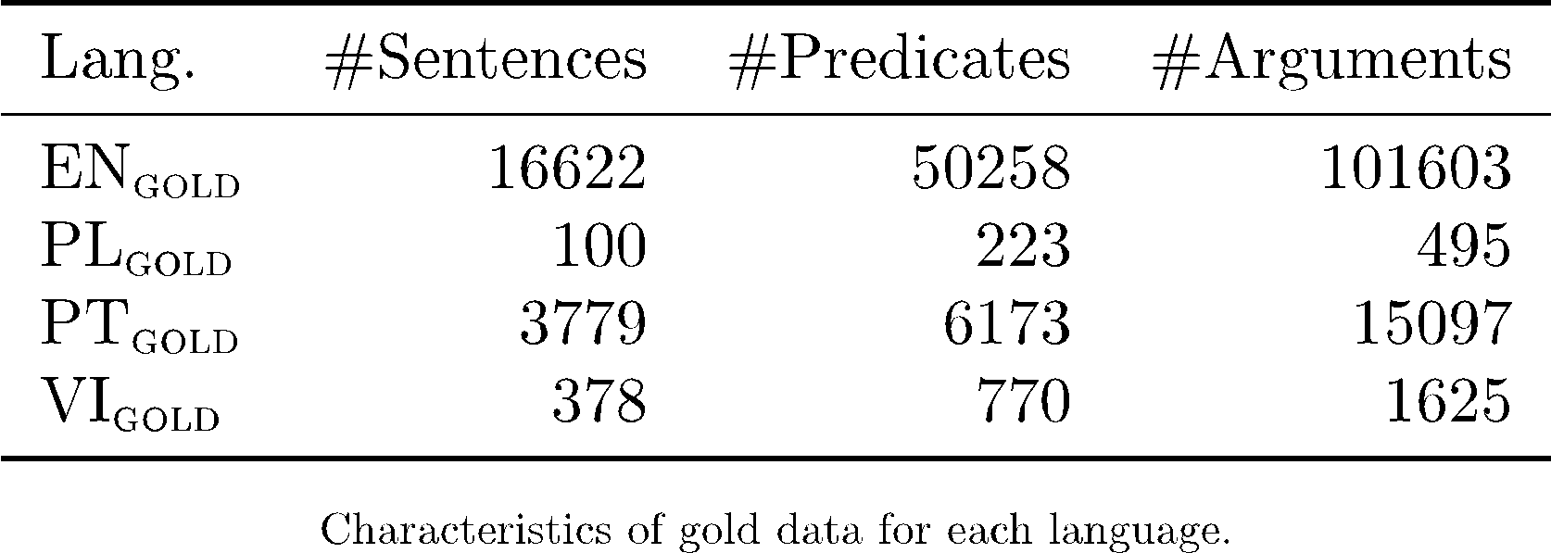
Gold Data
What we generate?
Polish
We select 100 English sentences from EN OntoNotes and translate them into Polish.
Then we manually label all the predicates and arguments according to English PropBank
Portuguese
We merge the two resources (Propbank.Br, UD Bosque ), projecting the SRL annotation from Propbank.Br on top of the dependencies from UD Bosque (UD 2.9) solving inconsistencies and fixing annotation errors
Vietnamese
We manually labeled 378 examples randomly selected from Tatoeba corpus.
24

Slide 26
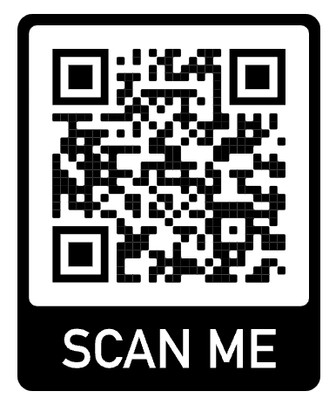
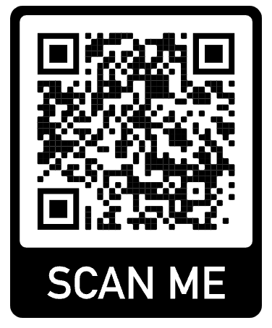
Dataset
For more examples
https://github.com/UniversalPropositions
https://universalpropositions.github.io/#introduction
25

