Slide 1
Exploratory Data Analysis
Data Science for Public Good
Joshua Goldstein
Vicki Lancaster
June 12 2020

Slide 2
Data Analysis Introduction
Data analysis is not a case of simply applying a directory of tools to a given problem, but rather one of
critical assessment,
exploration,
testing, and
evaluation.
It is a domain the requires intelligence and care, as well as the application of knowledge and expertise about the data. It is a challenging and demanding discipline. It is a discipline that is continuing to evolve. (Hand, 1999)

Slide 3
EDA Introduction
What is exploratory data analysis (EDA)?
EDA is a process that uses non-inferential statistics, such as graphical methods, to gain insight into a set of data.
“It characterizes the notion that statistical insights and modeling are driven by data.”
If you think of your data set as a story written in numbers, then EDA is the process of translating the story written in numbers to one illustrated with pictures.
EDA methods are used:
to isolate patterns and relationships,
uncover unexpected behavior,
to confirm or disprove or assumptions, and
to reveal information.

Slide 4
EDA Introduction
Why is exploratory data analysis important?
Most classical procedures are based on assumptions about the characteristics of a variable, and the validity of the analyses depends upon the validity of the assumptions.
The graphical methods of EDA provide powerful diagnostic tools for confirming assumptions, or when assumptions are not met, for suggesting corrective actions.

Slide 5
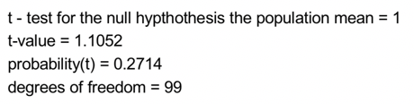
EDA Introduction
Results of a one-sample t-test on ‘some data’:
Result: p > 0.05, fail to reject the null hypothesis.
THE END…?

Slide 6
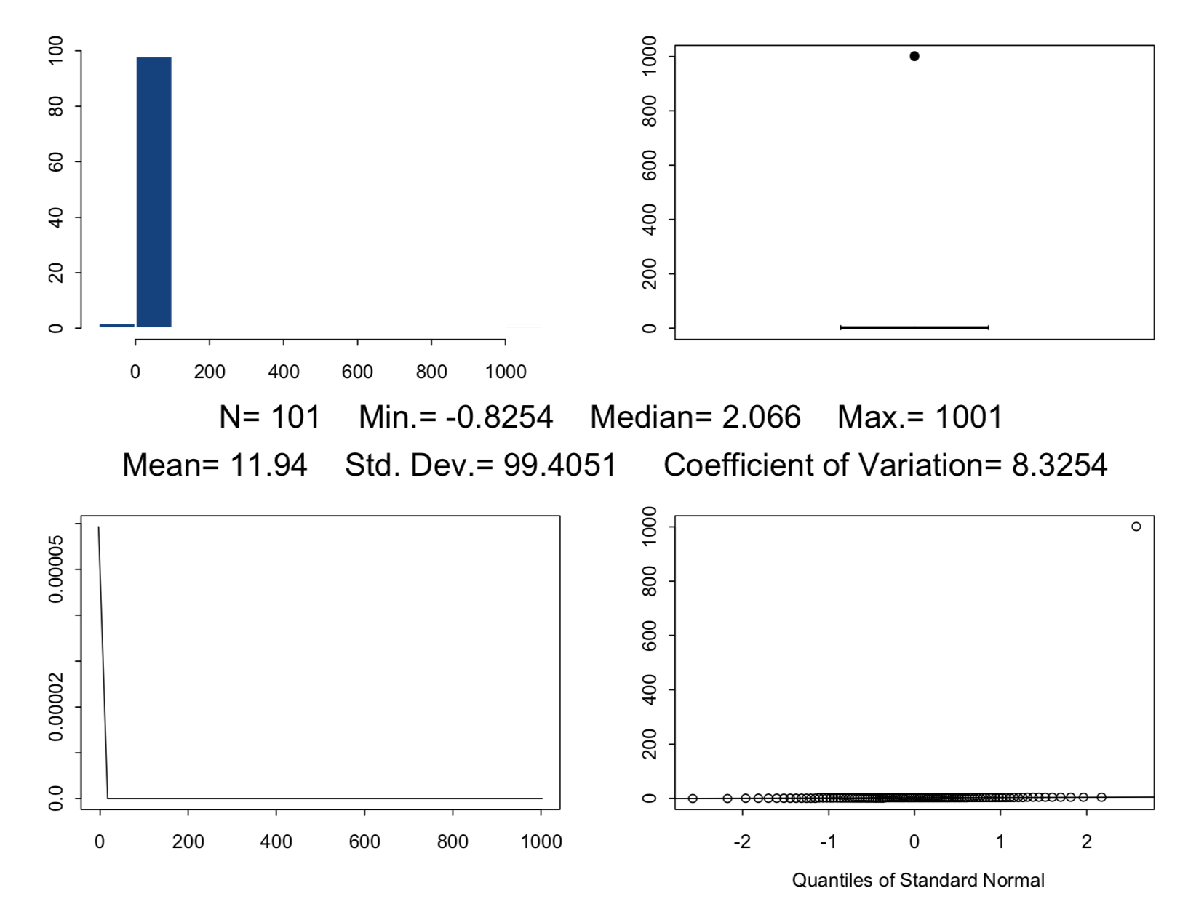
EDA Introduction
But, if you had done a few EDA plots on the data first ...
you would have noticed a “potential” outlier.

Slide 7
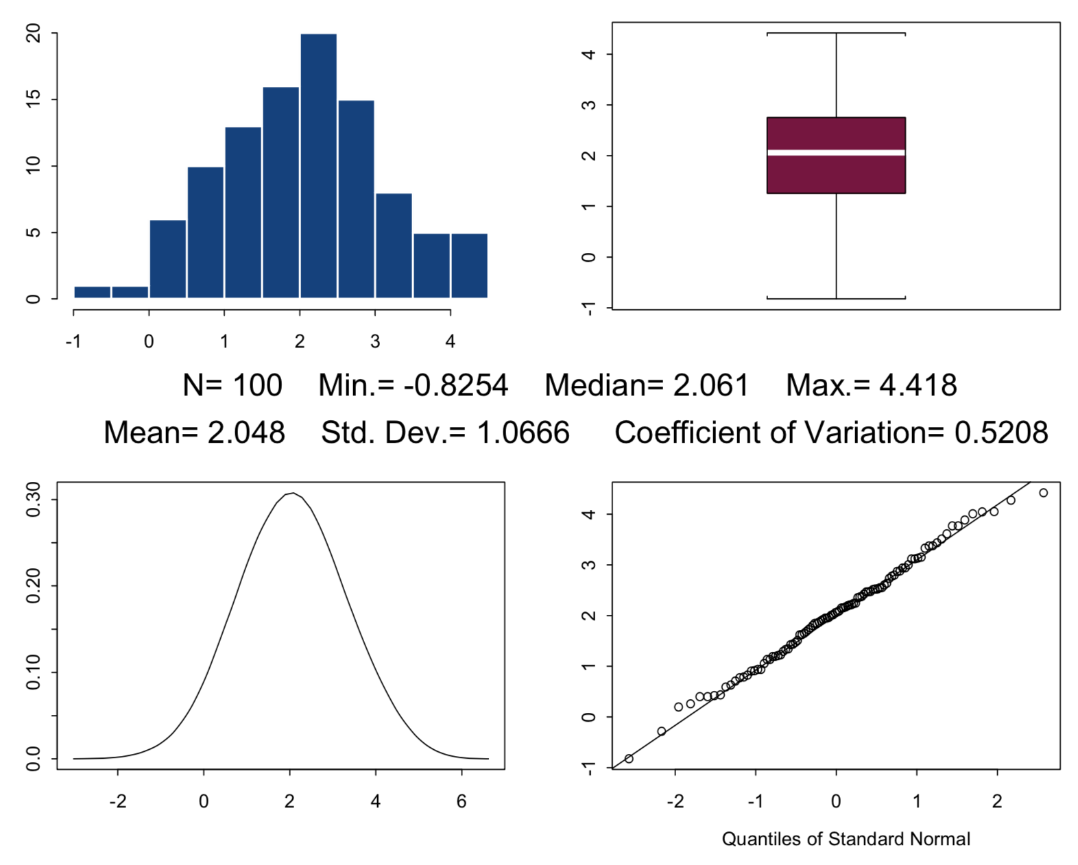
EDA Introduction
If it turns out the outlier is due to an assignable cause (for example a data entry error) and it is corrected ...

Slide 8
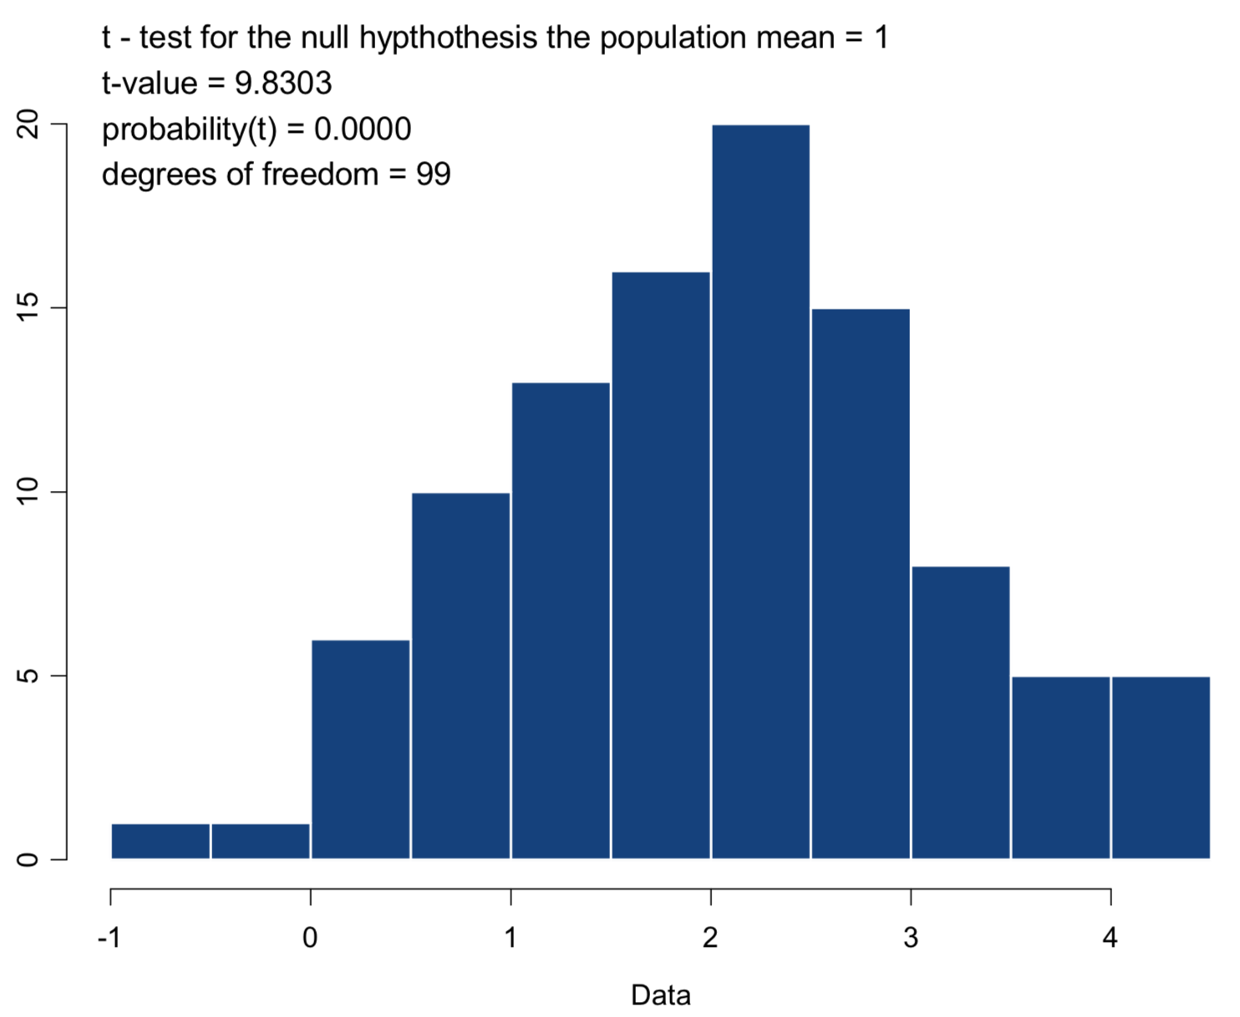
EDA Introduction
…the results of your t-test are now different.

Slide 9
EDA Introduction
“There is no single statistical tool that is as powerful as a well chosen graph.”
Graphical Methods for Data Analysis
John M. Chambers
William S. Cleveland
Beat Kleiner
Paul A. Tukey
Notes:
Discuss Tukey – overreliance on hypothesis testing
Very relevant today; a p-value is not a replacement for critical thinking

Slide 10
EDA Introduction
The first published presentation of EDA (1970 - 1971) was the preliminary edition of a book by John W. Tukey. His 1977 book is a definitive account,
Tukey, J. W. (1977). Exploratory Data Analysis. Addison- Wesley, Reading Mass.
He wanted to dispel the myth that we are not allowed to look at the data prior to modeling. At that time there was a tension between two opposing points of view:
that a hypothesis must not be data driven; and
that EDA was needed prior to inferential analyses to understand how rich a model the data could support.

Slide 11
Four Themes of EDA
Tukey identifies four themes that run through EDA:
Resistance
Residuals
Re-expression
Displays
Notes:
Brief description of each

Slide 12
Four Themes of EDA
Resistance is a term used to denote a property of measures of location or spread that make them relatively unaffected by the presence of outliers. The median is an example of a resistant measure of location and the interquartile range (IQR) is an example of a resistant measure of spread.
A summary statistic is resistant if
it is insensitive to any small change in a large part of the data, and
to any large change in a small part of the data.

Slide 13
Four Themes of EDA
Resistant summary statistics:
pay attention to the main body of the data and given little attention the outliers; and
are useful in graphical methods, particularly in the construction of box plots.
With outlier:
Outlier removed:

Slide 14
Four Themes of EDA
‘Robust’ versus ‘Resistant’
Robust is used to describe an inference procedure that is stable when model assumptions are violated. For example, the t-test is robust with respect to the assumption of normality.
Robustness: sensitivity to model assumptions.
Resistance is used to describe a statistic that is arithmetically stable under gross contamination of the data values. For example, the median is a resistant estimator.
Resistance: sensitivity to the data.

Slide 15
Four Themes of EDA
EDA characterized statistical modeling as decomposing the data into structure and noise,
data = fit + residuals,
and then examining residuals to identify structure and move it into the fit. The fitting process would then be repeated and followed by subsequent residual analysis.
This process has its roots in the general statistical paradigm of partitioning variability into two distinct parts, explained and unexplained variation.

Slide 16
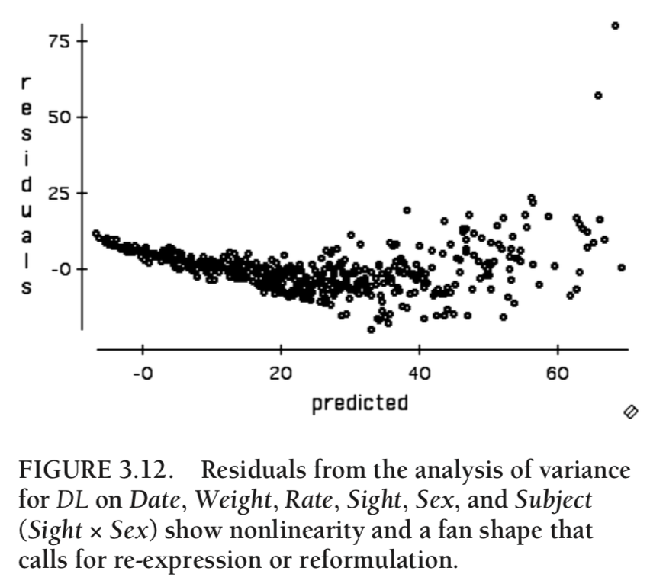
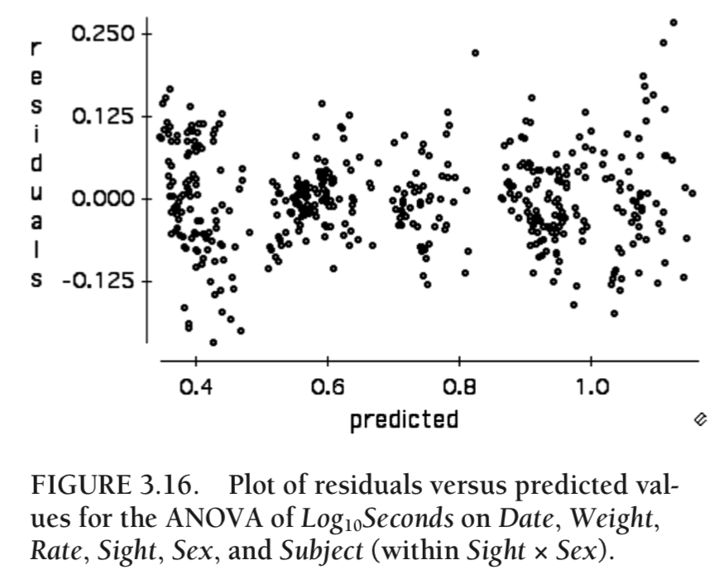
Four Themes of EDA
Velleman, Paul F., and David C. Hoaglin. "Exploratory data analysis." (2012).

Slide 17
Four Themes of EDA
The philosophy of EDA is that an analysis of a set of data is not complete without a careful examination of the residuals.
Resistant analyses provide clear separation between dominant behavior and unusual behavior in data.
Residuals contain any drastic departures from the pattern, as well as random fluctuations.

Slide 18
Four Themes of EDA
Re-expression involves the question of what scale would help to simplify the analysis of the data. Re-expression into another scale may help to
achieve symmetry,
facilitate interpretation,
promote constancy of variance,
achieve a more linear relationship, or
simplify structure for two-way tables
depending on the structure of the data. Re-expression most often comes from the family of functions known as power transformations, which take y into y^{p}, together with the logarithm.

Slide 19
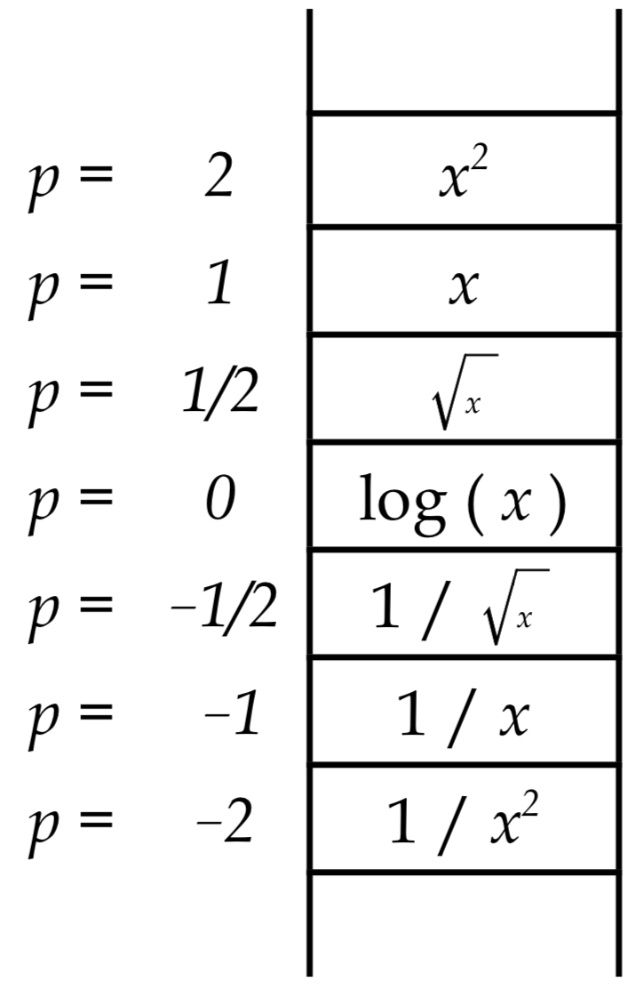
Four Themes of EDA
“Ladder” of transformations.
Box-Cox family:

Slide 20
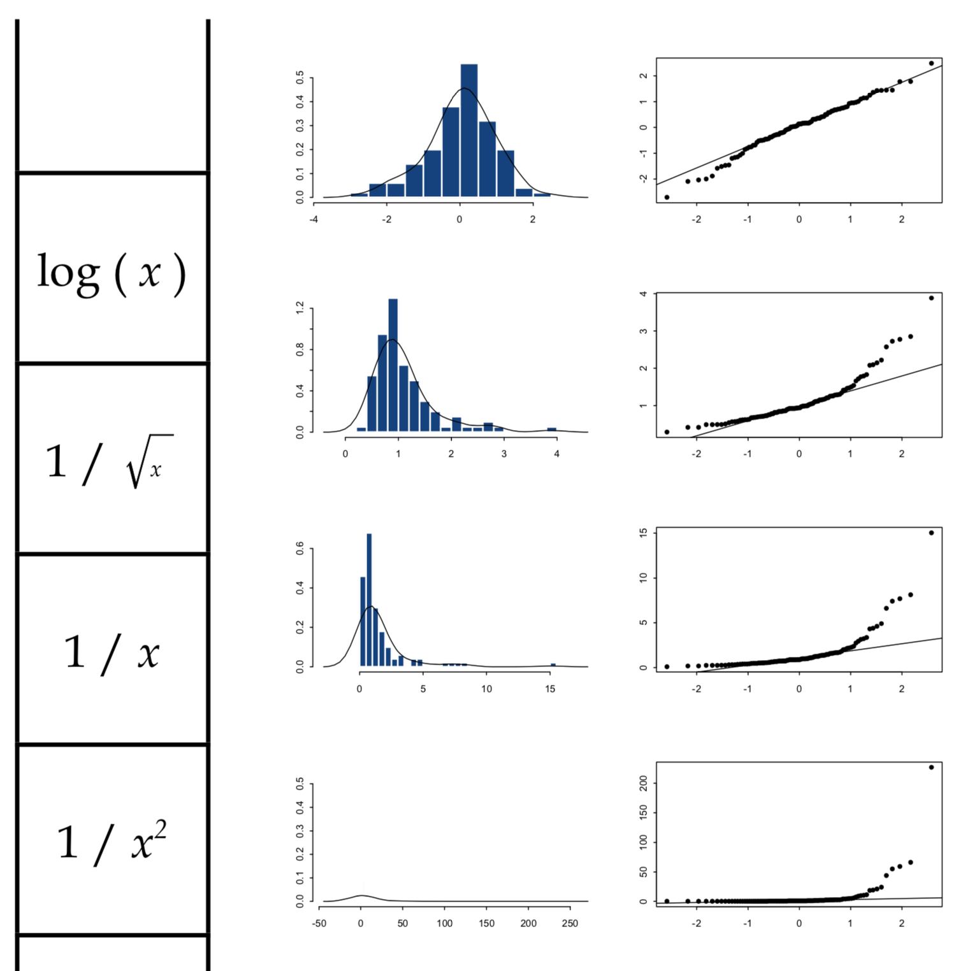
Four Themes of EDA
A standard normal quantile-quantile plot provides suggestions for transforming to achieve normality.
Notes:
qqplot: x-axis = quantiles of transformed data, y-axis = quantiles of theoretical normal.
Roughly normally distributed when x=y
Show effects as we descend down the ‘ladder’ of transformations

Slide 21
Four Themes of EDA
Displays meet the need to see the behavior of the data, to reveal the unexpected features, such as outliers; and confirm or disprove assumptions, such as the distributional assumptions of normality.
Tukey argued that (good) graphical methods should allow unexpected values to present themselves - once identified, models can be expanded or changed to account for them.

Slide 22
Displays of EDA
A cool example that illustrates the power of EDA.
For the LANL Environmental Restoration Project, an extensive site characterization was performed.
Surface soil samples are collected and compared to LANL background data. In particular, surface soil samples were collected from MDA G and analyzed for elemental uranium.
Notes:
Los Alamos National Lab environmental restoration project.
Material Disposal Area includes spent nuclear fuel and highly-radioactive fission products, to large quantities of plutonium and tritium, to building rubble and contaminated soil.

Slide 23
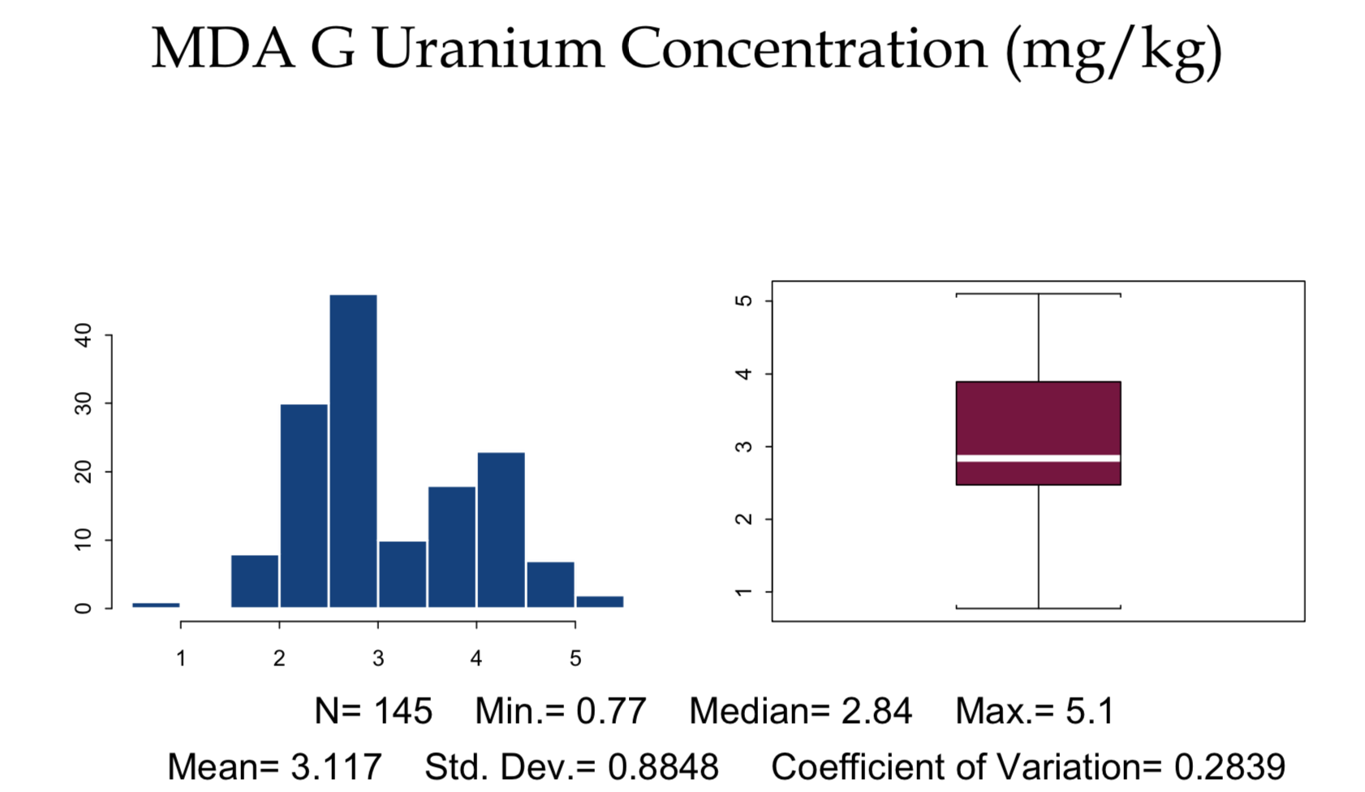
Displays of EDA

Slide 24
Displays of EDA
What can explain the bimodality in the data? Hypothesis:
Contaminations differ spatially because of historical disposal operations.
Geology issues - different rocks causing different background concentration distributions.
Chemistry issues - different analytical methods, data comparability issues.
Sample collection issues - different sampling methods, different field team, data comparability issues.

Slide 25
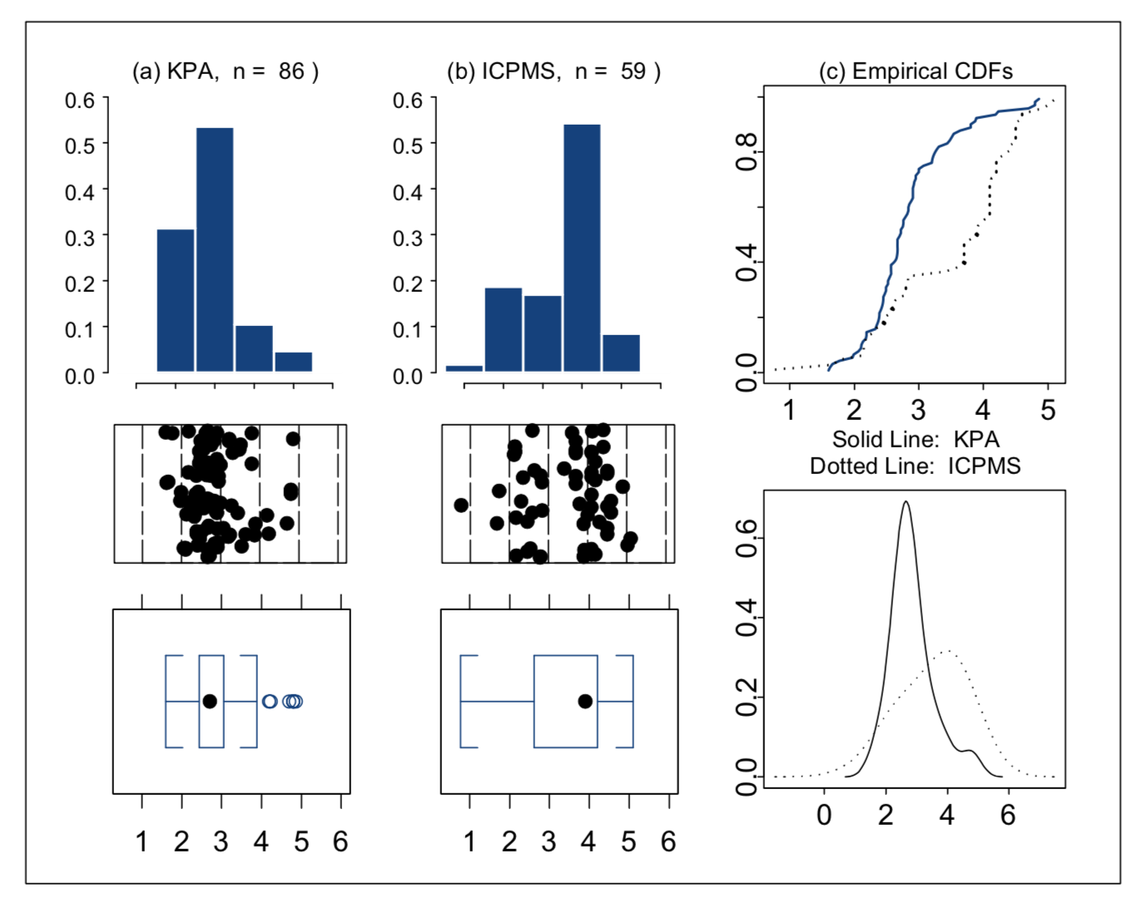
Displays of EDA
Uranium concentration (mg/kg) by analytic technique.
Longmire, Patrick A., et al. Statistical analyses of the background distribution of groundwater solutes, Los Alamos National Laboratory, New Mexico. No. LA-UR-04-7242. Los Alamos National Laboratory, 2004.
Notes:
KPA = kinetic phosphorescence analysis
ICPMS = inductively coupled plasma mass spectrometry

Slide 26
Displays of EDA
The problem was one of lack of comparability due to inclusion of two very different analytical methods.
EDA plots brought about a change in policy, KPA is no longer being used for uranium analysis in the LANL ER Project.

Slide 27
EDA “Checklist”
Make displays of individual variables and identify any special issues.
Check any models for the data by examining residuals.
Be aware of the opportunity to re-express variables to simplify models or satisfy model assumptions.
Be willing to remove or fit special terms for outliers or influential cases.
Iterate!

