Slide 1
Project Title: The Dynamics of Common Knowledge on Social Networks: An Experimental Approach
Researchers:
Gizem Korkmaz, Research Associate Professor, Biocomplexity Institute, University of Virginia
Email: gkorkmaz@virginia.edu
C. Monica Capra, Professor of Economics, Claremont Graduate University
Address: 170 E. 10th St., Claremont, CA 91784; Phone: (909) 607-3372
E-mail: monica.capra@cgu.edu
Teja Pristavec, PhD, Postdoctoral Associate, Biocomplexity Institute, University of Virginia
Email: tp2sk@virginia.edu
Graduate Students (VT):
Name (email)
Welcome and thank you for your interest in joining in our experiment!

Slide 2
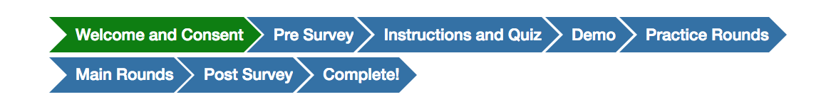
Welcome and Consent
Thank you for your interest in joining in our experiment!
These are the steps you will take to complete the experiment:
Notes:
Here make sure to mention that they must click the empty square to consent and then press NEXT.

Slide 3
Steps to Complete The Experiment:
THIS IS THE EXPERIMENTER SCRIPT...SAY, BUT NOT SHOW DURING PRESENTATION
Complete a voluntary consent form before you proceed with the study.
Complete a survey to collect information about socio-demographics. We remind you that the confidentiality of your responses will be protected.
Read Instructions followed by a Quiz that will ensure you understand the instructions.
The answers will be given immediately.
You can view the instructions and the quiz at any time during the experiment.
Demo: An interactive tour of the platform that describes how to use the experimental platform.
Complete Practice Rounds (up to 3) to get familiar with the platform.
You will be interacting with computer-controlled avatars during the practice rounds.
You will not observe the outcome of the rounds.
Complete the Main Rounds of the game (15 rounds).
Each round is independent from the other: whatever happens in a round does not affect the next round.
You will not observe the outcome of the rounds until the end of the experiment.
Complete a post survey to collect information about preferences. You will be paid for some of these questions based on the outcome.
Final (Cash) Payment: please make a note of your station number, raise your hand and an experimenter will direct you to the payment booth.
You will sign a form indicating the cash amount you received.

Slide 4
Instructions
The experiment consists of 15 rounds.
In each round, you will play in a group of 5 players (including you). You will see the list of all the players in your group on the screen.
Individual decisions per round: to participate or not participate in a group event -- a social or a cultural event (e.g., party, concert), playing in team sports (e.g., volleyball, football) or attending a political event (e.g., march, rally) -- in the experiment we won’t specify the kind of event.

Slide 5
Instructions
In each round, each player will be assigned a threshold, T (either T=1 or T=3)
(a) If your threshold is T=1:
If you participate and at least 1 other player participates, then your earnings in the round will be 100 points.
If you participate and no one else participates, then your earnings in the round will be 0 points.
If you do not participate, your earnings in the round will be 50 points regardless of what others do.
(b) If your threshold is T=3:
If you participate and at least 3 other players participate, then your earnings in the round will be 100 points.
If you participate and less than 3 other players participate, then your earnings in the round will be 0 points.
If you do not participate, your earnings in the round will be 50 points regardless of what others do.

Slide 6
Instructions
In each round, each player will be assigned a threshold, T (either T=1 or T=3)
T represents the number of other players that you need in order to make it worthwhile for you to participate in the group event.
Your earnings in a round depend on your threshold, your participation decision, and the participation decisions of other players in your group.
(a) If your threshold is T=1:
If you participate and at least 1 other player participates, then your earnings in the round will be 100 points.
If you participate and no one else participates, then your earnings in the round will be 0 points.
If you do not participate, your earnings in the round will be 50 points regardless of what others do.
(b) If your threshold is T=3:
If you participate and at least 3 other players participate, then your earnings in the round will be 100 points.
If you participate and less than 3 other players participate, then your earnings in the round will be 0 points.
If you do not participate, your earnings in the round will be 50 points regardless of what others do.
1 experimental point = 0.15 US dollars.
For your decisions, your total earnings in a round could be: $0, $7.5, or $15.00 depending on the outcome.
We will choose ONE random round to determine your final earnings.

Slide 7
Earnings
In each round, you will be assigned a threshold that can be either T=1 or T=3. This number will affect your payoffs, so pay attention.
Your earnings in a round depend on your threshold, your participation decision, and the participation decisions of the other 4 players in your group.
We will choose ONE random round to determine your final earnings.
1 experimental point = 0.15 US dollars.
For your decisions, your earnings in this part could be:
$0, $7.5, or $15.00, depending on the outcome.

Slide 8
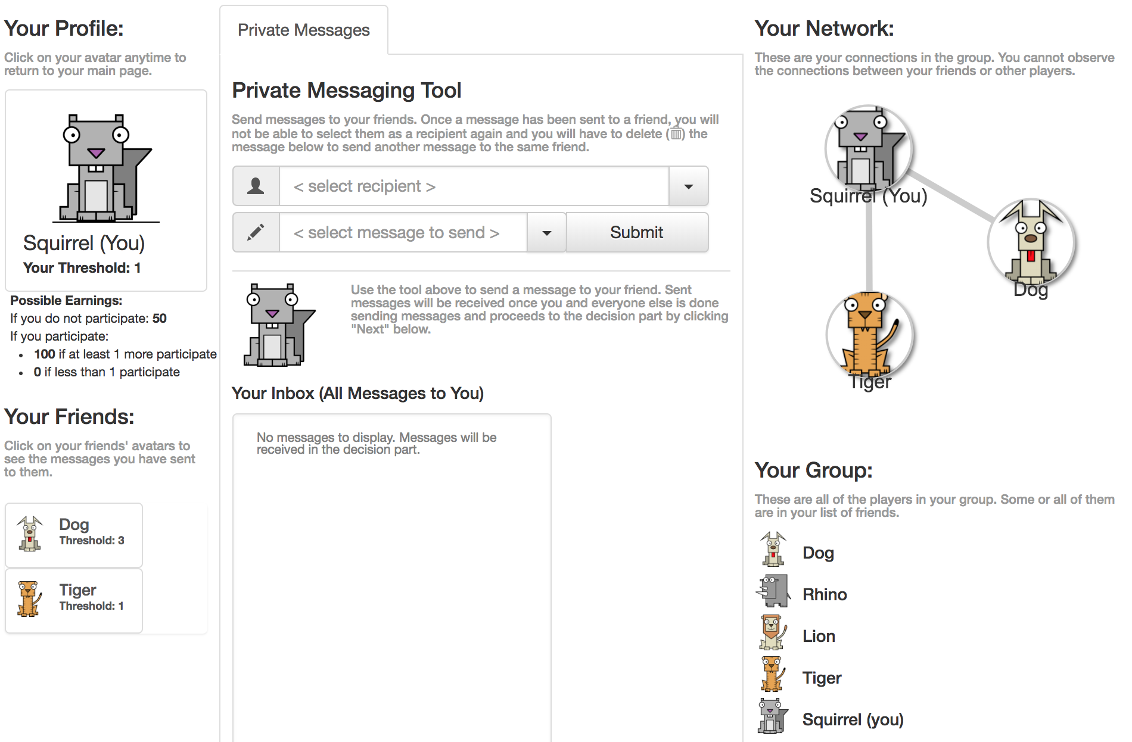
Experimental Platform
The Network
Your Profile: your avatar (a randomly chosen identity), and your threshold for the round.
Your Group: the list of all 5 players in your group.
Your Friends: players in your group that you are connected to. You can see the thresholds of your friends in 'Your Friends' box.
The Network: a diagram showing the connections between all players in your group. The gray line between two avatars means that they are friends.
The Private Messaging Tool: a place to send and receive private messages among friends. These messages will appear in Your Inbox.

Slide 9
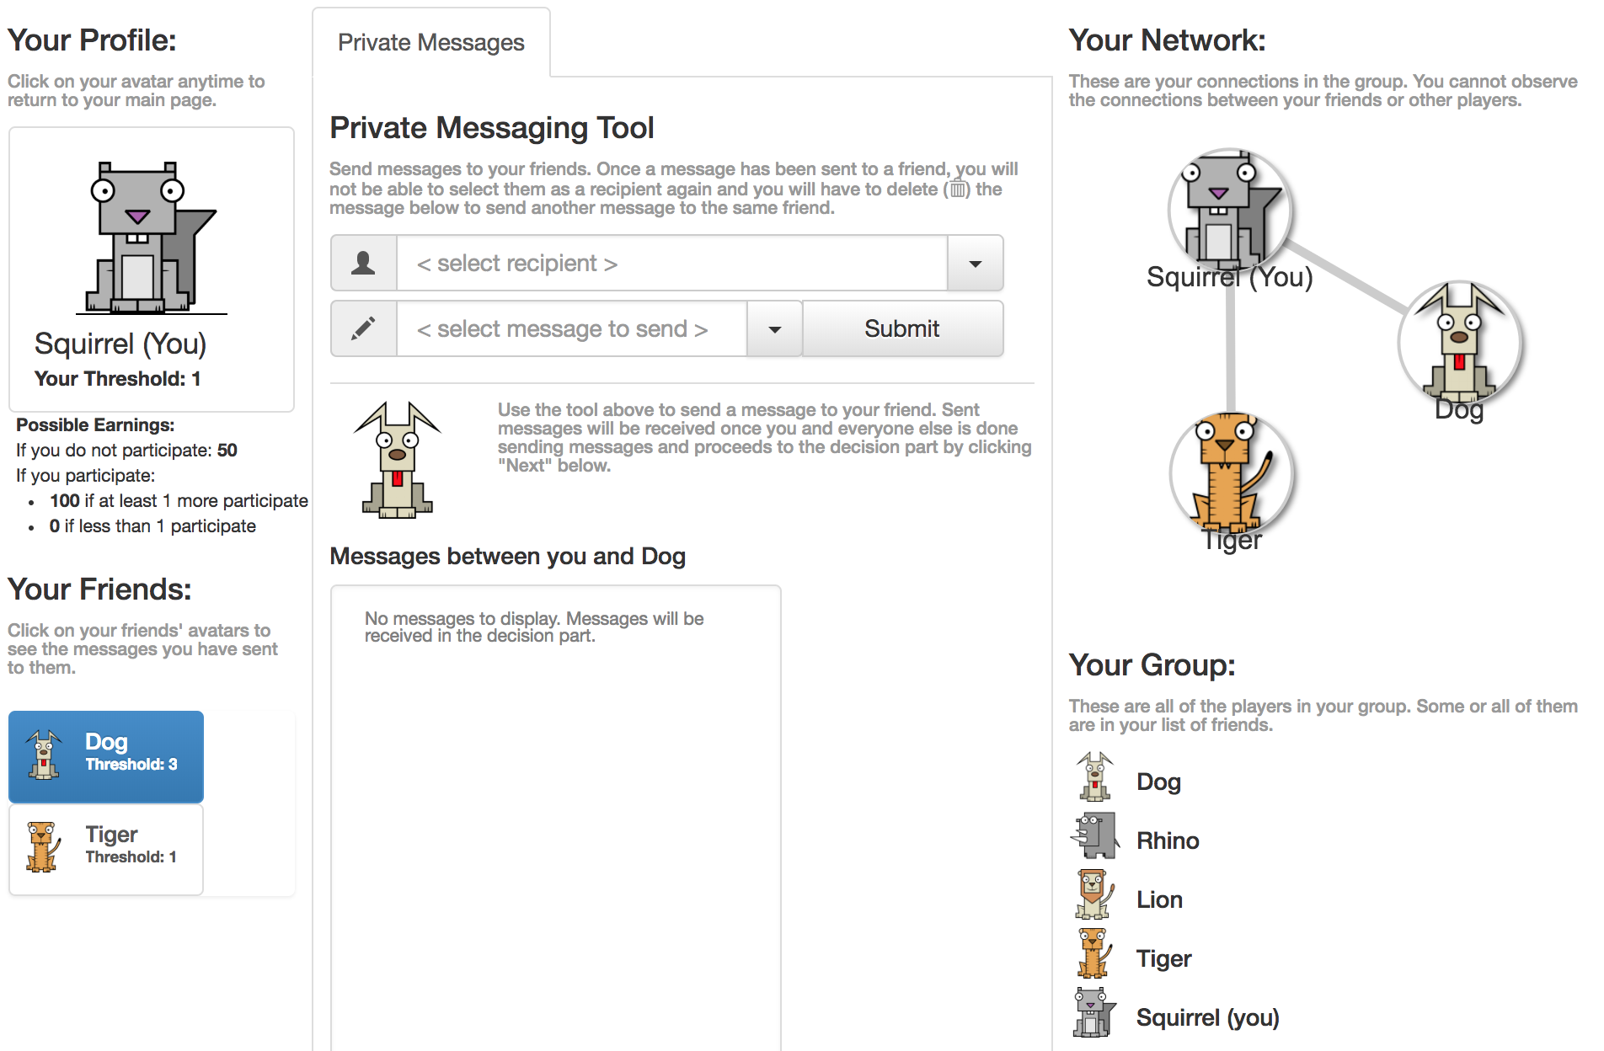
You can click on your friends’ avatars to see messages between you and them.
Notes:
“The private messaging tool allows you to send messages to your friends. Not your group.

Slide 10
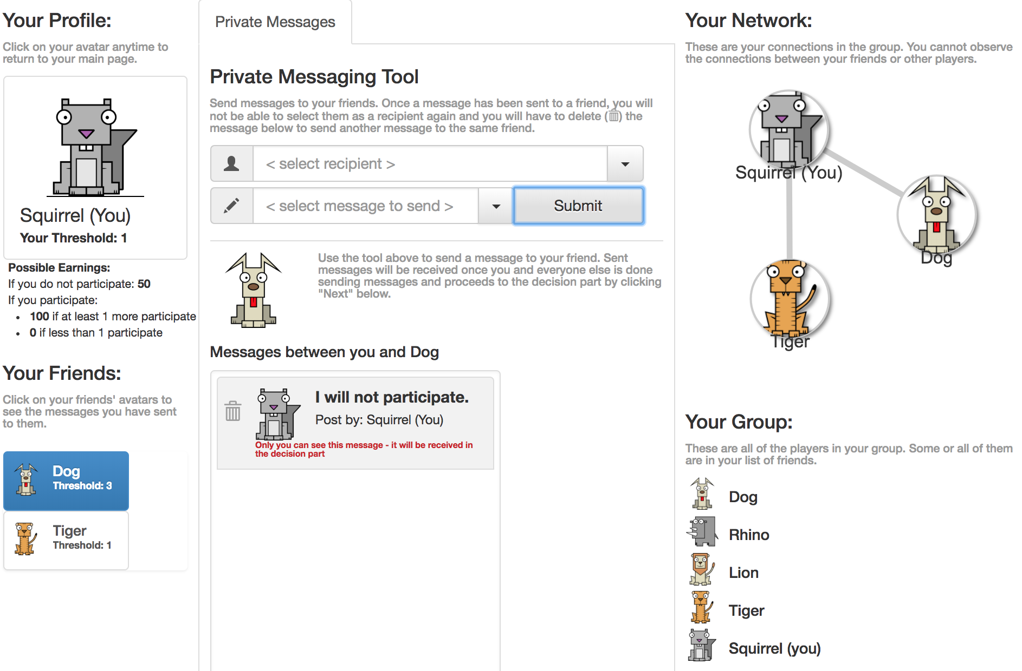
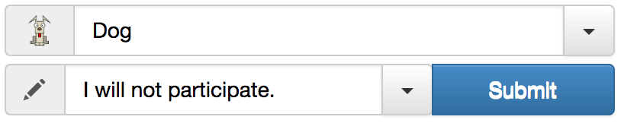
Experimental Platform
Each round has a messaging part followed by a decision part:
In the Messaging Part:
You can use the Private Messaging Tool to send messages "I will participate" or "I will not participate" to reveal your intention to participate or not in the group event.
You can also choose not to send any messages.
These messages will be received in the decision part.
Once you are done sending messages click next to proceed to the decision part.
The Network
Notes:
“In each round there is a private messaging tool that allows you to send messages such as “I will participate” or “I will not participate”. You can click on which of your friends you want to send a message. You may choose not to send messages.” “Press next to proceed”

Slide 11
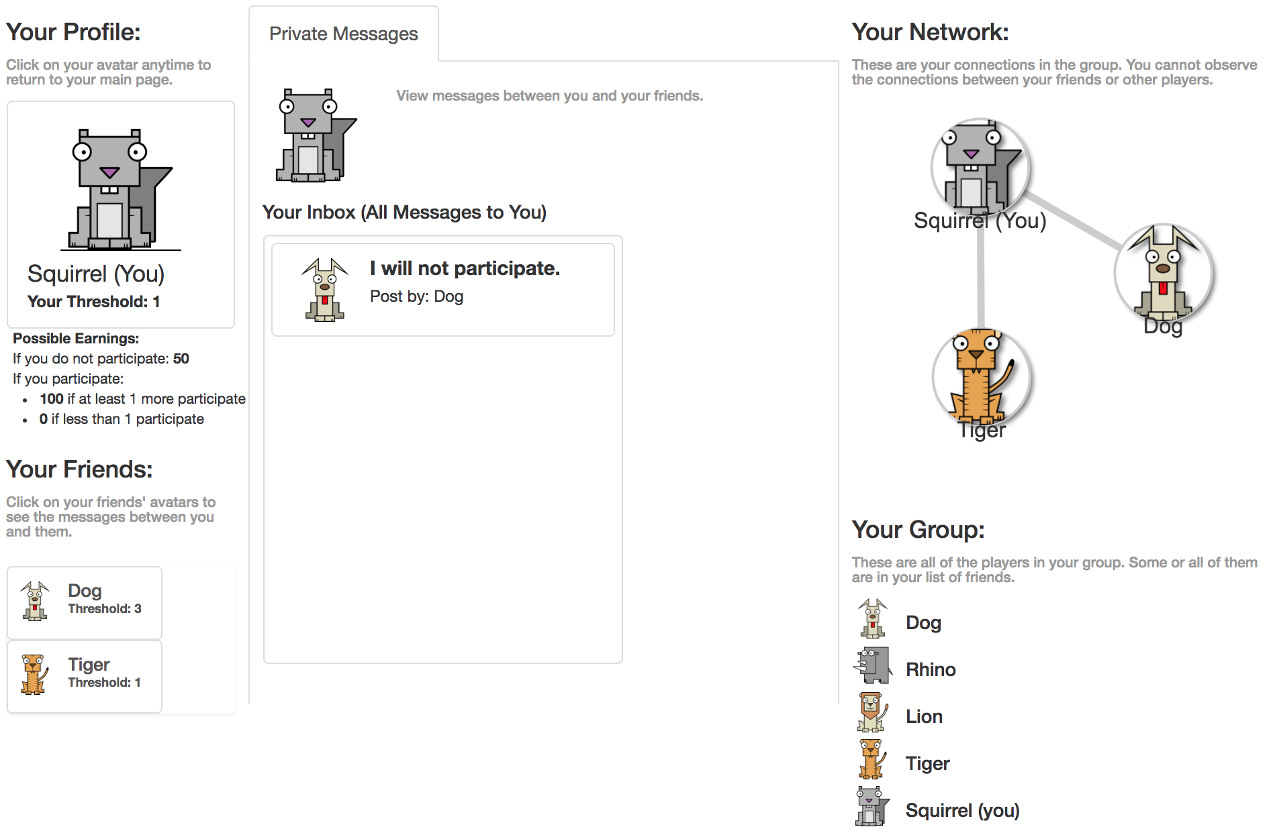
In the Decision Part:
You will view all the messages in your inbox
The Network
Notes:
“Your inbox shows what your friends sent to you. Dog sent “I will not participate.”

Slide 12
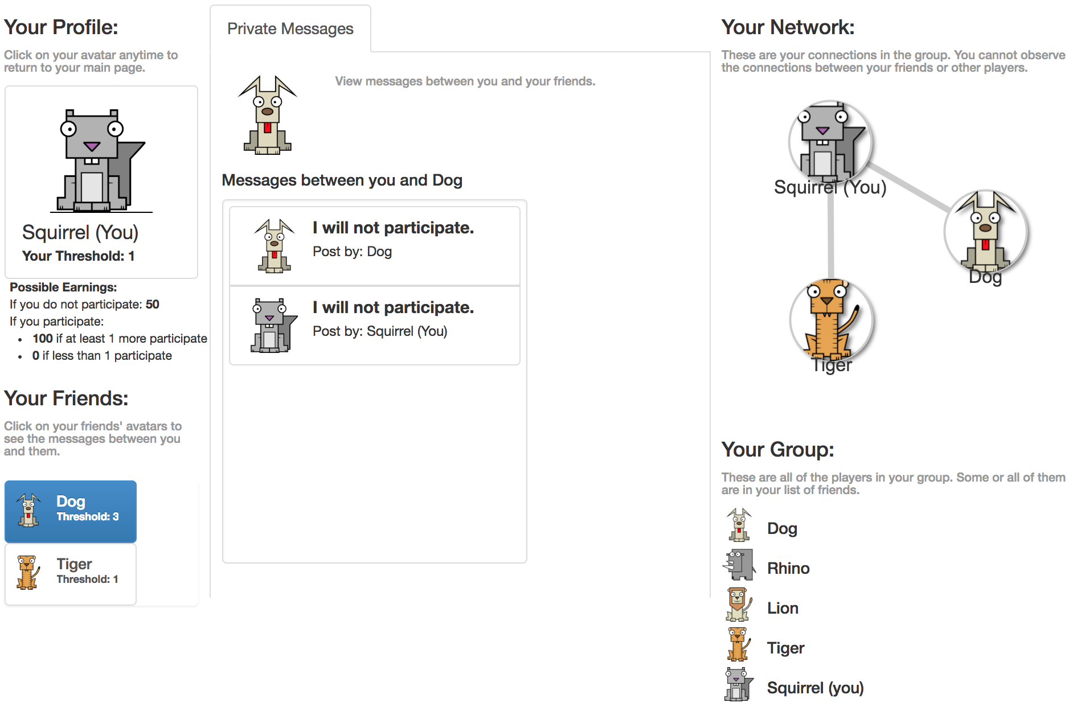
You can click on your friends’ avatars to see the messages between you and them
The Network
Notes:
You can click on your friends’ avatars to see messages between you and them.

Slide 13
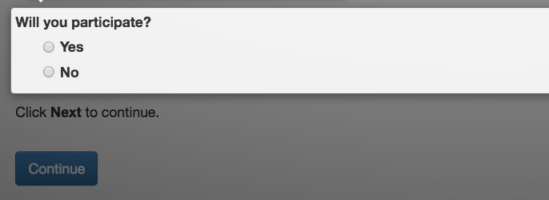
Experimental Platform
Then, you will choose participate or not participate for the round:
Once you submit your decision, a new round will start fresh.
Each round is independent from the other: whatever happens in a round does not affect the next round.
You will not observe the outcome of the rounds during the game until the end of the experiment.
In each round, every player must make a decision for the group to continue. You will receive a notification when your group is waiting for you.
You will be paid for ONE randomly chosen round. Since each round is independent and equally likely to be selected, you should pay careful attention to each round.
Notes:
I also said: “Please note that your group of 5 players will not be able to move to the next round unless you press next. You must pay attention and be careful so you make good decisions, but be aware that if you delay, you delay the whole group.”

Slide 14
Now we can start!
If you have any questions (now or during the experiment), please raise your hand and one of us will be with you to answer your question.
At the end of the experiment you will be paid privately and in cash. Please make sure you provide required information to be paid.
Notes:
I did not say this, but we should. “If you feel that the screen is frozen or you cannot proceed, please raise your hand”

