Slide 1
Keras

Slide 2


Slide 3
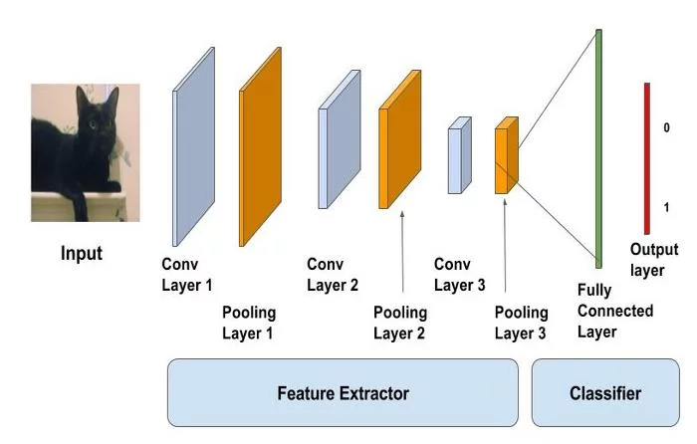

Slide 4
Keras is an open-source neural-network library written in Python.
It is capable of running on top of TensorFlow, Microsoft Cognitive Toolkit, Theano, or PlaidML

Slide 5
deep neural networks,
In addition to standard neural networks, Keras has support for convolutional and recurrent neural networks. It supports other common utility layers like dropout, batch normalization, and pooling

Slide 6
keras for classification
Keras for Regression

Slide 7
Setting up Keras
Before installing Keras, please install one of its backend engines: TensorFlow, Theano, or CNTK. We recommend the TensorFlow backend.
You may also consider installing the following optional dependencies:
cuDNN (recommended if you plan on running Keras on GPU).
HDF5 and h5py (required if you plan on saving Keras models to disk).
graphviz and pydot (used by visualization utilities to plot model graphs).

Slide 8
sudo pip install keras

Slide 9
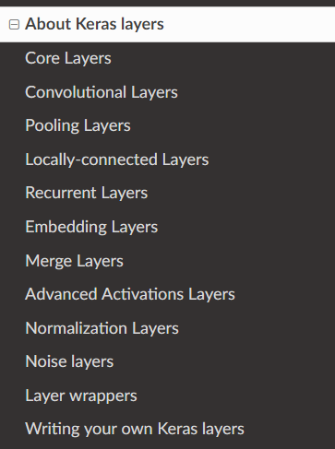
Different layers
in Keras

Slide 10
Core : Dense
Conv : Conv1D, Conv2d
Pooling: MaxPooling1D, GlobalMaxPooling1D
LocallyConnected1D
Recurrent : RNN, SimpleRNN, LSTM
Embedding
Merge: Add, Subtract
LeakyReLU, Softmax, Relu
BatchNormalization
GaussianNoise
TimeDistributed, Bidirectional

Slide 11
keras.layers.GaussianNoise(stddev)
A common use for nonzero is to find the indices of an array, where a condition is True.

Slide 12
Placeholder :
inputs = K.placeholder(shape=(2, 4, 5))

Slide 13
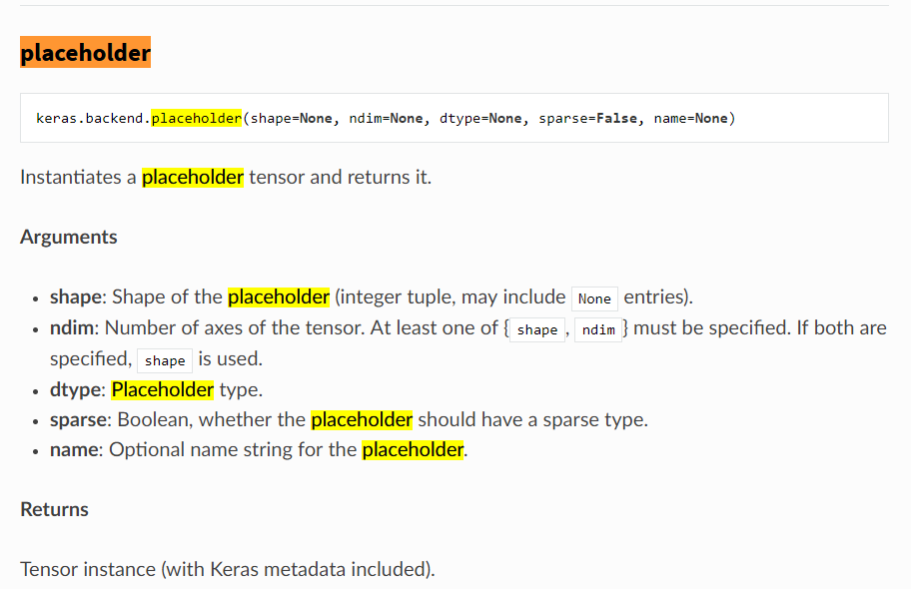

Slide 14
pool_size: Integer, size of the max pooling windows.
Initializations define the way to set the initial random weights of Keras layers.
model.add(Dense(64, kernel_initializer='random_uniform', bias_initializer='zeros'))

Slide 15
Regularizers allow to apply penalties on layer parameters or layer activity during optimization. These penalties are incorporated in the loss function that the network optimizes.

Slide 16
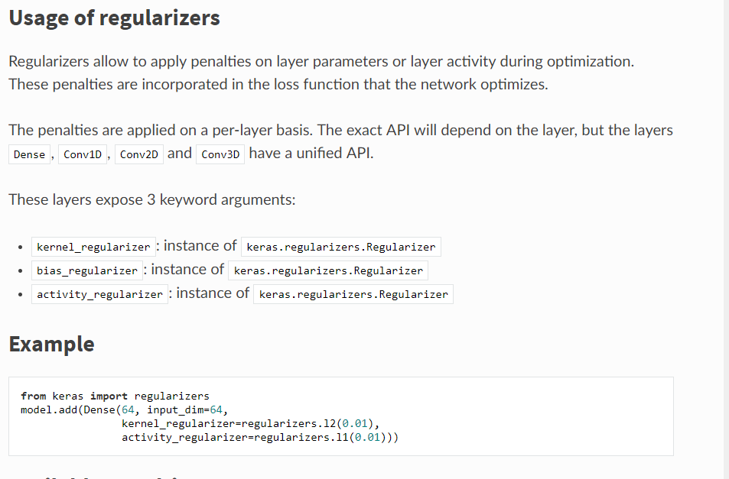

Slide 17
An optimizer is one of the two arguments required for compiling a Keras model:
from keras import optimizers
# All parameter gradients will be clipped to # a maximum norm of 1. sgd =
optimizers.SGD(lr=0.01, clipnorm=1.)
RMSprop
Adagrad
Adam

Slide 18
Activations can either be used through an Activation layer, or through the activation argument supported by all forward lay
from keras.layers import Activation, Dense model.add(Dense(64)) model.add(Activation('tanh')):
softmax
Elu (Exponential linear unit.)
Relu ( Rectified)
Tanh (Hyperbolic tangent activation function.)

Slide 19
Loss functions
model.compile(loss='mean_squared_error', optimizer='sgd')
mean_squared_error
mean_absolute_error
categorical_crossentropy
cosine_proximity

Slide 20
What is a "backend"?
Keras is a model-level library, providing high-level building blocks for developing deep learning models. It does not handle low-level operations such as tensor products, convolutions and so on itself. Instead, it relies on a specialized, well optimized tensor manipulation library to do so, serving as the "backend engine" of Keras. Rather than picking one single tensor library and making the implementation of Keras tied to that library, Keras handles the problem in a modular way, and several different backend engines can be plugged seamlessly into Keras.
At this time, Keras has three backend implementations available: the TensorFlow backend, the Theano backend, and the CNTK backend.

Slide 21
The Sequential model is a linear stack of layers.

Slide 22
Creating Neural Network
Sequential

Slide 23
Training Models
Sequential

Slide 24
Monitoring
In code
A callback is a set of functions to be applied at given stages of the training procedure. You can use callbacks to get a view on internal states and statistics of the model during training.
History
ModelCheckpoint
EarlyStopping (Stop training when a monitored quantity has stopped improving.)

Slide 25
Artificial Neural Network
Theory

Slide 26
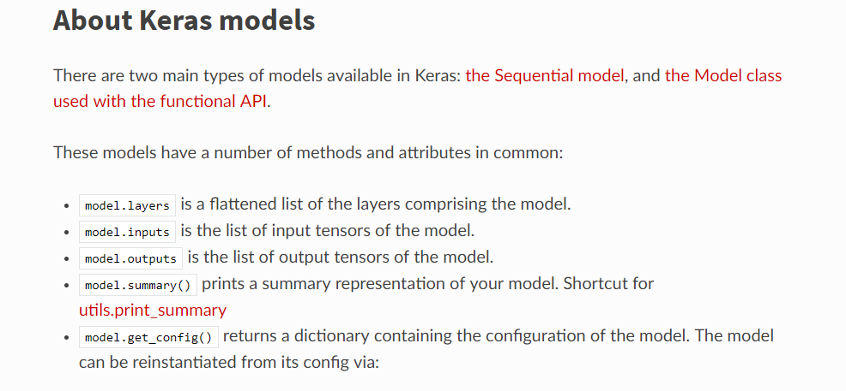
Keras Models

Slide 27
from keras.layers import Dense, Dropout, Activation, Flatten

