Slide 1
Machine Learning
Algirithms

Slide 2
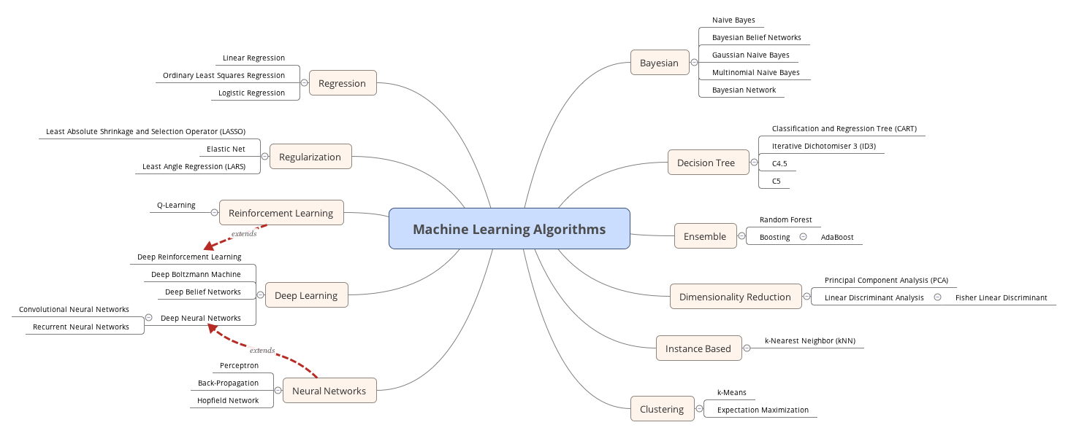

Slide 3
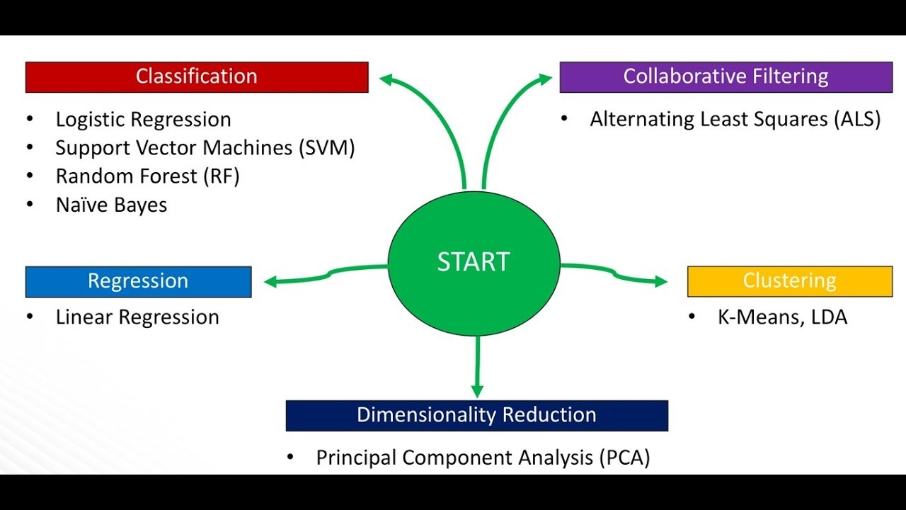

Slide 4
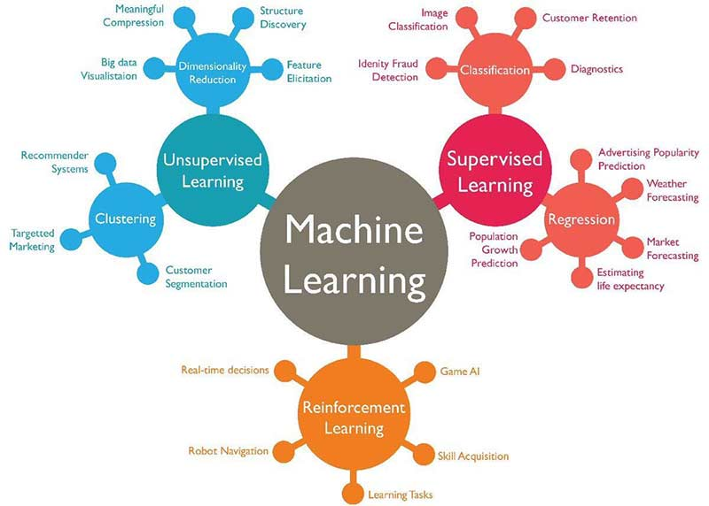

Slide 5
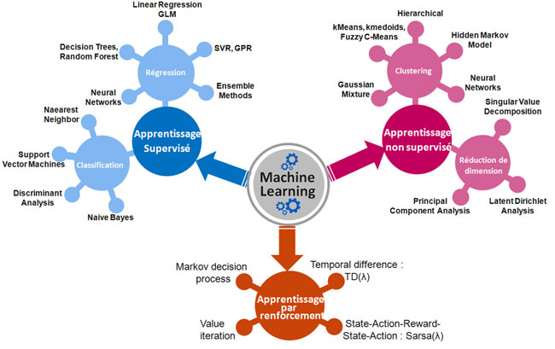

Slide 6
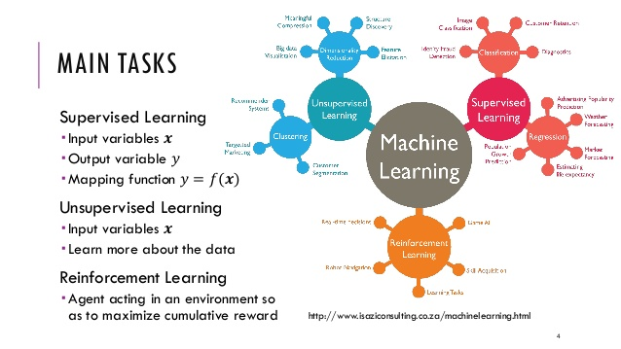

Slide 7
django
conda install -c auto django-project
conda install -c anaconda django
Run As - Admin
conda-forge
conda install -c some-channel packagename
C:\ProgramData\Anaconda3\Scripts\conda.exe

Slide 8
