Slide 1
Tableau

Slide 2
SQL Basics
Drag and drop Features
Connecting to Various Databases
Both SQL and NOSQL
Commercial

Slide 3
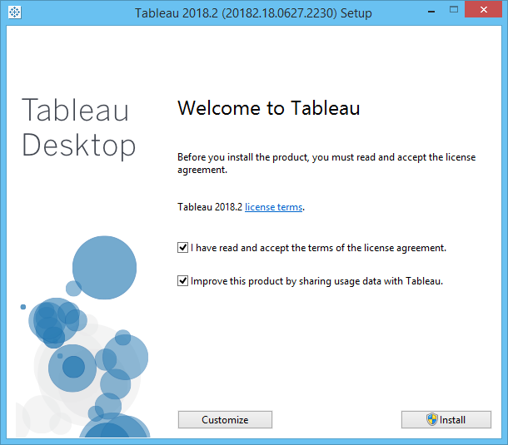
64 Bit ,
2018.2
Version

Slide 4
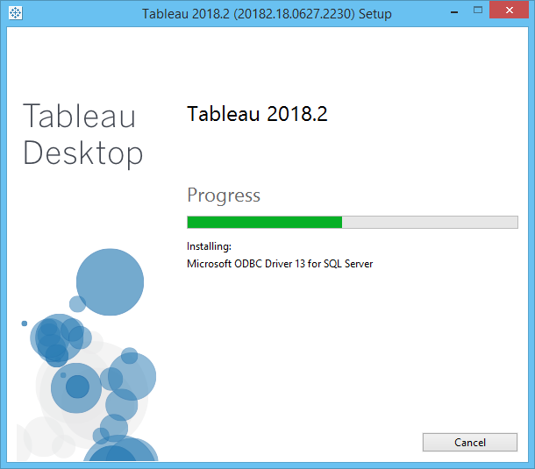

Slide 5
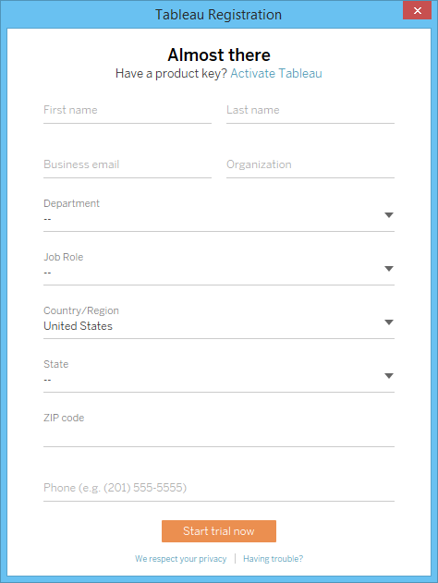
Trial Version

Slide 6
Fill Details

Slide 7
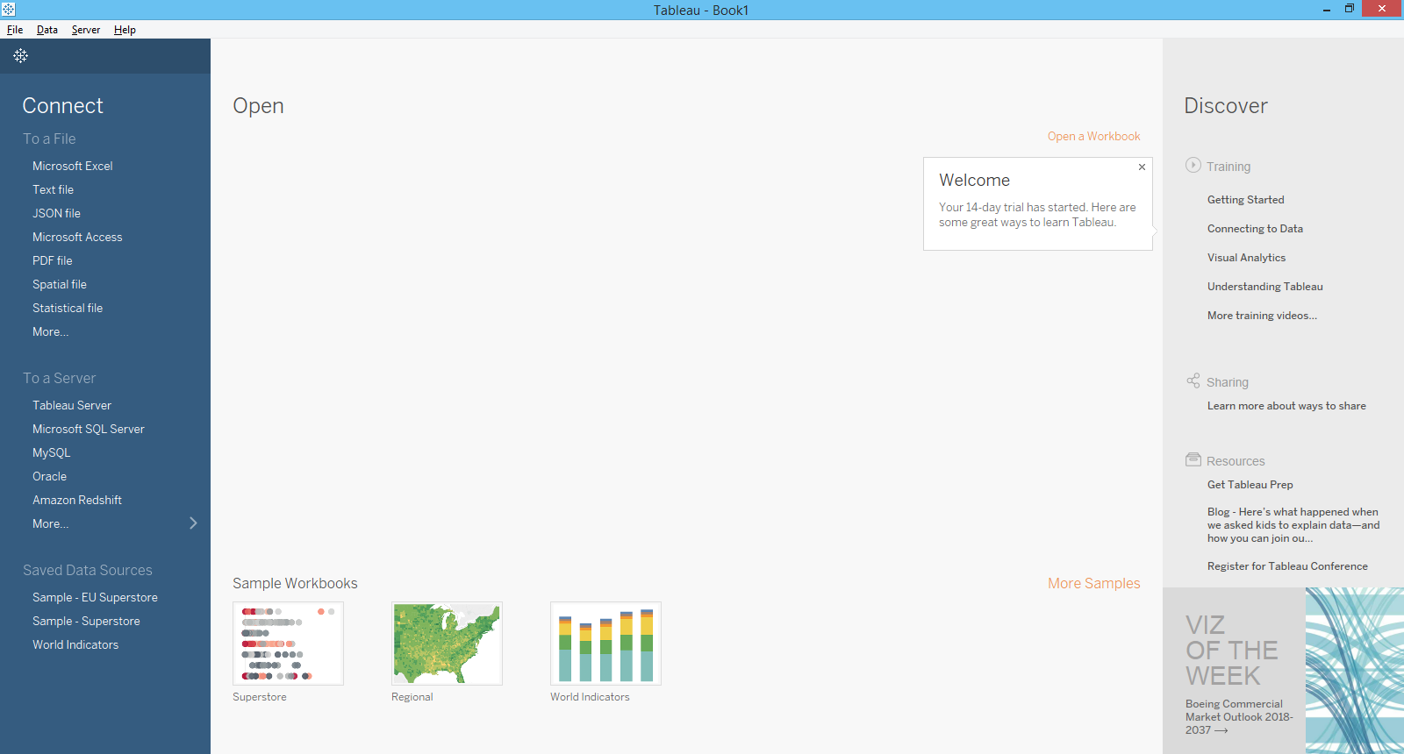

Slide 8
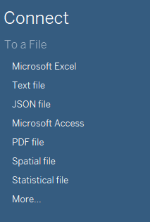

Slide 9
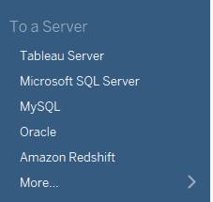

Slide 10
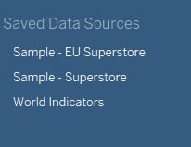

Slide 11
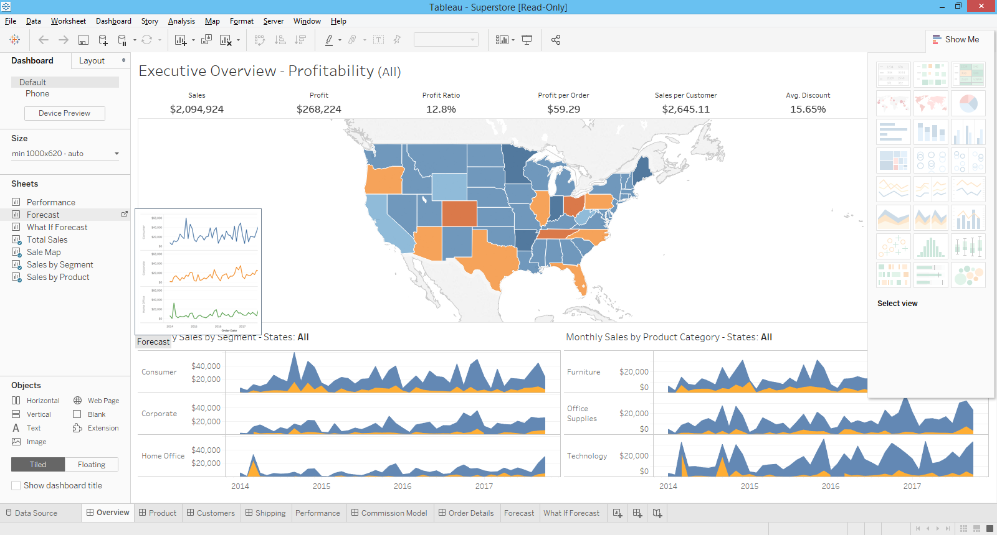
Sample – workbook

Slide 12
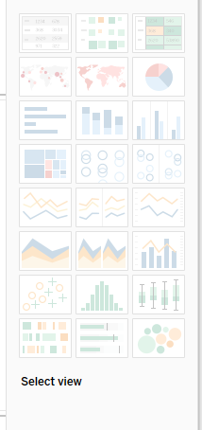

Slide 13

Load Excel
Cereals Excel/csv
DATA:
Dimension ( categories)
Measures ( quantity )
Connection: Live, extract

Slide 14
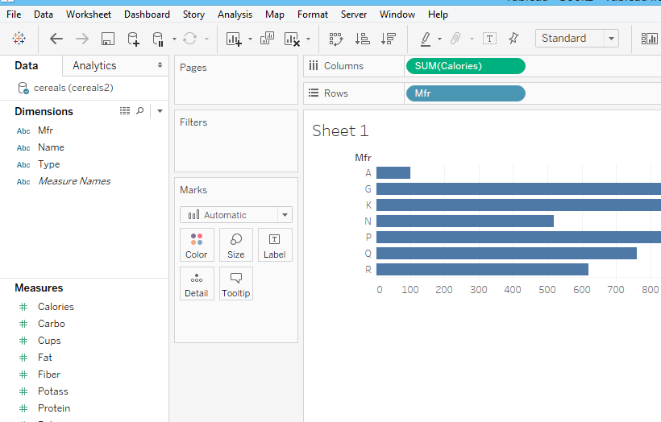

Slide 15
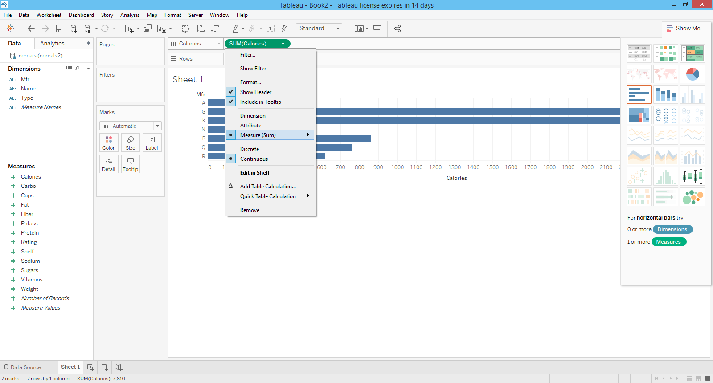

Slide 16
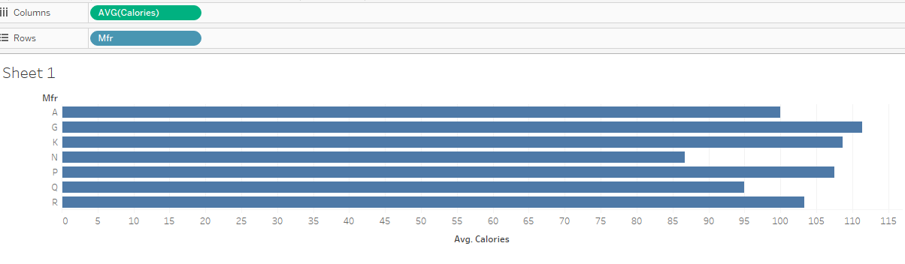

Slide 17
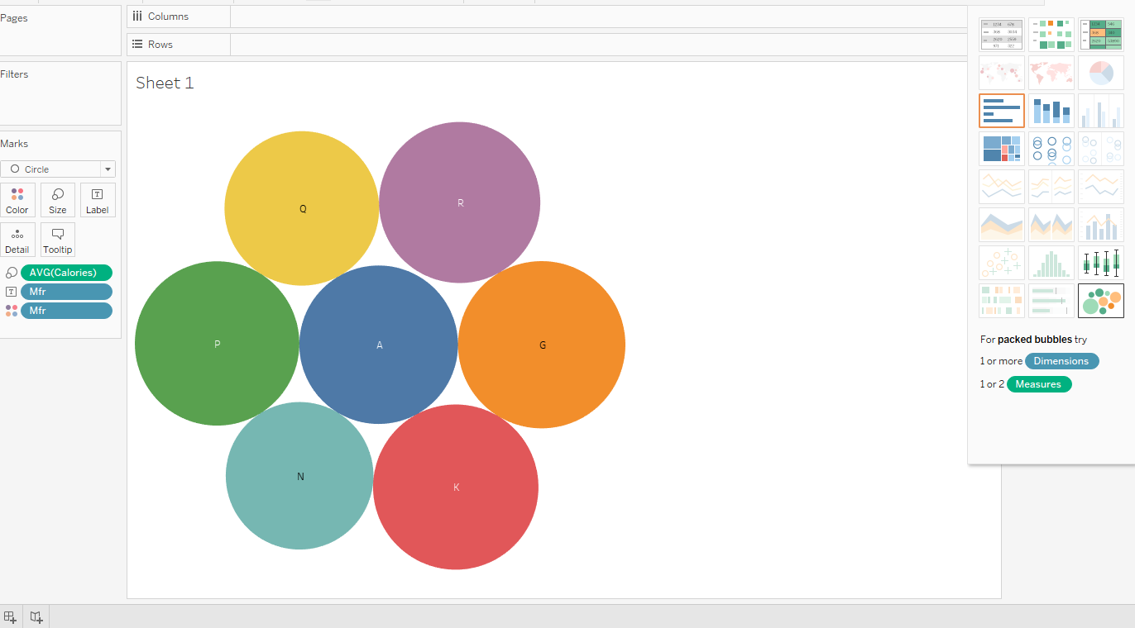

Slide 18
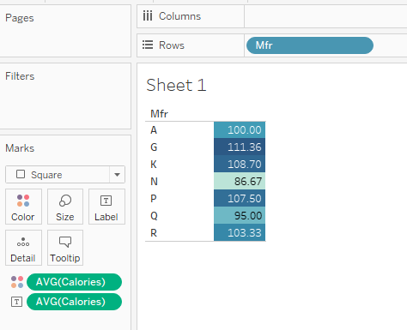

Slide 19
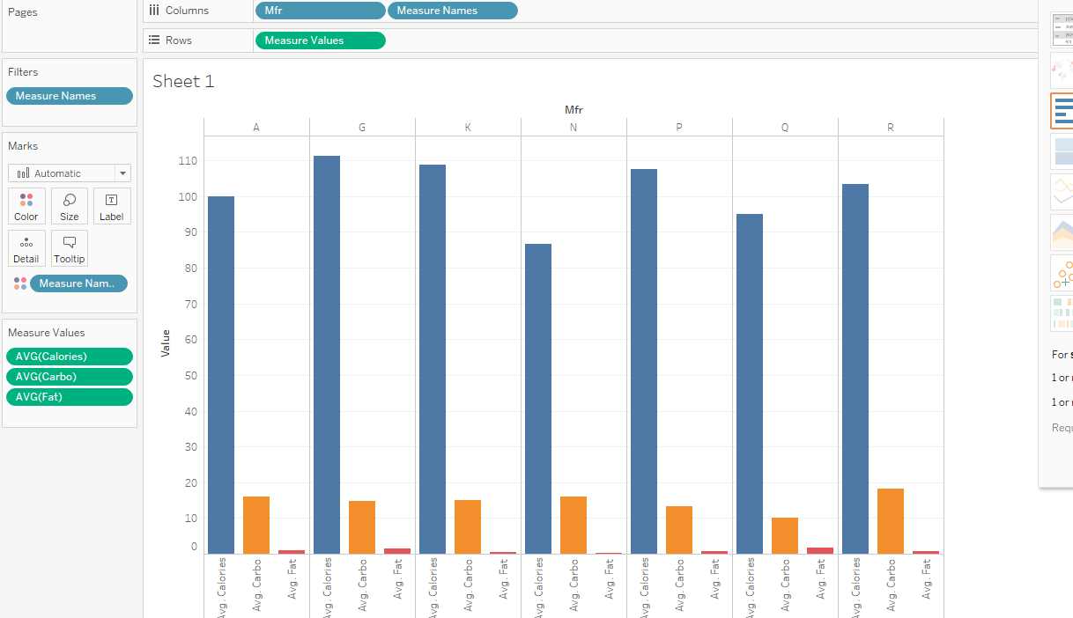

Slide 20
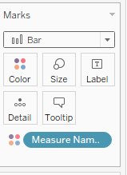
marks

Slide 21
Save : twb

Slide 22
Color
Size
Label
Detail
Tooltip

Slide 23
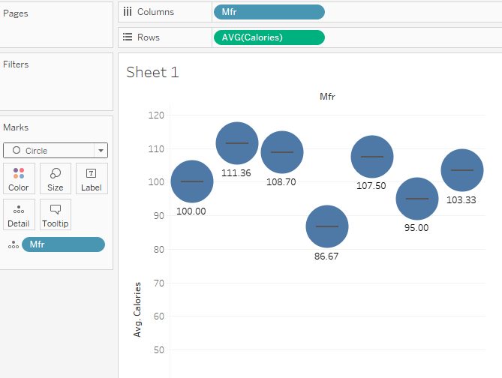

Slide 24

export

Slide 25
Auto Finance data

Slide 26
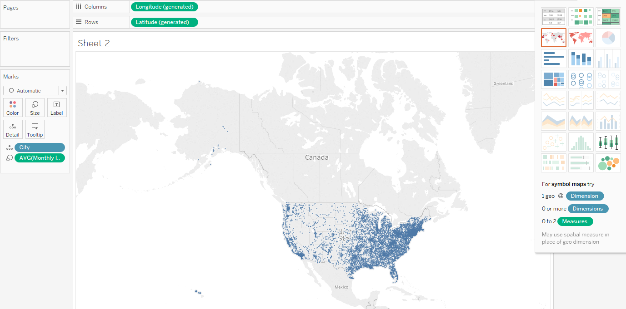
Map

Slide 27
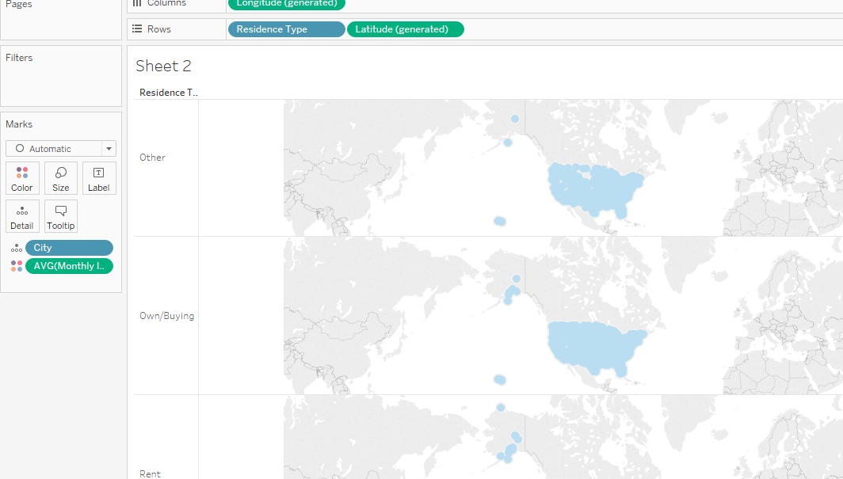

Slide 28
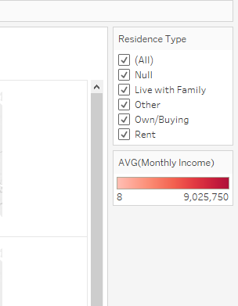
Show Filter

Slide 29
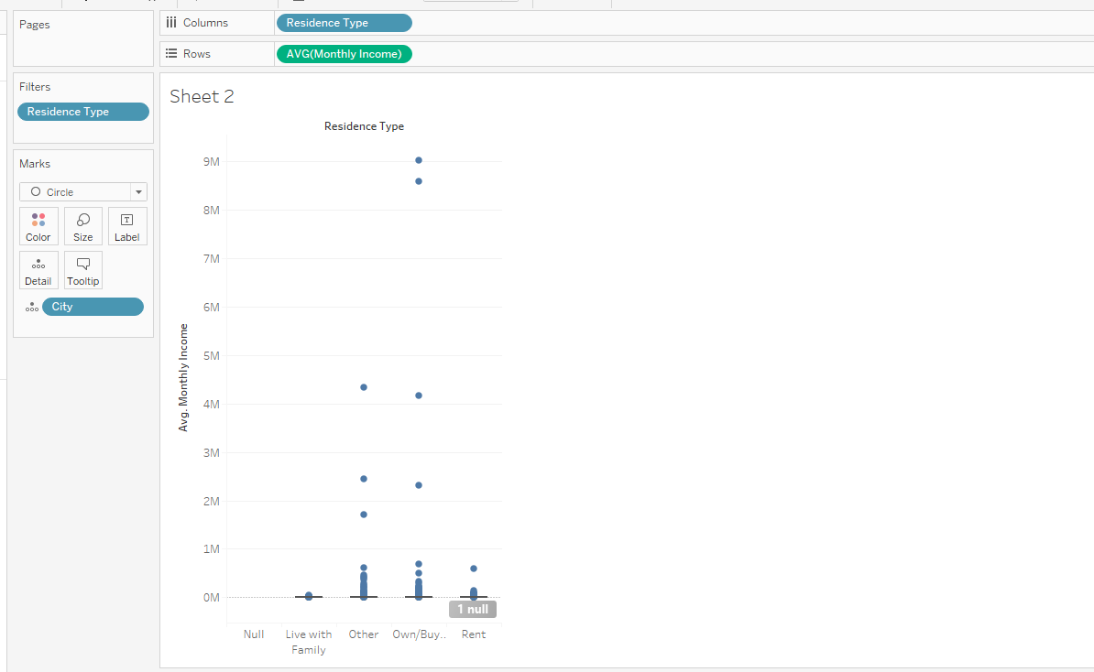

Slide 30
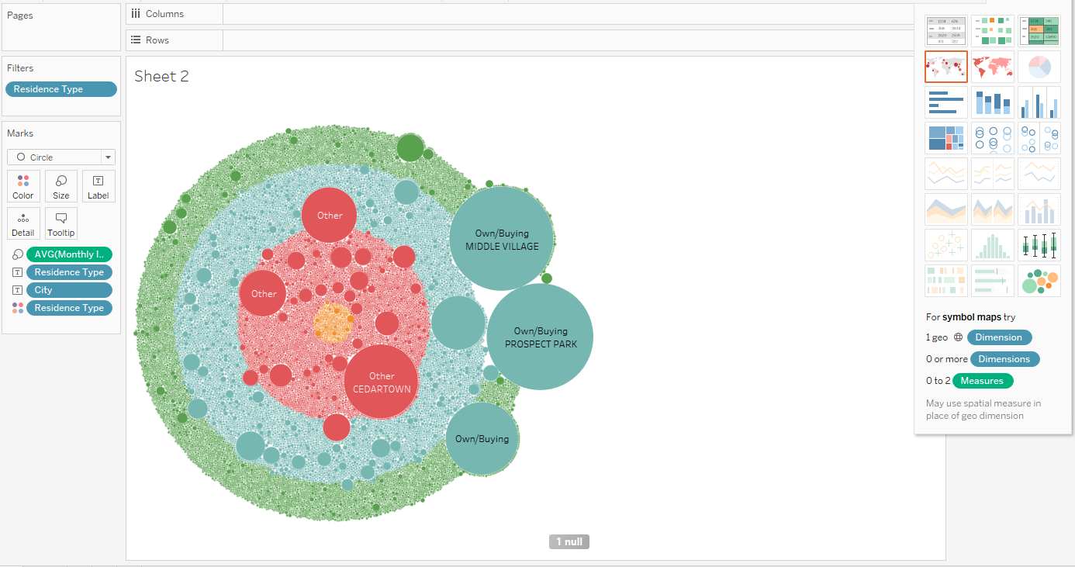

Slide 31
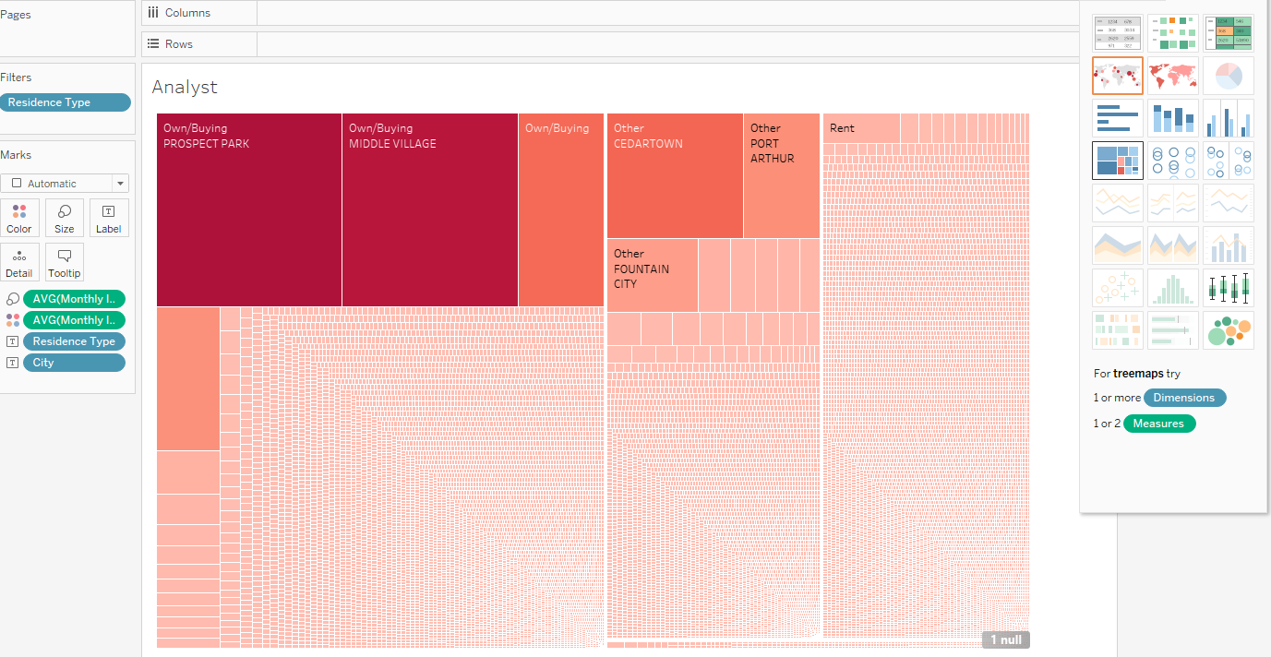

Slide 32
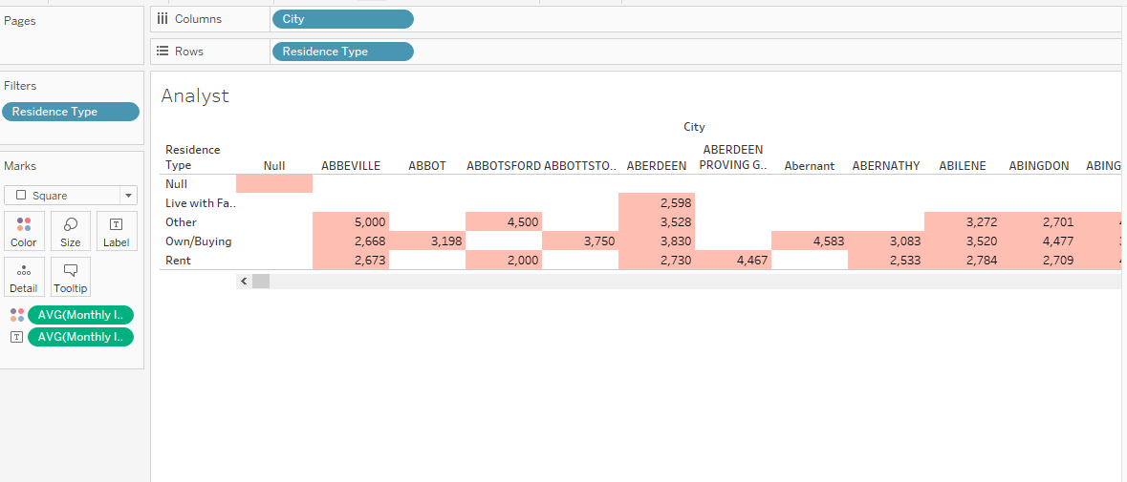

Slide 33
worksheet
Summary
Describe Sheet
Cross Tab
Actions - Advance

Slide 34
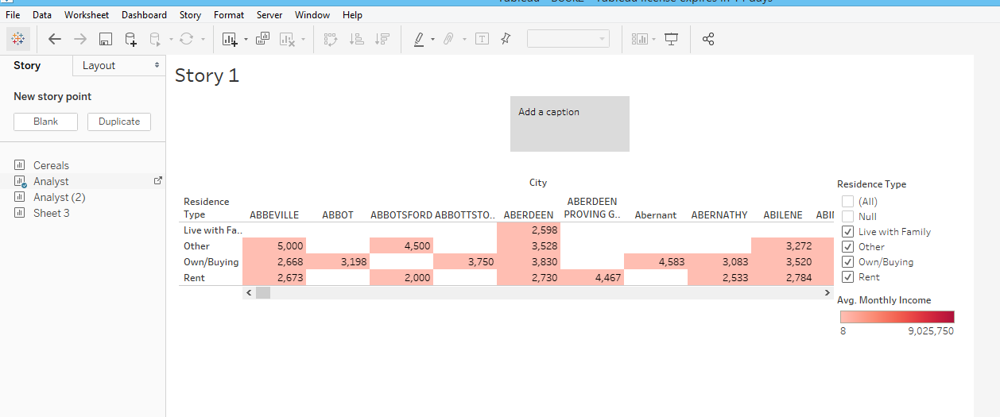
Story

Slide 35
Tableau Public
https://public.tableau.com/en-us/s/
Extract issue : Data -> Extract
Then after login, u can publish

Slide 36
Join
Union
Data blending ( 2 databases)
Cross-database join

Slide 37
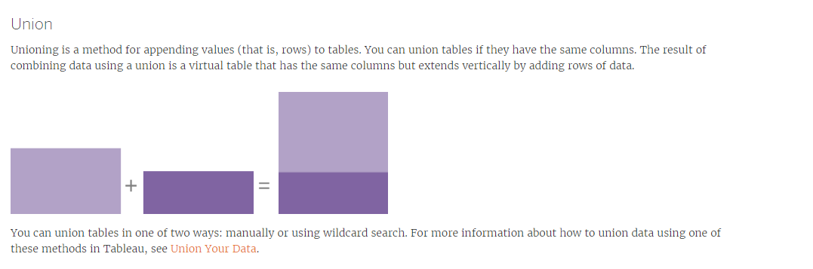

Slide 38
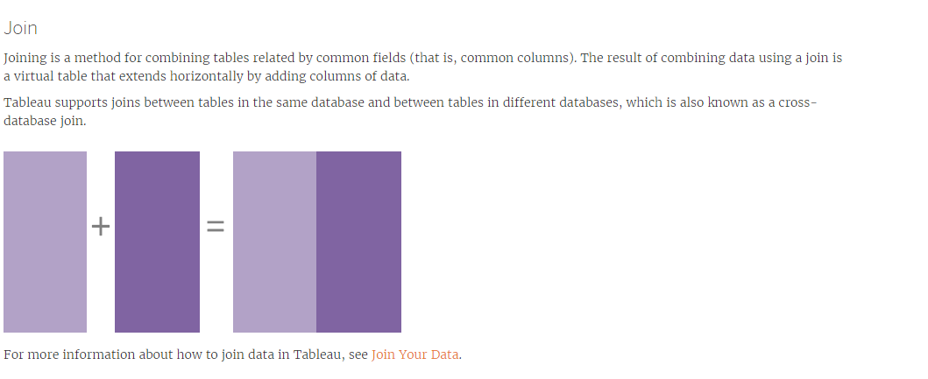

Slide 39
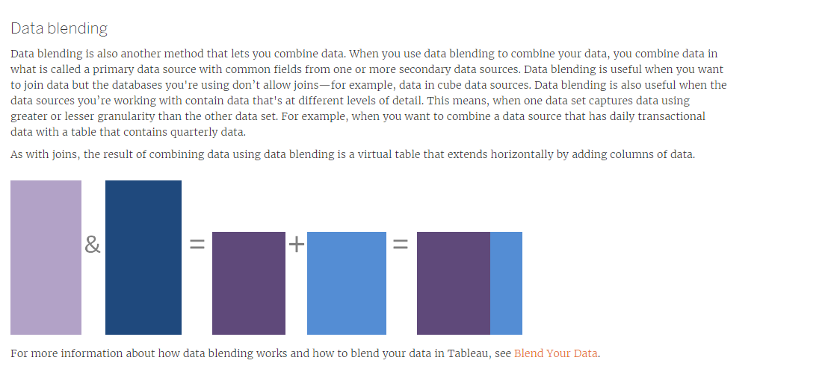

Slide 40
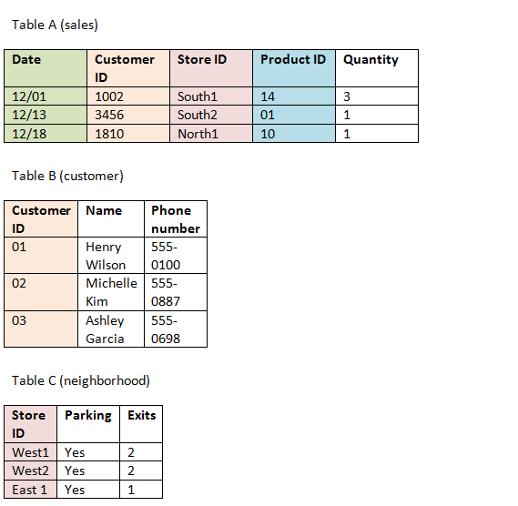

Slide 41
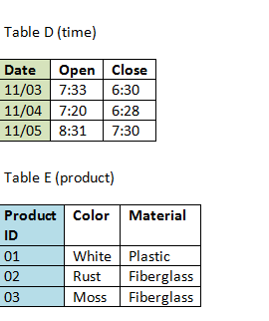

Slide 42
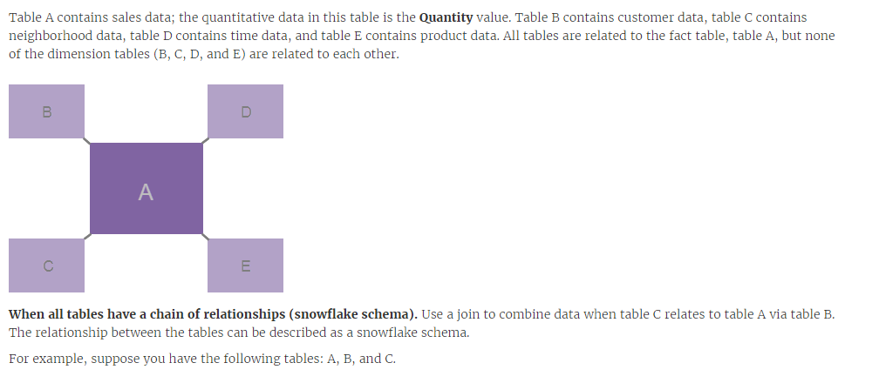

Slide 43
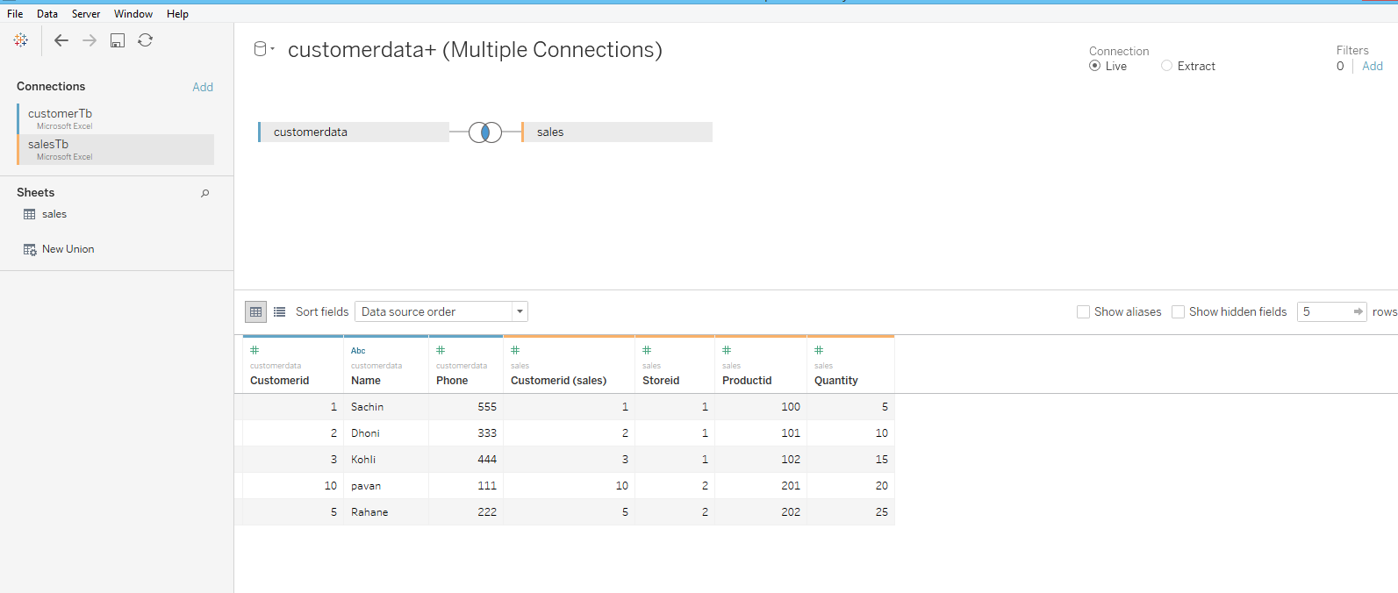

Slide 44
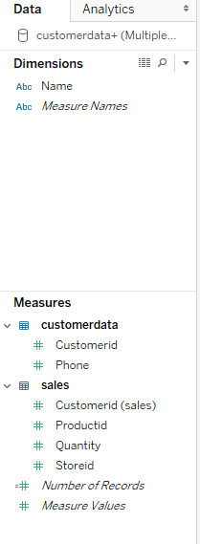

Slide 45
Measures -> Dimensions

Slide 46
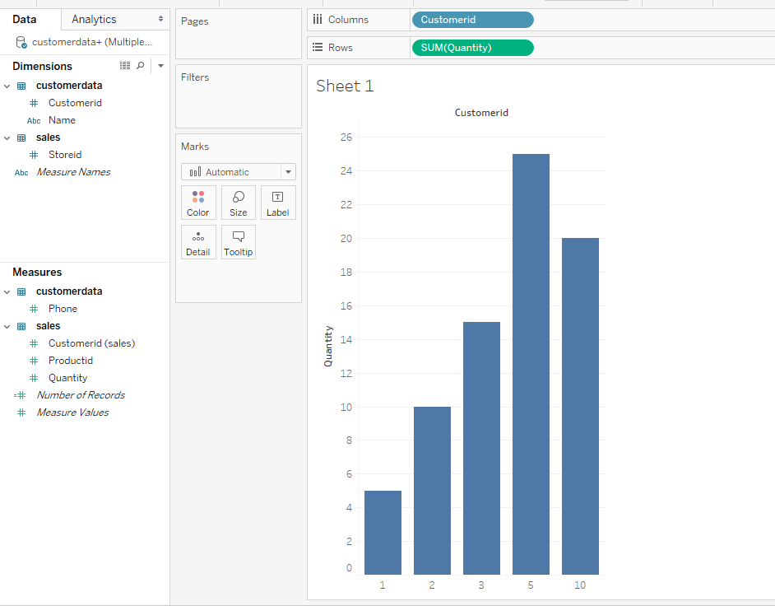

Slide 47
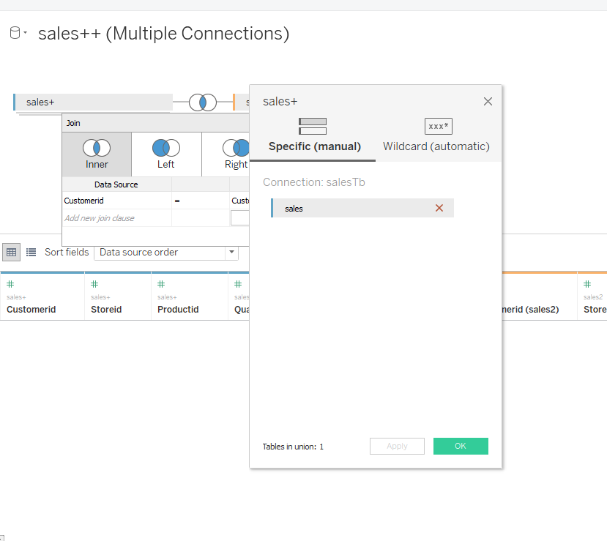

Slide 48
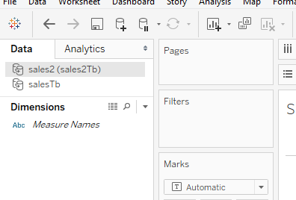
Append

Slide 49
Extract
After 2 files
Append

Slide 50
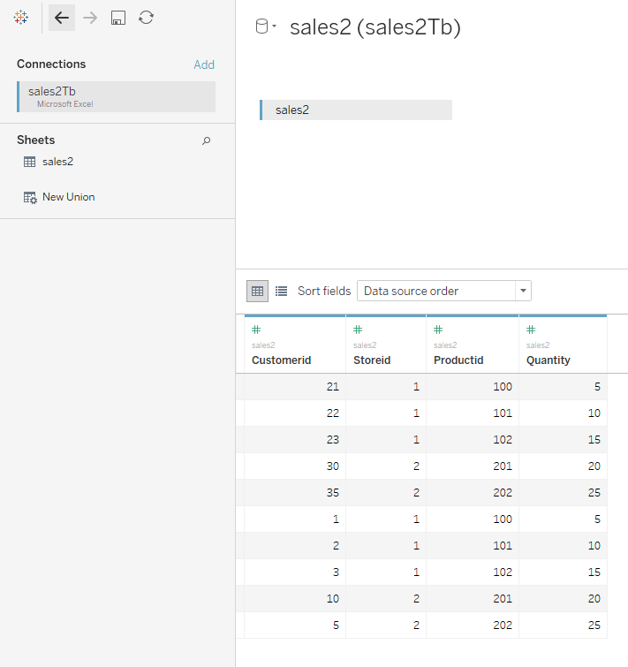

Slide 51
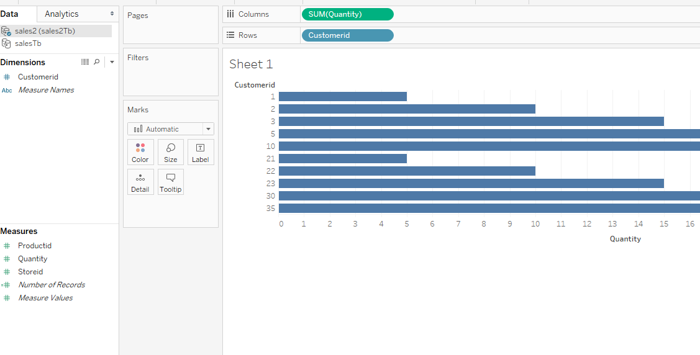

Slide 52
create a calculated field:
if Sum([Revenue) >0.25 THEN "Green"
ELSEif Sum([Revenue])<=0.25 then "Red"
END

Slide 53
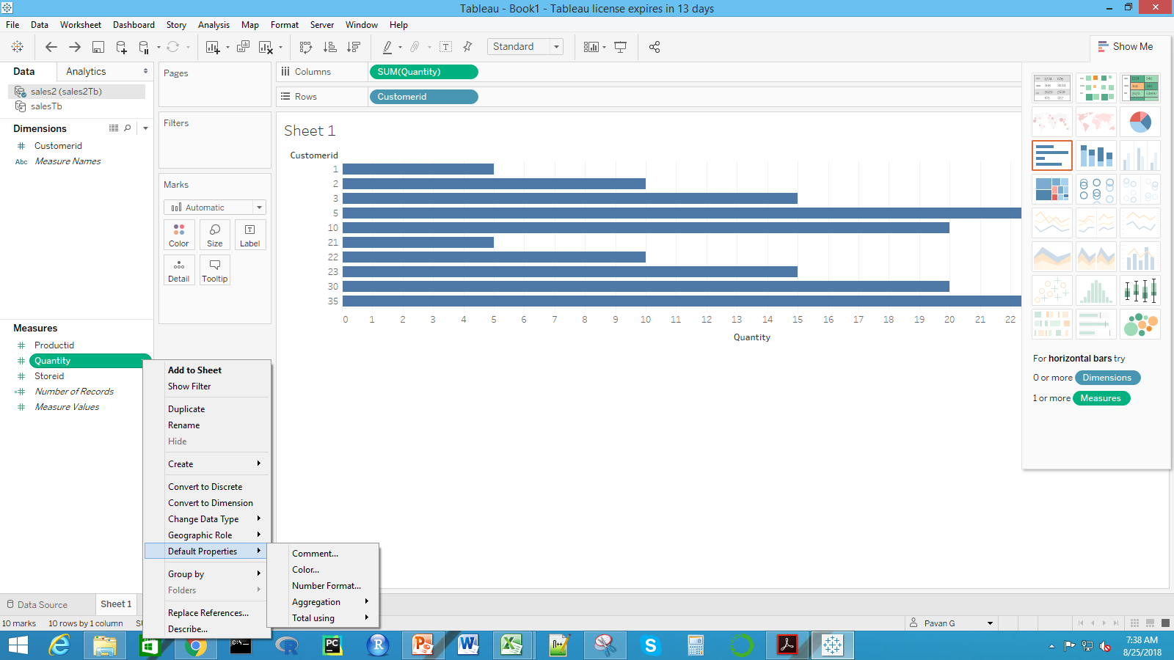

Slide 54
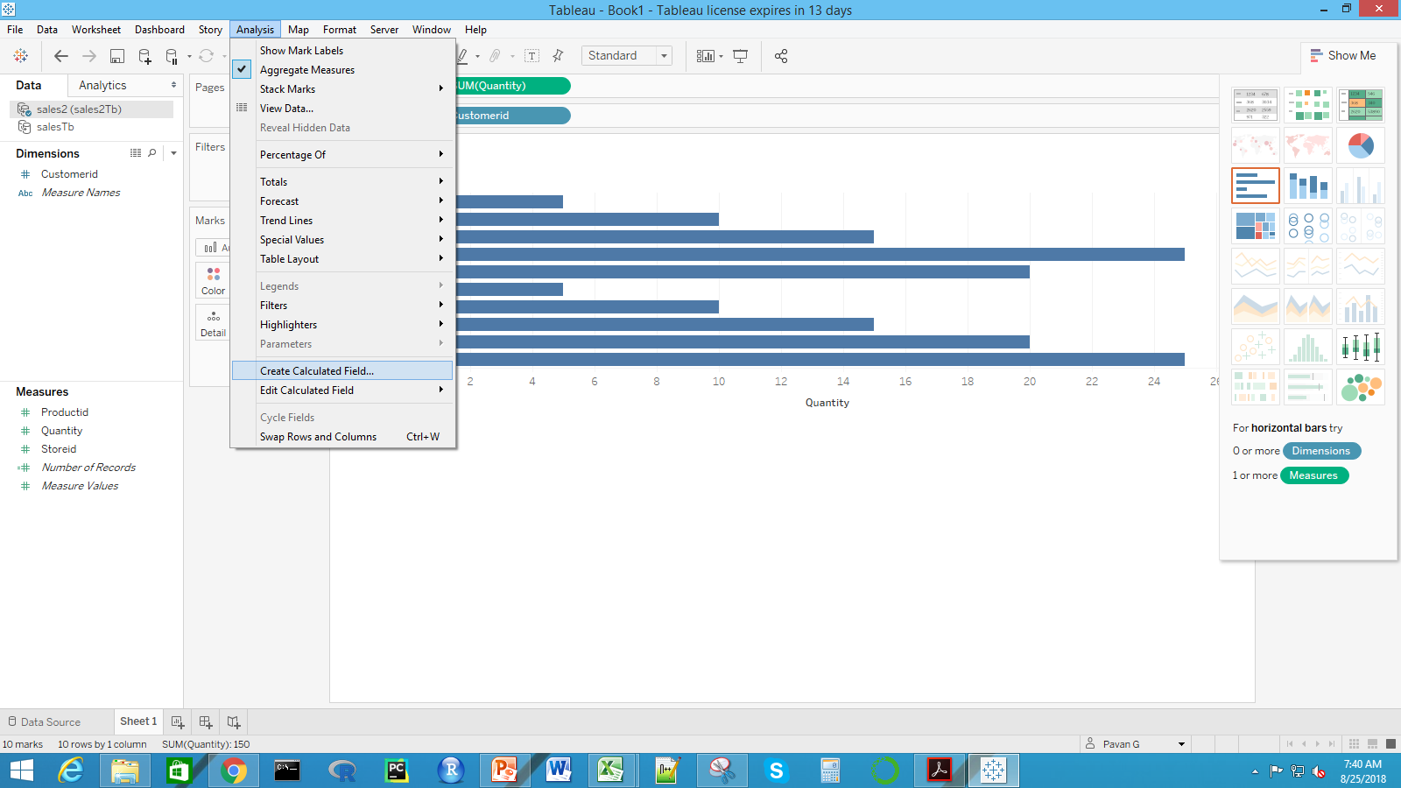
Create Calc Field

Slide 55
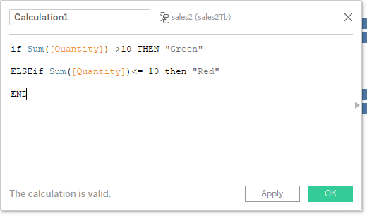

Slide 56
