Slide 1
Tensorflow

Slide 2
TensorFlow is one of the most popular libraries in Deep Learning.

Slide 3
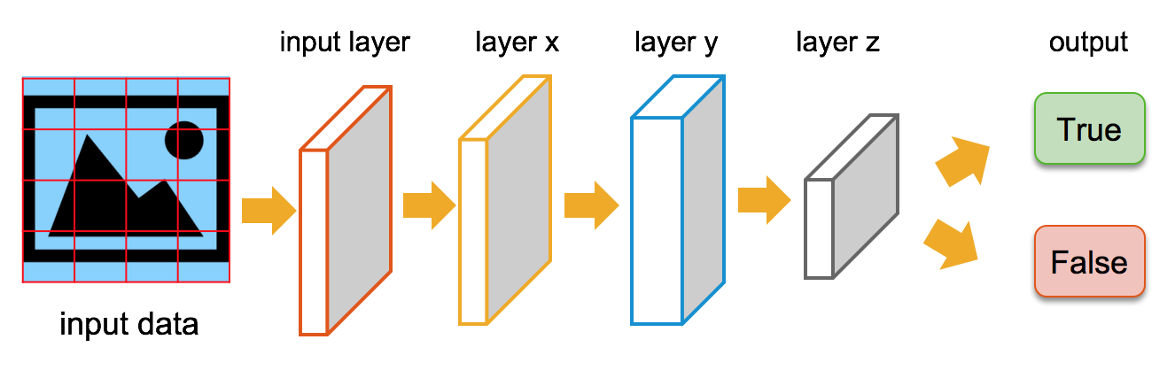

Slide 4
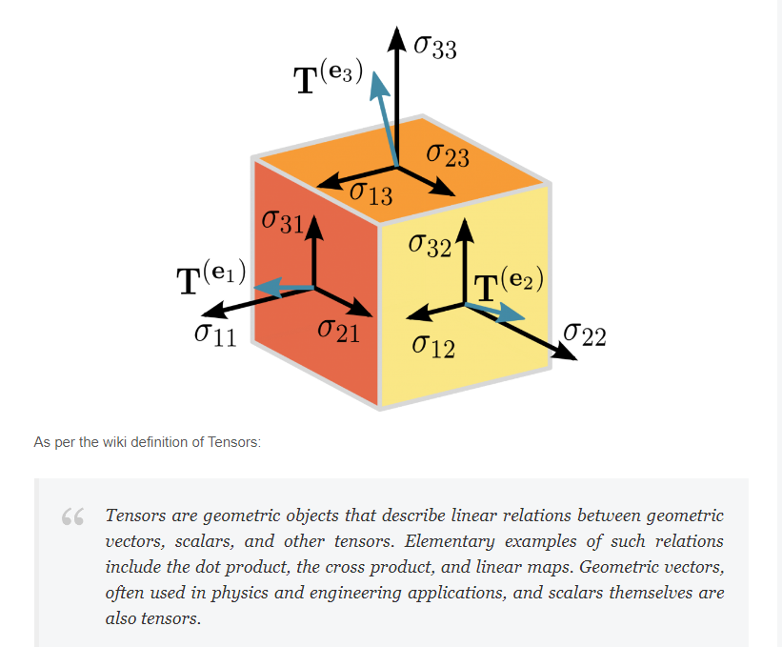

Slide 5
Deep Learning wants us to think that Tensors as Multidimensional Arrays.
A computational graph is a series of TensorFlow operations arranged into a graph of nodes.
Each node takes zero or more tensors as inputs and produces a tensor as an output.

Slide 6
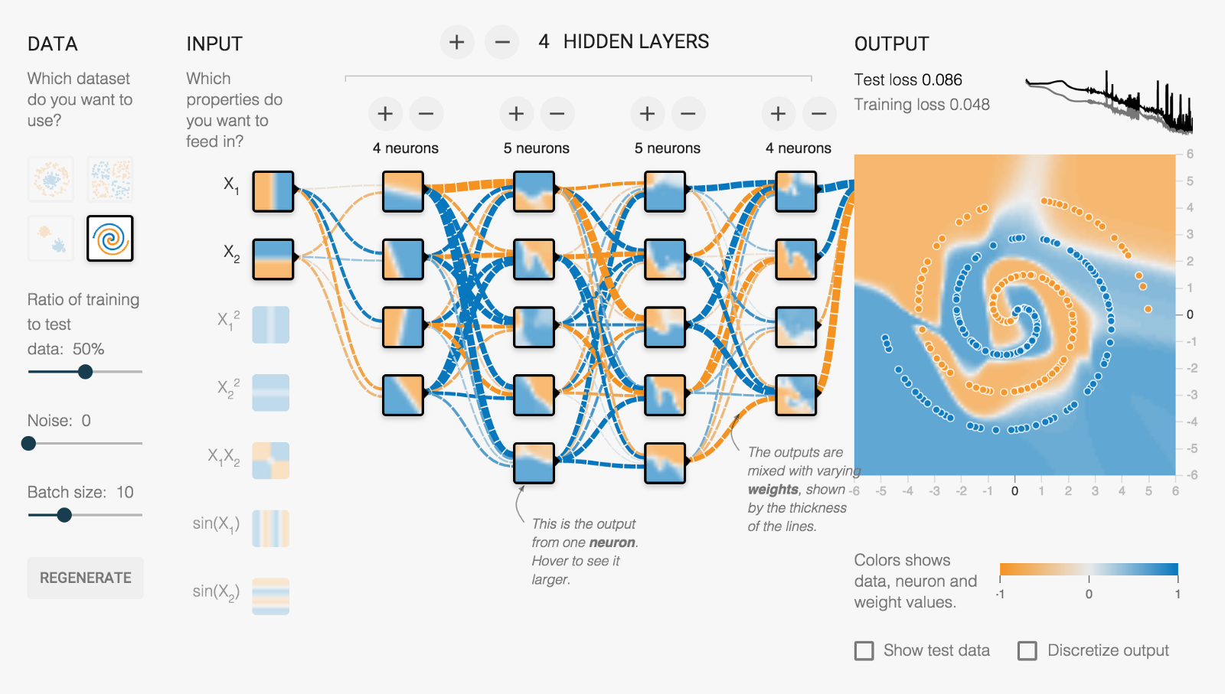

Slide 7
python -m tensorboard.main
tensorboard --logdir=path/to/log-directory

Slide 8
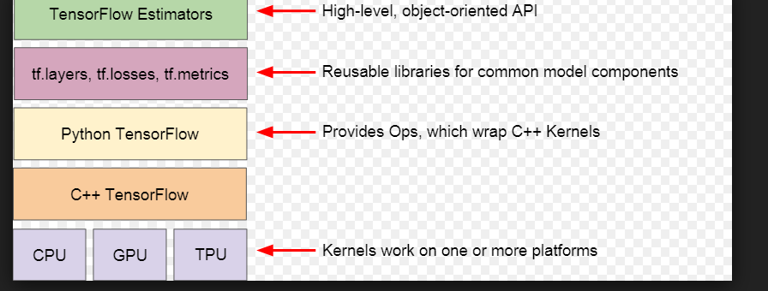

Slide 9
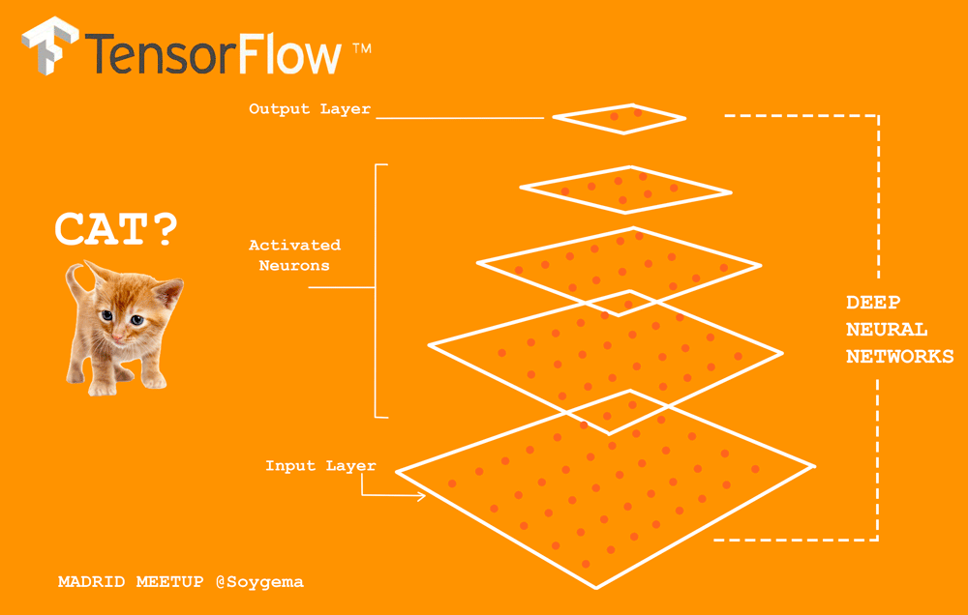

Slide 10
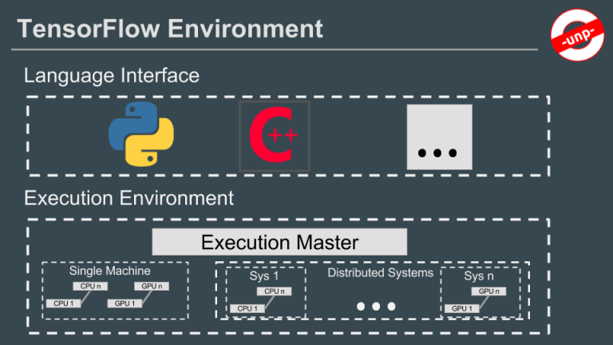

Slide 11
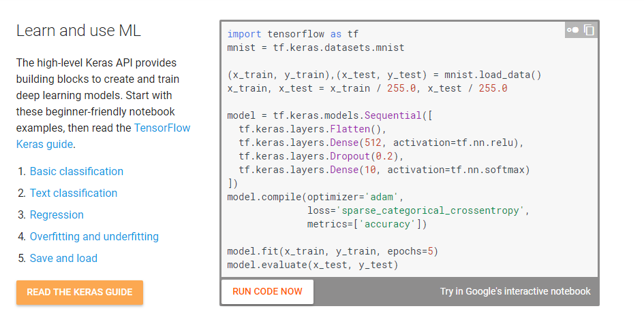

Slide 12
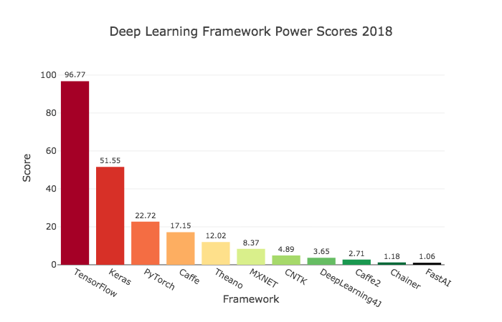

Slide 13
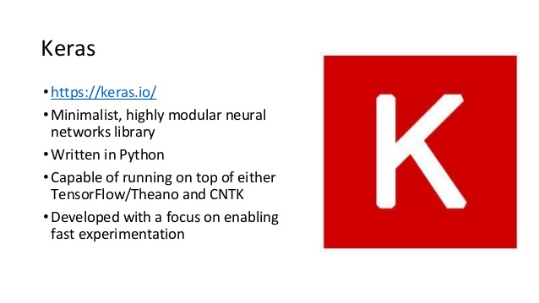

Slide 14
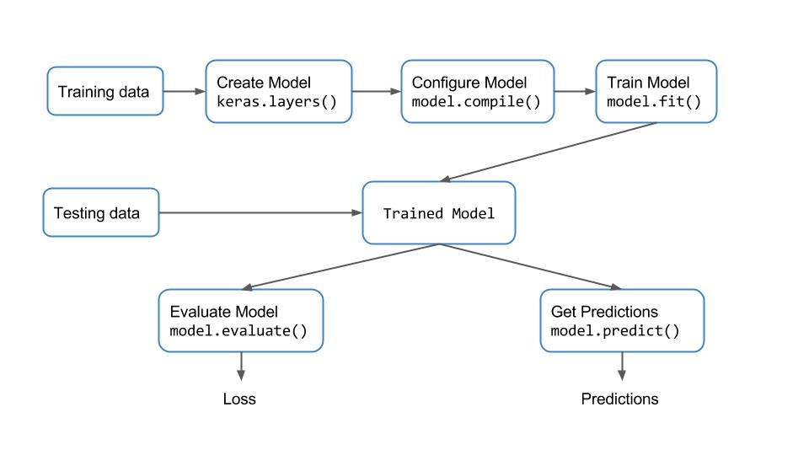

Slide 15
tf.placeholder Inserts a placeholder for a tensor that will be always fed
tf.argmax (Returns the index with the largest value across axes of a tensor)
tf.nn.conv2d (convolutional layer)
tf.nn.max_pool
tf.nn.relu - Relu which is the activation function , Computes rectified linear
create_weights
create_biases
tf.nn.softmax (Computes softmax activations.)

Slide 16
tf.nn.softmax_cross_entropy_with_logits - Computes softmax cross entropy between logits and labels
Measures the probability error in discrete classification tasks in which the classes are mutually exclusive (each entry is in exactly one class). For example, each CIFAR-10 image is labeled with one and only one label: an image can be a dog or a truck, but not both.

Slide 17
tf.train.AdamOptimizer
Optimizer that implements the Adam algorithm

Slide 18
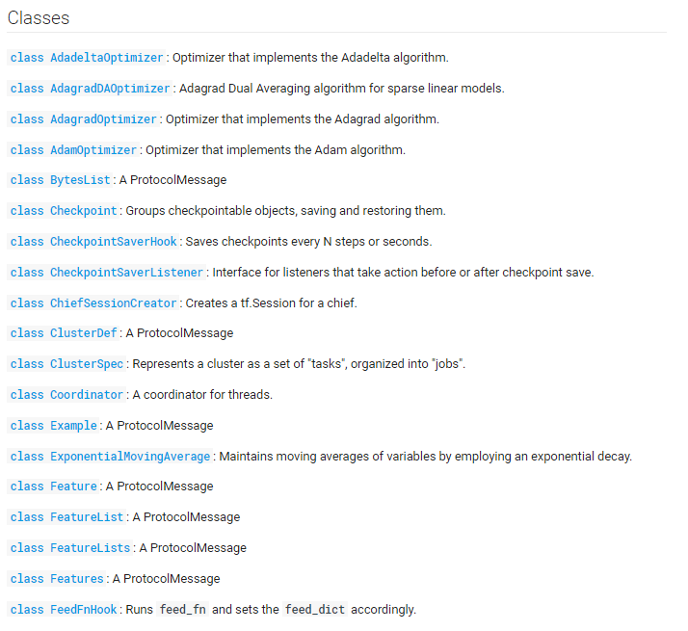

Slide 19
What is TensorBoard
Tensorboard is the interface used to visualize the graph and other tools to understand, debug, and optimize the model.

Slide 20
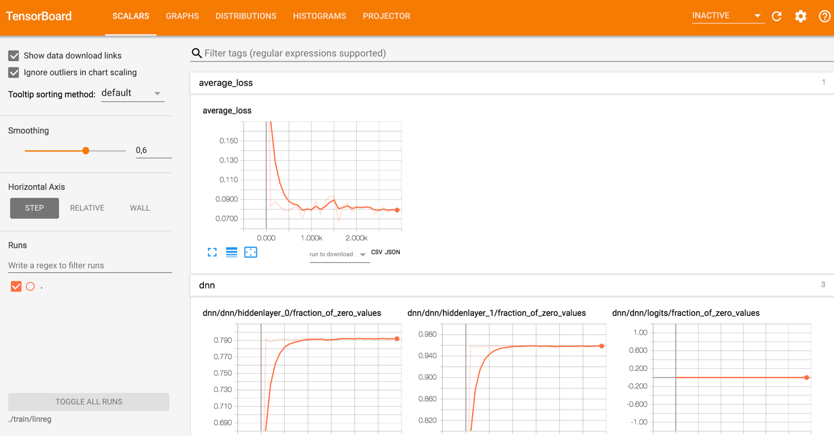

Slide 21
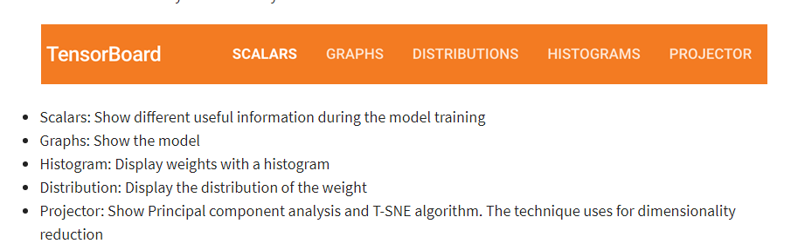

Slide 22
A neural network decides how to connect the different "neurons" and how many layers before the model can predict an outcome. Once you have defined the architecture, you not only need to train the model but also a metrics to compute the accuracy of the prediction. This metric is referred to as a loss function. The objective is to minimize the loss function.

Slide 23
In different words, it means the model is making fewer errors. All machine learning algorithms will repeat many times the computations until the loss reach a flatter line. To minimize this loss function, you need to define a learning rate.

Slide 24
It is the speed you want the model to learn. If you set a learning rate too high, the model does not have time to learn anything.

Slide 25
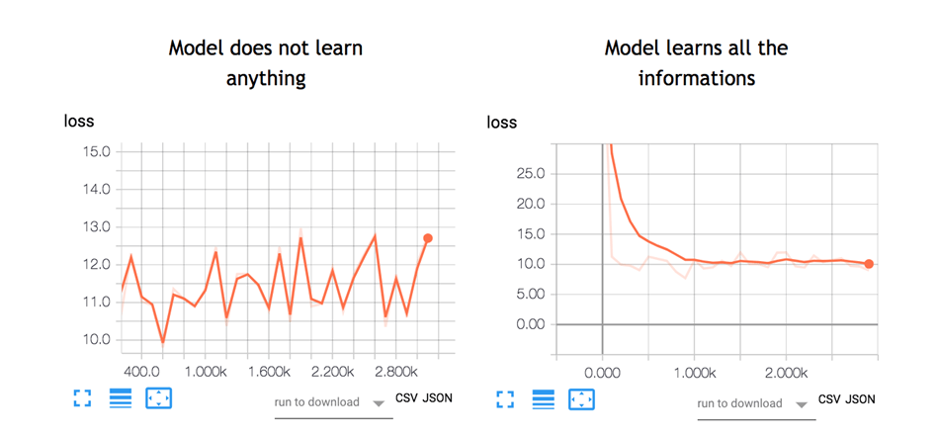

Slide 26
On anaconda prompt
tensorboard --logdir=.\train\linreg
http://localhost:6006

Slide 27
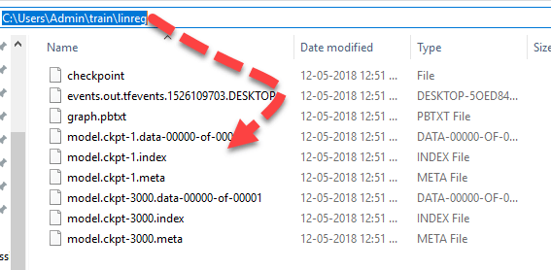

Slide 28
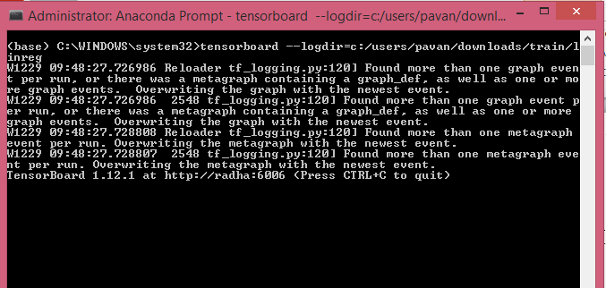
Full path

Slide 29
