Slide 2
A Markov chain is a mathematical system that experiences transitions from one state to another according to certain probabilistic rules.

Slide 3
The defining characteristic of a Markov chain is that no matter how the process arrived at its present state, the possible future states are fixed.
In other words, the probability of transitioning to any particular state is dependent solely on the current state and time elapsed

Slide 4
They arise broadly in statistical and information-theoretical contexts and are widely employed in economics, game theory, queueing (communication) theory,
genetics, and finance

Slide 5
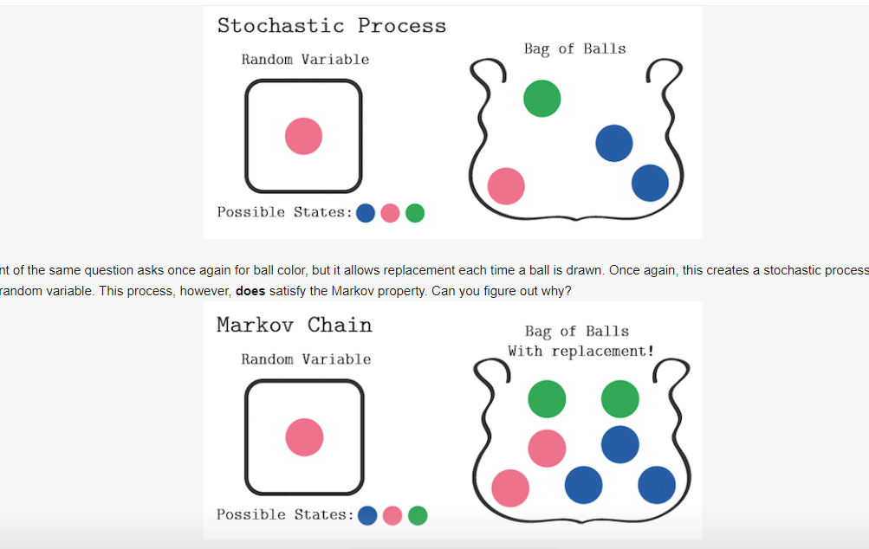

Slide 6
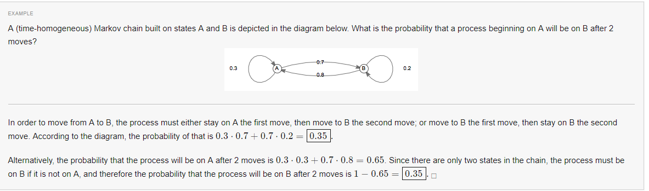

Slide 7
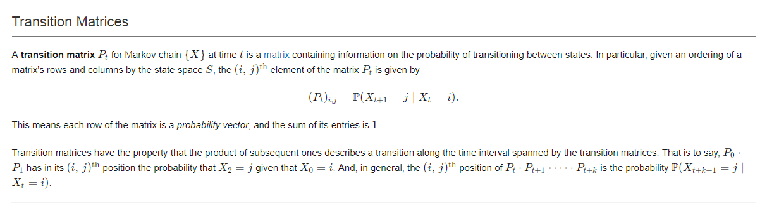

Slide 8
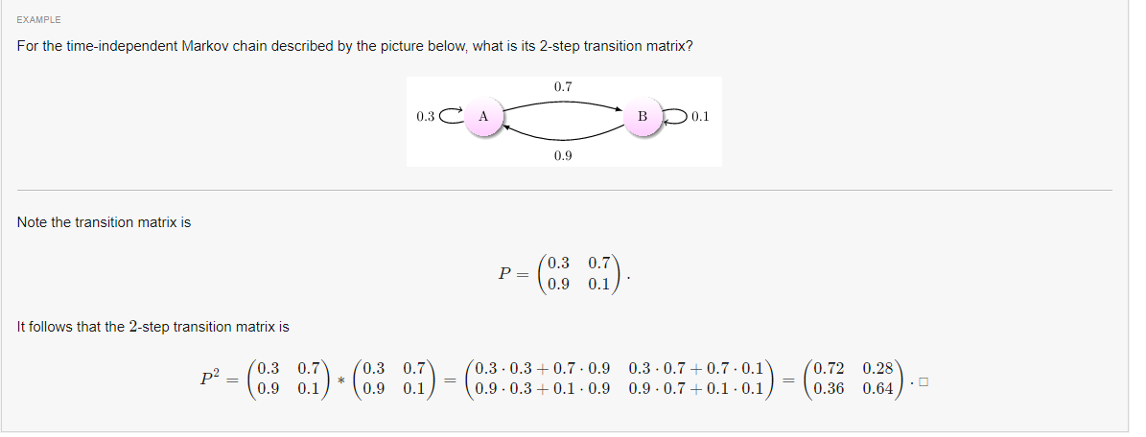

Slide 9
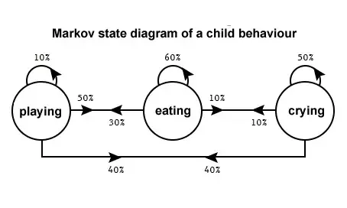

Slide 10
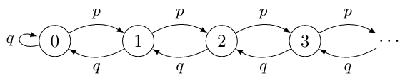
Ergodic Markov Chains
A Markov chain that is aperiodic and positive recurrent is known as ergodic. Ergodic Markov chainsare, in some senses, the processes with the "nicest" behavior.

Slide 11
Discrete Time Markov chain (DTMC).
A discrete-time Markov chain involves a system which is in a certain state at each step, with the state changing randomly between steps.

Slide 12
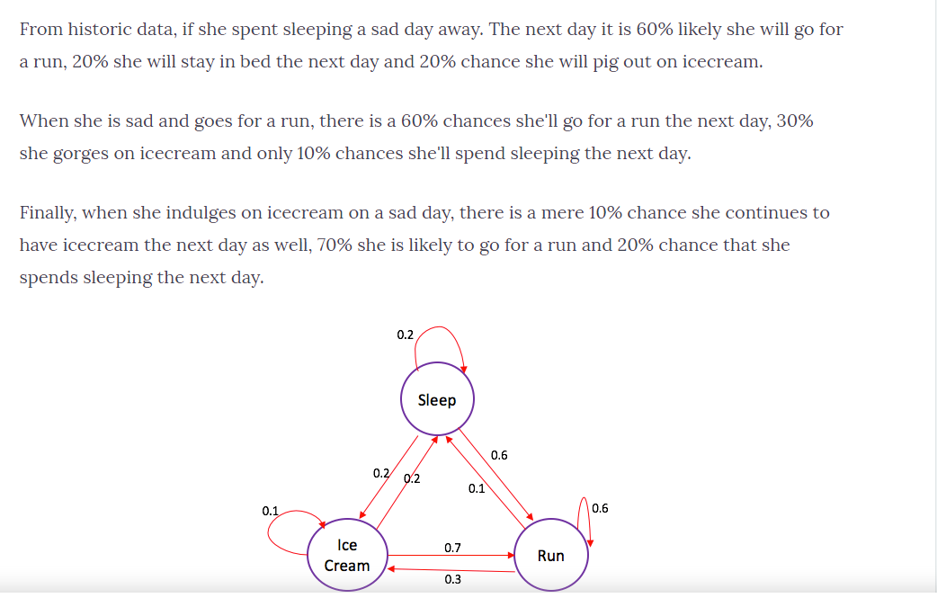

Slide 13
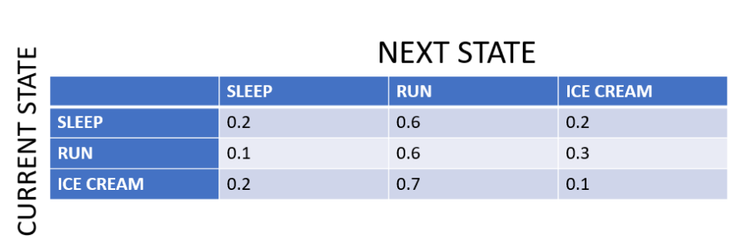

Slide 14
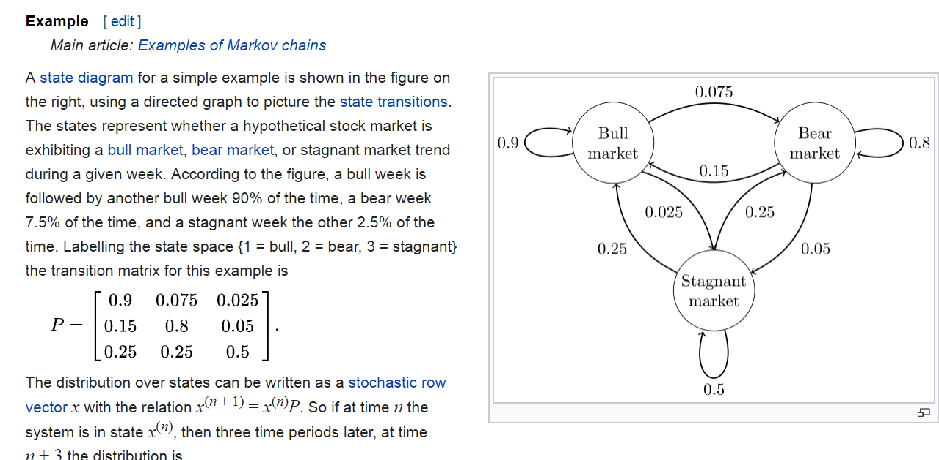

Slide 15
https://www.slideshare.net/gspedicato/long-term-care-insurance-with-markovchain-package

Slide 16
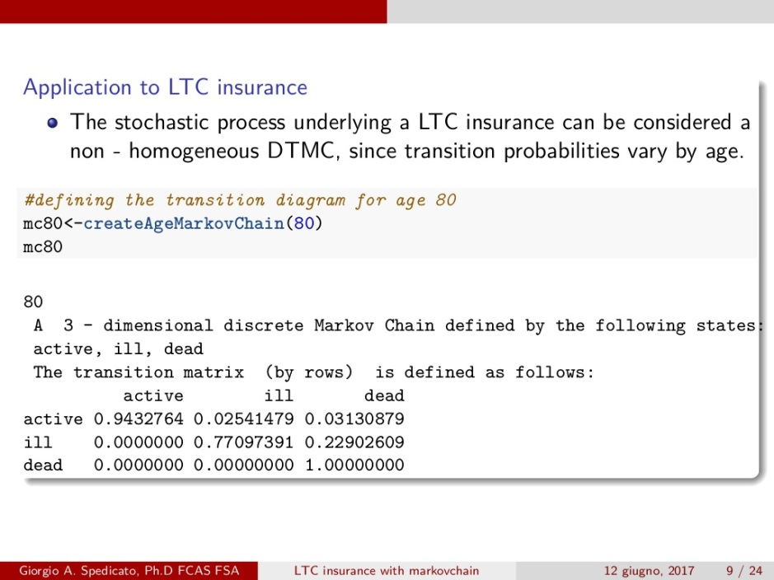

Slide 17
http://web.math.ku.dk/~mogens/lifebook.pdf

Slide 18
Hidden Markov Model (HMM) is a statistical Markov model in which the system being modeled is assumed to be a Markov processwith unobservable (i.e. hidden) states.

Slide 19
The hidden Markov model can be represented as the simplest dynamic Bayesian network. The mathematics behind the HMM were developed by L. E. Baum and coworkers.^{[1][2][3][4][5]} HMM is closely related to earlier work on the optimal nonlinear filtering problem by Ruslan L. Stratonovich,^{[6]} who was the first to describe the forward-backward procedure.

Slide 20
Acturial
Actuarial science is the discipline that applies mathematical and statistical methods to assess risk in insurance, finance and other industries and professions. Actuaries are professionals trained in this discipline. In many countries, actuaries must demonstrate their competence by passing a series of rigorous professional examinations.

Slide 21
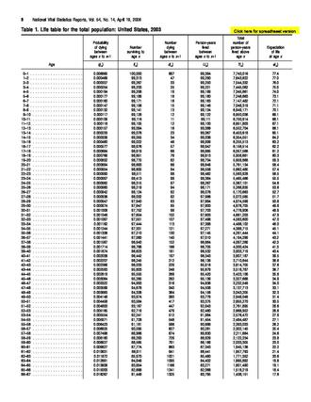

Slide 22
Stochastic refers to a randomly determined process.^{[1]} The word first appeared in English to describe a mathematical object called a stochastic process, but now in mathematics the terms stochastic process and random process are considered interchangeable.^{[2][3][4][5][6]} The word, with its current definition meaning random, came from German, but it originally came from Greek στόχος (stókhos), meaning 'aim, guess'

Slide 23
In artificial intelligence, stochastic programs work by using probabilistic methods to solve problems, as in
simulated annealing,
stochastic neural networks,
stochastic optimization,
genetic algorithms, and
genetic programming.

Slide 24
The name "Monte Carlo" for the stochastic Monte Carlo method
Monte Carlo methods, or Monte Carlo experiments, are a broad class of computational algorithms that rely on repeated random sampling to obtain numerical results. The underlying concept is to use randomness to solve problems that might be deterministic in principle. They are often used in physical and mathematical problems and are most useful when it is difficult or impossible to use other approaches. Monte Carlo methods are mainly used in three problem classes:^{[1]} optimization, numerical integration, and generating draws from a probability distribution.

Slide 25
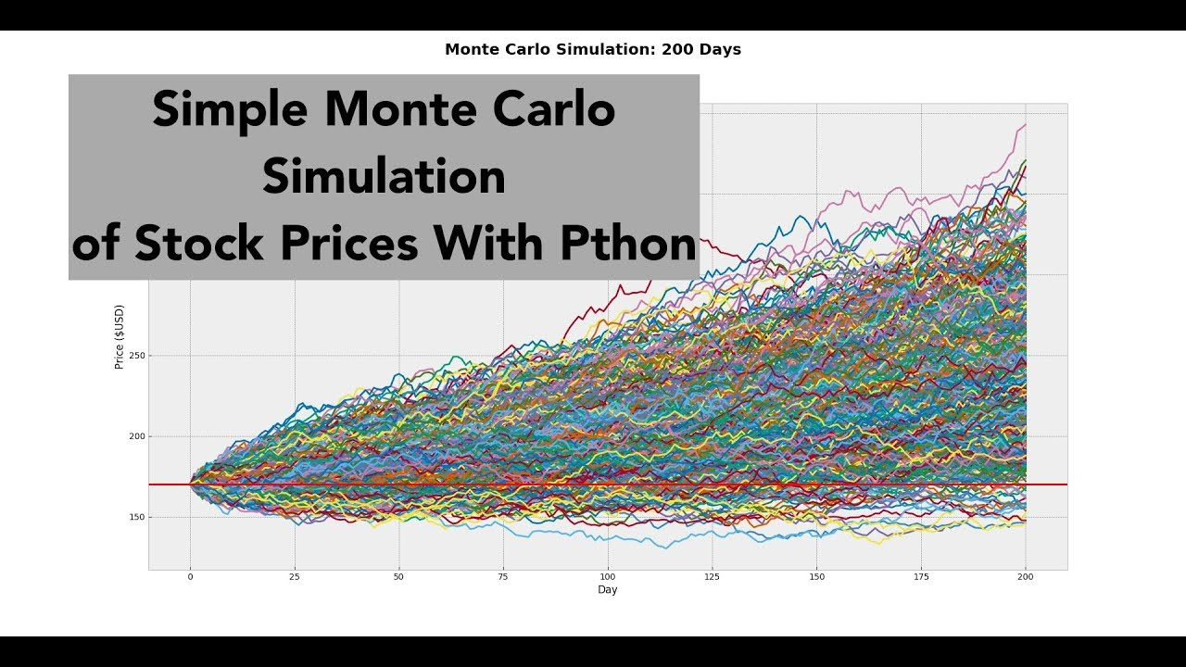

Slide 26
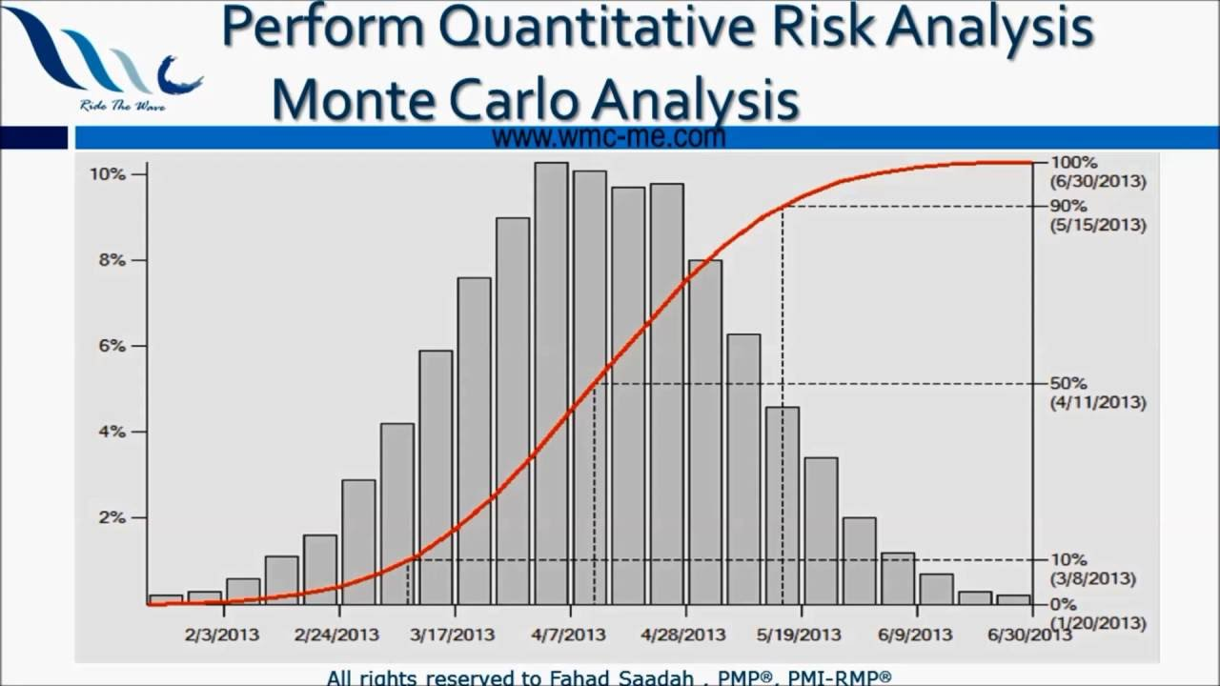

Slide 27
First,
the only certainty is that there is no certainty.
Second, every decision as a consequence is a matter of weighing probabilities.
Third, despite uncertainty we must decide and we must act.
And lastly we need to judge decisions not only on the results, but how those decisions were made. – Robert E. Rubin

