Slide 2
A Markov chain is a mathematical system that experiences transitions from one state to another according to certain probabilistic rules.

Slide 3
The defining characteristic of a Markov chain is that no matter how the process arrived at its present state, the possible future states are fixed.
In other words, the probability of transitioning to any particular state is dependent solely on the current state and time elapsed

Slide 4
They arise broadly in statistical and information-theoretical contexts and are widely employed in economics, game theory, queueing (communication) theory,
genetics, and finance

Slide 5
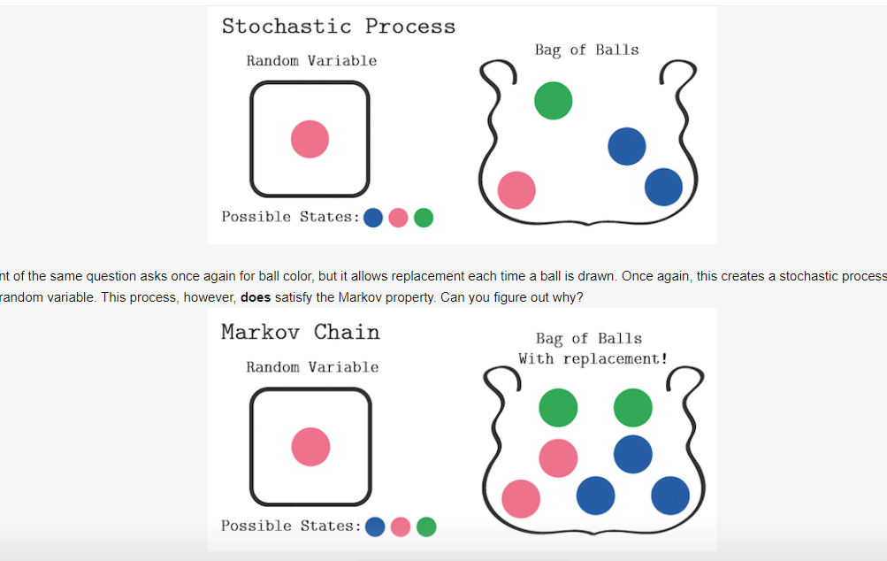

Slide 6
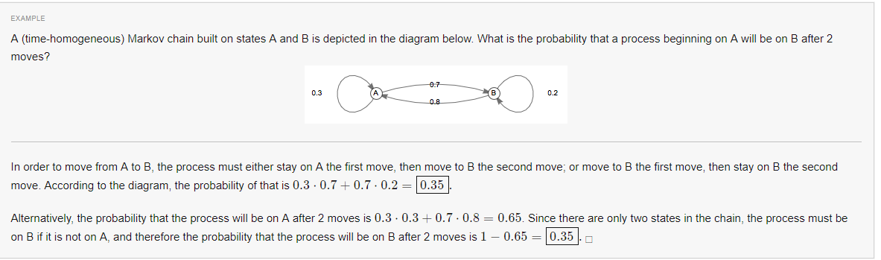

Slide 7
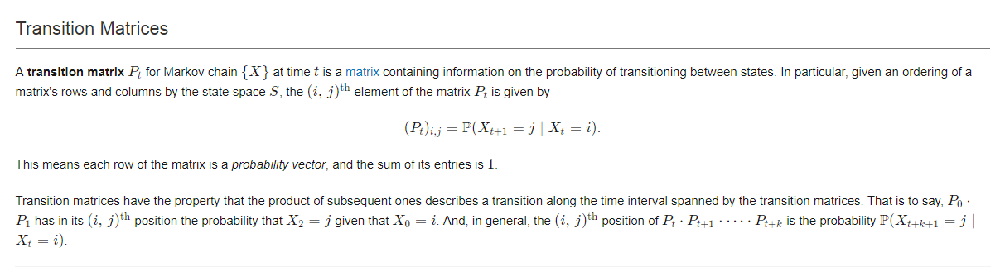

Slide 8
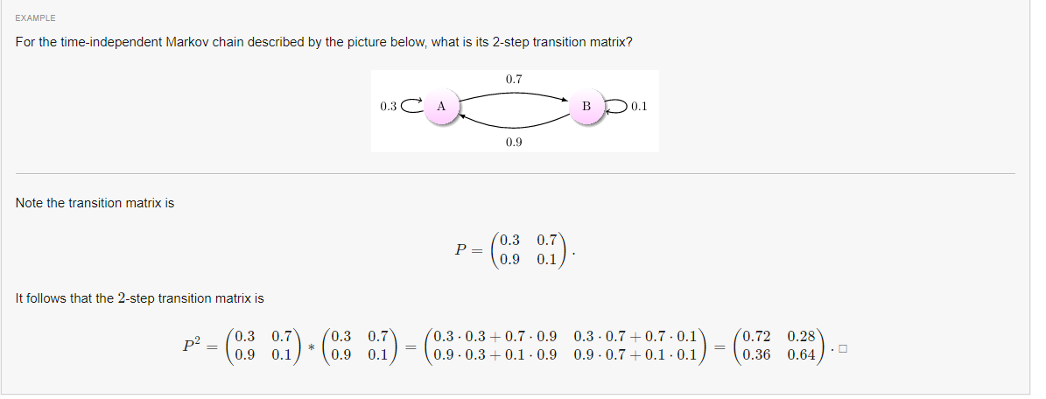

Slide 9
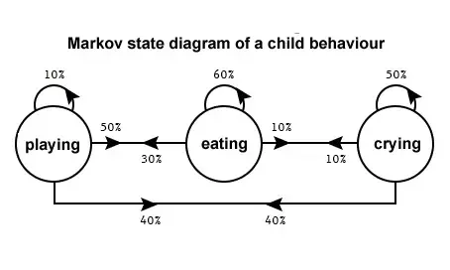

Slide 10
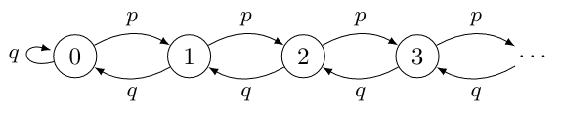
Ergodic Markov Chains
A Markov chain that is aperiodic and positive recurrent is known as ergodic. Ergodic Markov chainsare, in some senses, the processes with the "nicest" behavior.

Slide 11
Discrete Time Markov chain (DTMC).
A discrete-time Markov chain involves a system which is in a certain state at each step, with the state changing randomly between steps.

Slide 12
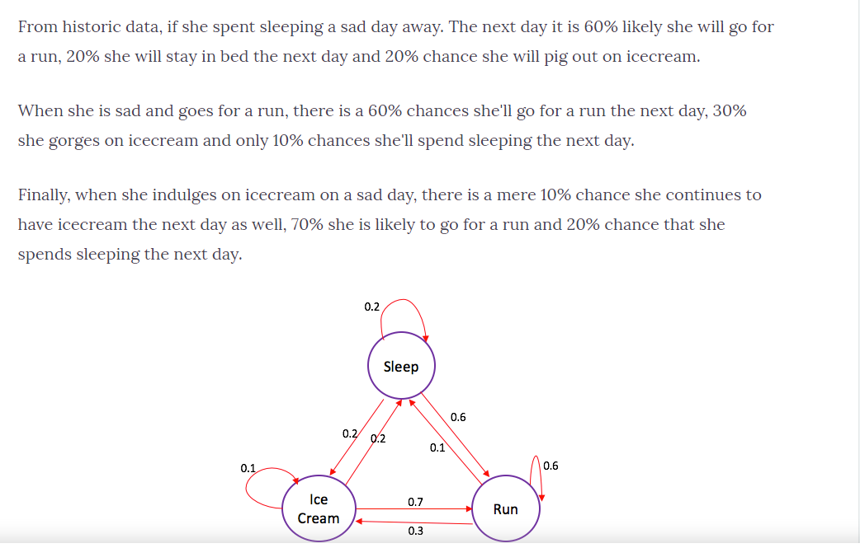

Slide 13
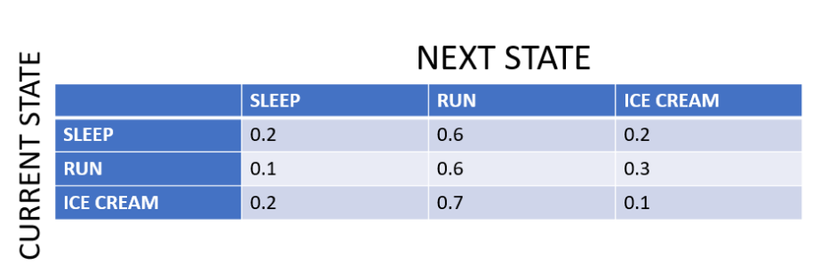

Slide 14
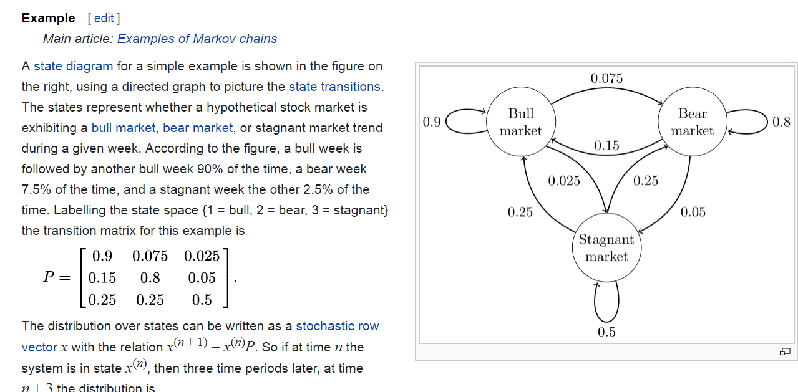

Slide 15
https://www.slideshare.net/gspedicato/long-term-care-insurance-with-markovchain-package

Slide 16
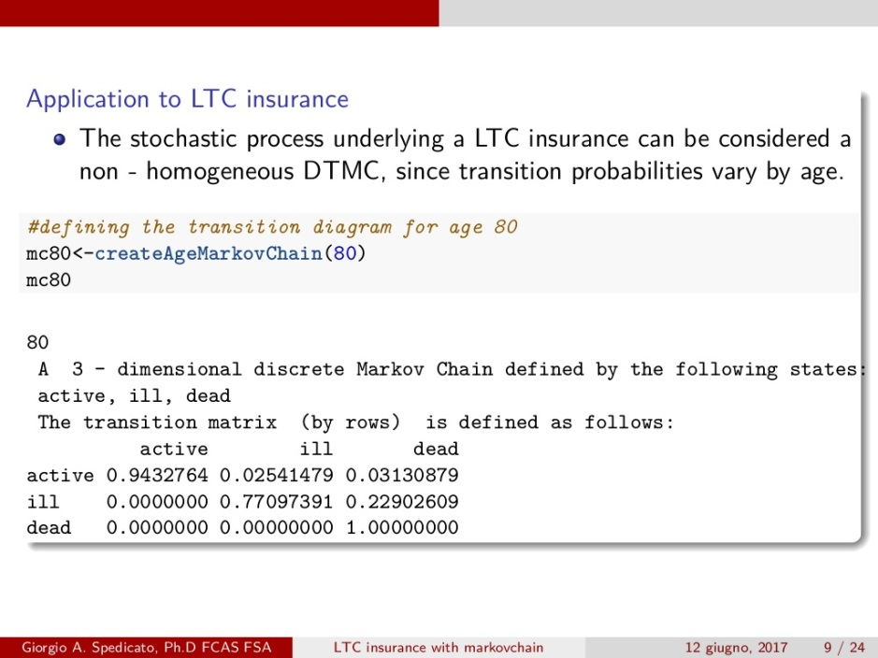

Slide 17
http://web.math.ku.dk/~mogens/lifebook.pdf

Slide 18
Hidden Markov Model (HMM) is a statistical Markov model in which the system being modeled is assumed to be a Markov processwith unobservable (i.e. hidden) states.

Slide 19
The hidden Markov model can be represented as the simplest dynamic Bayesian network. The mathematics behind the HMM were developed by L. E. Baum and coworkers.^{[1][2][3][4][5]} HMM is closely related to earlier work on the optimal nonlinear filtering problem by Ruslan L. Stratonovich,^{[6]} who was the first to describe the forward-backward procedure.

