Slide 1
PLOT

Slide 2
Residuals vs Fitted
Normal Q-Q
Scale-Location
Residuals vs Leverage

Slide 3
Residuals vs Fitted
This plot shows if residuals have non-linear patterns.
There could be a non-linear relationship between predictor variables and an outcome variable and the pattern could show up in this plot if the model doesn’t capture the non-linear relationship.
If you find equally spread residuals around a horizontal line without distinct patterns, that is a good indication you don’t have non-linear relationships.

Slide 4
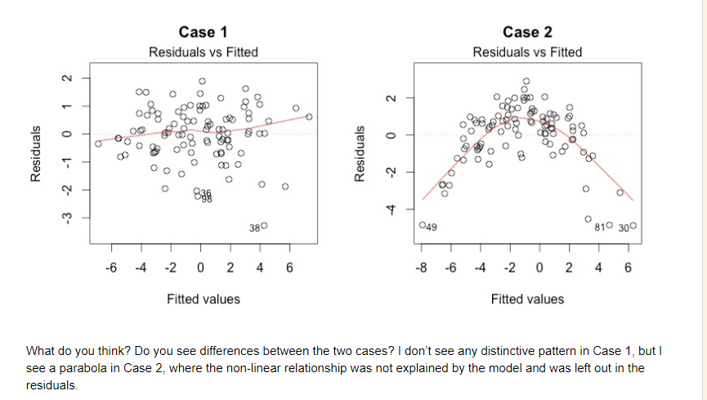

Slide 5
When conducting a residual analysis, a "residuals versus fits plot" is the most frequently created plot.
It is a scatter plot of
residuals on the y axis and
fitted values (estimated responses) on the x axis.
The plot is used to detect non-linearity, unequal error variances, and outliers.

Slide 7
Normal Q-Q
This plot shows if residuals are normally distributed.
Do residuals follow a straight line well or do they deviate severely?
It’s good if residuals are lined well on the straight dashed line.

Slide 8
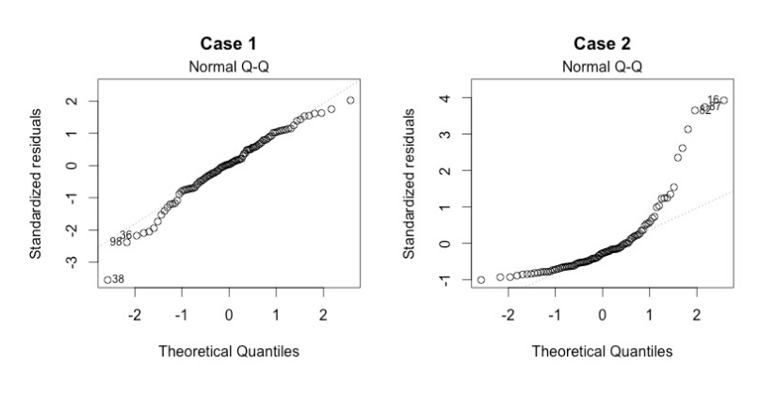

Slide 9
Scale-Location
It’s also called Spread-Location plot.
This plot shows if residuals are spread equally along the ranges of predictors.
This is how you can check the assumption of equal variance (homoscedasticity).
It’s good if you see a horizontal line with equally (randomly) spread points.

Slide 10
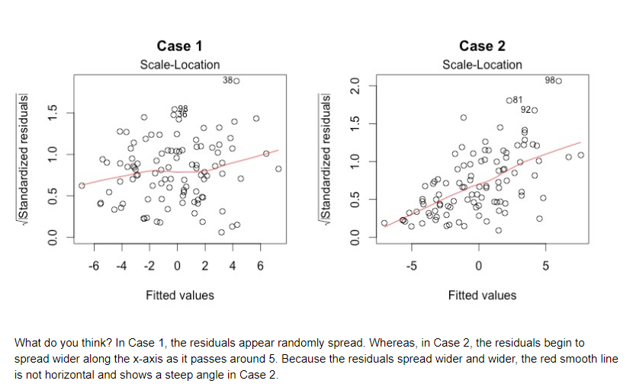

Slide 11
Residuals vs Leverage
This plot helps us to find influential cases (i.e., subjects) if any.
Not all outliers are influential in linear regression analysis (whatever outliers mean).
Even though data have extreme values, they might not be influential to determine a regression line.

Slide 12
When cases are outside of the Cook’s distance (meaning they have high Cook’s distance scores), the cases are influential to the regression results.
The regression results will be altered if we exclude those cases.

Slide 13
