Slide 1

Dividing to Conquer : Clustering Approach to Bank Customer Segmentation
Presented by
Arvind Attur
Deepak Karlekar
Piyush Vyas
Saswat Mishra
Shriyash Sonawane
Guided by
Anay Tamhankar Prasad Deshmukh
230343025049
230343025024
230343025055
230343025042
230343025048

Slide 2
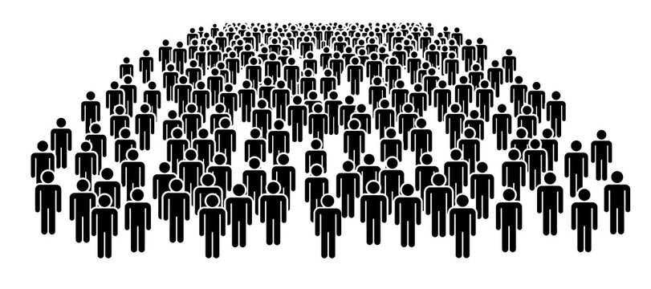
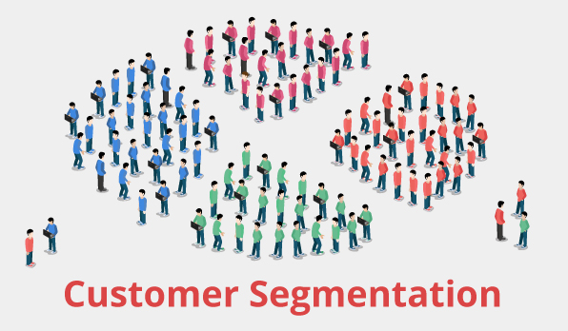
Introduction : It Is the approach of dividing a large and diverse customer base into smaller groups of related customers that are similar in certain ways and relevant to the marketing of a bank’s products and services. Some basic segmentation criteria include geography, income and spending habits.
Notes:
Insert a map of your country.

Slide 3


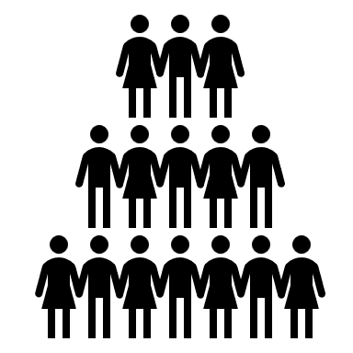


Types of Customer Segmentation :
Geographic
Behavioural
psychographic
Demographic
Location-based, such as from IP address or user-provided address
Age, marital status, sex, education level, occupation, income, religion, and nationality
Lifestyles, personalities, interests, beliefs. Attitudes, and values
Online shopping habits, loyalty, usage frequency, and website actions

Slide 4
Problem statement :
“Dividing to Conquer: Clustering Approach to Bank Customer Segmentation.”
Utilization of machine learning techniques to segment bank customers based on their financial behaviors, enabling the bank to enhance personalized services and strategies.
Notes:
Add key points in the history of your country to the timeline.

Slide 5
DATA ABOUT DATA:
Available on Kaggle.
There are more than 1048568 observations and 9 variables.
Data size is 67.56 MB.
Content - This dataset consists of 1 Million+ transaction by over 800K customers for a bank in India. The data contains information such as - customer age (DOB), location, gender, account balance at the time of the transaction, transaction details, transaction amount, etc.
Notes:
Insert a picture of an animal and or plant found in your country.

Slide 6
TECHNOLOGIES USED:
Python
Machine Learning
Pyspark
Tableau

Slide 7
System Architecture :
Pre –Processing using pyspark
(cleaning the missing values, selecting important features)
Machine Learning
K means clustering
Bisecting kmean clustering
Raw data
Visualisation
Notes:
Insert a picture illustrating a custom or tradition here.

Slide 8
Data Pre-Processing :
1) Cleaning the columns according to requirement
2) Converting target columns into binary values
2)Addition of new columns derived from existing columns.
3) Dropping missing values
3) Dropping missing values
4) Encoding of Categorical Columns
4) Data Balancing and Scaling
5) Data Balancing and Scaling
5) Encoding of Categorical Columns
6) Vector Assembling
6) Vector Assembling
Notes:
Insert a picture of the head leader of your country.

Slide 9
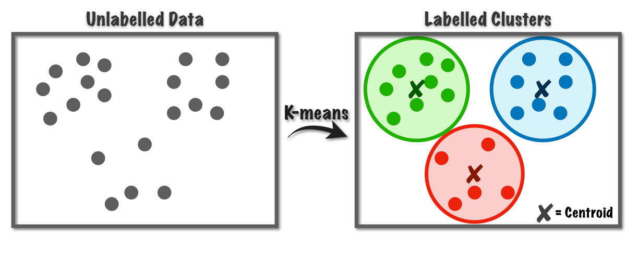
Elements Of Project :
K means Clustering –
K-Means is an unsupervised clustering algorithm that groups data points into 'k' clusters based on similarity.
K-Means is efficient, easy to understand, and works well on large datasets. It is suitable for data with clear separation between clusters.
Notes:
Insert a picture that illustrates some part of your country’s economy.

Slide 10
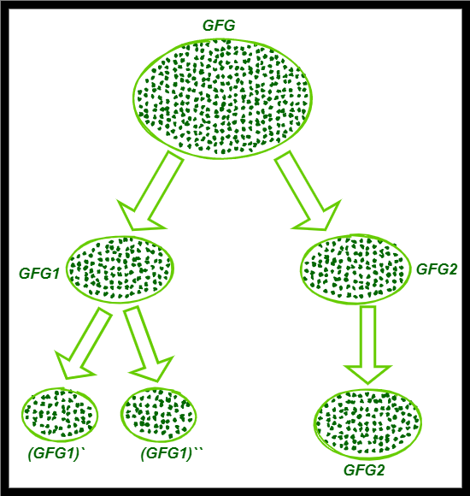
2) Bisecting Means Clustering –
Bisecting Means Clustering builds a tree-like structure of clusters, by iteratively merging or dividing clusters based on similarity.
It is similar to Hierarchical Clustering available in sklearn , SciPy libraries.
It offers a complete hierarchy of clusters, aiding interpretation. It doesn't require specifying the number of clusters in advance.

Slide 11
Output after analysis:
1. Cluster 1: Moderate Balance & Transaction Volume
- Customers in this cluster exhibit a balanced account profile with moderate account balances.
- Transaction history indicates a steady volume of transactions without extreme fluctuations.
- Likely represents a stable customer segment with moderate financial activity.
- Marketing strategies could focus on retention and upselling opportunities.
2. Cluster 2: Low Balance & High Transaction Volume
- Customers in this cluster have the lowest account balances among the segments.
- Transaction history reveals a high number of transactions, possibly indicating frequent purchases or small transactions.
- May consist of cost-conscious or budget-oriented customers.
- Targeted marketing could include promotions, loyalty programs, and product bundles.
3. Cluster 3: High Balance & Low Transaction Volume
- Customers in this cluster maintain the highest account balances within the segmentation.
- Transaction records suggest a lower frequency of transactions, potentially larger-value transactions.
- Likely represents a financially stable segment with a focus on wealth preservation.
- Marketing approaches may include investment opportunities and premium services.
Key Insights:
These clusters highlight distinct customer behaviors and financial preferences, enabling personalized strategies for engagement, retention, and value maximization.

Slide 12
Future Scope :
Advanced Machine Learning Techniques: As machine learning algorithms continue to advance, the use of more sophisticated techniques such as deep learning and ensemble methods could lead to more accurate and nuanced customer segmentation.
Dynamic Segmentation: Real-time customer segmentation that adapts to changing behaviors and preferences will become more crucial. Segmentation models that can adjust and update based on new data will offer more timely insights.
Predictive Segmentation: Combining customer segmentation with predictive analytics can enable businesses to anticipate future behaviors and needs of different customer groups, leading to proactive strategies.
Personalization at Scale: The future of segmentation lies in hyper-personalization. Businesses will leverage AI to tailor offerings to individual customers within segments, delivering highly personalized experiences.
Churn prediction : n the future, the integration of advanced artificial intelligence and machine learning techniques holds the potential to further enhance the accuracy and effectiveness of churn prediction in the banking sector, paving the way for more personalized and proactive customer retention strategies.

Slide 13
Thank you

Slide 14
3)Gaussian Mixture–
is a probabilistic model used for representing a dataset as a mixture of multiple Gaussian (normal) distributions. Each Gaussian distribution represents a cluster in the data
each data point is probabilistically assigned to one of the Gaussian distributions, indicating which cluster it likely belongs to. This probabilistic assignment allows for soft clustering, where a data point can belong to multiple clusters with varying degrees of membership.

