Slide 1
Software design
Database: Xiao xia
Web development: Xiaotian Shao, Xiaotian Li

Slide 2
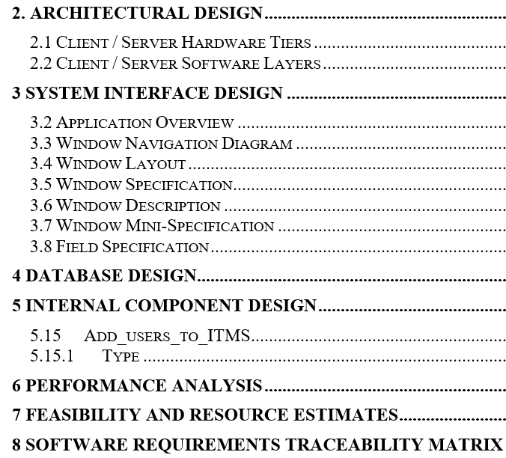
Outline
Architectural design
System interface design
Database design

Slide 3
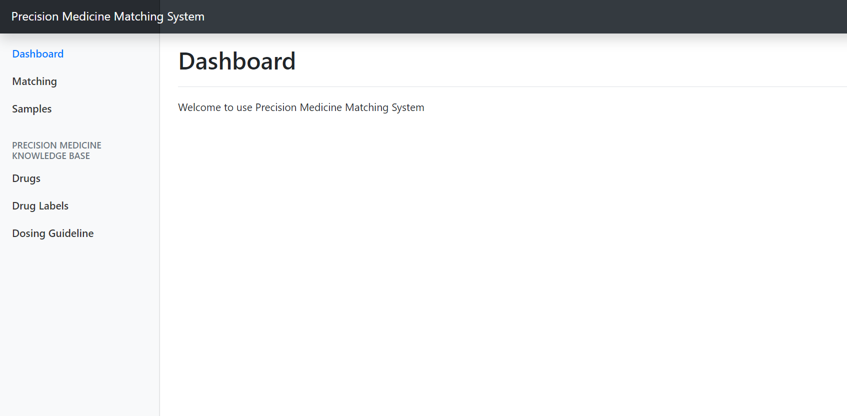
User Interface
Hello, admin
logout
Homepage
Upgrade a visitor to an administrator
You can input his/her username here
submit
Reset password
REQUIRES RIGHTS OF ADMINISTRATOR
Delete data
Upgrade visitor

Slide 4
Functions
For all users:
Reset password
Upload file
View upload history
For administrator only:
Update the database
Upgrade any user to admin
Delete the file along with the history uploaded by users

Slide 5
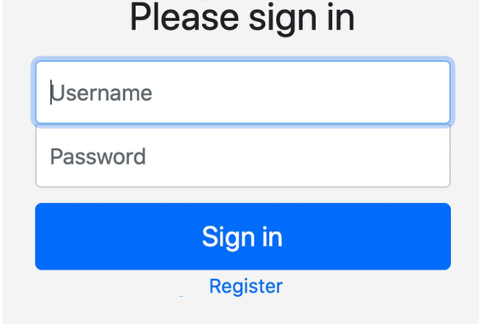
Login surface

Slide 6
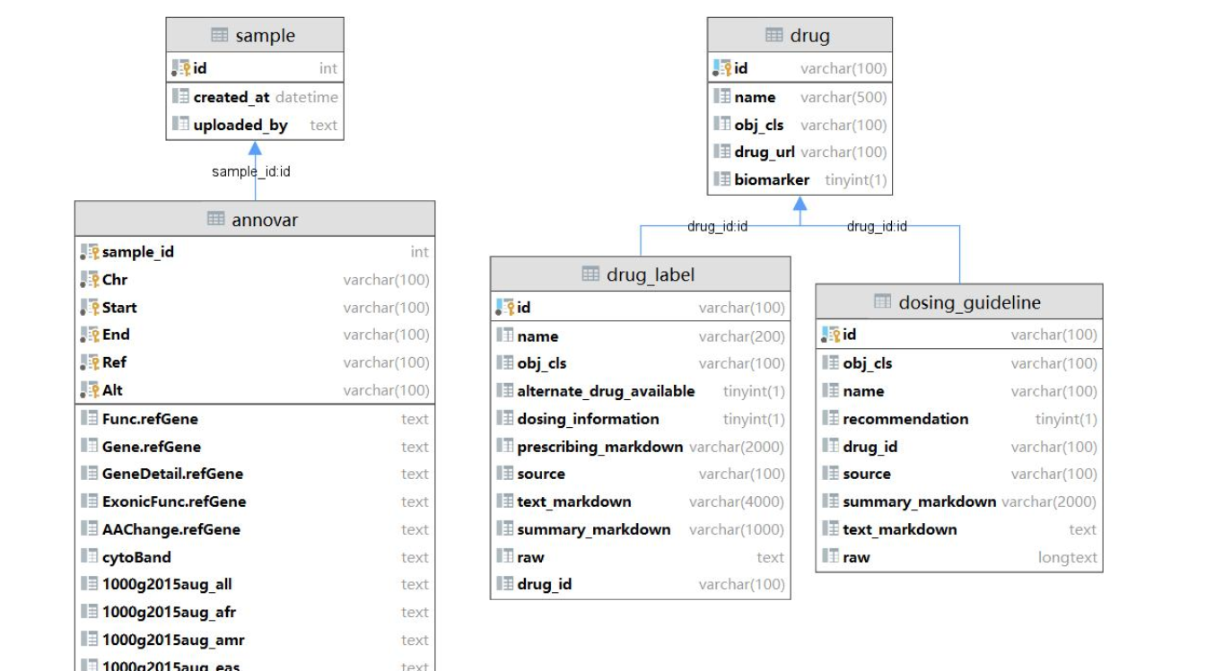
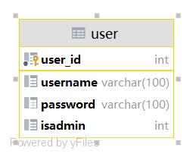

Database
user_id:user_id
···

Slide 7
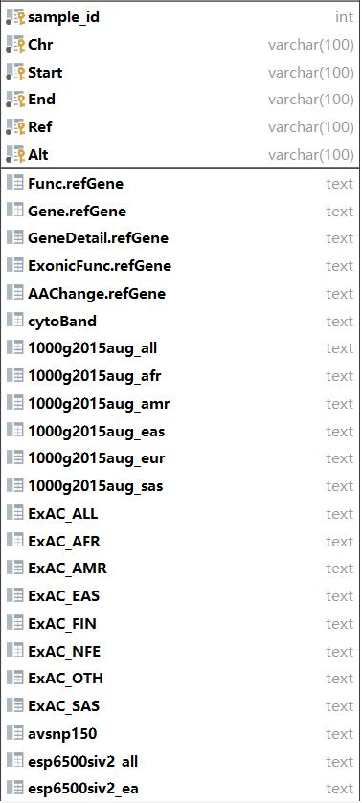
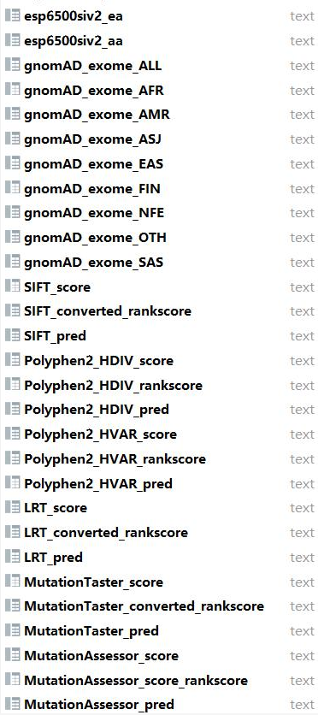
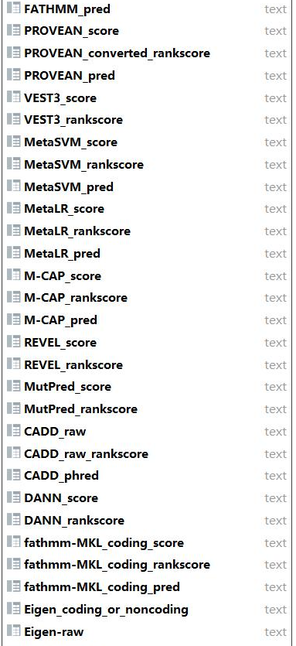
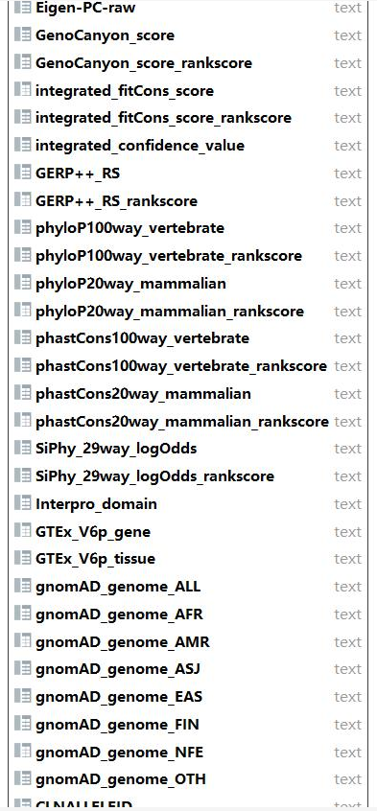

Slide 8
Database
user_id:user_id
···

