Slide 1
Requirement Analysis
Group4:
Ninghui Hao: Document development
Qichen Fu: Sequence analysis
Xia Xiao: Data and database development
Xiaotian Shao: Web service development
Xiaotian Li: Web service development
Zekai Ding: Test development
Notes:
The right to plan the course project
Development cycle
Building a bridge between requirement and software
User control flow and data flow ,how user can control the interaction, how the data be processed
Detailed picture about people
How to implement the functions

Slide 2
Outlines
Introduction
Functional requirements
External interface requirements
Non-functional requirements

Slide 3
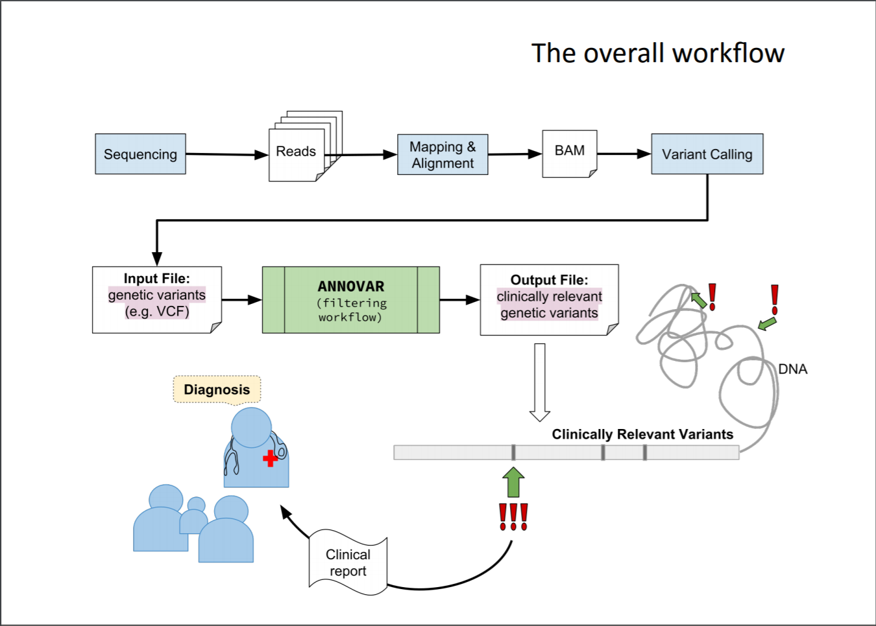

Slide 4
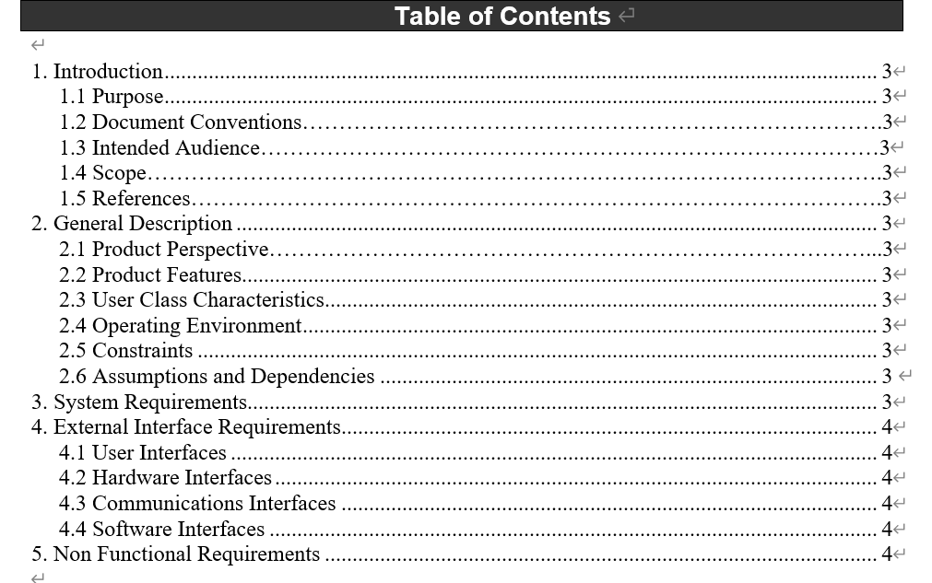
Notes:
User control flow
Test will repeat what the users will do (before analyze what will the uses do)
Working flow of requirement analysis (standard template)
chart from web to show (similar data/use control/system flow)(functionality and how people use it)
Ignore the uses, !!user flow, want do the users want to do using our software
Data section & user section , focus on data and user workflow
What kind of task
Abstract design
Needs for users
Requirement analysis (tables description diagram) → design
Circle chart to show what the users can see and what is software job
Stability, cross platform, availability, security,
Design: shape, appearance, technology
User of system have different roles
Role activity diagram: user control workflow, how different users going to use your system

Slide 5
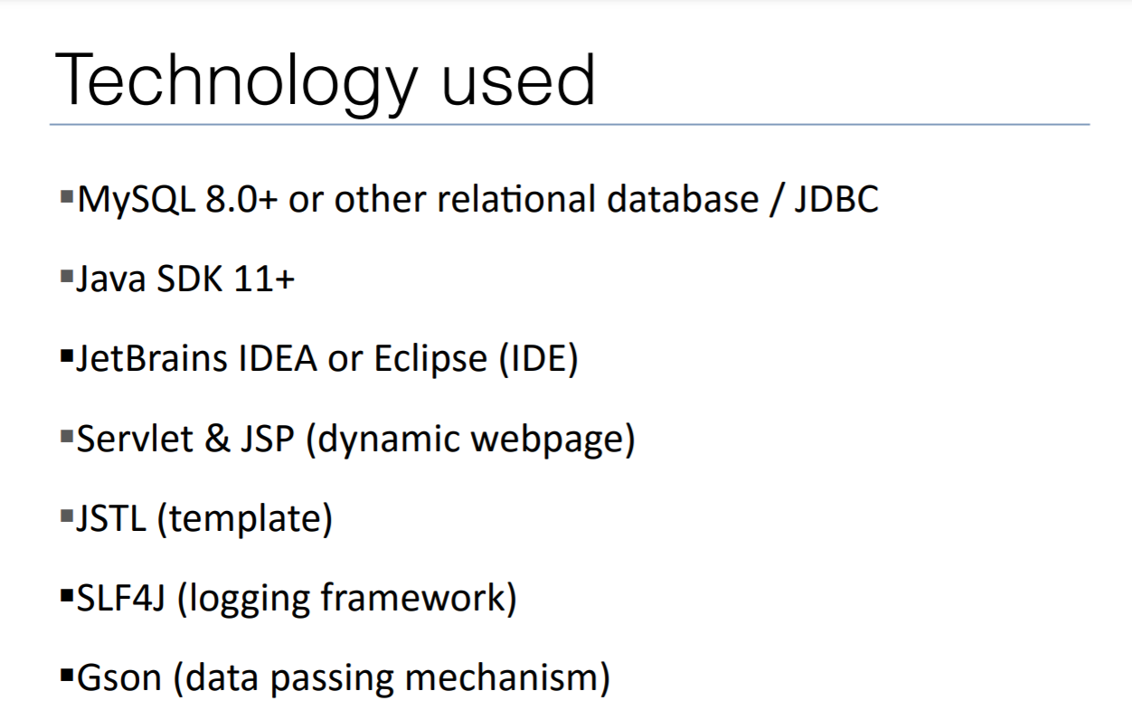

Slide 6
Introduction
Purpose:
a web ideally for clinicians to generate dosing guideline by matching the variances of patients with database through mutated gene names
Resource:
PharmGKB (rearranged)
Notes:
Now let move to the software development . The development model that we are going to use is waterfall.

Slide 7
Functional requirement
Design requirements:
Register and log in
Upload sequencing results (annovar output)
Access to database & match
Show ‘match result’ on the web page
Allow users to download results
Delete upload files by Admin
Update database monthly
Web developer
Tester
Database developer
Notes:
This part is mainly for web developer to implement the web function and tester to test the situations

Slide 8
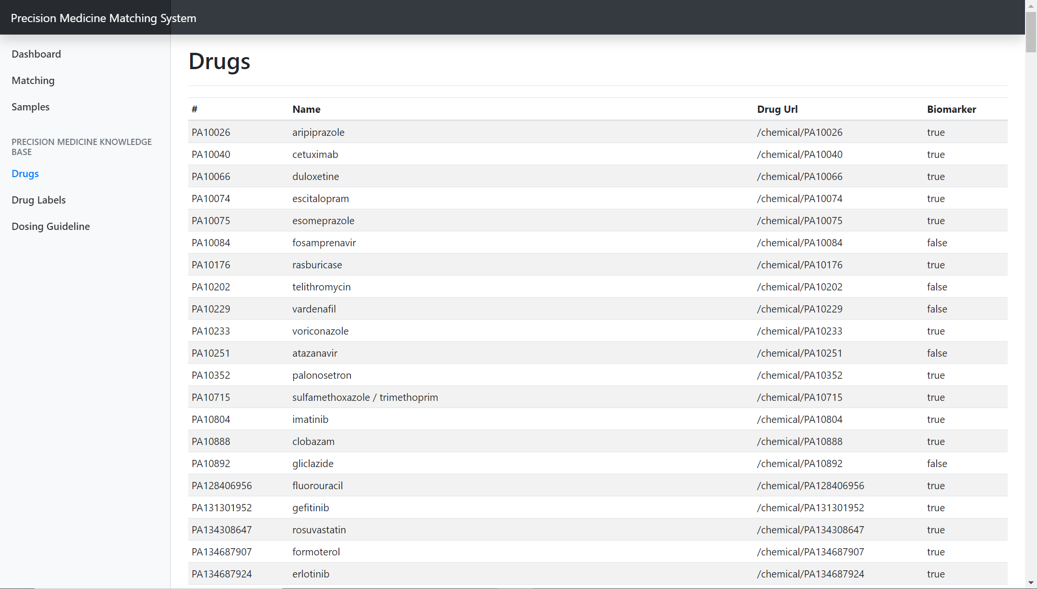
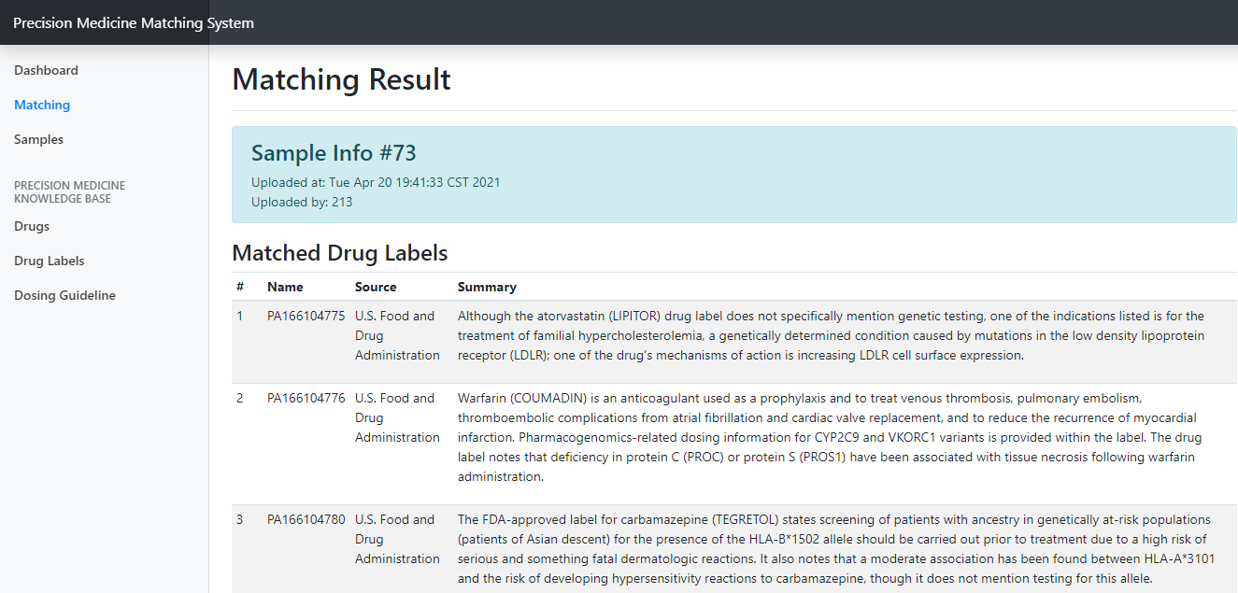
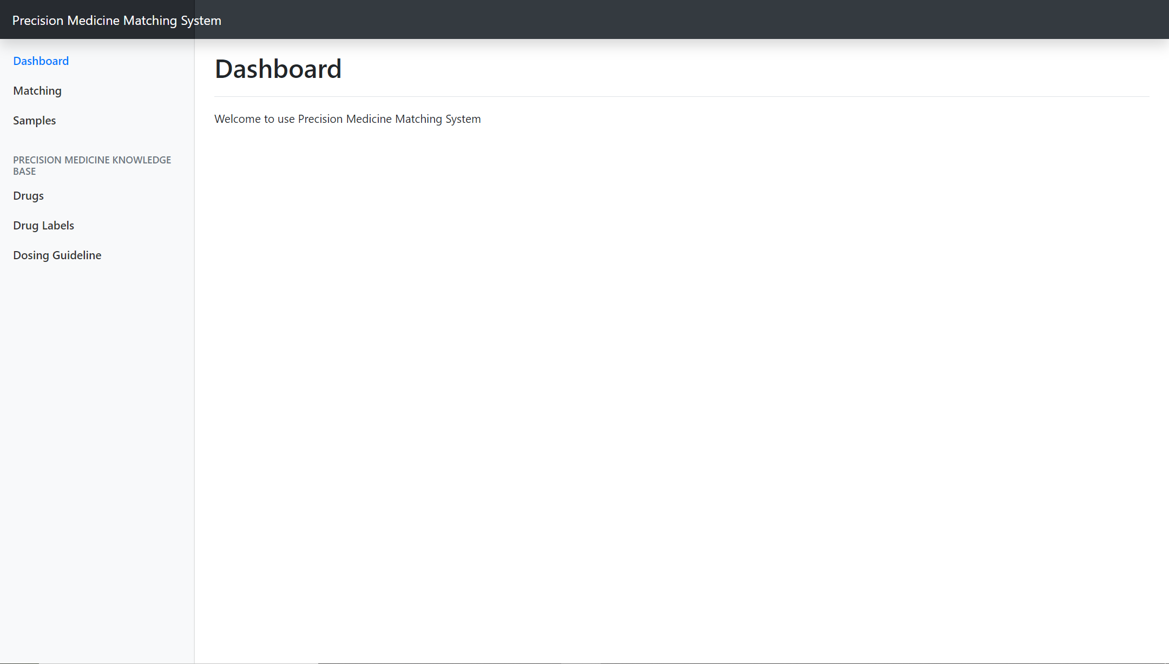
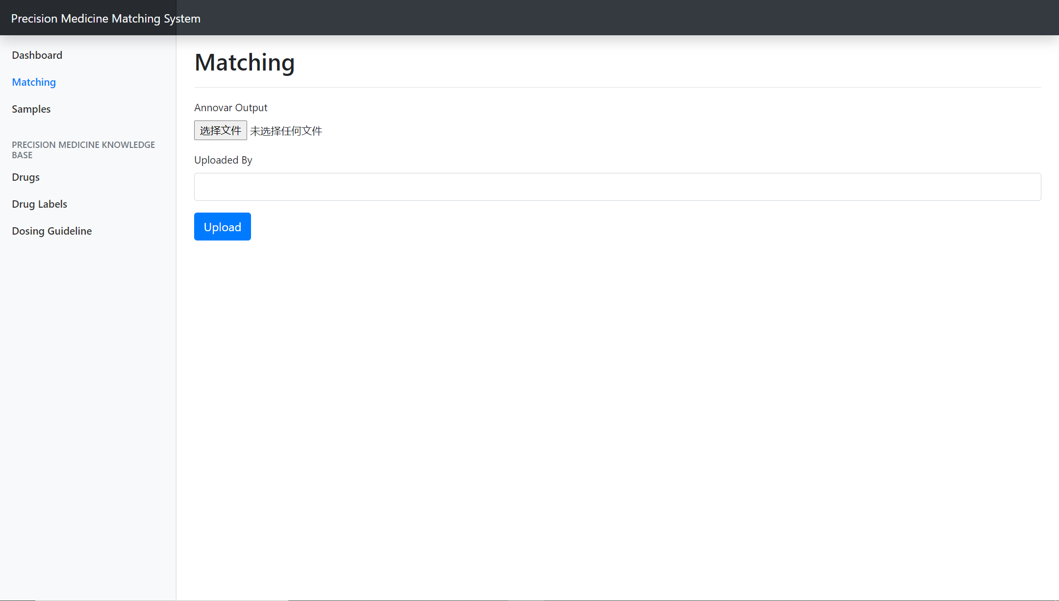
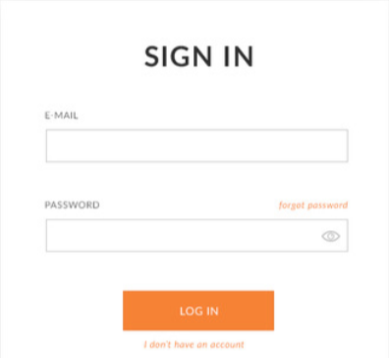
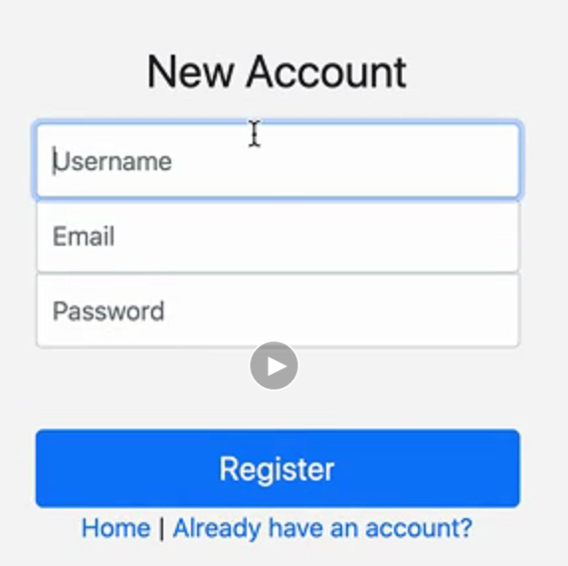
Graphics requirements
By: Carcreshes from Bing

Slide 9
External interface requirements
User interfaces
Users: Log in (register), match(upload), samples(result)
Admin: Samples (+update / delete users input by users’ name)
Notes:
Sidebar
Data and database developer, when generate database, using code rather than manually.

Slide 10
Non-functional requirement
Performance requirements
(Response time, data accuracy)
Safety & security requirements
Users need to log in (via username and passwords)
No way to get access to original data
Future updates
The database will be updated monthly.
test
Notes:
Manually one-click update

Slide 11
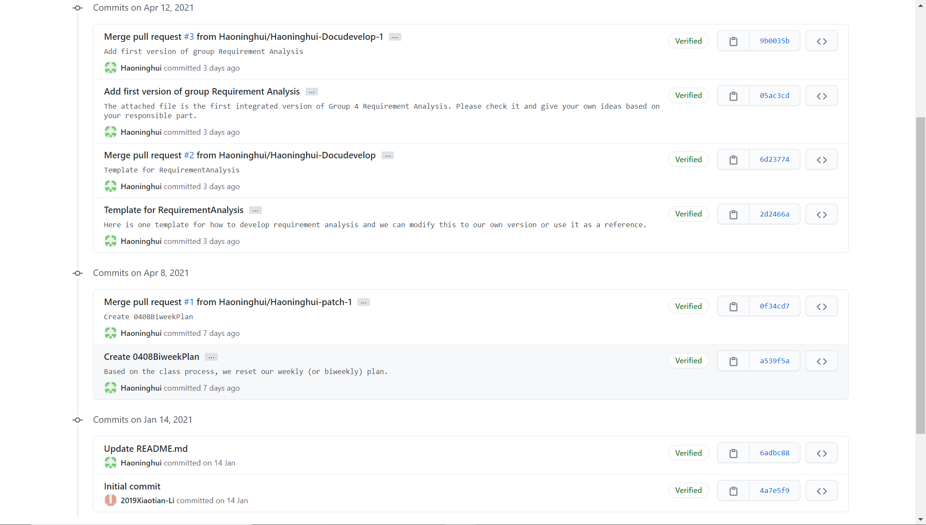
Teamwork

