Slide 1

AWS SBG LAUTECH
Infrastructure
as a Service
(IaaS)
Building, Deploying, and Managing Applications with AWS
Delightsome Asolo

Slide 2

WHOAMI
Delightsome
Asolo
dstixx05@awslautech:~ $ whoami --version
> Cybersecurity student in my finals at FUTA.
> Cloud and DevOps engineer.
> 2X AWS certified.
> Leader, AWS Student Builder Group FUTA.
> My journey: From learning cybersecurity to building with cloud infrastructure.
> My goal is to help more people move from learning cloud concepts to building and deploying real solutions.
_
Delightsome Asolo | AWS SBG LAUTECH
02

Slide 3
WARM-UP
Where are we on our
cloud journey?
LEVEL
3
LEVEL
2
LEVEL
1
I've deployed and managed applications in production.
LEVEL
0
I've built projects using multiple AWS services.
I've used the AWS Console or deployed a simple application.
I've heard about AWS, but I've never used it.
Delightsome Asolo | AWS SBG LAUTECH
03

Slide 4






CLOUD COMPUTING
Cloud computing is renting computing resources on demand.
Instead of purchasing and maintaining all your own computing infrastructure, you can access computing resources over the internet and pay according to the services and resources you use.
01
02
03
04
05
Compute
Storage
Networking
Databases
Security and access management
Delightsome Asolo | AWS SBG LAUTECH
04

Slide 5
01 / CHOOSE YOUR ABSTRACTION
How much of the stack
do you want to manage?
Cloud services differ in how much infrastructure responsibility stays with you.
IaaS
PaaS
SaaS
Infrastructure as a Service
Platform as a Service
Software as a Service
You manage the operating system, runtime, application and much of the configuration.
You focus on your application while the platform handles more of the underlying environment.
You use a finished application. The provider operates the application and its platform.
EC2
Amplify / Elastic Beanstalk
Gmail / Salesforce
More control
More managed by the provider
Delightsome Asolo | AWS SBG LAUTECH
05

Slide 6
02 / RESPONSIBILITY
The layers
of abstraction
As you move toward a managed service, AWS takes on more of the operational work.
LAYER
IaaS · EC2
Managed platform
SaaS
Application
YOU
YOU
PROVIDER
Runtime / dependencies
YOU
MOSTLY PROVIDER
PROVIDER
Operating system
YOU
PROVIDER
PROVIDER
Server / infrastructure
AWS
AWS
PROVIDER
This is a teaching model, not a universal rule. Exact responsibilities depend on the AWS service and configuration.
Delightsome Asolo | AWS SBG LAUTECH
06

Slide 7
03 / INFRASTRUCTURE BUILDING BLOCKS
What would you need to
run this on-premises?
Cloud infrastructure gives you service-based building blocks instead of requiring you to own the physical equipment.
TRADITIONAL DATA CENTRE
AWS BUILDING BLOCKS
COMPUTE
Physical servers
EC2
Virtual servers
STORAGE
Disks and storage arrays
EBS / S3
Block and object storage
→
NETWORK
Switches, routers, IPs
VPC
Virtual networking
SECURITY
Firewalls and access controls
IAM / SGs
Identity and network access controls
OPERATIONS
Power, cooling, monitoring
CloudWatch
Metrics, logs and alarms
Delightsome Asolo | AWS SBG LAUTECH
07

Slide 8
04 / WHY CHOOSE IAAS?
More control comes
with more responsibility
IaaS is useful when the flexibility is worth the operational work.
1
Control the environment
2
Build custom architectures
3
Tune for the workload
Choose the OS, packages, runtime and server configuration.
Configure networking, storage and deployment patterns to fit the workload.
Select instance sizes and optimize resources around performance and cost.
4
Learn the fundamentals
5
Support special requirements
6
Own the trade-offs
Understand what managed services abstract away.
Use OS-level tools or software that a managed platform may not support.
Plan patching, monitoring, availability, access and recovery.
Greater control does not automatically mean lower cost. Compare total effort, reliability and service limits.
Delightsome Asolo | AWS SBG LAUTECH
08

Slide 9
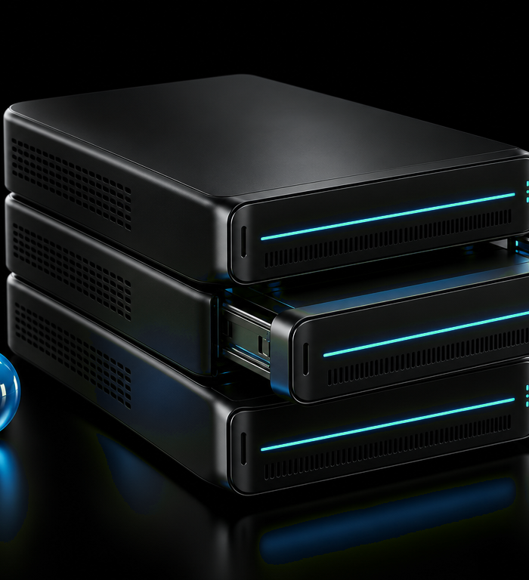

05 / THE WORKSHOP CHALLENGE
One React app.
Two routes to the web.
Watch what you need to configure yourself, and what the managed platform handles for you.
</>
React + Vite app
PATH A · IaaS
PATH B · MANAGED
EC2 + Nginx
Amplify Hosting
01 Provision instance
02 Configure server
03 Upload build
04 Manage updates
01 Connect repository
02 Configure build
03 Deploy
04 Push updates
Your challenge: compare the steps, not just the number of clicks. Ask who owns each responsibility.
Delightsome Asolo | AWS SBG LAUTECH
09

Slide 10
06 / PATH A · IAAS
What happens when
we deploy on EC2?
You get server-level control, so you also configure the path from the internet to your app.
VPC / SUBNET
Route +
Security Group
WEB
EC2
Nginx :80
Browser
Linux instance
/var/www/html
HTML · CSS · JS
Network
Compute
Application
VPC, subnet, route and inbound rules.
EC2 instance, OS and Nginx.
Static build files served to browsers.
Delightsome Asolo | AWS SBG LAUTECH
10

Slide 11
07 / LIVE DEMO · EC2
First, make a page. Then
deploy the React build.
This is the hands-on contrast: editing on the server versus publishing a built application.
1
SSH + nano
2
Build locally
3
Copy with SCP
Connect to the instance and create a simple page:
In the React project, run:
Upload the generated files:
sudo nano
/var/www/html/index.html
npm run build
scp -i key.pem -r dist/*
ec2-user@PUBLIC_IP:
/var/www/html/
Vite creates the dist/ directory.
EC2 serves the compiled HTML, CSS and JavaScript. The browser runs React; Nginx serves the static files.
Before testing: allow HTTP on port 80. Restrict SSH on port 22 to your own IP. Never share your private key.
Delightsome Asolo | AWS SBG LAUTECH
11

Slide 12
08 / PATH B · MANAGED HOSTING
Now let Amplify handle
more of the workflow
For this static React app, Amplify can build and publish from a connected Git repository.
01
02
03
04
05
Push code
Connect repo
Build
Publish
Update
Commit the app to GitHub.
Choose the repository and branch.
Amplify runs the configured build.
A hosted URL is created.
Push a change to trigger redeployment.
TYPICAL VITE SETTINGS
build command npm run build
output directory dist
Managed hosting reduces server administration, but your code, build settings, access and application design still matter.
Delightsome Asolo | AWS SBG LAUTECH
12

Slide 13
09 / COMPARE THE EXPERIENCE
What changed, and
what stayed the same?
The application is the same. The operational responsibilities shift.
RESPONSIBILITY | EC2 + NGINX | AMPLIFY HOSTING
Server setup | Install and configure Nginx | Hosting server is managed
Build | Run build locally | Build runs from connected repository
Publish updates | Copy files again | Push a commit to redeploy
OS-level control | Direct access to EC2 | No direct server administration
Operations | Patching, access, monitoring | Less server work; app still needs care
Managed does not mean responsibility-free. It means the boundary of responsibility has moved.
Delightsome Asolo | AWS SBG LAUTECH
13

Slide 14

10 / STORAGE DEMO
Think of EBS as a
cloud pen drive
The data lives on an EBS volume, separately from the EC2 instance using it.
EBS
EC2
Persistent volume
EC2
Instance A
Instance B
demo.txt lives here
UNMOUNT → DETACH → ATTACH
1
Write
2
Move
3
Read
Create a file on Instance A.
Unmount before detaching.
Mount on B. Do not format again.
Delightsome Asolo | AWS SBG LAUTECH
14

Slide 15

11 / BEYOND SERVERS
What if you don't want to
manage a server at all?
AWS Lambda runs code in response to events. You focus on the function and its permissions.
01
02
03
04
05
EVENT
TRIGGER
FUNCTION
ACTION
RESULT
HTTP request
API Gateway
AWS Lambda
Run code
Response
No server to administer
Event-driven
Not the same as EC2
AWS manages the underlying execution environment.
Functions can respond to HTTP, schedules, and service events.
You trade server control for an event-driven execution model.
Delightsome Asolo | AWS SBG LAUTECH
15

Slide 16
12 / TAKEAWAYS
Choose the right level
of abstraction
Before choosing a service, ask what your application actually needs.
01
02
03
IaaS
Managed hosting
Lambda
More control over the server and environment.
Less server administration and a simpler publishing workflow.
Run code in response to events without managing a server.
What do I need to manage, and what should I let AWS manage for me?
?
Delightsome Asolo | AWS SBG LAUTECH
16

Slide 17

LET'S CONNECT
Thank
you.
Let's connect
@Dstixx05
linktr.ee/delightsomeasolo
Delightsome Asolo | AWS SBG LAUTECH
17

