Slide 1





Slide 2
Step function VS Lambda function
Lambda is a compute service that lets you run code without provisioning or managing servers.
Step Functions allows coordination of multiple AWS services into serverless workflows.

Slide 3
What is Step Function?
Orchestrate multiple AWS services to accomplish tasks.
Create steps in a process where the output of one step becomes the input for another step, all using a visual workflow editor.
Convenient functionality: automatic retry handling, triggering and tracking for each workflow step
Logs the state of each step, so when things go wrong, you can diagnose and debug problems quickly.

Slide 4
Why Step Function
Step Functions is based on the concepts of tasks and state machines.
Use serverless workflows
Define workflows in JSON
Monitor from console, CLI and API
Run each step-in sequence
Retry failures
Catch exceptions

Slide 5
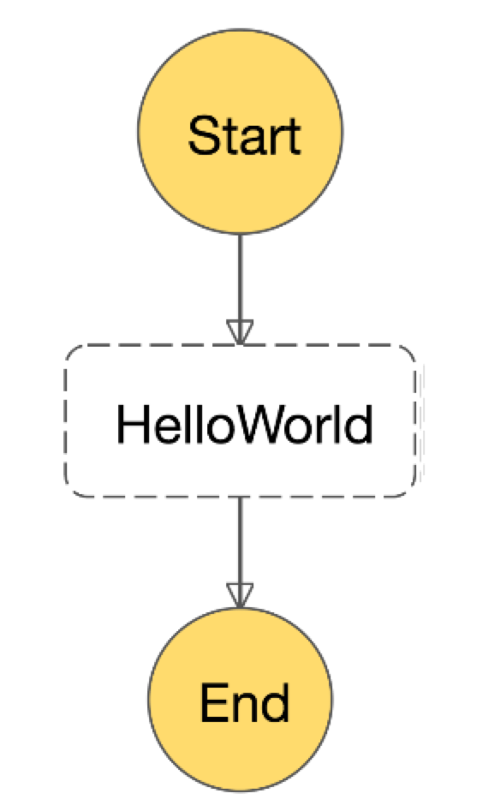
{
"Comment": "Hello World Example", "StartAt" : "HelloWorld",
"States" : {
"HelloWorld" : {
"Type" : "Task",
"Resource" : "${lambdaArn}",
"End" : true
}
}
}

Slide 6
Standard Vs Express
Standard Workflows are ideal for long-running
Run up to one year
Ideal for DevOps, ETL etc
Express Workflows are ideal for high-volume, event-processing workloads
Run up to 5 minutes
Ideal for IoT, streaming data processing etc

Slide 7
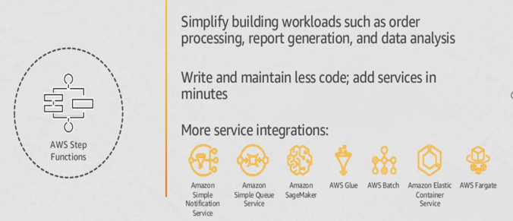
Integrate with other AWS services

Slide 8
Seven State Types
Task | A single unit of work
Choice | Adds branching logic
Parallel | Fork and join the data across tasks
Wait | Delay for a specified time
Fail | Stops an execution and marks it as a failure
Succeed | Stops an execution successfully
Pass Map | Passes its input to its output steps for each element of an input array

Slide 9
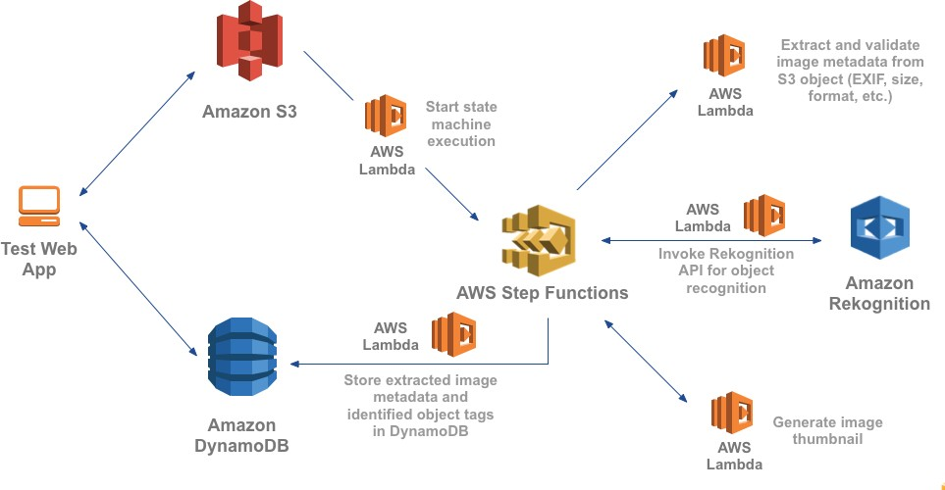
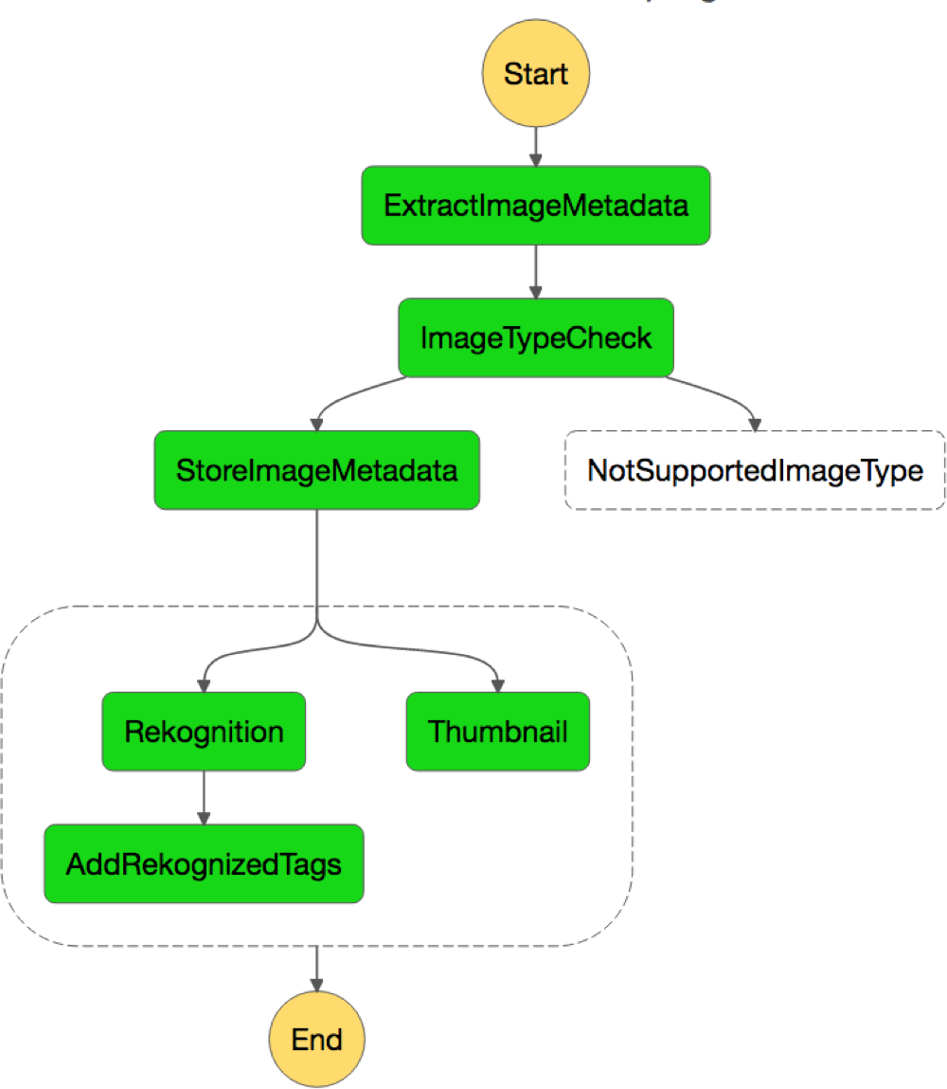
Image Recognition and Processing Backend
Task
Choice
Fail Parallel

Slide 10












Amazon EBS Snapshot Management
State Machines
create-snapshot
complete event
copy-snapshot
complete event
invoked by Amazon CloudWatch Events
Whenever a new EBS snapshot completes:
Tag Snapshot
Tag SnapshotCopy
Count Snapshots
Count Snapshots
Tag
Count
Copy to DR region
Delete Expired
Errors Sent
to SNS
Errors Sent to SNS
Choice
Notification
Topic
Choice
Notification
Topic
CopyToDRRegion
Success
State
Delete
Snapshots
Delete
Snapshots
Parallel State
Pass State
State Machine
State Machine
Primary Region
DR Region

Slide 11
Demo

Slide 12
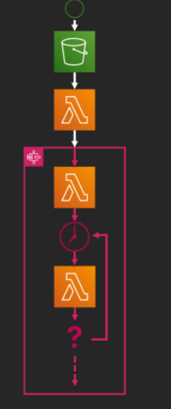
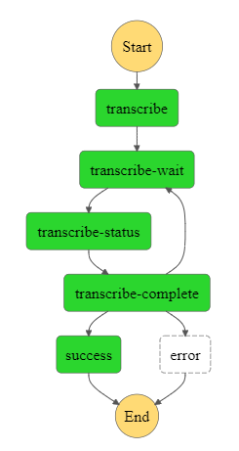
Manage a Long-Running Process

Slide 13
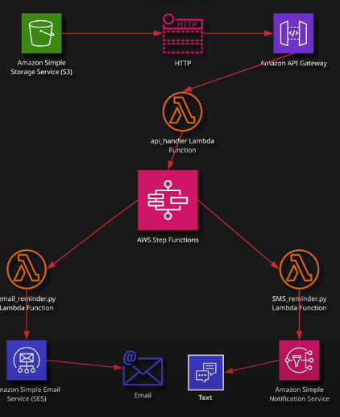
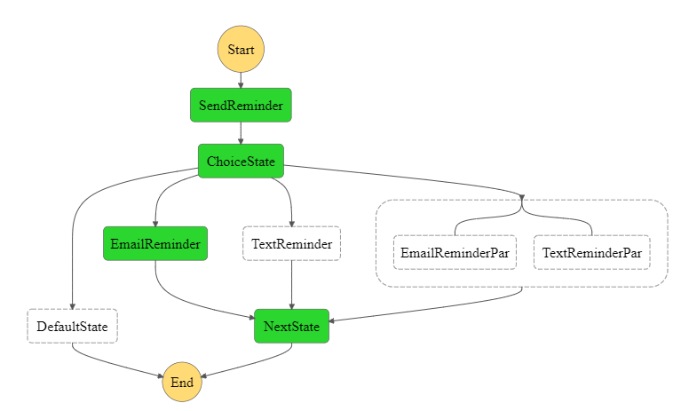
Serverless Reminder on AWS with Step Functions, API Gateway, Lambda, and S3

