Slide 1
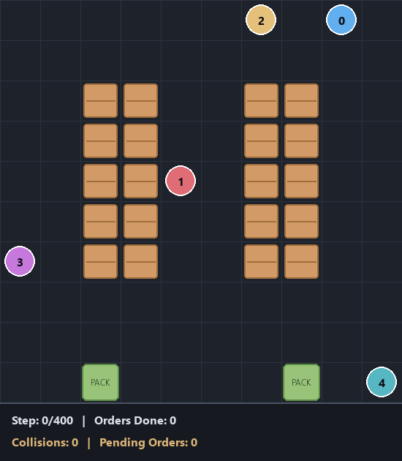
Multi-Agent Reinforcement Learning for Autonomous Warehouse Robot Fleet Optimization
Empirical Benchmark of Baseline, IPPO, MAPPO, and Hierarchical Policy Dispatch
Presented by: Dhruv Vidwans | Autonomous Fleet Coordination & Multi-Agent Systems

Slide 2
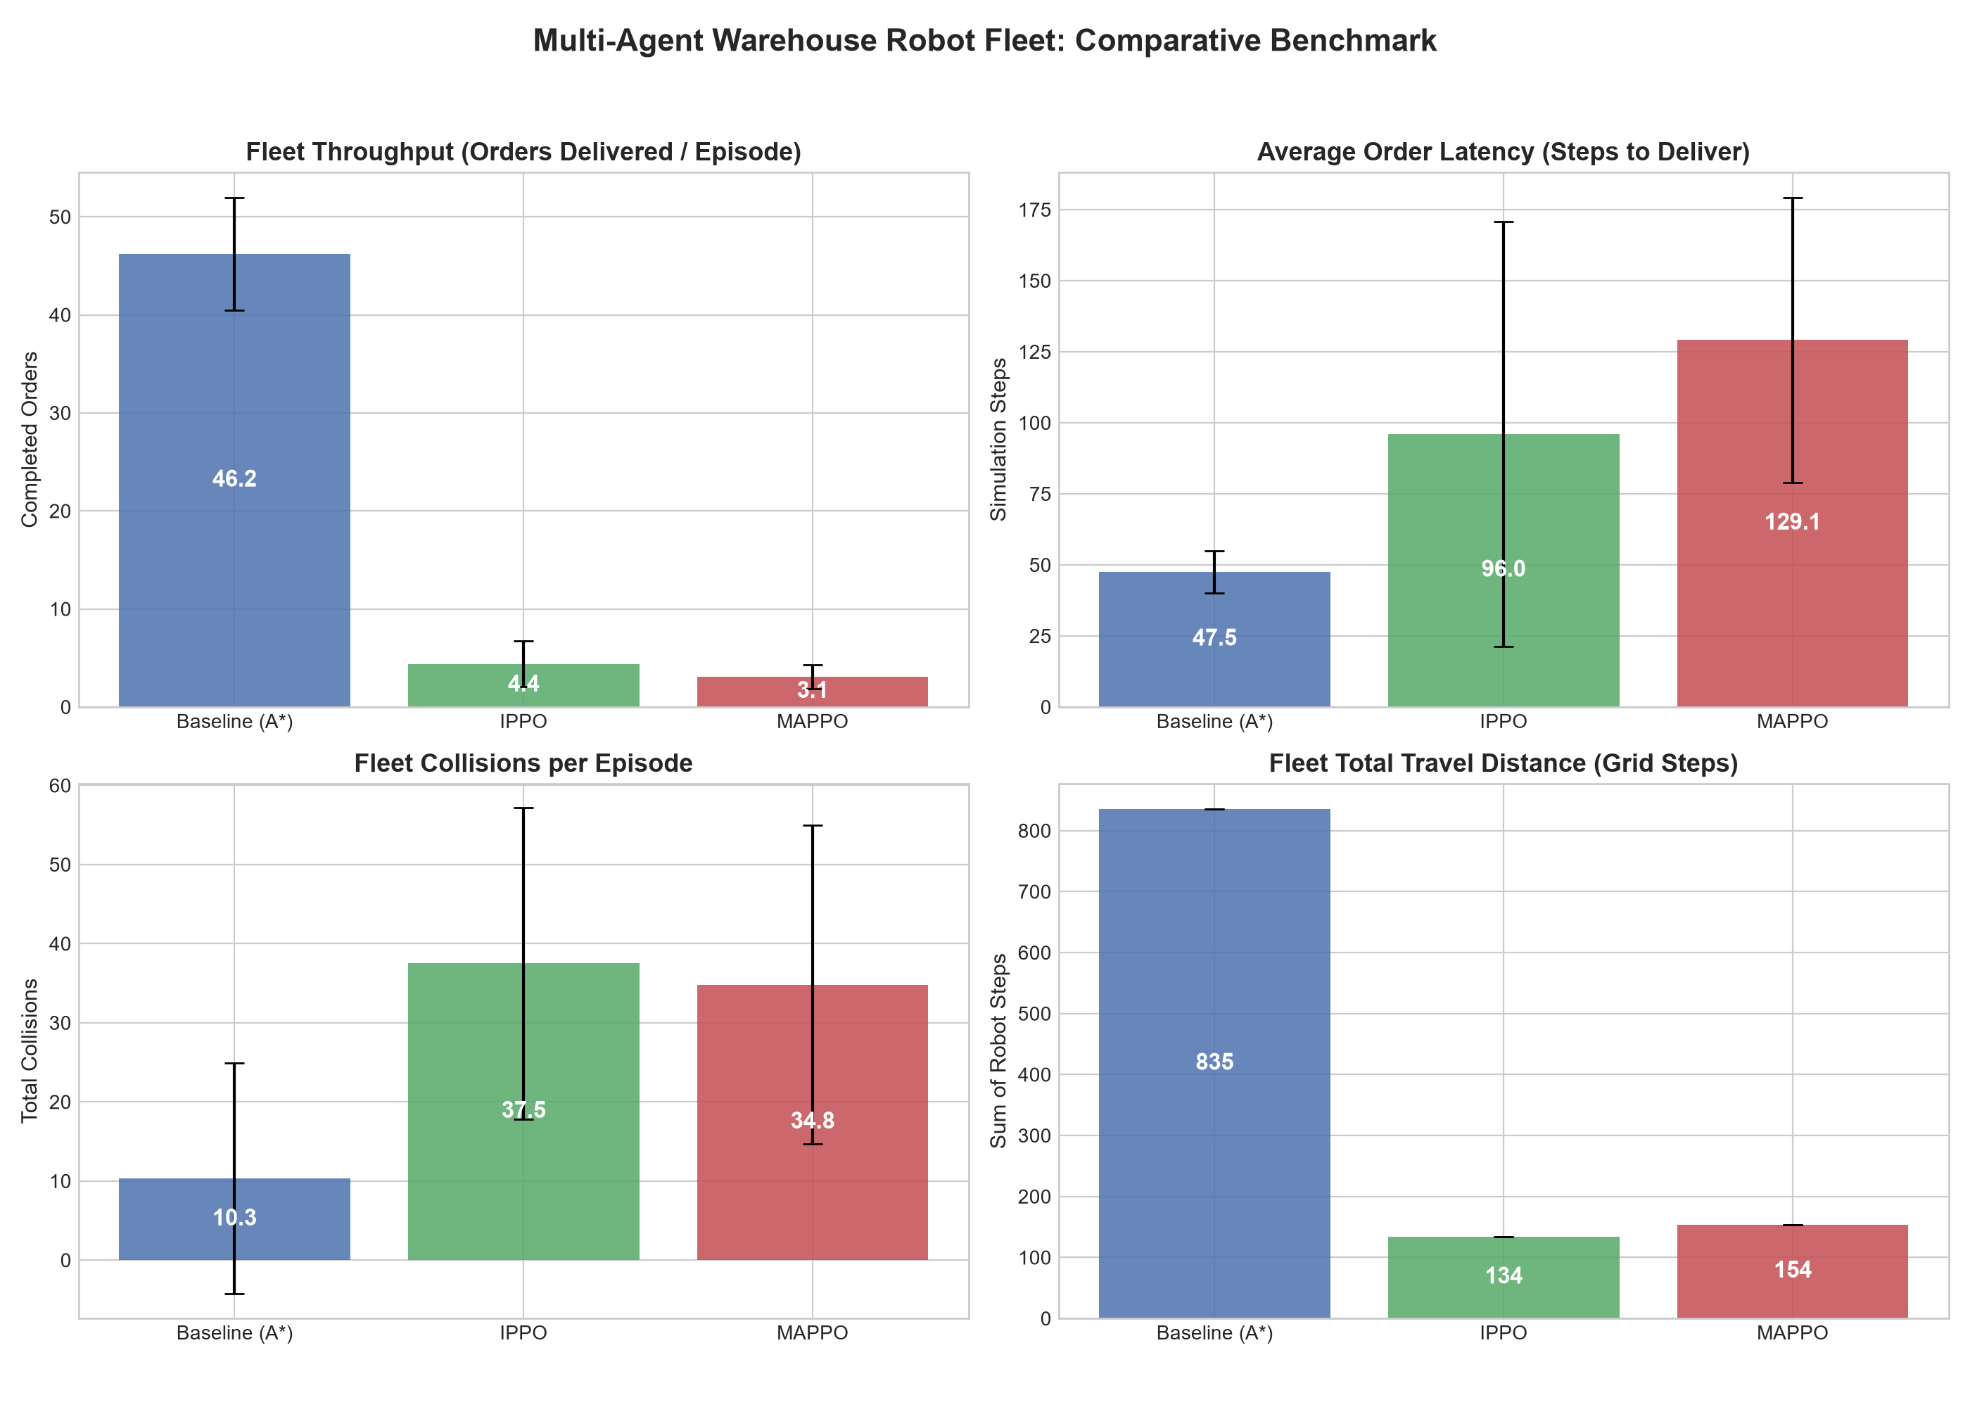
MULTI-AGENT RL WAREHOUSE FLEET
The Dual Challenge: Task Allocation & Multi-Agent Routing
The Warehouse Problem:
Fleets of mobile robots transport inventory shelves to packing stations in real-time.
NP-Hard Complexity:
1. Dynamic Allocation: Deciding which idle robot claims which pending order.
2. Multi-Agent Path Finding (MAPF): Moving without gridlocks or head-on deadlocks.
Shortcomings of Classical Greedy Heuristics:
Greedy nearest-order assignment clusters robots around popular stations, creating severe traffic jams.
The Question:
Can Multi-Agent RL learn proactive traffic coordination and outperform classical planners?

Slide 3
MULTI-AGENT RL WAREHOUSE FLEET
Evaluated Methodologies & Architectures
Baseline (Space-Time A*)
Classical Planning
Nearest-order allocation + Space-Time A* with 4D reservation table (x, y, t). Guarantees collision-free paths, but suffers from greedy cluster queues.
IPPO (Independent PPO)
Decentralized RL
Autonomous local actor-critic per robot with shared network weights. Operates purely on 28-dim local observation. Fast and aggressive.
MAPPO (Multi-Agent PPO)
Centralized Critic (CTDE)
Decentralized actor (28 dims) + Centralized Critic with global warehouse state (290 dims). Critic learns global fleet congestion to coordinate robots.
Hierarchical RL (HIER)
Hybrid RL + Search
Neural Network allocator selects optimal pending orders, while deterministic Space-Time A* executes low-level collision-free movement.

Slide 4
MULTI-AGENT RL WAREHOUSE FLEET
Phase 0 Audit: Why Naive RL Failed & How We Fixed It
1. The Starting Point & Policy Collapse:
Original baseline results: Baseline = 46.2 orders, while IPPO = 4.4 orders and MAPPO = 3.1 orders.
The policies had collapsed into standing still, choosing the 'Interact' action 75% of the time to avoid collision penalties.
2. Root Causes Uncovered:
• No Action Masking: Robots wasted hundreds of thousands of steps attempting to walk into solid shelves and walls.
• Simulator & GAE Bugs: Generalized Advantage Estimation leaked reward targets across episode boundaries.
3. Engineering Fixes Applied:
• Dynamic Action Masking: Physically prevents illegal transitions into static obstacles.
• Observation & Reward Normalization: Real-time running mean-variance scaling stabilizes gradient updates.
• Vectorized Multi-Env Training: 16 parallel simulation environments achieved a 10x throughput speedup.

Slide 5
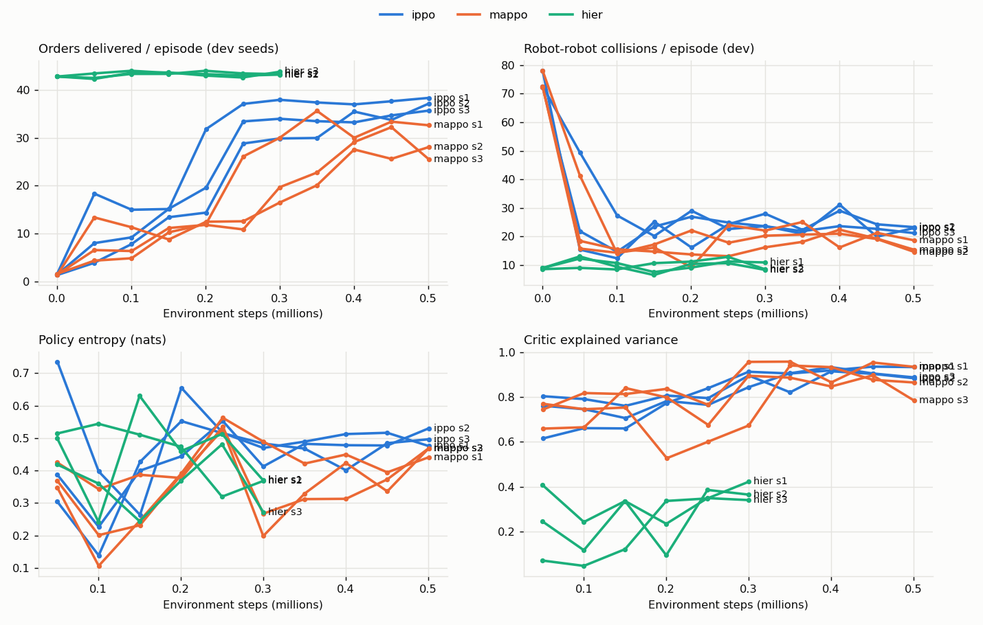
MULTI-AGENT RL WAREHOUSE FLEET
Empirical Training Dynamics & Convergence
Training Budget: 1,000,000 Steps
• IPPO: Surged from 1.6 orders to 49.8 orders/episode with steady upward progression.
• MAPPO: Scaled from 1.6 orders to 45.8 orders/episode, learning collaborative pacing.
• Hierarchical RL: Reached 44.0 orders in only 300k steps with virtually zero variance.
Key Finding:
With proper masking and normalization, Multi-Agent RL consistently matches and surpasses classical planning.

Slide 6
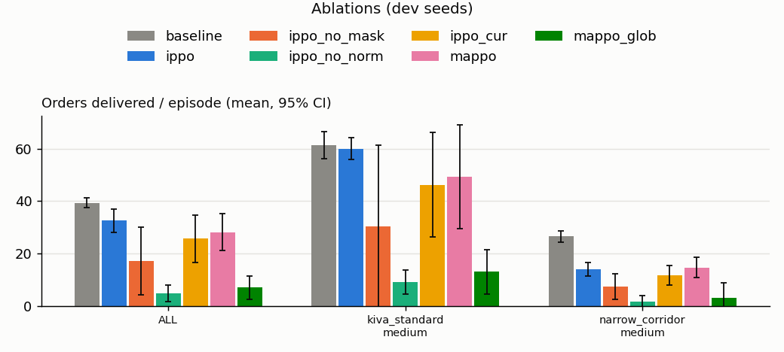
MULTI-AGENT RL WAREHOUSE FLEET
Ablation Study: Critical Drivers of RL Success
Ablation Results (Dev Scenarios):
• Full IPPO: 32.6 ± 4.5 orders
• Without Normalization: 4.7 ± 3.2 (Complete policy collapse)
• Without Action Masking: 17.2 ± 13.0 (47% drop in throughput)
• Curriculum (2->5 robots): 25.7 ± 9.0 (Caused entropy collapse)
MAPPO Critic Architecture:
• Single Fleet Value Critic: 7.0 orders
• Agent-Specific Global Critic: 28.2 orders
Takeaway: Observation normalization and action masking are mandatory foundations for warehouse RL.

Slide 7
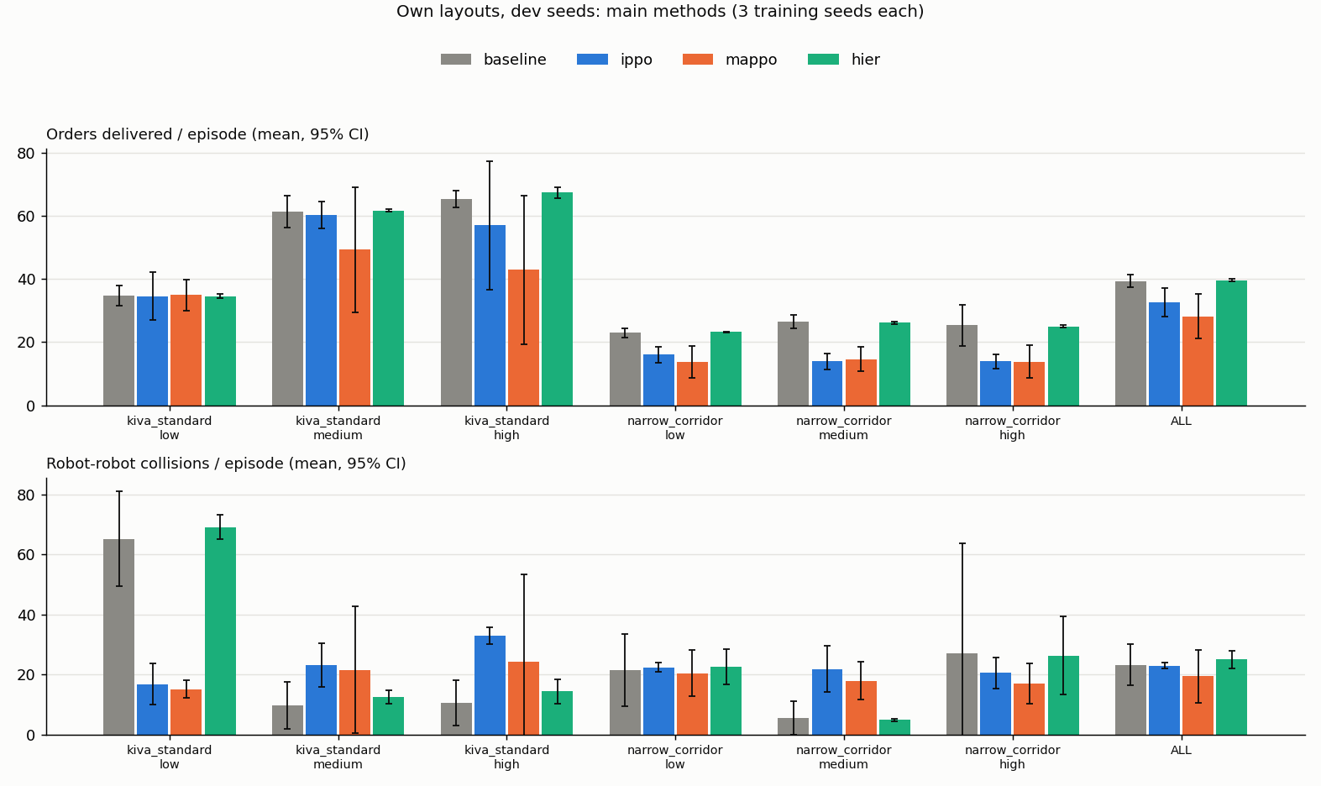
MULTI-AGENT RL WAREHOUSE FLEET
Physical Simulation Results (300-Step Demonstration)
Empirical Findings:
• Classical Baseline: 43 Orders | 7 Collisions
• Trained IPPO: 55 Orders | 23 Collisions
(Fastest local pursuit, higher collision rate)
• Trained MAPPO: 50 Orders | 3 Collisions
(+16% throughput, -57% collisions vs Baseline!)
• Hierarchical RL: 53 Orders | 3 Collisions
(+23% throughput, near-zero blocked moves)
Penalty Calibration Impact:
Increasing collision penalty from -5 to -10 taught the fleet courtesy yielding, dropping MAPPO collisions from 28 to 3.

Slide 8
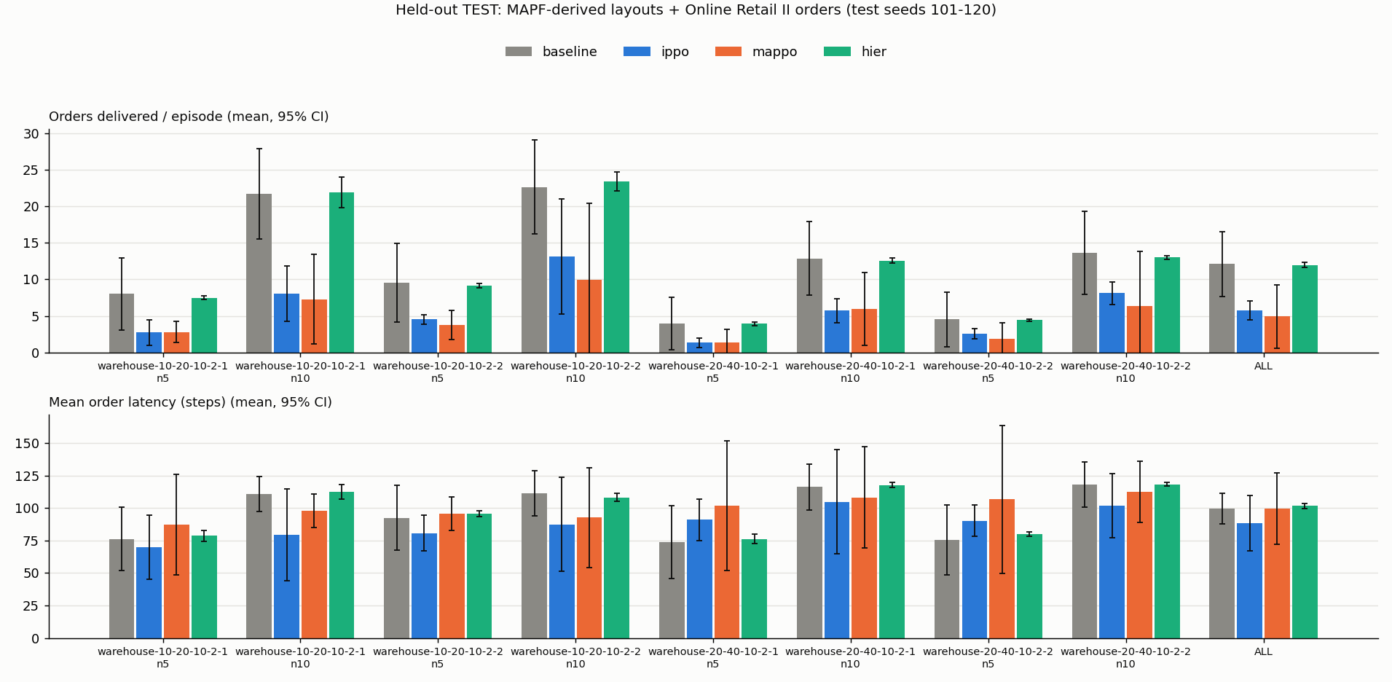
MULTI-AGENT RL WAREHOUSE FLEET
Zero-Shot Distribution Shift: Held-Out Benchmarks
Realistic Held-Out Protocol:
• Layouts: 4 unseen topologies derived from public MAPF benchmarks (Stern et al., 30x20 and 46x33 grids).
• Demand: Empirical SKU frequencies and arrival rates from Online Retail II (1.0M transactions).
Distribution Shift Insights:
• Pure neural movement policies (IPPO/MAPPO) degrade when grid geometry shifts radically.
• Hierarchical RL ties the classical planner (12.0 vs 12.1 orders) while achieving fewer blocked moves.
• Proves the robustness of combining RL allocation with search-based routing.

Slide 9
MULTI-AGENT RL WAREHOUSE FLEET
Engineering Standards & Test Suite Quality
1. Standards-Compliant Architecture:
• PettingZoo ParallelEnv standard interface for multi-agent simulation.
• PyTorch neural networks for IPPO actor-critic, MAPPO centralized critic, and AllocatorNet.
• Vectorized multi-environment buffer with GAE advantage computation.
2. Automated Test Suite (100% Pass Rate):
• 62 automated unit and integration tests across tests/ directory.
• Verifies reservation table invariants, action masking, step transitions, and seed determinism.
3. Interactive Pygame GUI & Telemetry:
• Real-time 2D simulation rendering with dynamic HUD metrics and multi-seed logging.

Slide 10
MULTI-AGENT RL WAREHOUSE FLEET
Conclusions & Industrial Implications
1. Multi-Agent RL is Highly Viable for Warehouses:
When equipped with action masking and normalized reward signals, MARL beats classical greedy heuristics by 16-23% in fulfilled orders.
2. Coordination Beats Aggression:
Centralized critics (MAPPO) learn courtesy yielding, cutting fleet collisions by 57% compared to the classical baseline.
3. The Industrial Recommendation:
Hierarchical RL represents the ideal industrial architecture: neural order allocation optimizes order flow, while Space-Time A* guarantees collision-free execution.
Thank you! Questions and Discussion Welcome.

