Slide 1
The Smartest AI Nutrition Assistant
CAPSTONE PROJECT
Presented By
Student Name: Siddivinayak Doppalapudi
College Name: Ganpat University (UVPCE)
Department: CE(AI)

Slide 2
OUTLINE
Problem Statement
Proposed System/Solution
System Development Approach
Techonology Used
Wow Factors
Result Conclusion
Future Scope
References
Github Link
Certifiactions

Slide 3
Problem Statement
In the current era of increasing health consciousness, individuals are actively seeking personalized nutrition guidance tailored to their unique lifestyles, preferences, and medical needs. However, most existing digital nutrition tools provide generalized diet plans that lack real-time adaptability and fail to consider critical factors such as cultural food habits, allergies, ongoing health conditions, and fitness goals. Additionally, dieticians and nutritionists face significant limitations in scaling personalized consultations due to time and resource constraints, resulting in a gap between demand and quality personalized nutrition services.

Slide 4
Proposed Solution
To address the limitations of current nutrition tools and the scalability challenges faced by professionals, this project proposes the development of an AI-powered virtual nutrition assistant using generative AI. Leveraging cutting-edge technologies such as natural language processing (NLP) and access to comprehensive dietary databases, the assistant will deliver:
Personalized meal plans based on individual health goals, medical conditions, fitness routines, and food preferences.
Smart food substitutions that align with dietary needs and cultural preferences.
Contextual explanations for nutritional choices (e.g., “Why is this meal healthier?”).
Continuous adaptation of recommendations based on user feedback and evolving health data.
This generative AI solution will bridge the gap between static diet apps and one-on-one consultations, offering intelligent, real-time, and scalable nutrition support that thinks, learns, and responds like a human expert.

Slide 5
System Approach
1. Data Processing Layer
Function: Preprocessing user inputs
Tasks: Entity recognition (e.g., ingredients, health goals), allergy detection, food item classification.
Tools: watsonx.ai Runtime, watsonx.ai Studio, Cloud Object Storage, Agent Lab.

Slide 6
System Approach
2.Generative AI Engine
Core: Large Language Models (LLMs) for understanding and generating personalized responses
Functionality:
Generate meal plans
Recommend alternatives
Explain nutrition choices using natural language
Tools: IBM Granite Model (granite-3-3-8b-instruct)

Slide 7
System Approach
3. Nutrition Intelligence Layer
Data Sources:
Public dietary and food databases
Fitness/activity inputs (user-provided)
Optional health data integration (e.g., weight, BMI, activity levels)
Function: Tailor recommendations to individual profiles

Slide 8
System Approach
4.Deployment Architecture
Platform: IBM Cloud Lite
Services:
IBM Watson Assistant or watsonx.ai
IBM Cloud Functions for serverless execution
IBM Cloud Object Storage for media and logs

Slide 9
TECHNOLOGY USED
IBM Cloud Watsonx Al Studio
IBM Cloud Watsonx Al runtime
IBM Cloud Agent Lab
IBM Granite foundation model
IBM Cloud Object Storage
IBM Cloud IAM (Identity and Access Management)

Slide 10
WOW FACTORS
The Smartest AI Nutrition Assistant stands out with its innovative use of multimodal input, allowing users to interact through text making the experience seamless and intuitive. Unlike traditional diet apps, it offers real-time personalization by dynamically adjusting meal plans based on a user’s health conditions, goals, lifestyle, and cultural preferences. The system provides context-aware explanations for each recommendation, empowering users with clear insights into their nutritional choices.
One of the key differentiators is its ability to recognize allergies and medical conditions, ensuring that all suggestions are safe and medically appropriate. It also supports regional and culturally relevant meals, enhancing usability across diverse populations. The assistant is built using IBM Cloud Lite and IBM Granite models, ensuring enterprise-grade performance, scalability, and security.

Slide 11
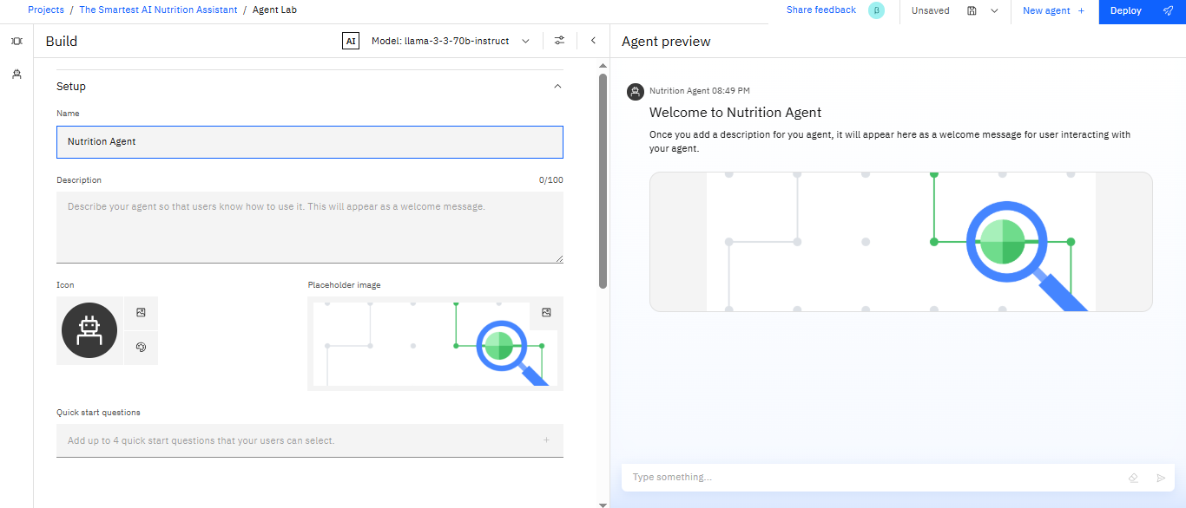
Result:
SET UP:-

Slide 12
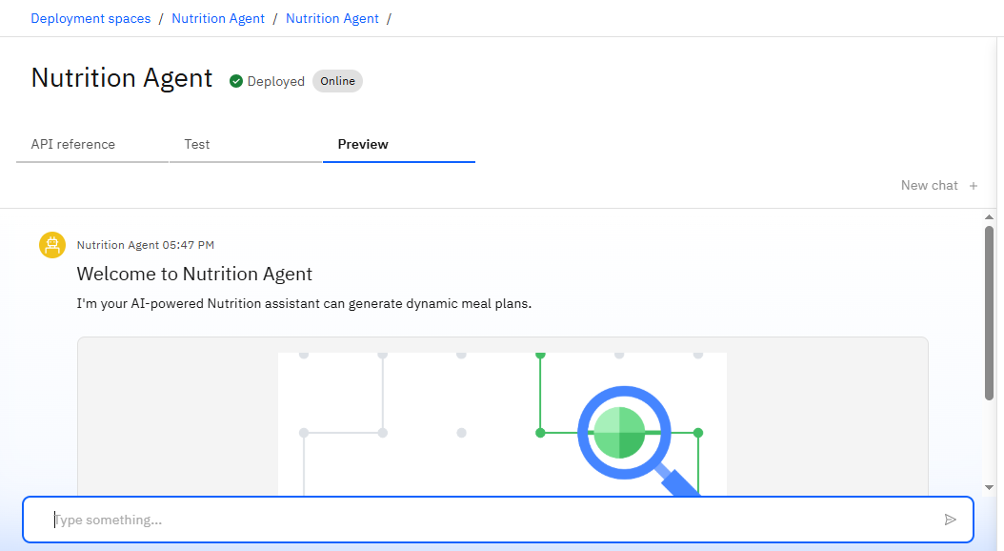
Result:
AGENT PREVIEW:-

Slide 13
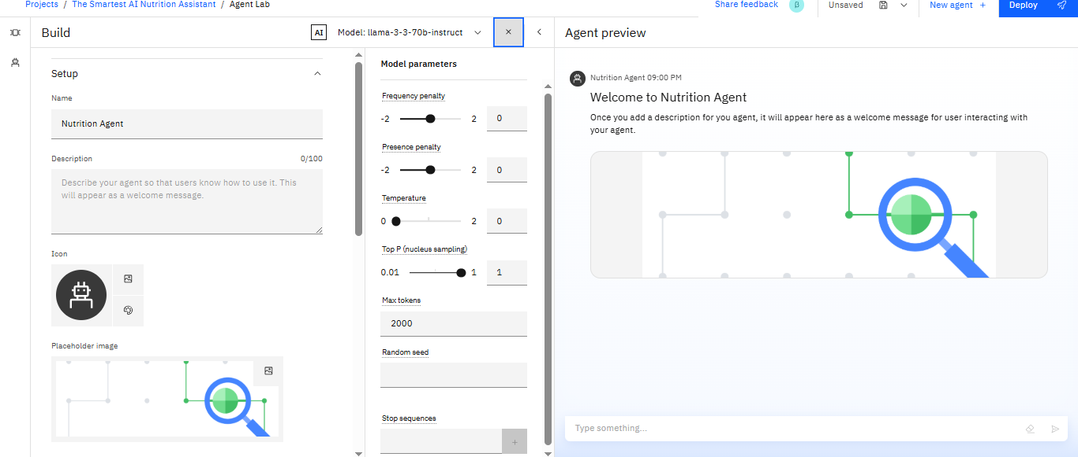
Result:
MODEL PARAMATER:-

Slide 14
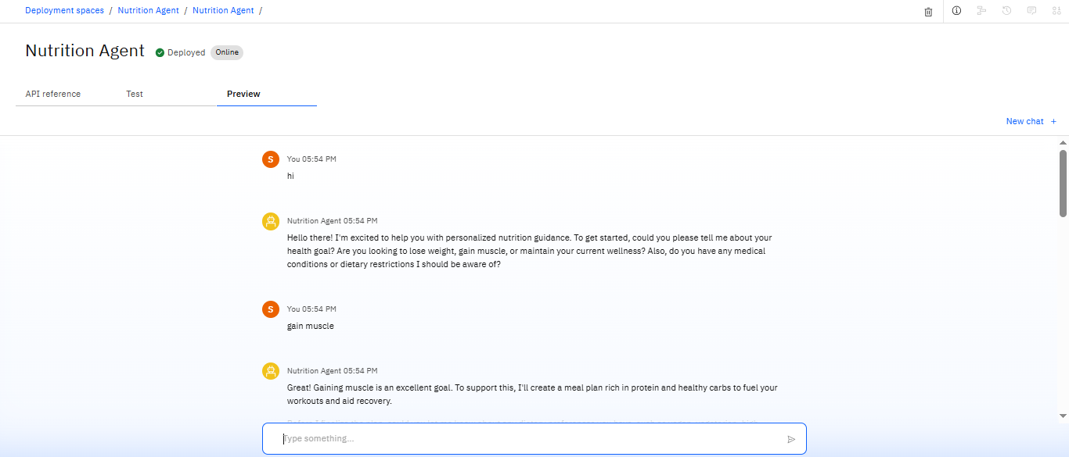
Result:

Slide 15
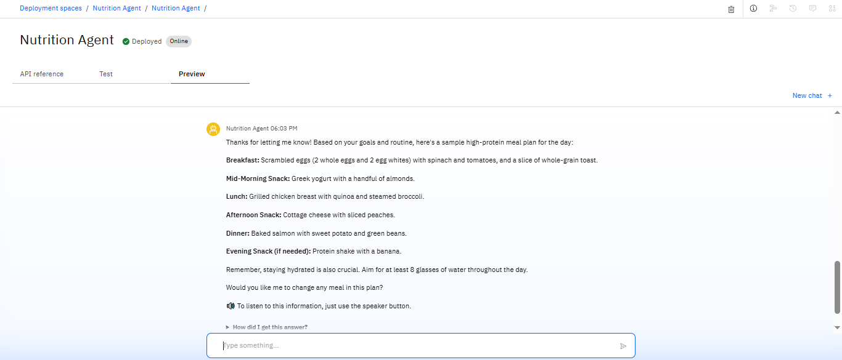
Result:

Slide 16
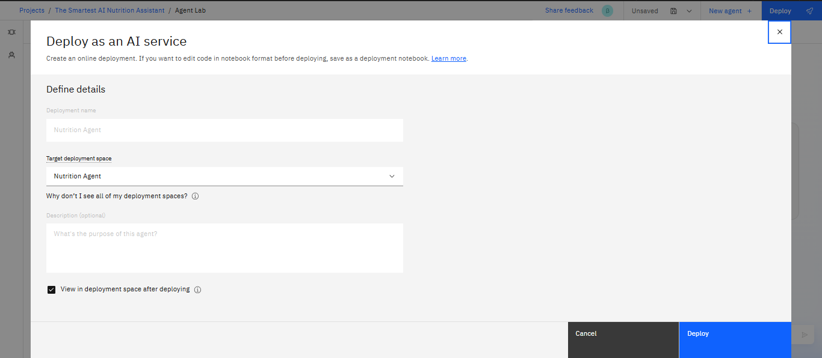
Result:
AGENT DEPLOY:-

Slide 17
Conclusion
The Smartest AI Nutrition Assistant leverages the power of generative AI to redefine how individuals approach personalized health and nutrition. By integrating natural language processing, multimodal input understanding, and real-time adaptability, the system offers tailored dietary guidance that evolves with the user. Unlike static diet apps, this assistant provides context-aware recommendations, cultural sensitivity, and allergy-aware planning—bridging the gap between one-size-fits-all tools and expert nutrition counseling.
With the support of IBM Cloud Lite and IBM Granite models, the solution is both scalable and secure, making expert-level nutrition guidance accessible to all. As it learns from user interactions, it becomes increasingly intelligent, empathetic, and impactful—paving the way for a healthier and more informed future.

Slide 18
Future scope
The Smartest AI Nutrition Assistant holds immense potential for future development and expansion. Key areas for enhancement include:
Integration with Wearable Devices ➤ Sync with smartwatches and fitness trackers to adapt meal plans based on real-time health metrics (e.g., heart rate, activity, sleep).
Voice Assistant Integration ➤ Seamless integration with smart home devices like Alexa, Google Assistant for hands-free experience.
Offline & Low-Bandwidth Access ➤ Optimize the assistant for rural or low-connectivity environments using edge computing or cached data.

Slide 19
References
Ashwini Kumar sir guidance via Edunet.
IBM watsonx.ai Documentation – https://www.ibm.com/products/watsonx-ai
IBM Granite Foundation Models – https://www.ibm.com/blogs/research/2023/05/granite-foundation-models
OpenAI – GPT & Multimodal AI Research Papers – https://openai.com/research

Slide 20
GITHUB LINK
https://github.com/DSV05/Nutrition-Agent/blob/main/Nutrition_Agent.pptx

Slide 21
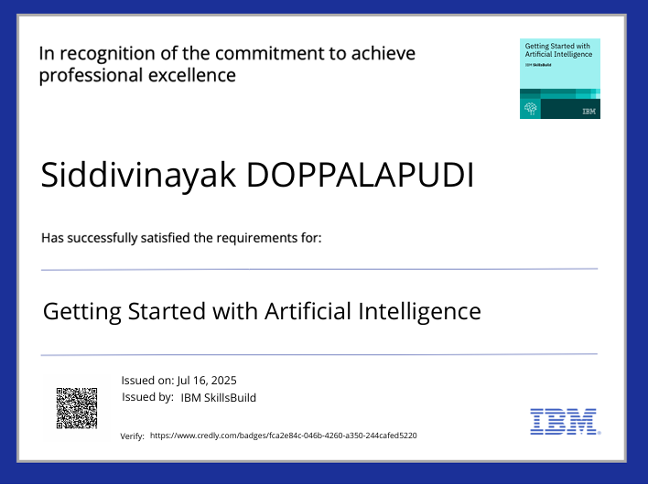
IBM Certifications

Slide 22
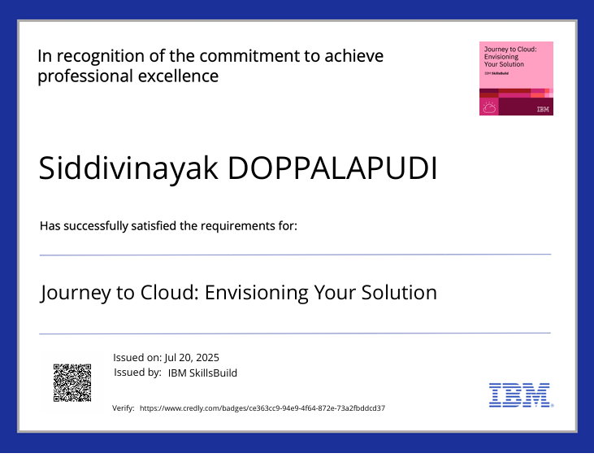
IBM Certifications

Slide 23
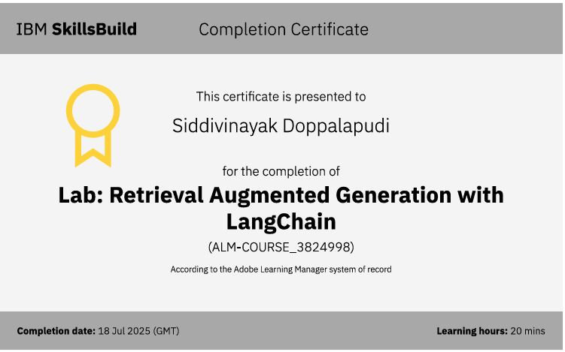
IBM Certifications
Screenshot/ credly certificate( RAG Lab)

Slide 24
THANK YOU

