Slide 1


TechSpotter
David Cordeiro – up202108820
Diogo Viana – up202108803
Gonçalo Martins – up202108707
Sofia Minnemann – up202007342

Slide 2


Dataset
Metadata and Transcript of YouTube videos from popular English-Speaking Tech Youtubers, that have an available, manually written, English transcript.
Data obtained using YouTube Data API v3, in Python.
Licensing under YouTube API Services Terms of Service.

Slide 3
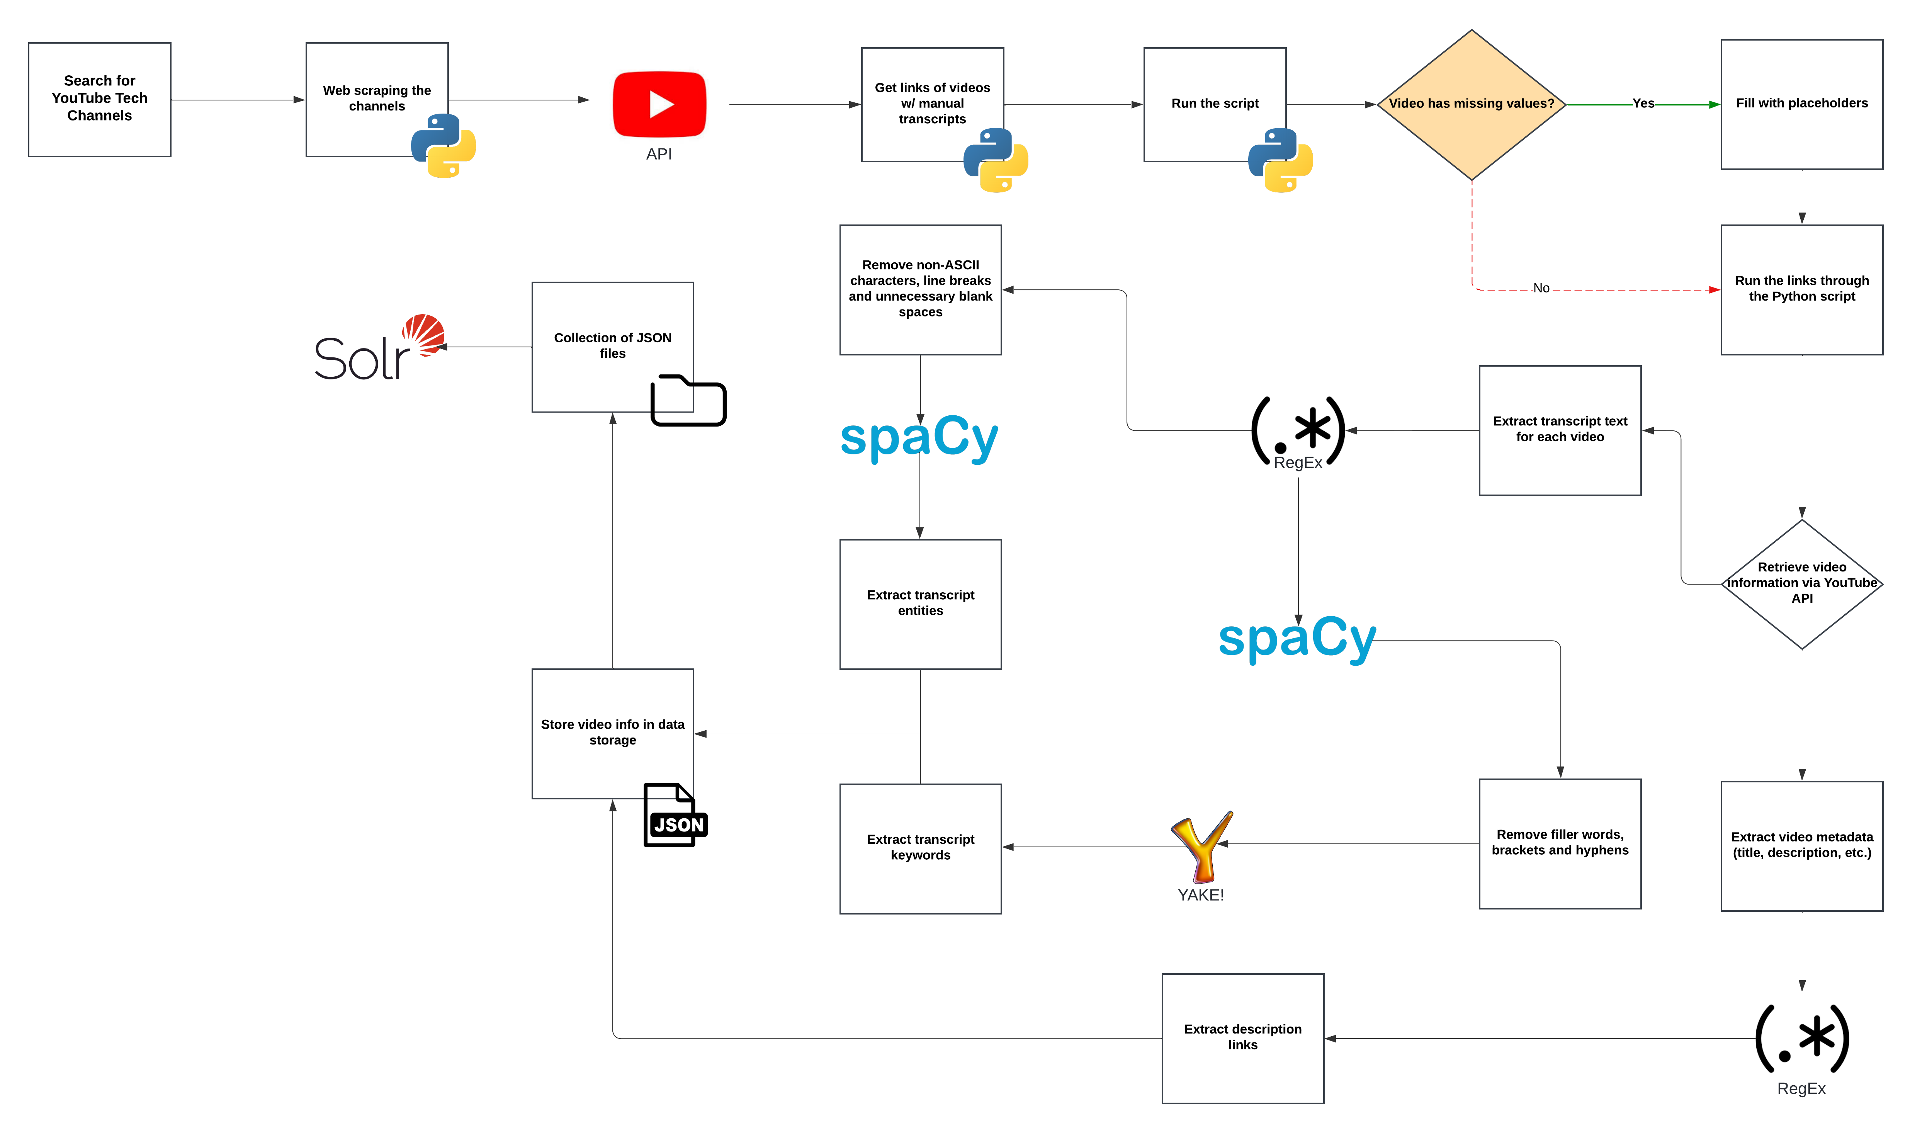
Pipeline

Slide 4
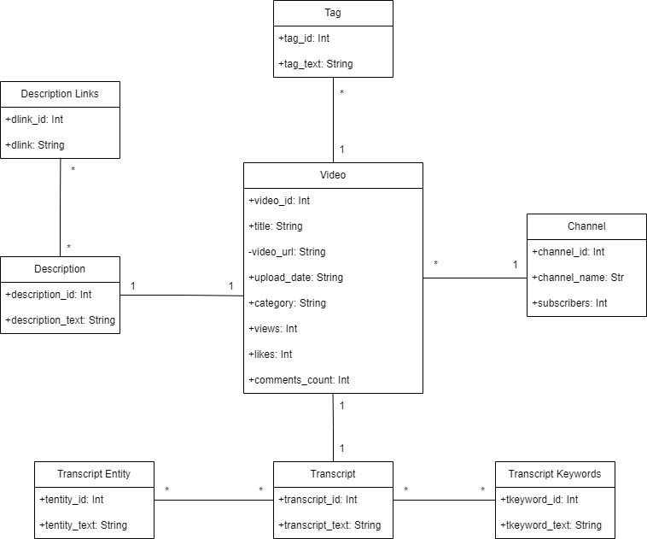
Conceptual Model

Slide 5

Data Characterization (Statistics)
Total number of documents: 8346
Total size of the collection: 153.5 MB
Video with the smallest document: "The #1 Most Overpriced Tech in 2023!"
Video with the largest document: "The real cost of the PS5 Pro | The Vergecast"
Earliest upload date: 2012-05-15
Latest upload date: 2024-10-15

Slide 6
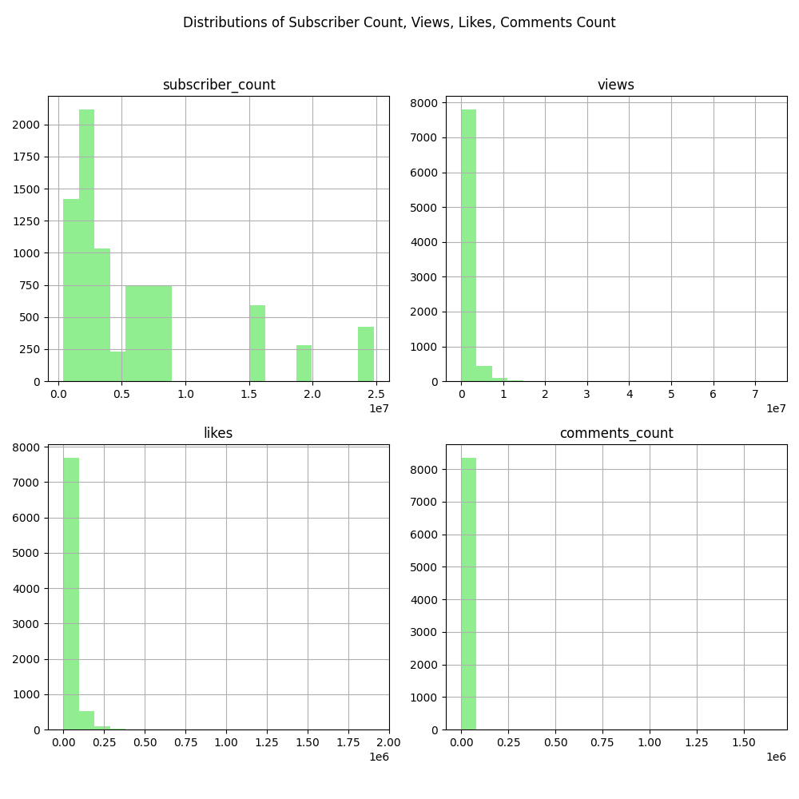
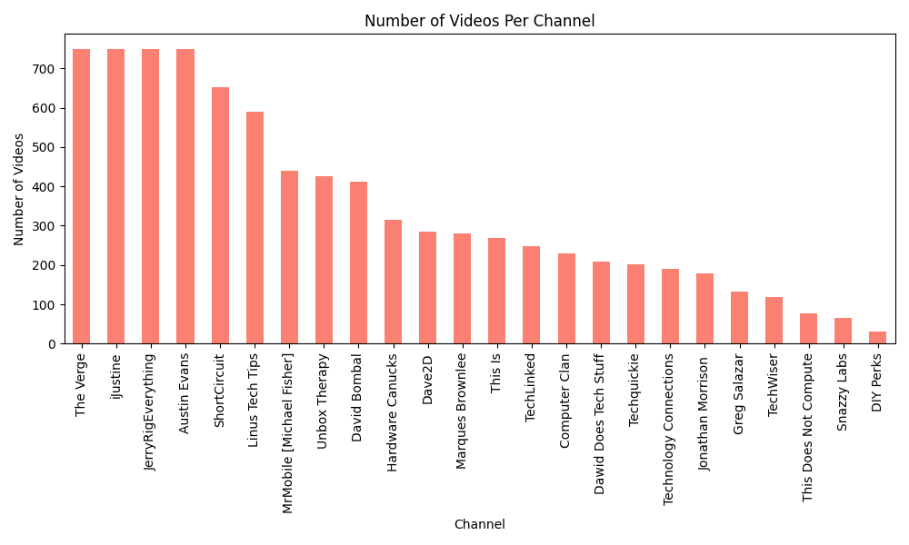
Data Characterization (Statistics)

Slide 7
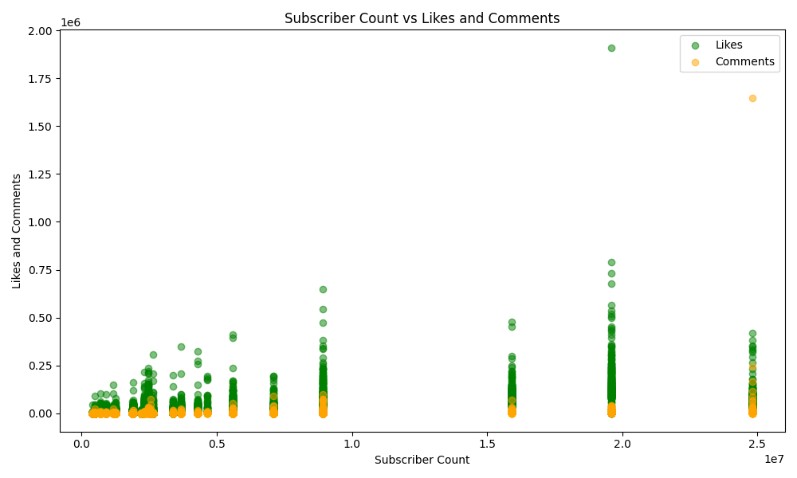
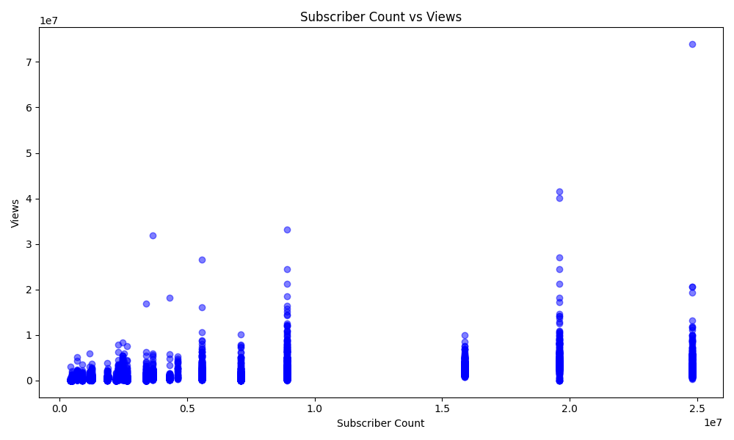
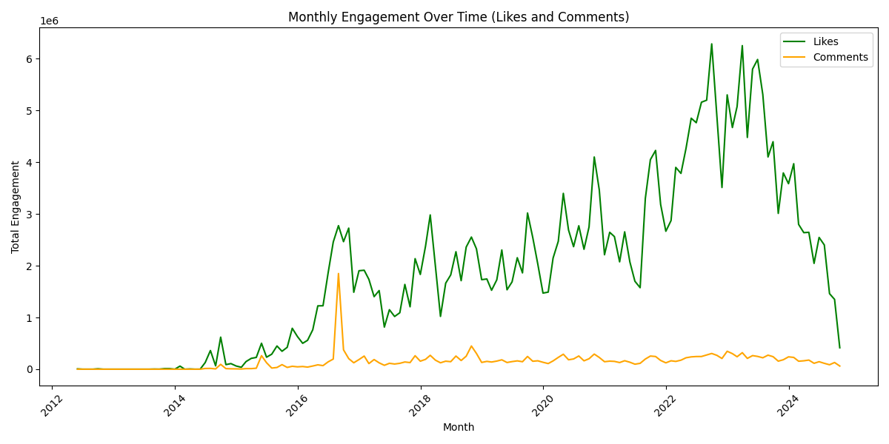
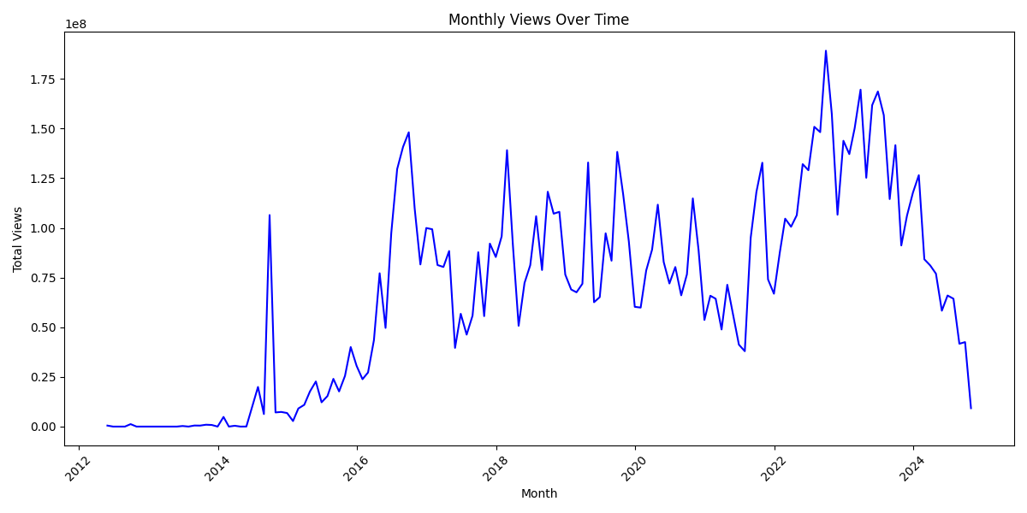
Data Characterization (Comparisons)

Slide 8
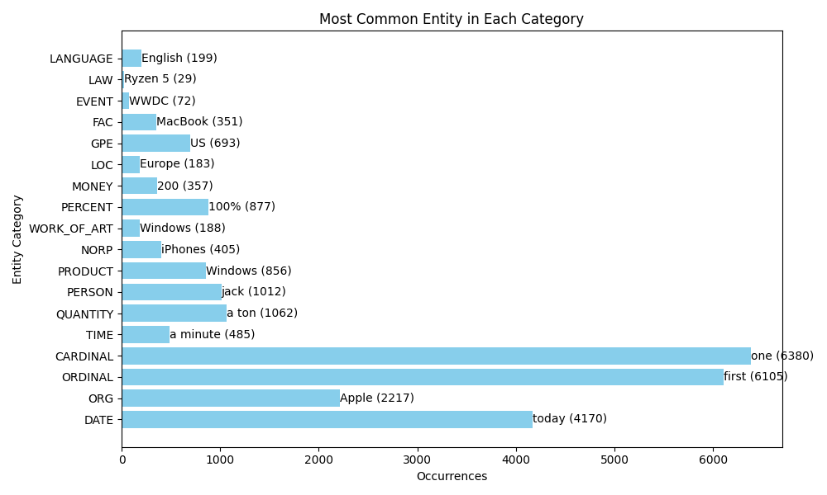
Data Characterization (Text Analysis)

Slide 9

Search scenarios
The user wants to find a video that discusses a particular feature of a product, like “battery life”. ​
The user wants to quickly find specific information from the tech review without watching the full video.​
A company wants to identify YouTube channels with high engagement metrics, such as views, likes, and comments, for potential sponsors and collaborators.​
A researcher wants to analyze trends over time by examining the number of views and likes for specific tech products (e.g., smartphones).​
The user is interested in finding videos reviewing new technologies, such as product releases.​

Slide 10

Any questions?

