Slide 1
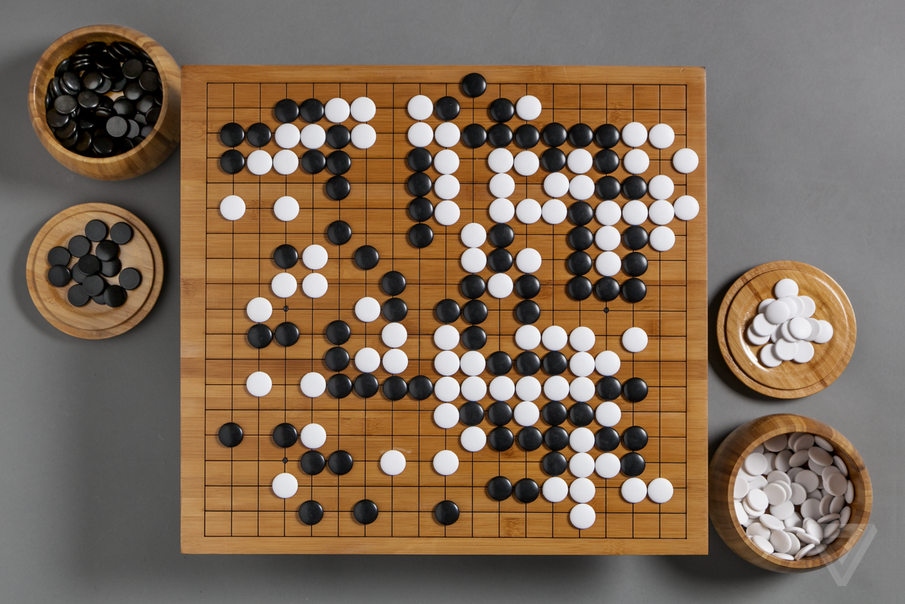
Gamma Go
A Go playing A.I. written in Allegro Common Lisp
David Wallach

Slide 2
Weiqi/Baduk/Igo (
Literally translates as “Encircling Game”
Originated in China at least 2500 years ago
Oldest game still played in its original form
  Some rules have been added
    Minor variation between rule sets (Japanese vs. Chinese)
  Different board sizes
    Common are 9x9, 13x13, and 19x19
Constructive vs. Destructive (Chess)

Slide 3
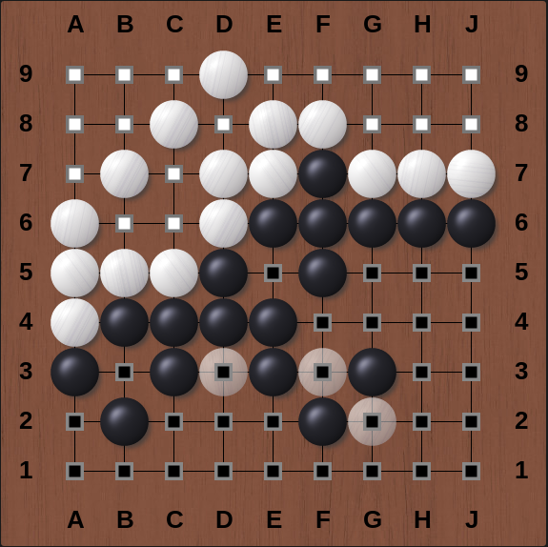
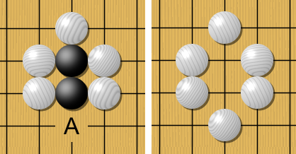
Basic Rules
You can play on any empty position on the board
The game is over when both players pass consecutively or when one player resigns
The winner is determined by who has the most points
Points are gotten two ways
  A) Territory – Encircling empty board positions
  B) Captures – Encircling opponents pieces
A)
B)
A) Personal game on https://www.online-go.com
B) CC BY-SA 2.0, https://commons.wikimedia.org/w/index.php?curid=37110

Slide 4
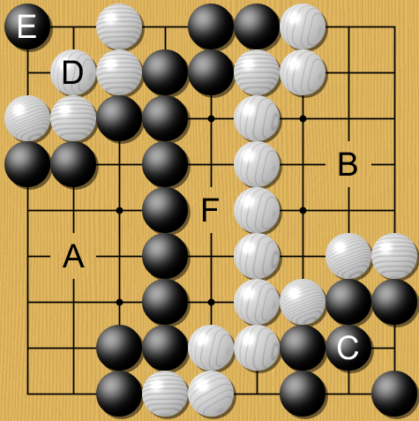
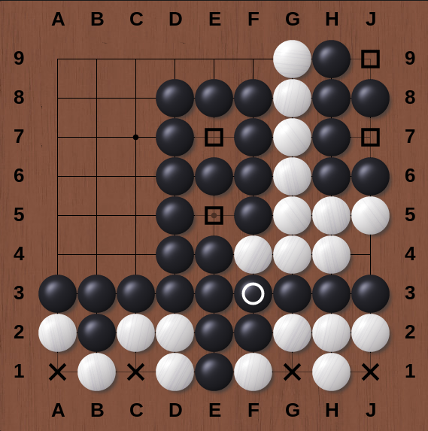
Basic Rules
Life
  For a group to be considered alive it needs two “eyes”
  Eyes are liberties surrounded on all sides (Squares)
  False eyes do not guarantees life (Crosses)
Example Scoring
  Black: 29
    Territory: A(14) + C(2) + E(8)
    Captures: D(5)
  White: 14
    Terrirory: B(14)
    Captures: 0

Slide 5
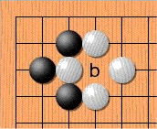
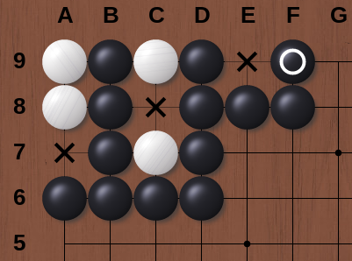
Additional Rules
A) Ko
  The board cannot return to its previous state
  Super Ko (cannot return to any previous state)
B) Suicidal Moves
  Playing in an eye
  Creating a group with no liberties
C) Komi
  Points given to white to balance black playing first
  Typically between 5 and 8 often with 0.5 to prevent ties
  I’m using 6.5

Slide 6
Alpha Go
Beat Lee Sedol 4 -1 in 2016
Lee Sedol was ranked 2nd in the world at the time
Uses a combination of A.I. approches
  Monte-Carlo tree search
  Three neural networks
  Various machine learning techniques

Slide 7
Network One – Policy Network
Data collected from games between well ranked players on KGS (> 4 dan) on KGS
Trained with stochastic gradient ascent on a sample set of 30 million (state, action) pairs
  Supervised Learning
Solves the bootstrapping problem
Selects the moves during the default policy play out of MCTS

Slide 8
Network Two – Better Policy Network
Starts as the first network
Initially trained by playing against previous iterations of the first network
Then trained against previous iterations of itself
Again uses stochastic gradient ascent
  Reinforcement learning
The data from these games is recorded

Slide 9
Network Three – Value Network
Trained to predict who wins a game based on board position
Uses the data generated during the training of the second network
Only one position per game was used to train this network to prevent over-fitting
Returns a value at each leaf node
That value is combined with value obtained by MCTS with policy network

Slide 10
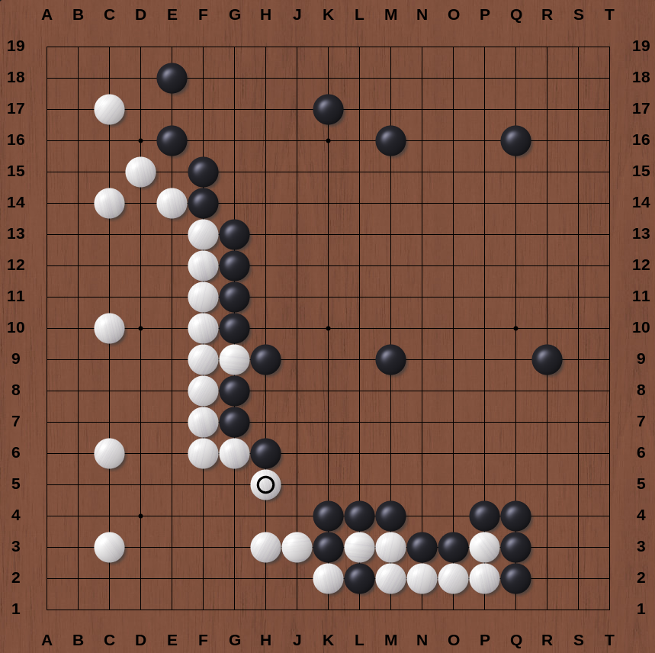
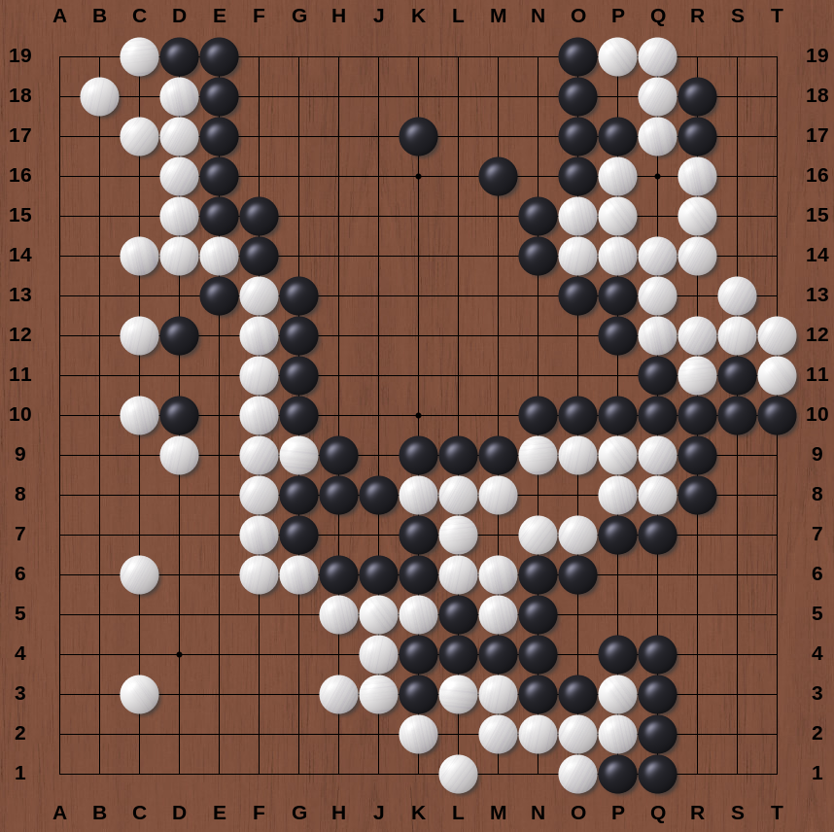
Humans make mistakes
Board one has black in the lead
Board two shows white won the game

Slide 11
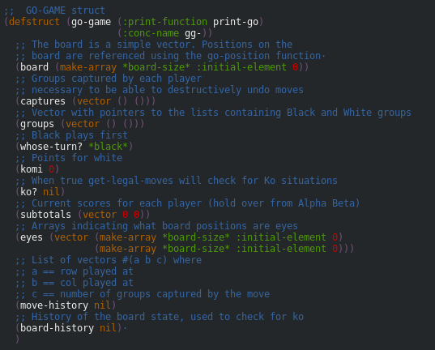
My Project
Done
Go game written in Lisp
Setup with MCTS
Multi-thread MCTS
Setup with 1st Policy network
To Do
Find more 9x9 game files
Train 1st network
Setup training pipeline for 2nd policy network
Setup value network
Train value network
Maybe
Networks on GPU?
Try 19x19?

Slide 12
References
Images with dark board are screenshots from my games/examples on OGS
  https://online-go.com
All other images are from wikimedia commons
  https://wikipedia.org
Alpha Go Paper
  https://gogameguru.com/i/2016/03/deepmind-mastering-go.pdf

