Slide 1
Gamma Go
David Wallach

Slide 3
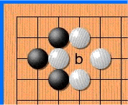
Ko

