Slide 1
NATIVE CONTENT
Editable text and vector shapes preserve structure for downstream conversion.

Slide 2
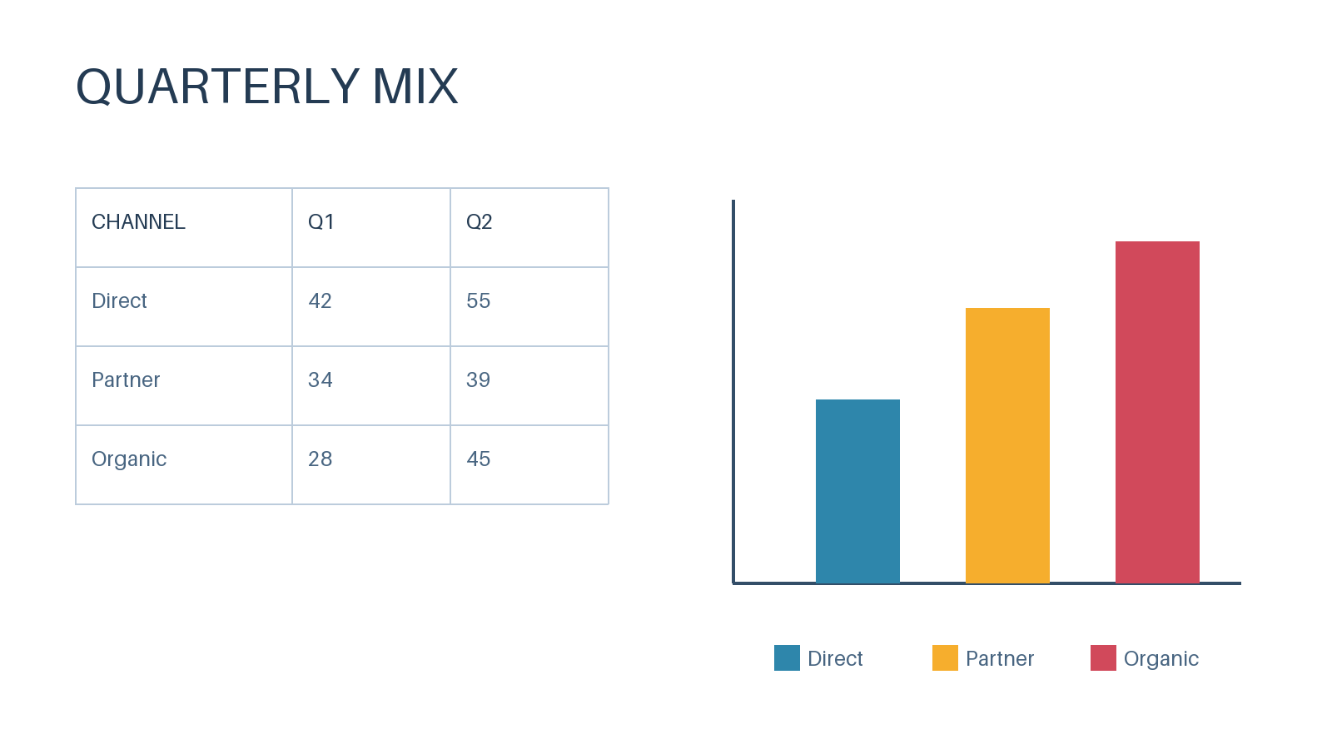

Slide 3
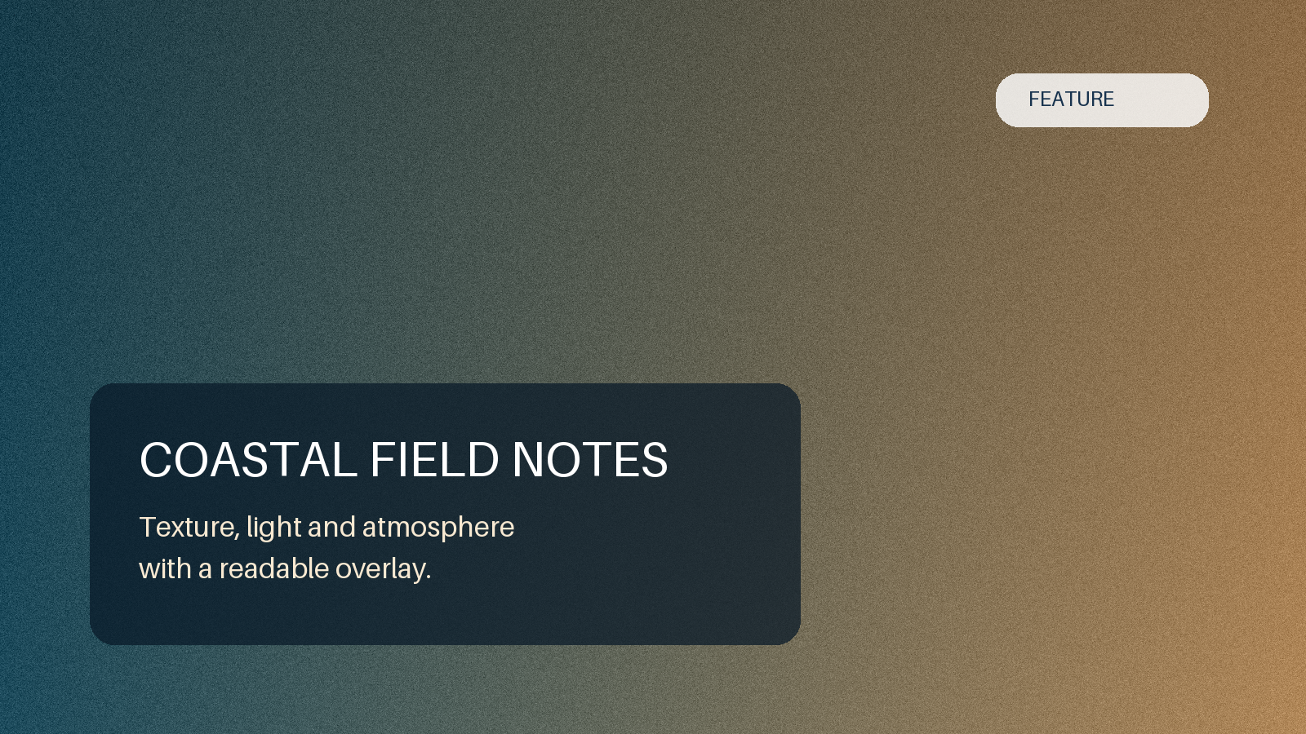
MIXED CONTENT
Native text remains editable while the image region retains visual detail.

