Slide 1

NATIVE SIGNALS
PAGE 01
MODE NATIVE
STATE EDITABLE
Native text + vector shapes + raster candidate

Slide 2

STRUCTURED TEAMS
PAGE 02
MODE NATIVE
STATE EDITABLE
Native text + vector shapes + raster candidate

Slide 3
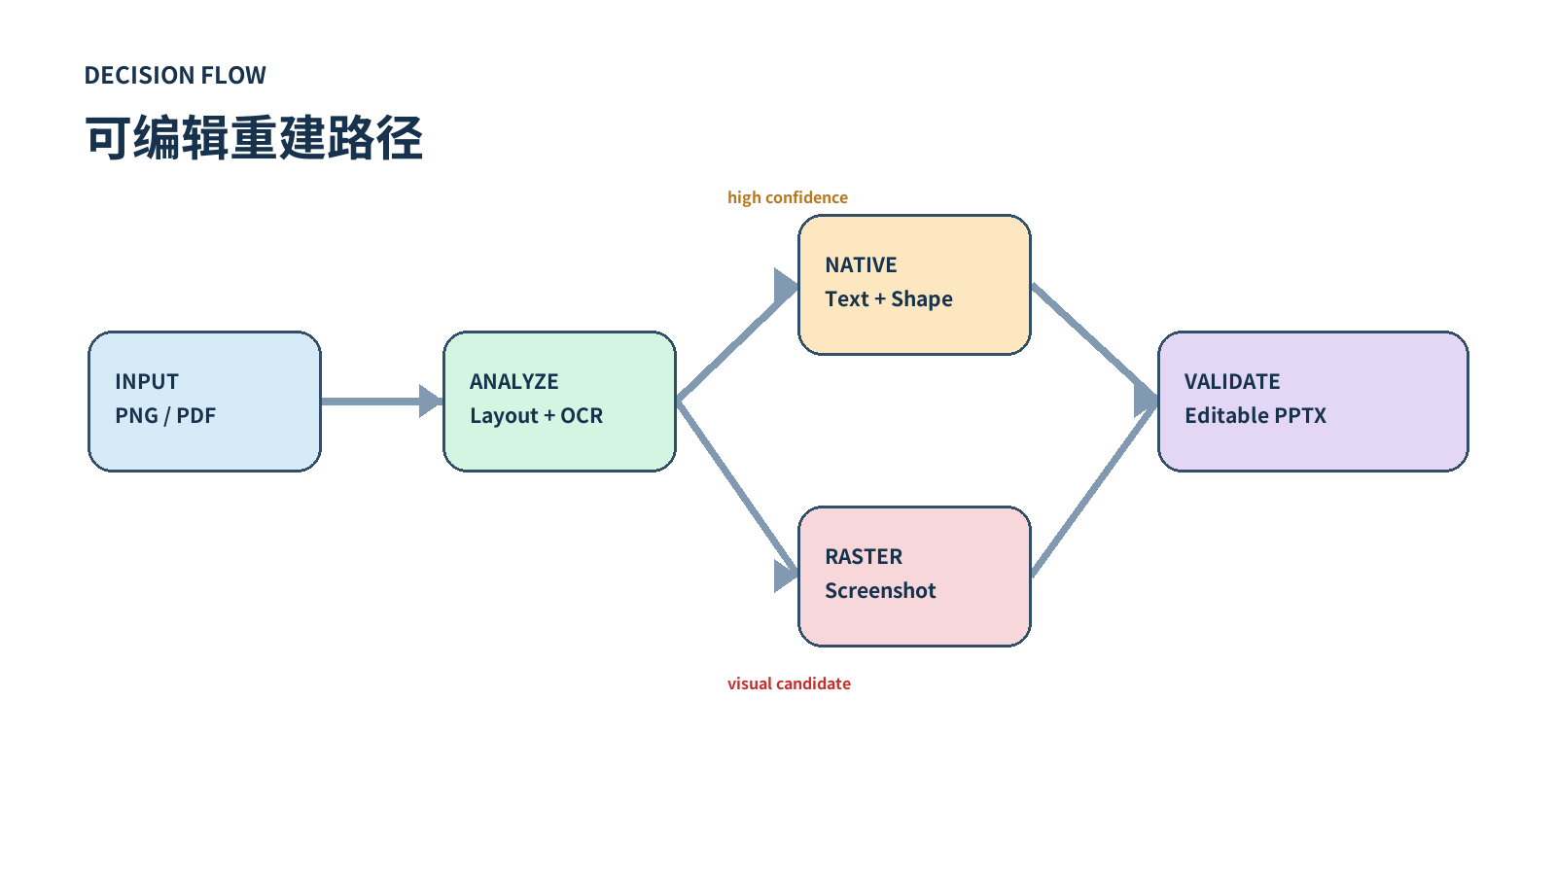
DECISION PATH
PAGE 03
MODE NATIVE
STATE EDITABLE
Native text + vector shapes + raster candidate

Slide 4
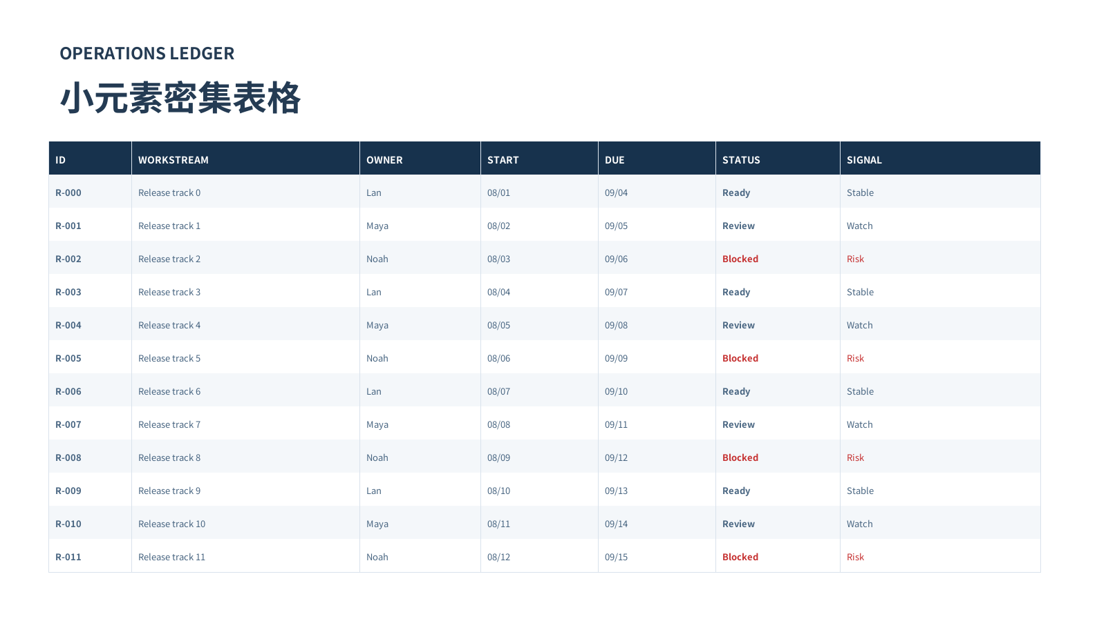
RELEASE MATRIX
PAGE 04
MODE NATIVE
STATE EDITABLE
Native text + vector shapes + raster candidate

