Slide 1

Loan Default Analysis
Exploratory Data Analysis
Aiding Loan Default Prediction
Presented by: Sabarish S

Slide 2
Overview of the Analysis
Objective:
Develop a basic understanding of risk analytics in banking and explore how data-driven insights can reduce loan default risks.
Key Goals:
Investigate the impact of loan type, loan purpose, credit score, and other variables on default rates.
Examine correlations between financial factors such as upfront charges, loan amounts, interest rates, and property values.
Provide actionable recommendations to enhance lending strategies and minimize risk.
Notes:
This slide sets the stage for what will be explored and helps the audience understand the methodology used.

Slide 3
Data Overview
ID: Unique identifier for each loan.
Year: The year the loan was issued.
Loan Limit: The limit set on the loan, whether fixed or variable.
Gender: Gender of the borrower (potential data issue in the “Sex Not Available” category).
Loan Type: Type of loan (personal, business, etc.).
Loan Purpose: Reason for the loan (e.g., mortgage, education).
Income: Annual income of the borrower.
Credit Score: The borrower’s credit score (may not be as significant in this dataset).
Status: The loan status indicating whether the borrower defaulted (1) or not (0).

Slide 4
Methodology
Analysis Approach:
Data exploration and preprocessing.
Statistical analysis to identify significant patterns.
Visualizations to uncover insights into loan default tendencies.
Variables Analyzed:
Loan type and purpose.
Business or commercial nature of loans.
Credit scores, interest rates, upfront charges, loan amounts, and property values.
Tools Used:
Python (Pandas, Matplotlib, Seaborn).
Statistical Tests (Chi-Square, Correlation Analysis).

Slide 5
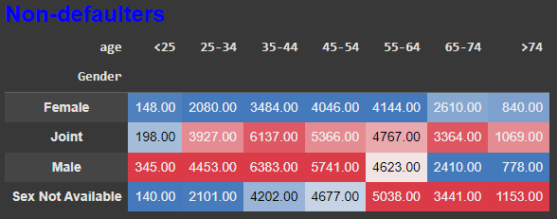
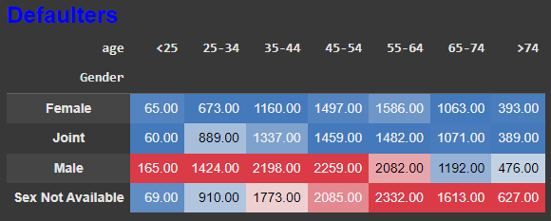
Gender, Age, and Loan Default Status
Gender: Males have a slightly lower default rate compared to females.
Age Group: Default rates are highest in the 35-54 age range. This could indicate that middle-aged borrowers may face more financial stress or have less stable financial situations.
“Sex Not Available” Category: This category has an unusually high proportion of non-defaulters, suggesting potential data quality issues or missing values that may need to be addressed.
Notes:
This slide helps to uncover the influence of demographic factors, like gender and age, on loan defaults.

Slide 6
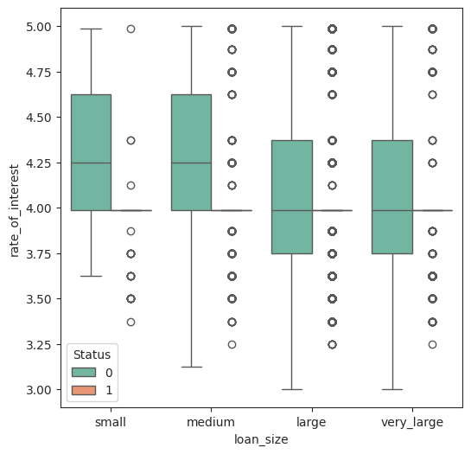
Loan Amount, Interest Rate, and Default
The rate of interest decreases with the increase in loan size.
The defaulters are concentrated at 4% rate of interest, across loan_size.
Notes:
This slide underscores the relationship between loan terms (amount and interest rate) and the risk of default.

Slide 7
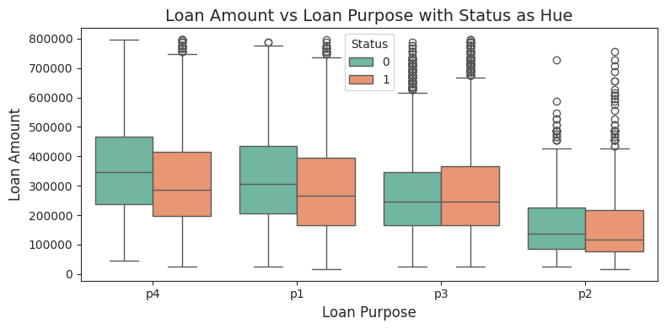
Loan Amount, Loan Purpose, and Default
Non-defaulters have higher loan amounts than defaulters across all loan purposes, except for p3.
Loan amounts for p3 are the same for both non-defaulters and defaulters, suggesting other factors may influence defaults in this category.
Notes:
This slide provides insight into how loan type and its purpose affect default rates.

Slide 8
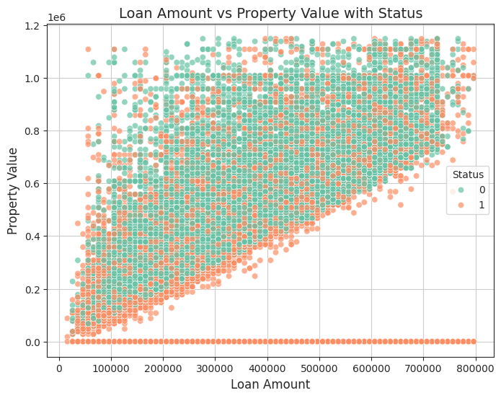
Loan Amount, Property Value, and Default
Property Value = 0 and higher Loan Amount correlates with higher default rates
Suggesting that borrowers with larger loans but fewer assets are at greater risk of defaulting.
Notes:
This slide illustrates how asset value (property) and liability (loan amount) interact to affect default likelihood.

Slide 9
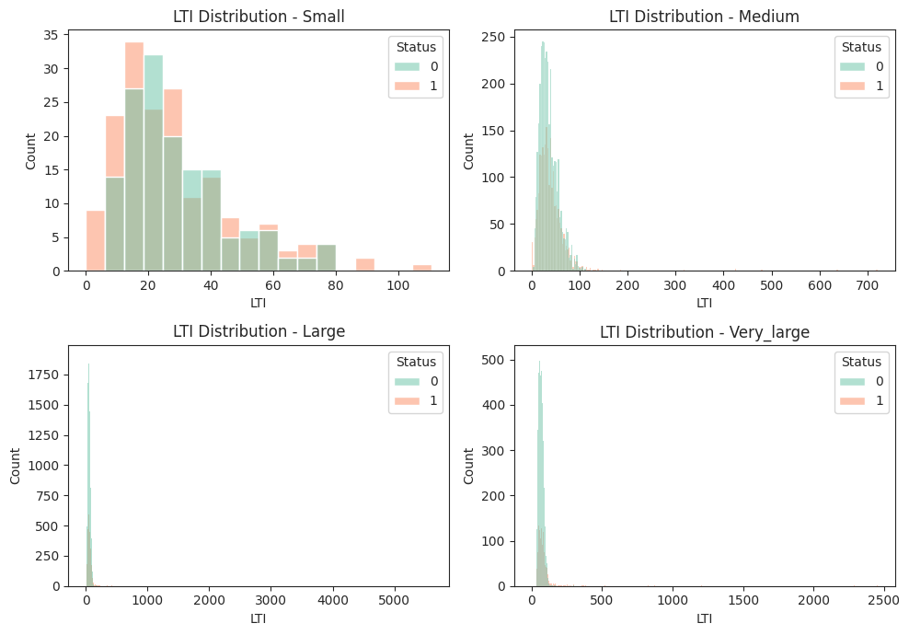
LTI Distribution vs Status by loan_sizes
Higher LTI ratios in small loan categories indicate that borrowers with smaller loans typically have lower incomes.
Borrowers with medium to very large loans exhibit improved LTI ratios, reflecting their higher income levels and better financial stability.
Notes:
This slide provides a critical analysis of financial leverage and its effect on loan defaults.

Slide 10
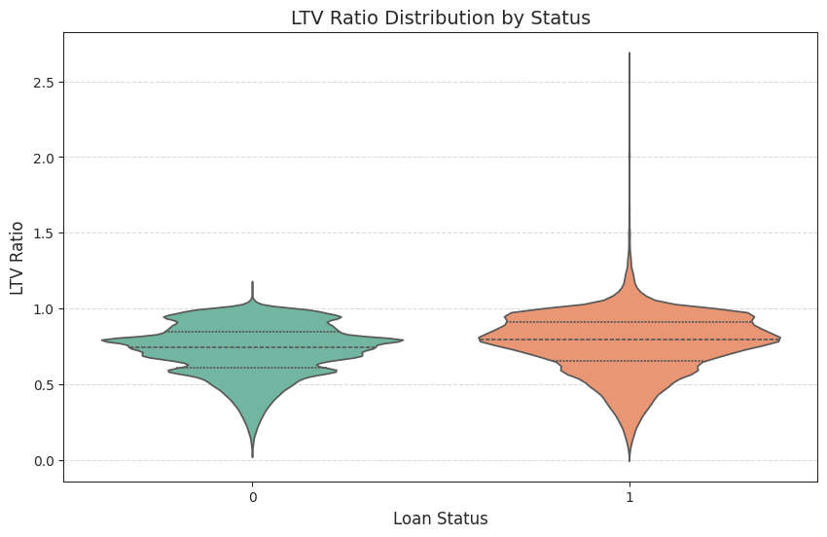
LTV Ratio vs Status
LTV = Loan Amount / Property Value
If LTV > 1.1 , then Status = Defaulters
Notes:
This slide provides a critical analysis of financial leverage and its effect on loan defaults.

Slide 11
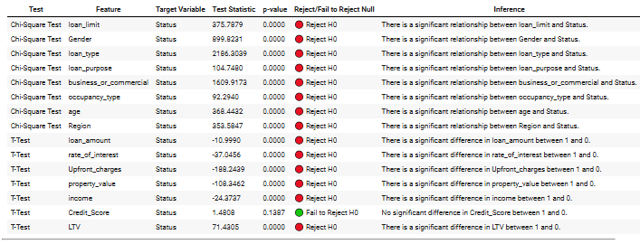
Hypothesis Testing Summary
Notes:
This slide emphasizes the need to rethink the importance of certain features, such as Credit Score, when building models.

Slide 12
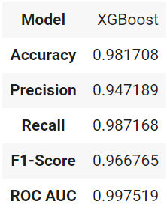
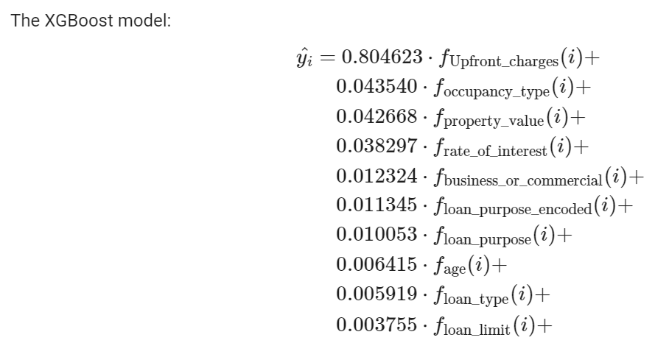
Classification Modelling
Summary:
The key takeaway is that Upfront Charges are the most important factor influencing the predicted outcome.
The other features like Occupancy Type, Property Value, and Rate of Interest have smaller but still relevant impacts on the prediction.
Features such as Flag No Property and Missing Loan Purpose are effectively neutral in this model, as their coefficients are zero.
Notes:
https://colab.research.google.com/drive/1Yx1w9rqCj3Eq3HKhY5OjmjLNBai3lLaa?usp=sharing

Slide 13
Recommendations
Strategy | Description | Purpose
LTV Ratio Limits | Keep Loan-to-Value (LTV) ratios below 1 to reduce default risk. | Minimize loan amount vs. property value.
Targeted Loan Products | Adjust interest rates and terms for high-risk loans. | Discourage risky borrowers with tailored terms.
Income Verification Policies | Use Loan-to-Income (LTI) checks to verify income sufficiency. | Ensure borrowers can afford the loan.
Proactive Risk Monitoring | Regularly analyze borrower data to flag potential defaulters. | Identify risks early to take corrective action.
Predictive Features | Use data like Loan Amount, Interest Rate, Income, Property Value, LTV, Gender, and Age in default prediction. | Enhance predictions of loan default risk.
Address Data Quality Issues | Resolve missing values in key variables and mitigate gender bias. | Improve model accuracy by ensuring clean data.
Notes:
This slide summarizes the key takeaways from the EDA and points out areas needing further refinement.

Slide 14
Conclusion
Key Takeaway:
A data-driven approach to risk analytics can significantly reduce default risks. Leveraging insights into borrower behavior, loan characteristics, and financial metrics enables smarter lending decisions.
Next Steps:
Extend the analysis to include additional datasets and variables. Implement machine learning models for predictive risk scoring.
Notes:
This final slide wraps up the analysis and outlines the necessary steps for moving toward model development.

