Slide 1
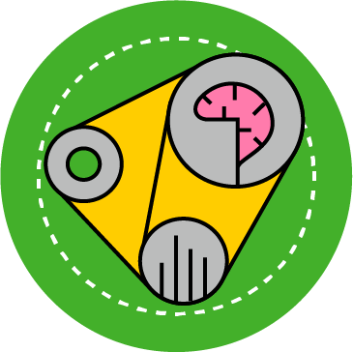

Sai Samyukta Palle - Virtual Trial Rooms
Artificial Intelligence Guild Apprentice Capstone Presentation
Sense & Incubate | 2022

Slide 2
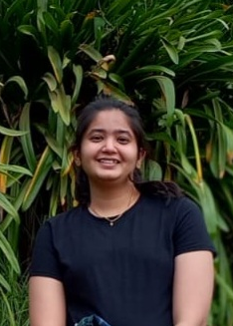
Introduction
Why am I learning about Machine Learning and Artificial Intelligence?
According to Ford Motor Company’s survey about driving habits, 49% of Indian respondents spend more than twelve hours a week driving. Prolonged driving results in -
innumerable accidents
negative psychological effects
1
2
In fashion space, fear of how a style (e.g. clothing apparels & hairstyles) will look is a big obstacle.
Countless such applications, made me passionate about Computer Vision space, especially –
Segmentation Maps
Pose Estimation
Biographical Details
Level: Analyst
Offering Portfolio: Core Business Operations
Offering: Application Modernization & Innovation
Industry / Sector: TMT

Slide 3
Capstone
Overview & Major Highlights

Slide 4
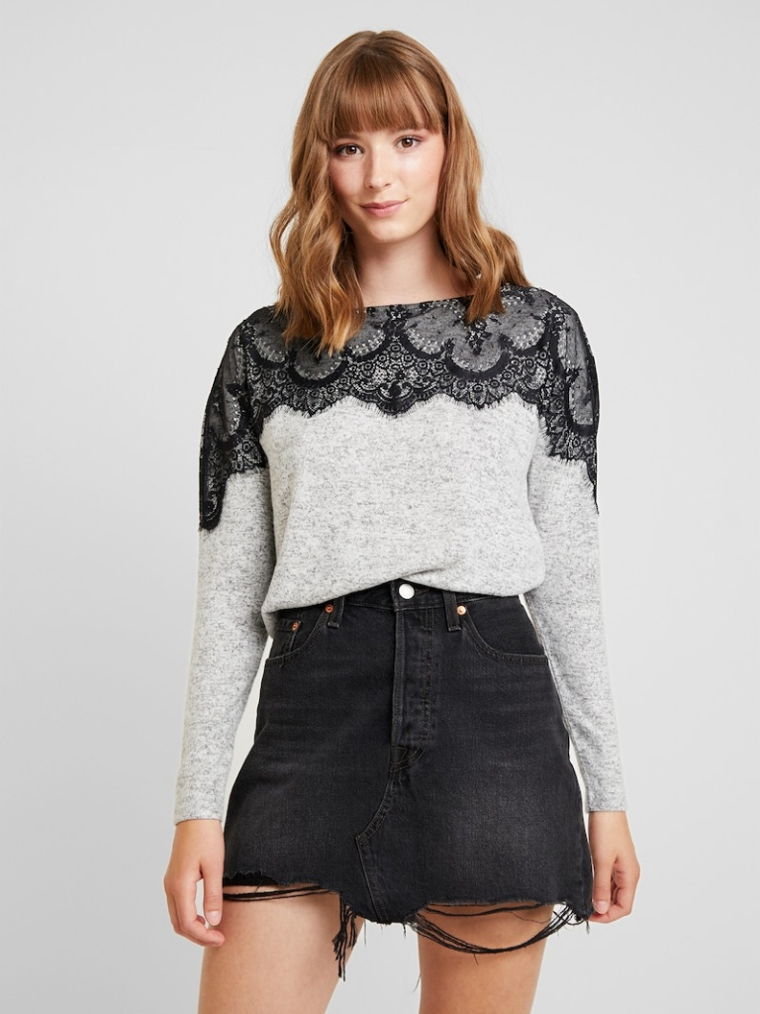
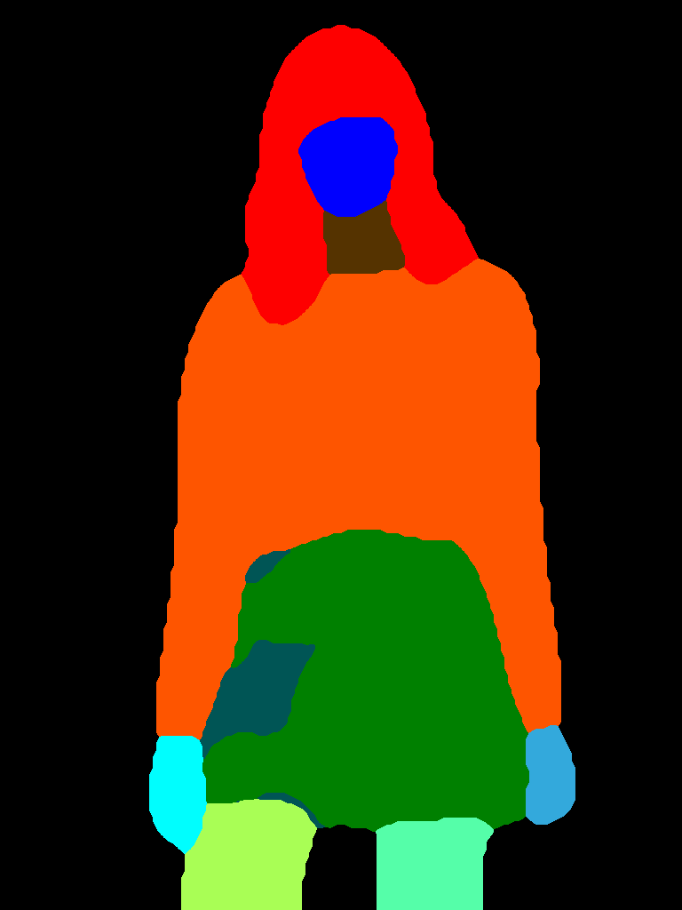
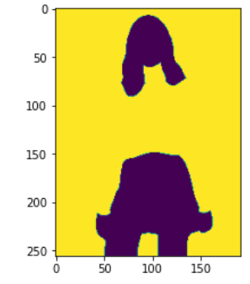
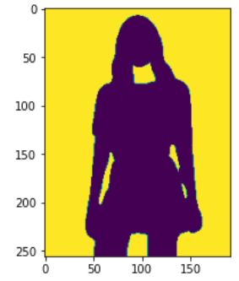
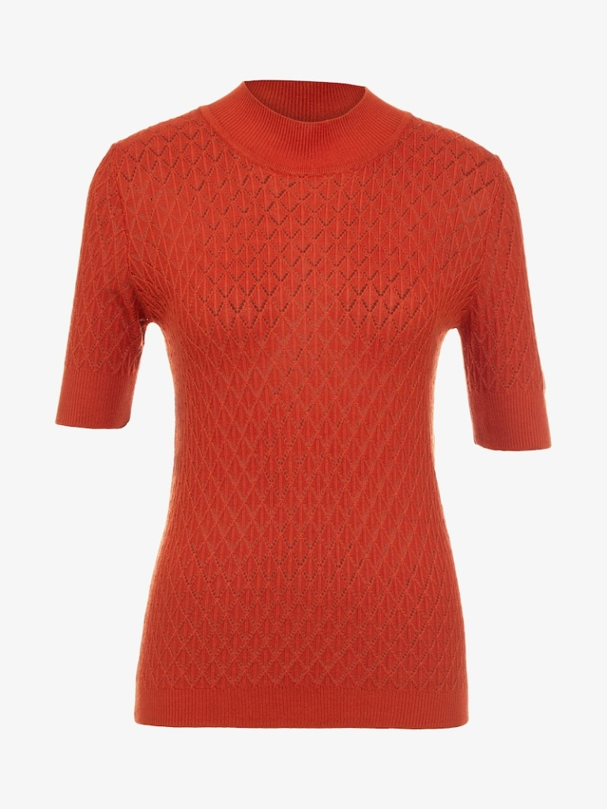
Virtual Trial Rooms
A Network that can enable users to virtually try on clothes. Worked on a Segmentation Map of an individual with a new clothing item.
VITON HD paper
1
2
3
5
4
Kaggle
4

Slide 5
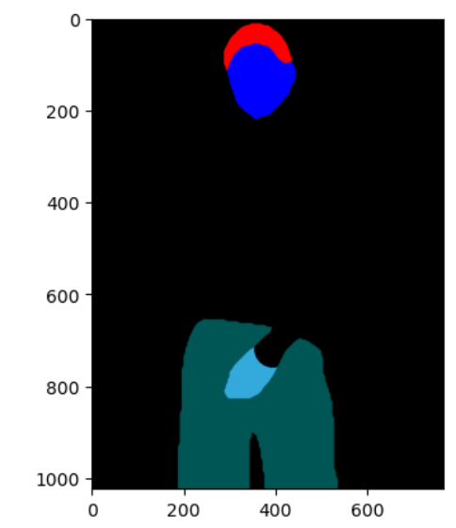
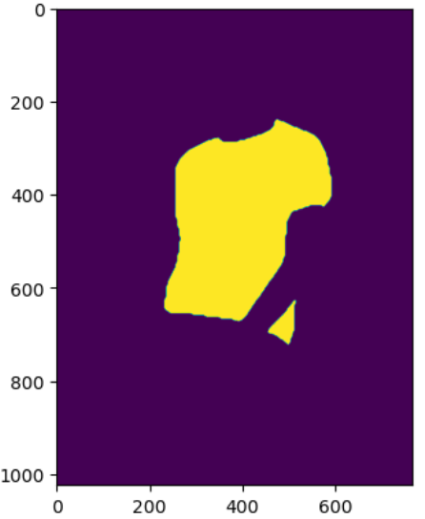
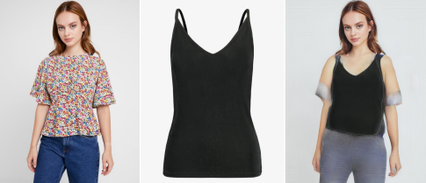
Preprocessing
Segmentation into –
Upper, Lower, Neck and Arms & Legs
Removing Upper Mask (Till Wrist)
Hence, for arms used Pose Information

Slide 6
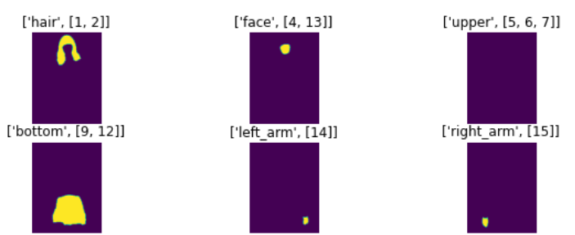
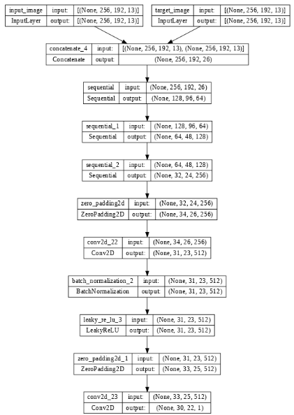
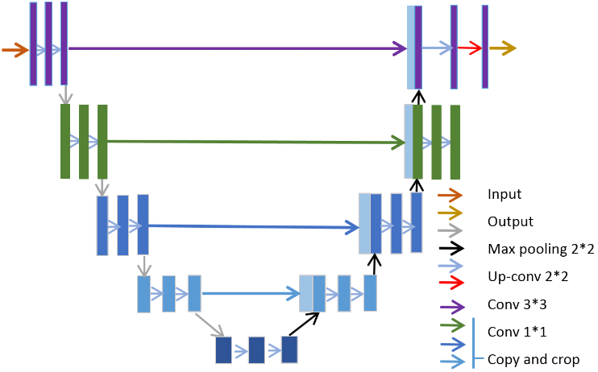
Model
Input – Clothing + Segmentation Map (with 13 categories like hair, face, upper) + Pose Information -> (m, height, width, 21)
Output – Segmentation Map with new Clothing -> (m, height, width, 13)
GAN –
Generator
Discriminator

Slide 7
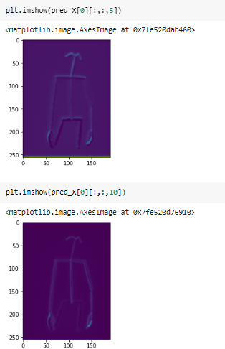
Issues
The code is not able to take each channel as different feature.

Slide 8
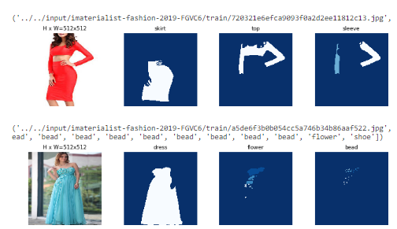
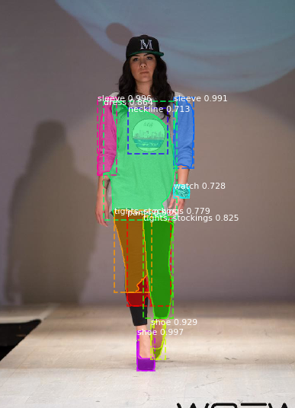
Additional Tasks …
Clothing Segmentation:
Used –
Mask RCNNs
Trained on “head” layers
Hyperparameters –
Learning Rate
Epochs

Slide 9
Learning Outcomes

Slide 10
Conclusion & Next Steps
And our skills grow
Your Learning Outcomes
There is a shortage of data where one person is wearing multiple different garments. (Led to manually editing using Photoshop)
GANs concept - U-Net Architecture
Torch
Growing Your Mastery
Creating data.
Learning more about GANs (Extending its uses in NLP)
Participating in hackathons related to the same field.
Giving Back
Seeking new project opportunities in the space.

Slide 11
Thank You!

