Slide 1
Chicago Crime Data Analysis
Daniel Sanchez
BAN 502
Dr. Stephen Hill
Course Project – Phase One

Slide 2
Overview
This presentation highlights findings from an analysis of 14,630 crimes reported in Chicago in the year 2018.
Findings will include:
Arrests vs Non-Arrests
Strong Predictors of Arrest Rates
Location and Crime Type Trends

Slide 3
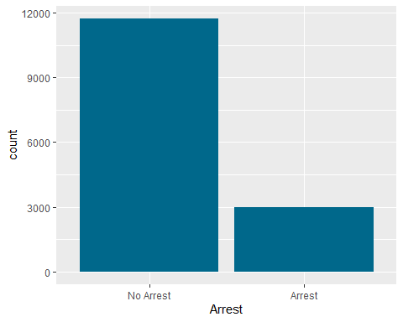
Arrest Rates
Overall, non-arrests far outweigh arrests for crimes reported.

Slide 4
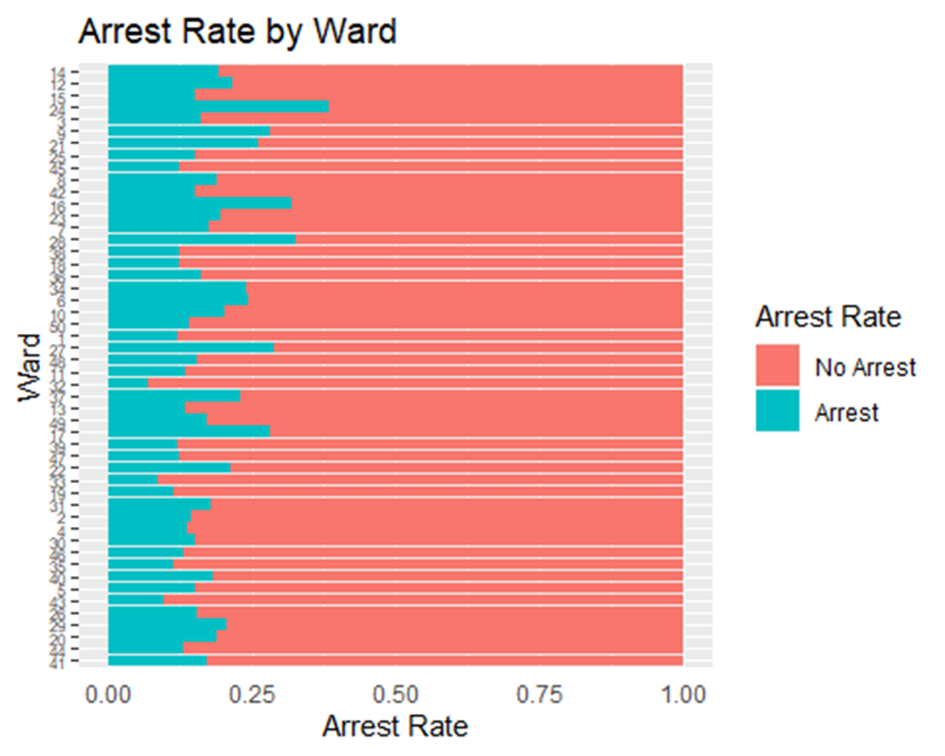
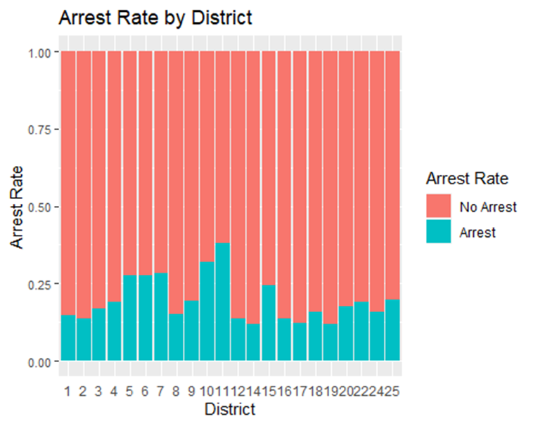
Fluctuations in arrest rates by ward show more arrests in certain areas than others.
District where the crime occurs may also help predict the arrest rate.

Slide 5
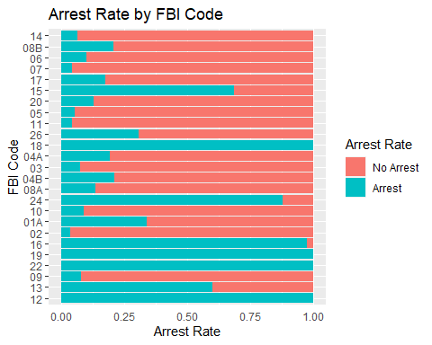
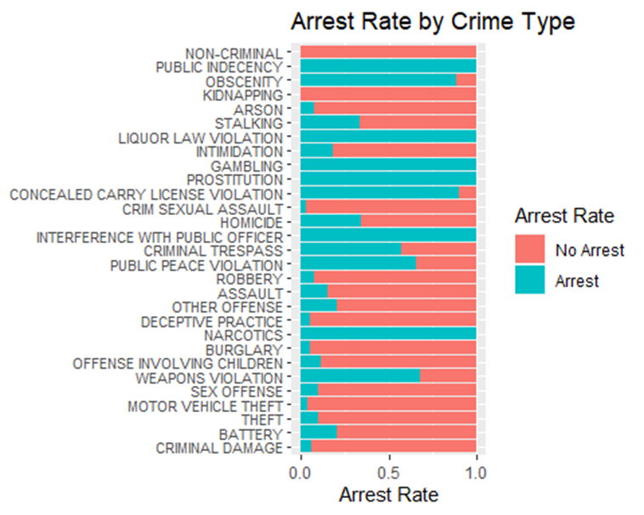
The arrest rate between the FBI Codes of crimes varies greatly.
Primary Crime Type is also predictive of the rate of arrest. Note the high arrest rate of sting operations and direct police involvement.

Slide 6
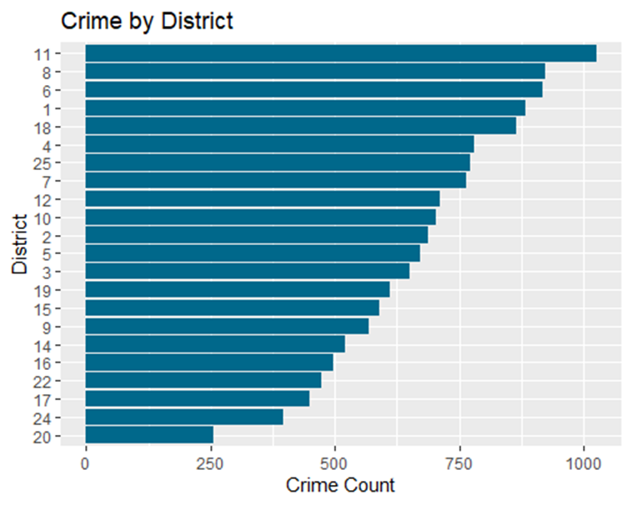
Crime Location
Total crimes reported varies by district.
District 11, 8, and 6 are the top three districts for crimes reported.

Slide 7
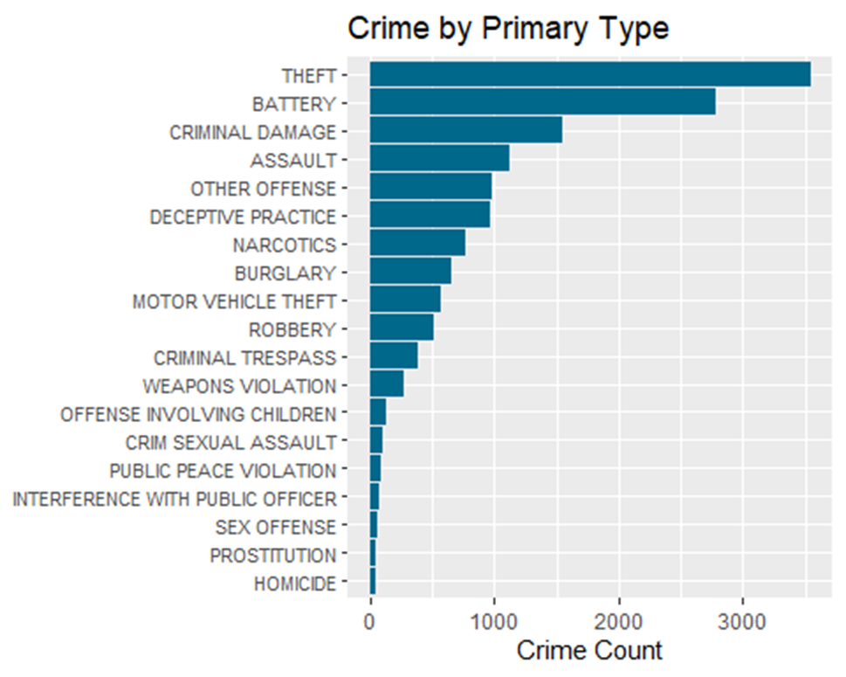
Crime Type
Top three primary crime types include theft, battery, and criminal damage.

