Slide 1
History
Suleyman Demirel University
CSS634: Deep Learning
PhD Abay Nussipbekov

Slide 2
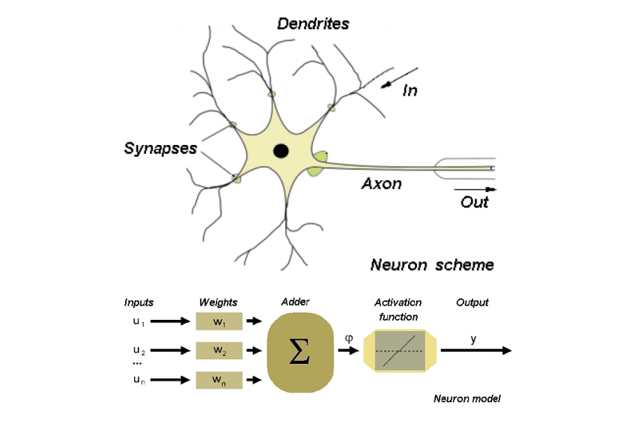
First Generation Neural Networks: McCullogh Pitts (1943)

Slide 3
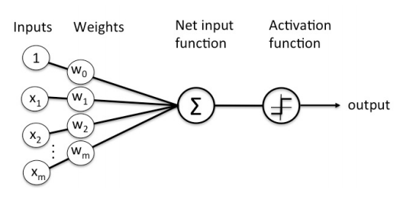
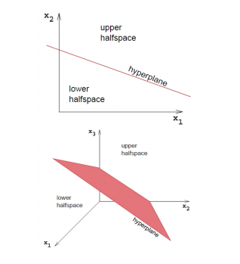
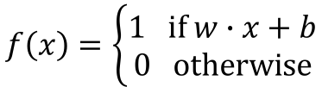
Frank Rosenblatt's Perceptron (1957)
$$f\left(x\right)=\left\{\begin{matrix}1 if w∙x+b \\ 0 otherwise\end{matrix}\right.$$
Assumes data are linearly separable
A perceptron represents a decision surface in a d dimensional space as a hyperplane
Many boolean functions can be represented by a perceptron: AND, OR, NAND,NOR

Slide 4
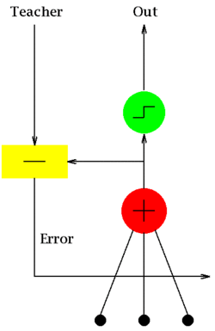

Widrow and Hoff's ADALINE (1960)
A nicely differentiable neuron model
Adaline is a single layer neural network with multiple nodes where each node accepts multiple inputs and generates one output.
$$y=\sum_{j=1}^{n}{x_{j}w_{j}+c}$$

Slide 5
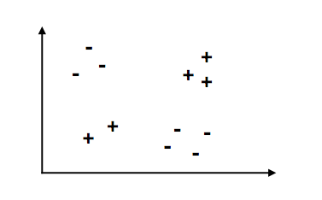
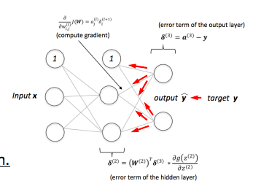
Problems
Perceptrons (and ADALINEs) could not solve XOR problems
Neurons, a dead end? Start of the first "AI Winter”
Solution to the XOR problem: hidden layers and non-linear activation functions
New problem: Hard to train
Solution: Backpropagation
It was later shown that "neural nets" are universal function approximators
Hornik, K., Stinchcombe, M., & White, H. (1989). Multilayer feedforward networks are universal approximators. Neural networks, 2(5), 359-366.

Slide 6
Improvements
Shortly after followed a breakthrough in image recognition using some clever enhancements to
a) make training more efficient
b) extract local features (and better capture feature dependency)
by
Weight sharing
Pooling
LeCun, Y., Boser, B., Denker, J. S., Henderson, D., Howard, R. E., Hubbard, W., & Jackel, L. D. (1989). Backpropagation applied to handwritten zip code recognition. Neural computation, 1(4), 541-551.

Slide 7
Other Early Works
Recurrent Neural Networks and Backpropagation through time
Some time created in the 1980's based on Rumelhart's work
New problems: vanishing and exploding gradients!
Schmidhuber, Jürgen (1993). Habilitation thesis: System modeling and optimization. Page 150 ff demonstrates credit assignment across the equivalent of 1,200 layers in an unfolded RNN.
Solution: LSTMs (still popular and commonly used)
Hochreiter, S., & Schmidhuber, J. (1997). Long short-term memory. Neural computation, 9(8), 1735-1780.

Slide 8
New Problems
2nd "AI Winter" in the late 1990's and 2000's
Probably due to popularity of Support Vector Machines and Random Forests
Also, neural networks were still expensive to train, until GPUs came into play

Slide 9
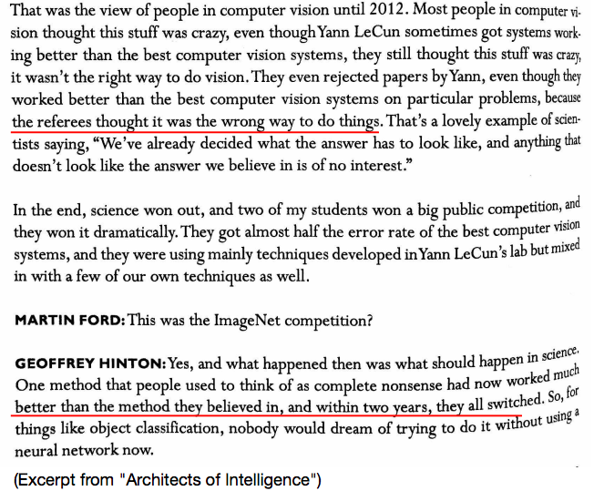
When did Deep Learning Become Really Popular

Slide 10
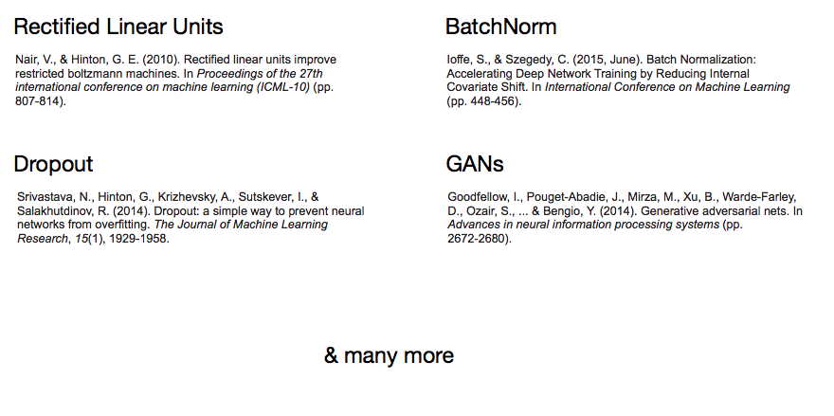
New Enhancements

Slide 11
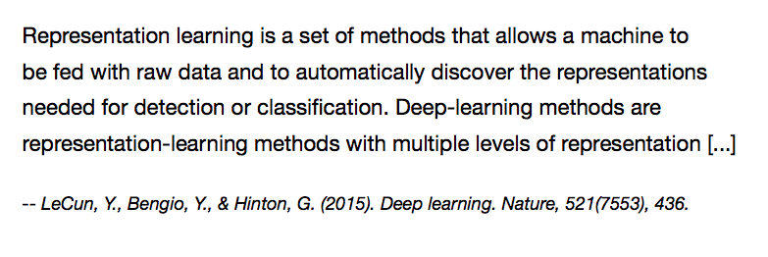
“Deep Learning” term

Slide 12
Publishing Culture
In contrast to most other fields:
Mostly Open Access
Mostly Conferences (double-blind peer review, competitive ~25% acceptance rate)
Usually preprints online

Slide 13
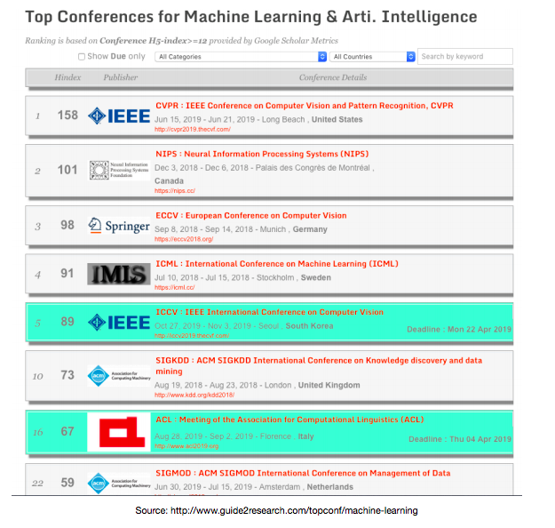

Slide 14
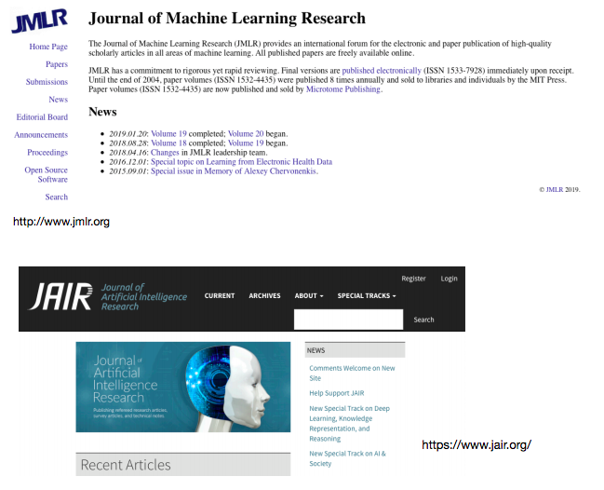

Slide 15
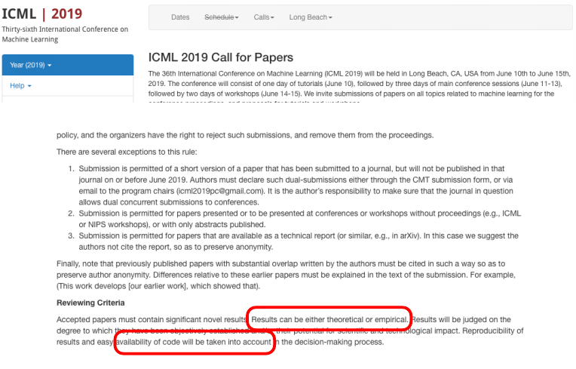

Slide 16
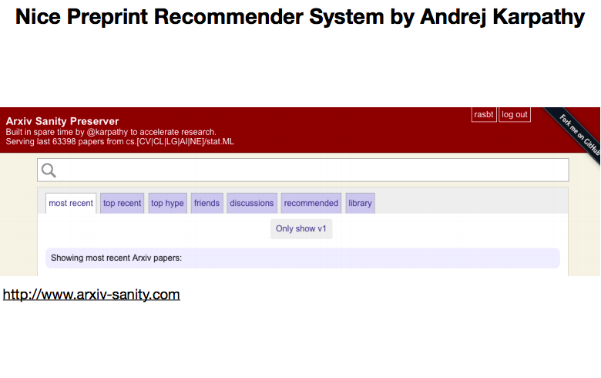

Slide 17
Current Trends
Applications across fields and in industry
Engineering new tricks
Developing specialized hardware
Developing theory and understanding

Slide 18
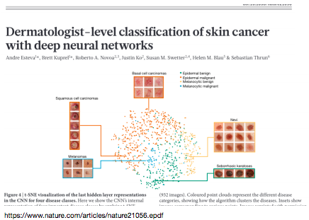
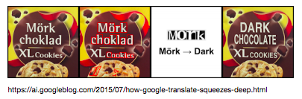
Applications

Slide 19
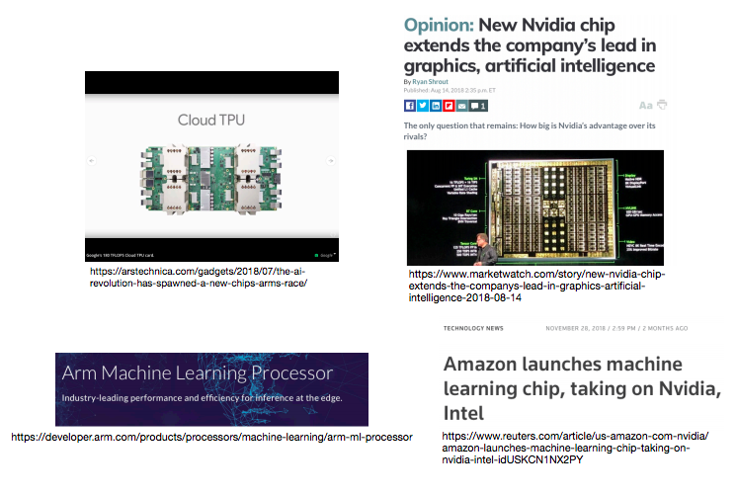
Developing Specialized Hardware

Slide 20
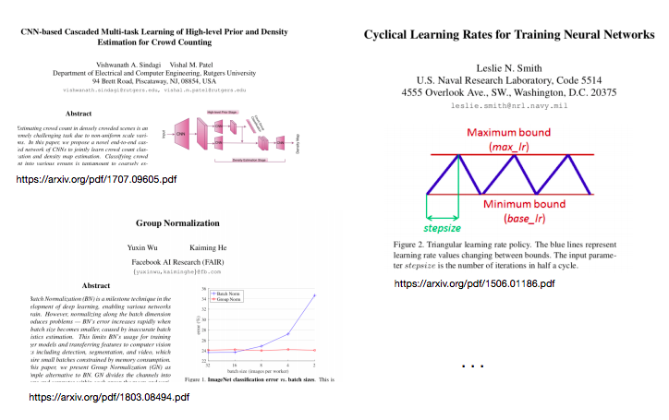
Engineering New Tricks

Slide 21
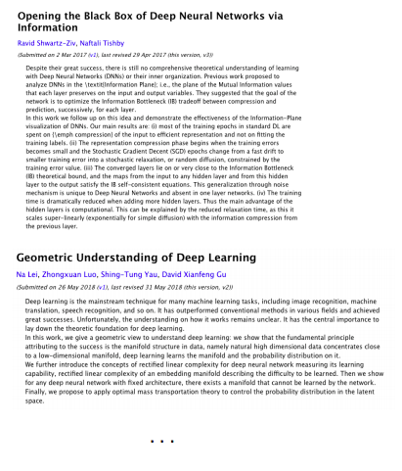
Developing Theory and Understanding

Slide 22
Resources Used
STAT 479: Deep Learning by Sebastian Raschka
CMSC 35246 Deep Learning by Shubhendu Trivedi and Risi Kondor

