Slide 1
Overview
Suleyman Demirel University
CSS634: Deep Learning
PhD Abay Nussipbekov

Slide 2
Topics
Overview
The Perceptron
Logistic Regression and Multi-class Classification
Neural Networks
Regularization, Normalization and Weight Initialization
Learning Rates and Optimization Algorithms
Convolutional Neural Networks
Recurrent Neural Networks
Autoencoders
Generative Adversarial Networks
Reinforcement Learning

Slide 3
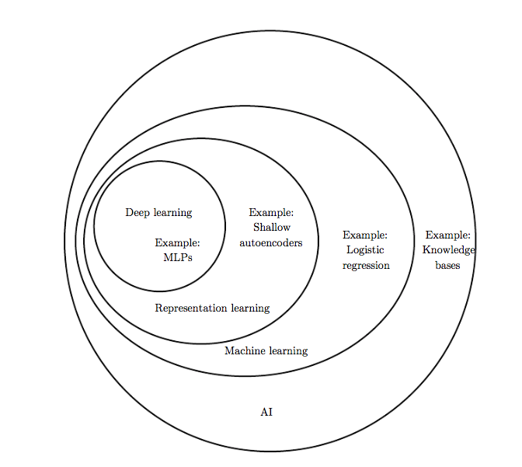
What is Deep Learning?

Slide 4
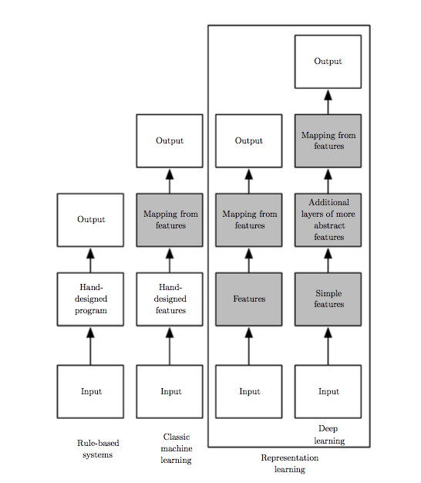
What is Deep Learning?

Slide 5
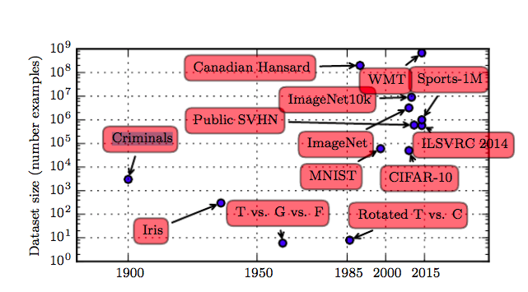
Increasing Dataset Sizes
Acceptable performance with around 5,000 labeled examples per category
Human performance when at least 10 million examples

Slide 6
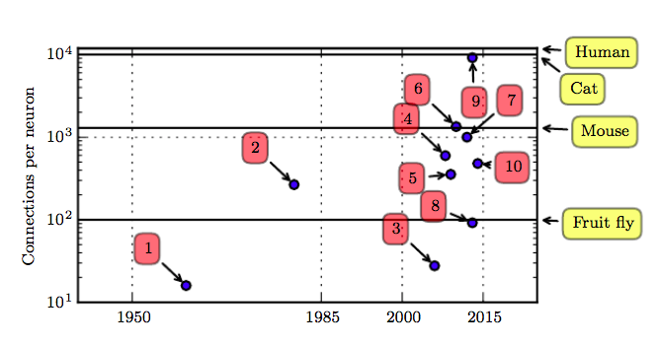
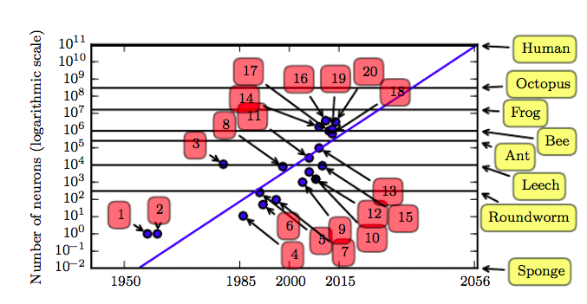
Increasing Model Sizes
Unless new technologies allow faster scaling, we will not have the same number of neurons as the human brain until at least the 2050s (may be even larger as biological neurons may represent more complicated functions).

Slide 7
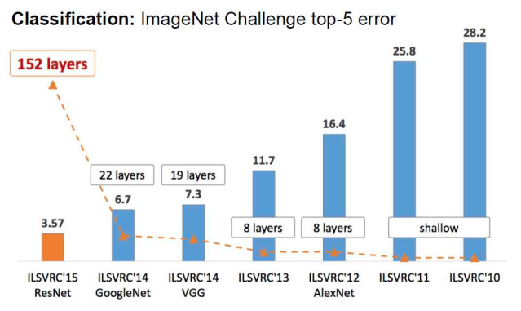
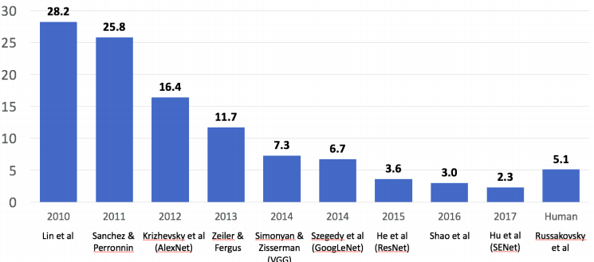
Increasing Accuracy, Complexity and Real-World Impact
Individual objects in tightly cropped, extremely small images (Rumelhart et al., 1986a)
Modern networks typically recognize at least 1,000 different categories of objects

Slide 8
AI Effect
AIS researcher Rodney Brooks complains "Every time we figure out a piece of it, it stops being magical; we say, 'Oh, that's just a computation.'"

Slide 9
Before diving in
Let’s recap what is machine learning first…

Slide 10
Machine Learning
“Machine learning is the field of study that gives computers the ability to learn without being explicitly programmed” – Arthur L. Samuel, AI pioneer, 1959
“Machine learning is automating automation” (Prof. Pedro Domingo, University of Washington)

Slide 11
Why Machine Learning?
“A breakthrough in machine learning would be worth ten Microsofts” (Bill Gates, Chairman, Microsoft)
“Machine learning is the next Internet” (Tony Tether, former director, DARPA)
“Machine learning is going to result in a real revolution” (Greg Papadopoulos, former CTO, Sun)
Machine learning today is one of the hottest aspects of computer science” (Steve Ballmer, CEO, Microsoft)

Slide 12
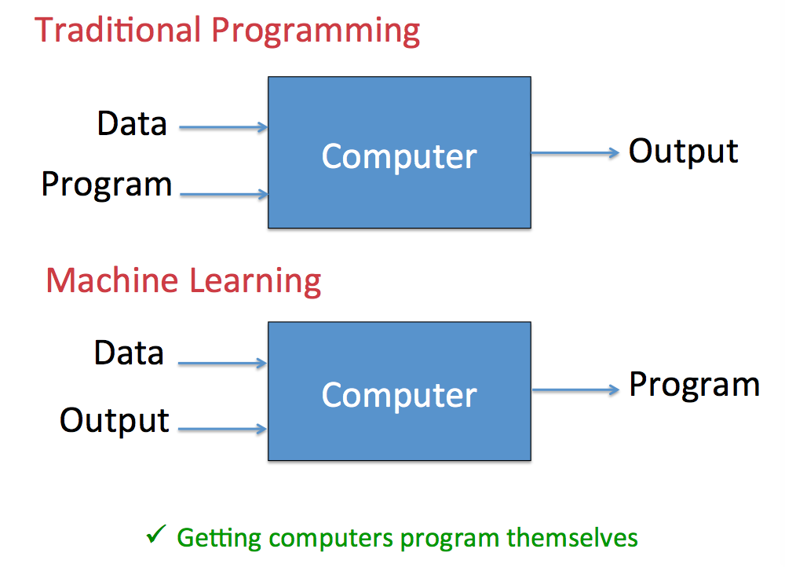
Machine Learning

Slide 13
Applications of ML/DL
Email spam detection
Face identification, recognition, verification (e.g., iPhone X)
Web search (e.g., Google, Baidoo)
Sports analytics and predictions
ATMs (e.g., reading checks)
Credit card fraud
Stock predictions

Slide 14
Applications of ML/DL
Smart assistants (Apple Siri, Amazon Alexa, ...)
Product recommendations (e.g., Netflix, Amazon)
Self-driving cars (e.g., Uber, Tesla)
Language translation (Google translate)
Robotics
Drug design
Medical diagnoses
Space
…

Slide 15
Types of Learning
Supervised learning
Training data includes desired outputs
Classification, regression
Unsupervised learning
Training data does not include desired outputs
Find hidden structure in data
Clustering, dimensionality reduction/representation learning
Reinforcement learning
The learner interacts with the world via “actions” and tries to find an optimal policy of behavior with respect to “rewards”(feedback) it receives from the environment
Learning with a critic who merely states that something is right or wrong, but does not say specifically how it is wrong.

Slide 16
Some Other Types of Learning
Semi-supervised learning
Training data includes a few desired outputs
Self supervised learning
Type of supervised learning where training data is autonomously labeled
In self-supervised learning, the system learns to predict part of its input from other parts of it input. In other words a portion of the input is used as a supervisory signal to a predictor fed with the remaining portion of the input. (Yann LeCun)

Slide 17
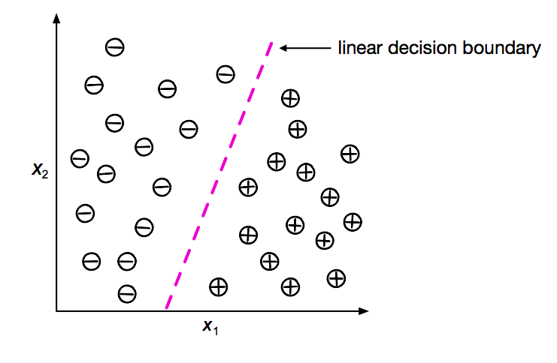
Supervised Learning: Classification
Binary classification example with two features ("independent" variables, predictors)

Slide 18
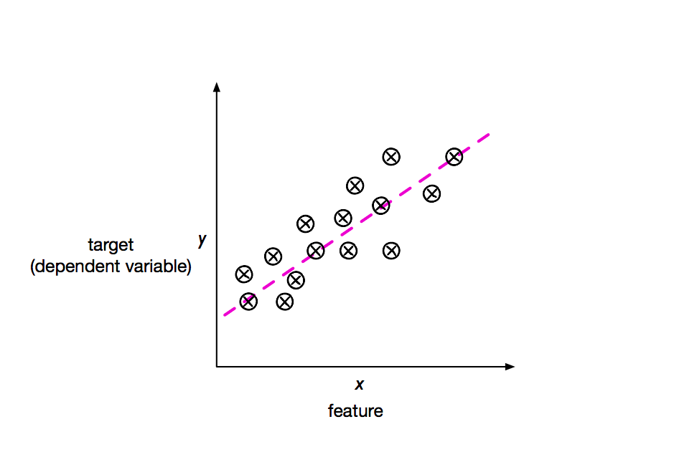
Supervised Learning: Regression

Slide 19
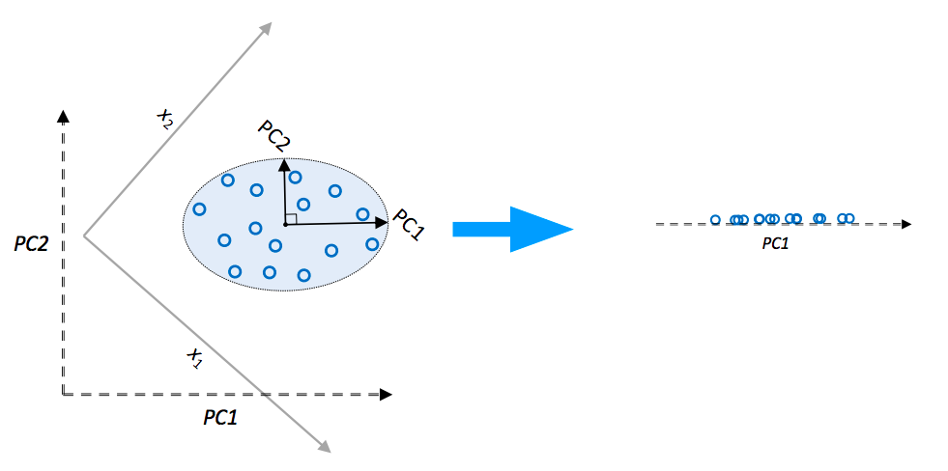
Unsupervised Learning: Representation Learning/ Dimensionality Reduction
E.g. Principal Component Analysis

Slide 20
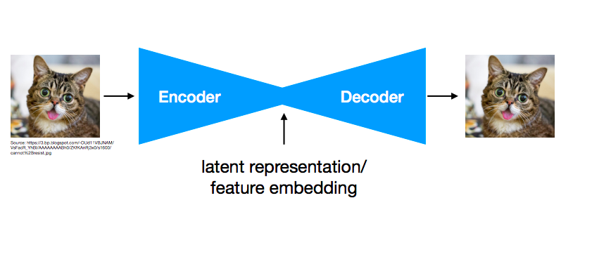
Unsupervised Learning: Representation Learning/ Dimensionality Reduction
E.g. Autoencoders

Slide 21
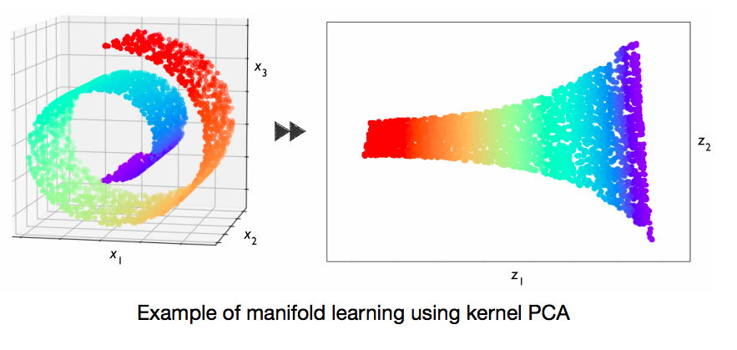
Unsupervised Learning: Representation Learning/ Dimensionality Reduction

Slide 22
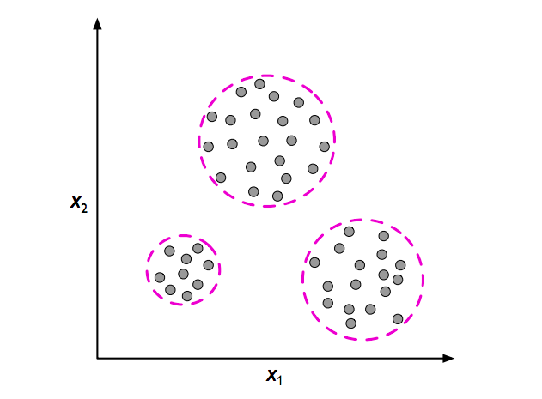
Unsupervised Learning: Clustering
Assigning group memberships to unlabelled examples

Slide 23

How to Choose Right Algorithm?

Slide 24
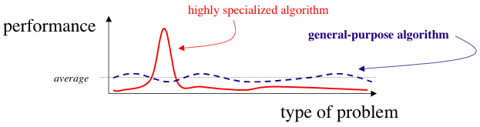
The No Free Lunch Theorem
“Any two optimization algorithms are equivalent when their performance is averaged across all possible problems” (Wolpert 1996).
In other words, in some sense, no machine learning algorithm is universally any better than any other.

Slide 25
Steps in developing ML application
Collect data
Scraping a website
RSS feed
API
Read from different devices (wind speed, blood glucose levels, etc.)
Use publicly available data
Prepare the input data
Make sure it’s in a usable format (lists, matrices, dictionaries, etc.)
Algorithm-specific formatting (e.g. need features in a special format, target variables and features as strings or integers)
The choice of the distinguishing features is critical. Depends on problem. Needs prior knowledge.

Slide 26
Steps in developing ML application
Analyze the input data
Looking at the data simply in a text editor to make sure you don’t have empty values or if you can recognize any patterns or if there’s anything obvious, such as a few data points that are vastly different from the rest of the set.
Plotting data in one, two, or three dimensions can help. But most of the time you’ll have more than three features.
If it’s a production system and you know what the data should look like, or you trust its source, you can skip this step. This step is human involvement which is not for automated system. It makes you understand you don’t have garbage coming in.

Slide 27
Steps in developing ML application
Train the algorithm
This is where the ML takes place. This step and the next step are where the “core” algorithms lie, depending on the algorithm. You feed the algorithm good clean data from the first two steps and extract knowledge or information.
Unsupervised algorithms skip this step

Slide 28
Steps in developing ML application
Test the algorithm
Evaluate it to see how well it does. In the case of supervised learning, you have some known values you can use to evaluate the algorithm. In unsupervised learning, you may have to use some other metrics to evaluate the success.
In either case, if you’re not satisfied go to step 4 or 1
Cost – depends on problem domain.

Slide 29
Main components of ML
Tens of thousands of machine learning algorithms
Hundreds new every year
Every machine learning algorithm has three components:
Representation
Evaluation
Optimization

Slide 30
Representation
Decision trees
Sets of rules / Logic programs
Instances
Graphical models (Bayes/Markov nets)
Neural networks
Support vector machines
Model ensembles
Etc.

Slide 31
Evaluation
Accuracy
Precision and recall
Squared error
Likelihood
Posterior probability
Cost/Utility
Margin
Entropy
Etc.

Slide 32
Optimization
Combinatorial optimization
- E.g.: Greedy search
Convex optimization
- E.g.: Gradient descent
Constrained optimization
- E.g.: Linear programming

Slide 33
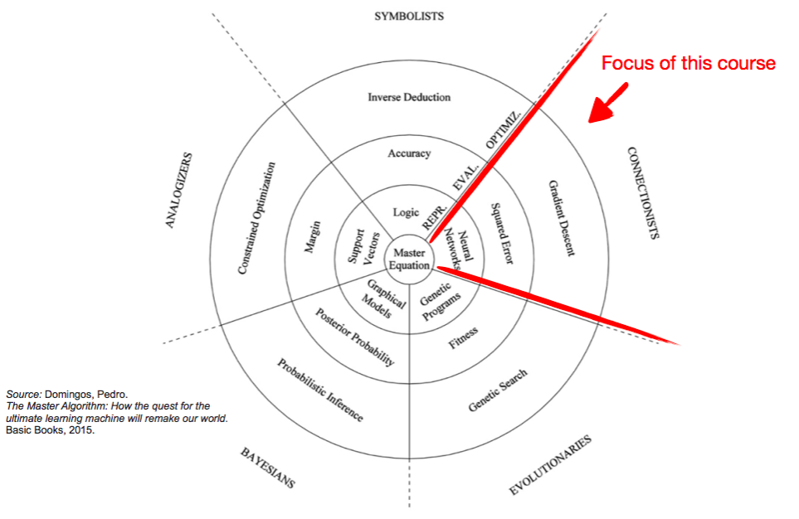
Pedro Domingo's 5 Tribes of Machine Learning

Slide 34
Cost Functions
Maximize the posterior probabilities (e.g., naive Bayes)
Maximize a fitness function (genetic programming)
Maximize the total reward/value function (reinforcement learning)
Maximize information gain/minimize child node impurities (CART decision tree classification)
Minimize a mean squared error cost (or loss) function (CART, decision tree regression, linear regression, adaptive linear neurons, ...)
Maximize log-likelihood or minimize cross-entropy loss (or cost) function
Minimize hinge loss (support vector machine)

Slide 35
Resources Used
Relatively new field, no “best” textbook
Deeplearningbook by Ian Goodfellow, Yoshua Bengio and Aaron Courville
Deeplearning.ai course by Andrew Ng
CS231n: Convolutional Neural Networks for Visual Recognition by Fei-Fei Li, Andrej Karpathy, Justing Johnson
STAT 479: Deep Learning by Sebastian Raschka
CMSC 35246 Deep Learning by Shubhendu Trivedi and Risi Kondor
Scientific papers, online references and etc.

Slide 36
Grade Policy
Midterm exam: 30%
Assignments: 30%
Final
- Practical part: 20%
- Theoretical part: 20%

Slide 37
Recommended Background
Linear Algebra: vectors, matrices, linear equations, …
Sanity check: What is identity matrix? Lp norm?
Probability and Statistics: types of probabilities, distributions, Bayes theorem, likelihood
Sanity check: Probability vs likelihood? Covariance matrix? pdf? Bayes theorem? Why is “naïve Bayes” naive?
Information Theory: entropy, …
Sanity check: why KL divergence is not a distance measure between 2 vectors?
Calculus: derivatives, chain rule, …
Sanity check: Chain rule? Jacobian matrix?
Numerical Calculations: gradient descent, …
Sanity check: what is numerical underflow?
Machine Learning: representation, evaluation, optimization
Sanity check: How to choose appropriate algorithm? How to detect overfitting and underfitting? Evaluation? Bootstraping, bagging, boosting?
Algorithms and Data Structures: time and memory complexities, dictionaries, sets, lists, sorting, …
Sanity check: explain hash map
Programming proficiency in Python:
Sanity check: Given two sparse matrices A and B, return the result of AB. (Assume A’s column number is equal to B’s rows number)
[p for p in range(100) if not (x for x in range(2,p) if not p%x)]
What are the generators and iterator in Python?
Confidence in Numpy:
Sanity check: how to find the positions of missing values in numpy array?
Desire: if you don’t have any of the above but a really strong desire, consistency and patience then that’s enough!

