Slide 1
Perceptron
Suleyman Demirel University
CSS634: Deep Learning
PhD Abay Nussipbekov

Slide 2
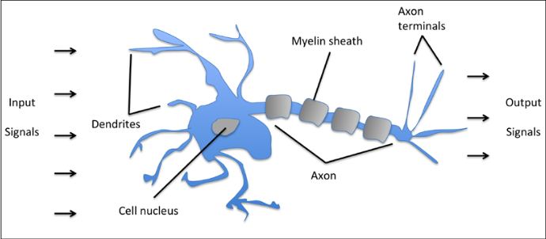
Inspired by Biological Brains and Neurons

Slide 3
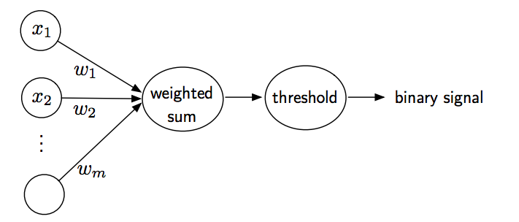
Logic Gate
Simple logic gate with binary outputs
Signals arrive at dendrites
Integrated into cell body
If signal exceeds threshold, generate output, and pass to axon

Slide 4
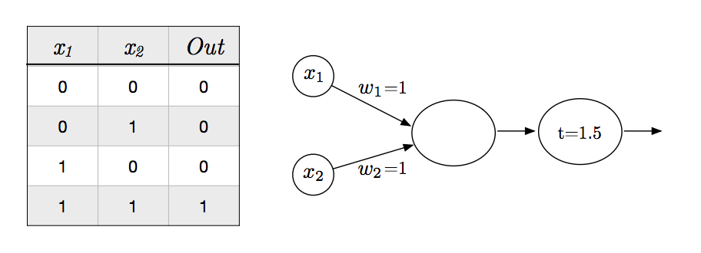
Logic AND Gate

Slide 5
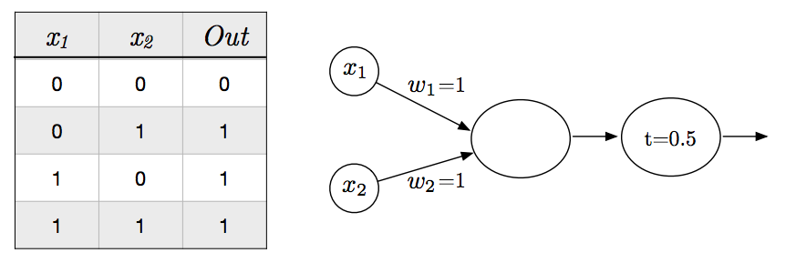
Logic OR Gate

Slide 6
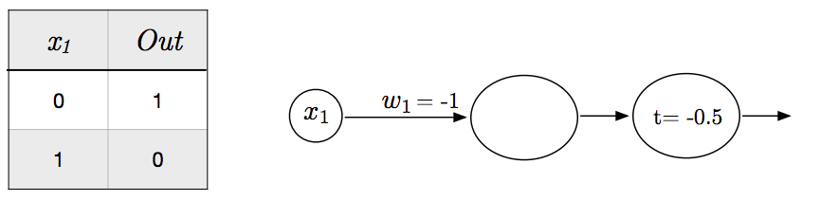
Logic NOT Gate

Slide 7
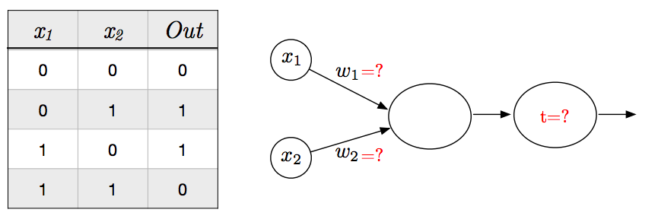
Logic XOR Gate

Slide 8

Rosenblatt Perceptron
Binary classification task
Positive class (1) vs. negative class (-1)
Define activation function $φ\left(z\right)$
Takes as input a dot product of input and weights
Net input: $z=w_{1}x_{1}+…+w_{n}x_{n}$
$$w=\left[\begin{matrix}w_{1} \\ w_{2} \\ \begin{matrix}⋮ \\ w_{n}\end{matrix}\end{matrix}\right], x=\left[\begin{matrix}x_{1} \\ \begin{matrix}x_{2} \\ ⋮\end{matrix} \\ x_{n}\end{matrix}\right]$$

Slide 9

Heaviside Step Function
$φ\left(z\right)$ known as activation
if activation above some threshold, predict class 1
predict class -1 otherwise
Heaviside Step Function
$$φ\left(z\right)=\left\{\begin{matrix}1 if z≥θ \\ −1 otherwise\end{matrix}\right.$$

Slide 10
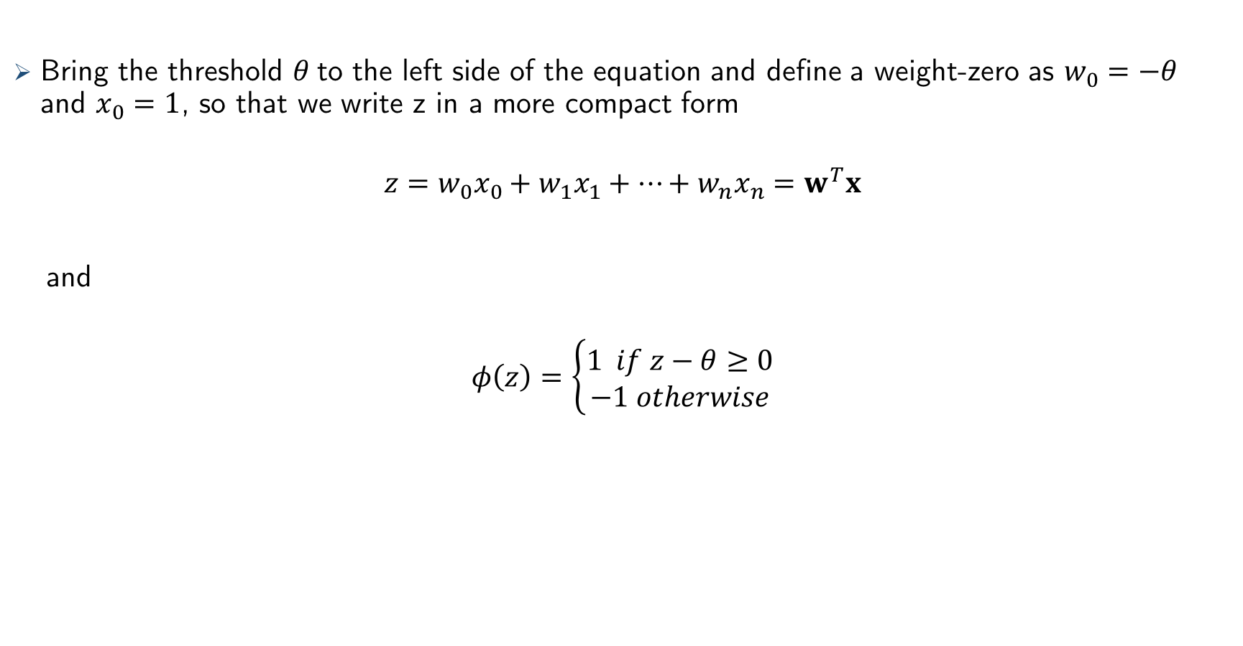
Step Function Simplified
Bring the threshold $θ$to the left side of the equation and define a weight-zero as $w_{0}=−θ$ and $x_{0}=1$, so that we write z in a more compact form
$$z=w_{0}x_{0}+w_{1}x_{1}+…+w_{n}x_{n}=w^{T}x$$
and
$$φ\left(z\right)=\left\{\begin{matrix}1 if z−θ≥0 \\ −1 otherwise\end{matrix}\right.$$

Slide 11


Basic Linear Algebra
Vector dot product
$$z=w^{T}x=\sum_{j=0}^{n}{w_{j}x_{j}}$$

Slide 12
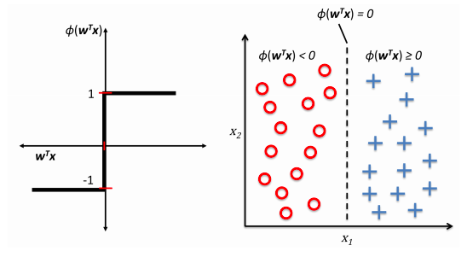
Input Squashed Into a Binary Output

Slide 13
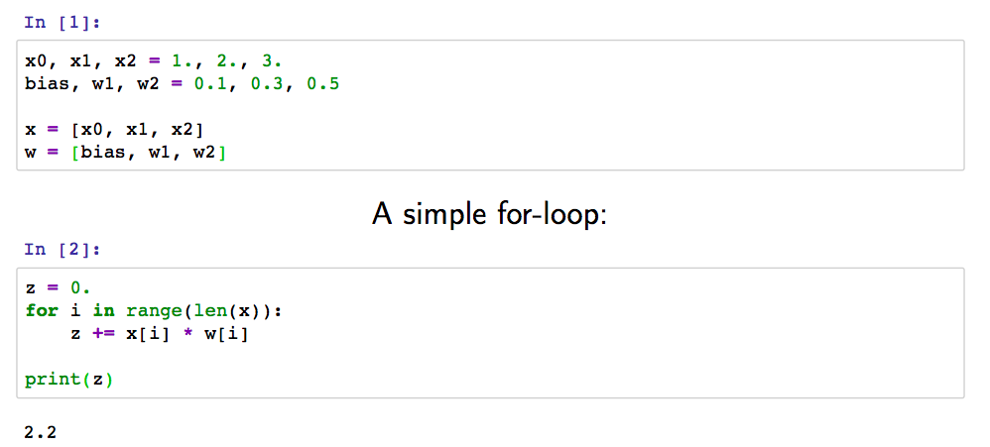
Interlude: Vectorization

Slide 14
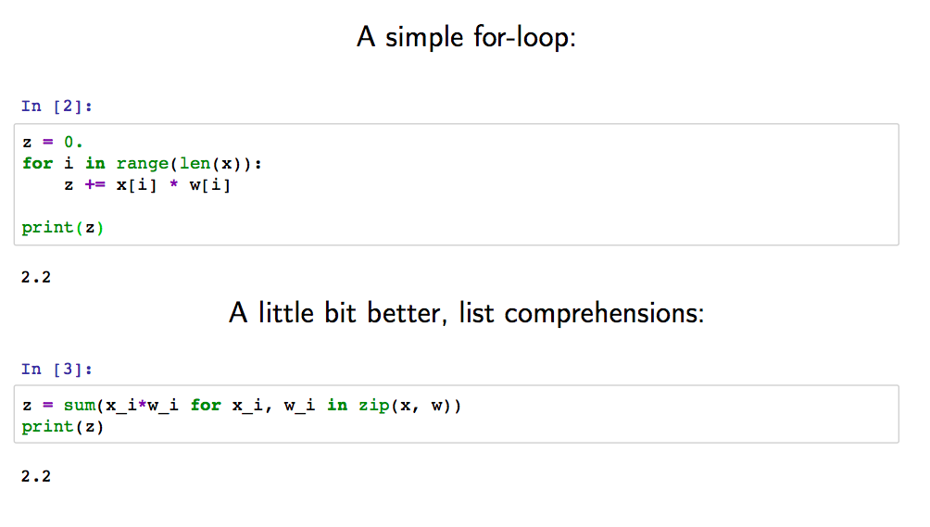
Interlude: Vectorization

Slide 15
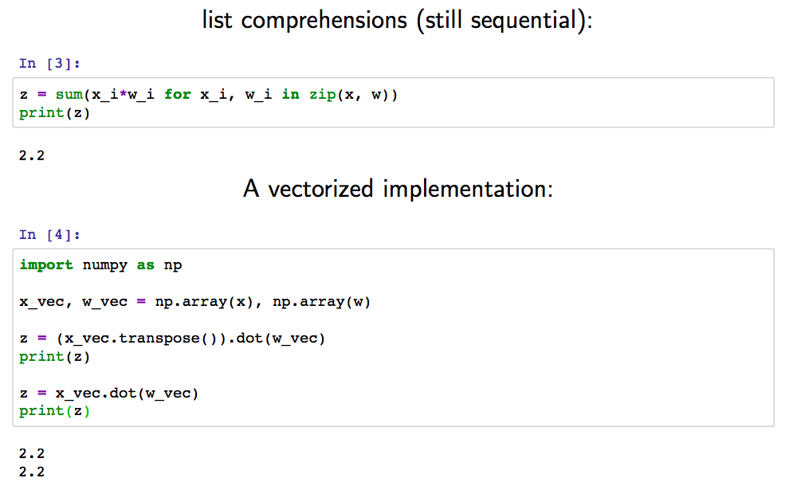
Interlude: Vectorization

Slide 16
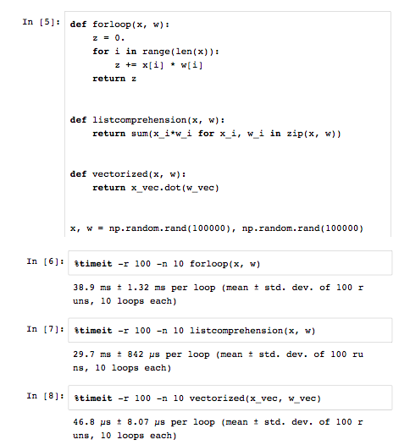
Interlude: Vectorization

Slide 17
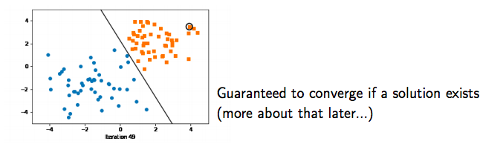
The Perceptron Learning Algorithm
If correct: Do nothing if the prediction if output is equal to the target
If incorrect, scenario a) If output is 0 and target is 1, add input vector to weight vector
If incorrect, scenario b) If output is 1 and target is 0, subtract input vector from weight vector

Slide 18

The Perceptron Learning Algorithm
Let
Initialize w:=0
For every training epoch:
A. For every $\left(x^{\left(i\right)}, y^{\left(i\right)}\right)∈𝒟:$
(a) ${\hat{y}}^{(i)} :=σ\left(x^{\left(i\right)T}w\right)$
(b) $err :=\left(y^{\left(i\right)}−{\hat{y}}^{\left(i\right)}\right)$
(c) $w≔w+err×x^{(i)}$
$$𝒟=(\left(x^{\left(1\right)},y^{\left(1\right)}\right),\left(x^{\left(2\right)},y^{\left(2\right)}\right), …,(x^{\left(m\right)},y^{\left(m\right)}))∈{(ℝ^{n}×\{0, 1\})}^{n}$$

Slide 19
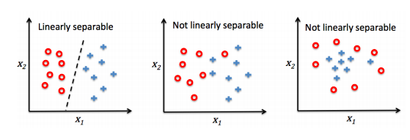
Linear Separability

Slide 20
Convergence
Convergence guaranteed if
The two classes linearly separable
Learning rate is sufficiently small
If classes cannot be separated:
Set a maximum number of passes over the training dataset (epochs)
Set a threshold for the number of tolerated misclassifications
Otherwise, it will never stop updating weights (converge)

Slide 21
Perceptron Conclusion
The (classic) Perceptron has many problems
Linear classifier, no non-linear boundaries possible
Binary classifier, cannot solve XOR problems, for example
Does not converge if classes are not linearly separable
Many "optimal" solutions in terms of 0/1 loss on the training data, most will not be optimal in terms of generalization performance

Slide 22
Resources Used
STAT 479: Deep Learning by Sebastian Raschka
Python Machine Learning book by Sebastian Raschka

