Slide 1





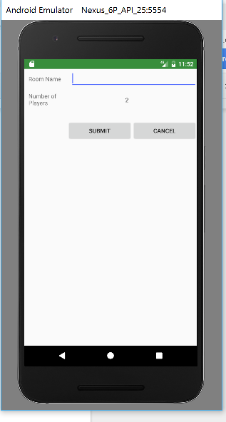
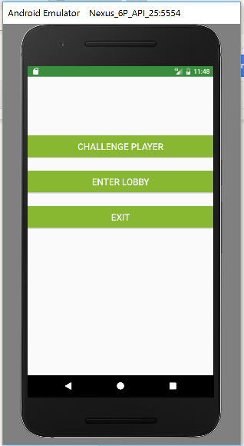
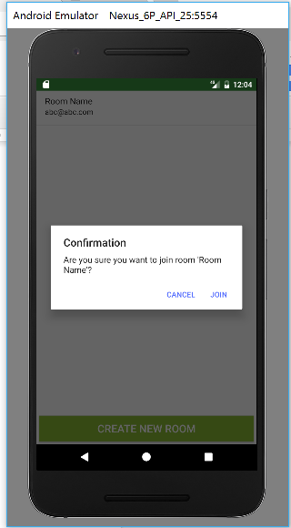
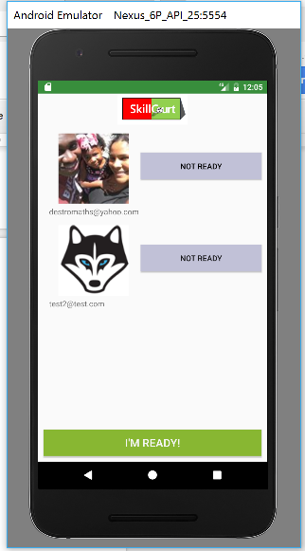
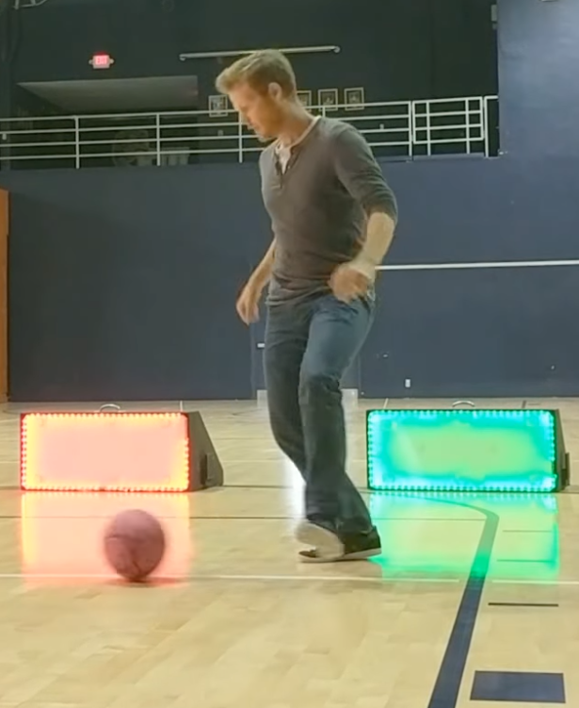
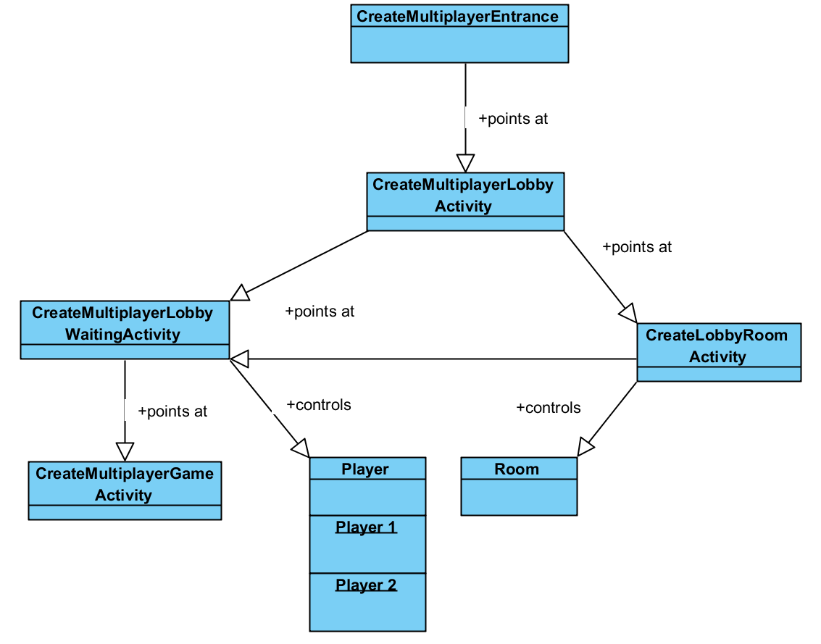
School of Computing & Information Sciences
Senior Project, 2017, Spring
SkillCourt 7.0
Student: Chandan Aubel, Florida International University
Mentor: Mohsen Taheri, Florida International University
Instructor: Masoud Sadjadi, Florida International University
Current System
SkillCourt features a constantly changing, interactive environment to practice with. Players willl attempt to kick the ball into the nearby LED pads. The goal is to strike the green pads while avoiding the red ones. All this is tracked and scored with real-time feedback and smartphone support.
Problem
When looking to practice soccer in a competitive environment, the players need a field, a team and a coach to strive. However, with technology always improving, advances to track player progress, run coach drills and compare your progress with team members are desired.
Solution
SkillCourt provides a way for players to match up with their coaches and teammates. In doing so, they are able to practice custom sequences tailored for them as well as improve their accuracy in their weakest areas. Players may also track their progress over time to get a visual representation of their accomplishments.
Screenshots and Pictures
Requirements
As a Player I want to:
Create a lobby to play with other users
Join an existing lobby to play with other users
View my opponent’s progress in real-time
Synchronize with player so that we can start simultaneously
System Design
The system uses Java in our Android development environment to connect with the Arduino boards inside of our kick pads after authenticating users through our database. Hits into these notify the program through the ArduinoManager at which point we update the UI. In the case of Multiplayer play, we report the hits to Firebase and synchronize players in real-time.
Implementation
Pull user profile information from social media
Paint the portraits using the Picasso library
Track changes in real-time database with event listeners
Update UI in callback methods
Post new data to Firebase
Update a room’s status depending on player status
Allocate pads depending on game mode
Object Design
Verification
Verification was handled iteratively with each new addition to make sure the system was robust. Since much of the work was through Firebase, monitoring the database through the natural flow of events served to catch many of the issues we would run into.
Summary
SkillCourt will allow athletes or beginners to practice soccer in an intuitive and interactive environment. We hope that our work will aid in allowing this application to improve the abilities of soccer players worldwide.
Acknowledgement
The material presented in this poster is based upon the work supported by Pedro Carillo. I am thankful to the help that I received from my group members, Alvaro Silva and Antonio Riverol Special thanks also goes to our product owner Guðmundur Traustason for all of his motivation, support and encouragement..
Notes:
‹#›

