Slide 1






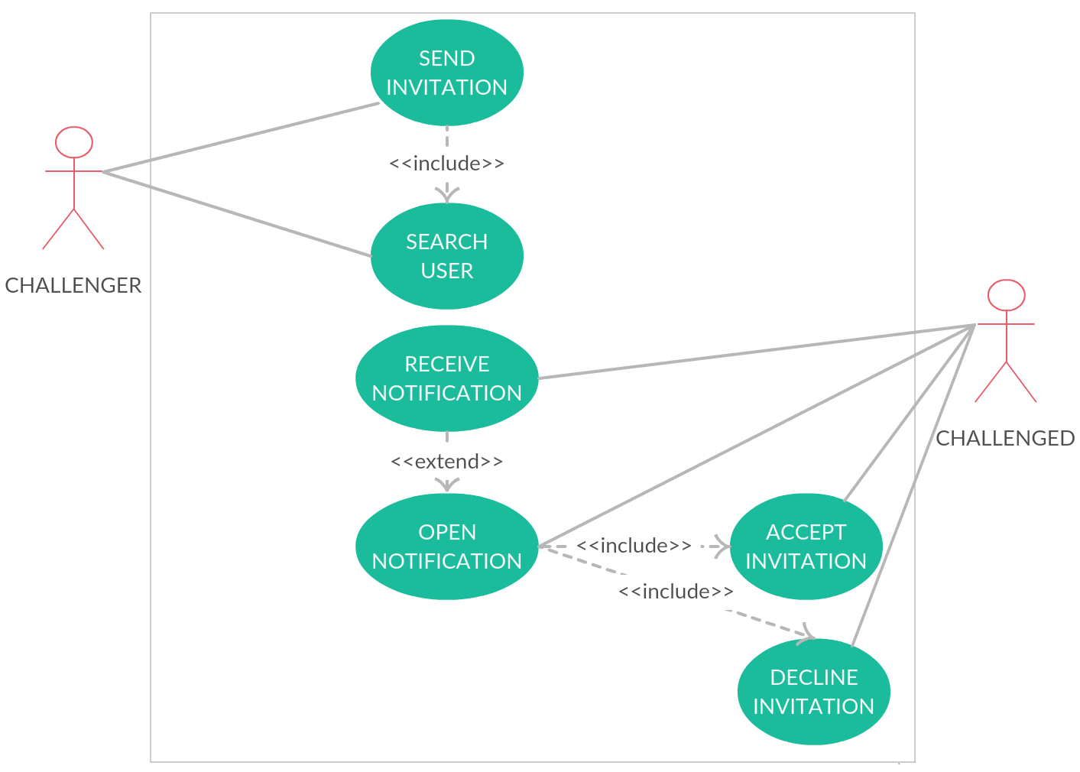
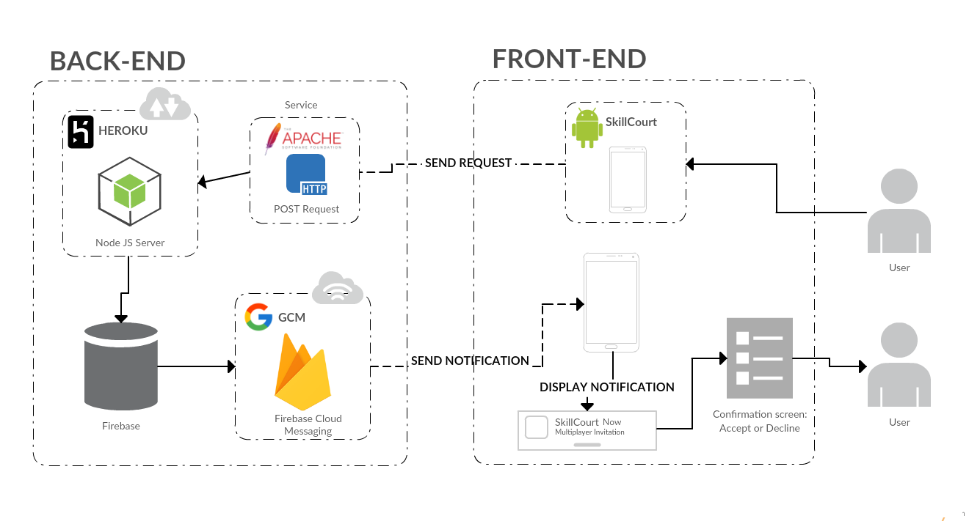

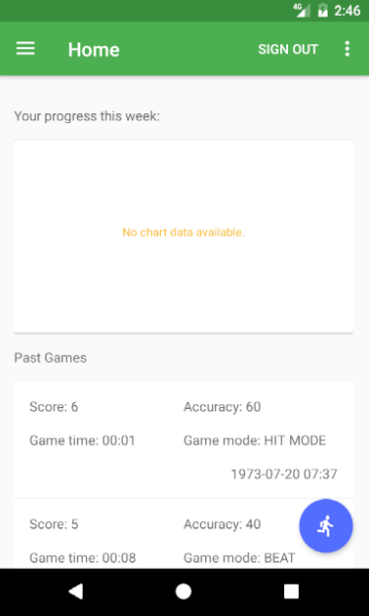
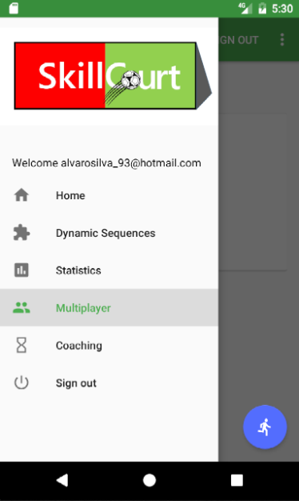
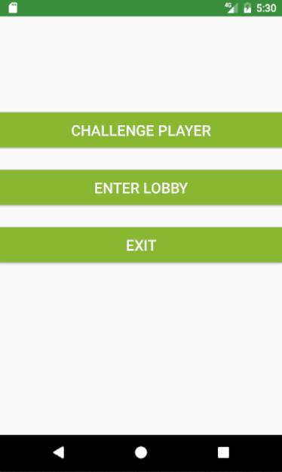
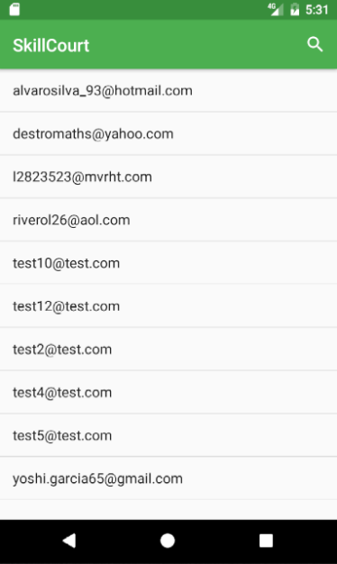
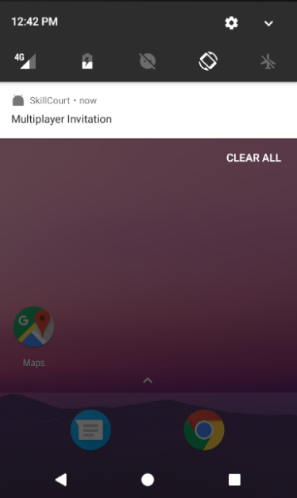
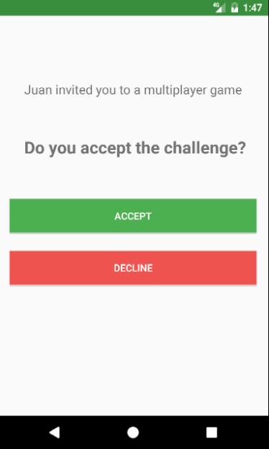
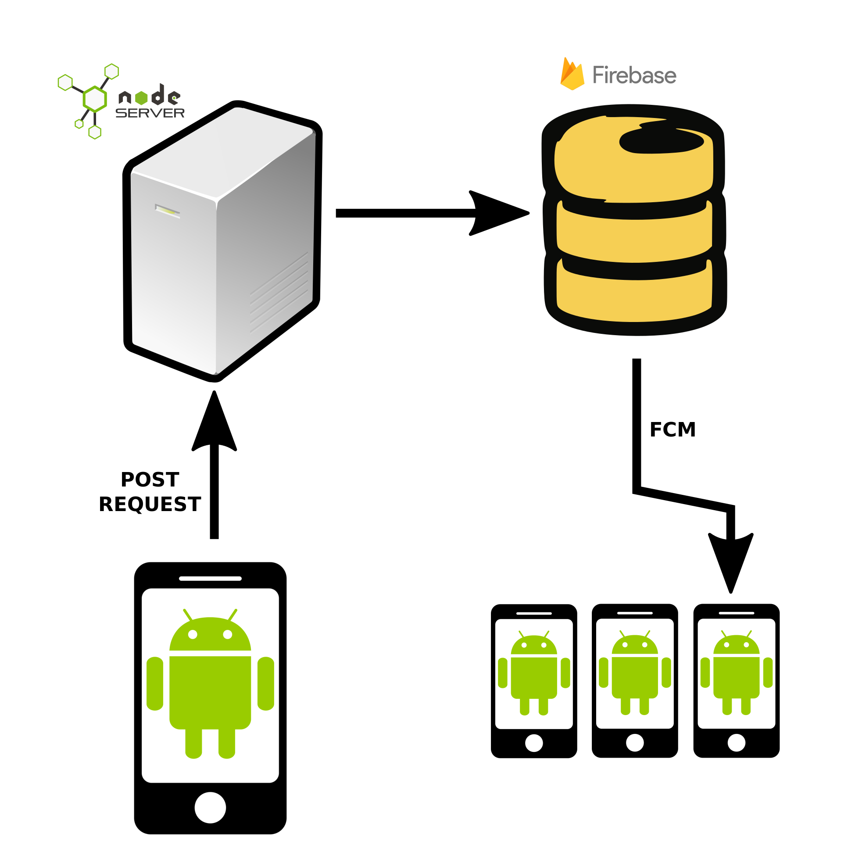

School of Computing & Information Sciences
Senior Project, 2017, Spring
SkillCourt 7.0
Student: Alvaro Silva, Florida International University
Mentor: Guomundur Traustason, Mohsen Taheri
Instructor: Masoud Sadjadi, Florida International University
Problem
Players wants to play against other players.
Players want to compare their performance with other players.
Players want these features to be on real time.
Current System
SkillCourt app:
Unique mode: Single Player.
No capable of sending or receiving notifications.
Solution
Create a Multiplayer Mode
Players can challenge other players by sending requests.
Players play simultaneously.
Players receive results during and after the game.
System Design
Requirements
As a Challenger I want to:
Search for a player.
Send invitation to this player.
As a Challenged I want to:
Receive notifications.
Open notification.
Accept or Decline invitation.
PLAYER 1 (CHALLENGER)
PLAYER 2 (CHALLENGED)
Implementation
For handling notifications:
Use the Firebase Cloud Messaging for sending notifications to devices.
Create a server that interacts with this service.
Server is based in Node.js and is hosted in Heroku.
Server is able to receive HTTP POST requests.
POST requests are sent by the device using the Apache Library.
Apache Library provides HTTP services for the device.
For selecting the challenged player:
Search the user in the database using his email.
After locating the user, system will take his Registration Key.
This Registration Key is going to be send to the Server.
Server will use this Key to target the user.
z
Verification
Send Invitation
Description: Test if the implementation for sending the notification for multiplayer mode works..
Expected Results: Convert the Registration ID in a JSON object, send this to the app server, server to decode, send the Registration ID to FCM Server; create a room and add the challenger to it.
Actual Result: Converts, decodes, send the Registration ID, creates the room and adds the challenger.
Status:
Summary
The app now is capable of sending invitations to other users.
Challenger just need to search the user by his email.
If the user is in the database, the system will take his Registration Key.
System will send the Key to the Server by HTTP POST request.
Server will interact with the FCM to send the notification to the target user.
Target user will receive notification.
Clicking the notification will send the user to the Accept/Decline screen.
Acknowledgement
The material presented in this poster is based upon the work supported by Mohsen Taheri. I am thankful to the help that I received from my group members, Chandan Aubel, Antonio Riverol, and from the project owner Guomundur “Gummi” Traustason.
Notes:
‹#›

