Slide 1


MIECO: Metabolite Identification Evidence Codes
Daniel Schober
Steffen Neumann

Slide 2
Contents
Project setting
Metabolite Identification Schemes
Review state of the art
MI Schemes
Terminologies/ontologies
Why yet another ontology?
Efforts we can re-use
ECO
Our Use Case
Basic MI evidence patterns
MIECO overview
MIECO Use Case Example

Slide 3
Project context
PhenoMeNal H2020 EU Project
Phenome and Metabolome aNalysis
http://phenomenal-h2020.eu/home/
e-Infrastructure
processing, analysis & information-mining of metabolomics phenotyping data
Contribute to WP 8 Data standards
D8.4: Signal processing and analysis data exchange format
D8.4.1: specifications for derived data matrices and terminology for description of analysis & statistical results (M24)

Slide 4
MetSoc Ident Task force
Metabolomics Society: Metabolite Identification Task Group
Objective
update 4 Level reporting standard by adding increased granularity on instruments, data & bioinformatics resources

Slide 5
What are we talking about ?
Metabolite Assignments
assertions on the involvement of a compound under investigation
Metabolite Characterisation
Compoubnd is of a certain backbone structure (Identification on the class level).
Metabolite Identification
totally defined molecular structure (Identification on the individual level)

Slide 6
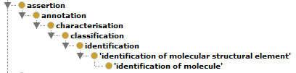
Assertions
A simple is-a taxonomy

Slide 7
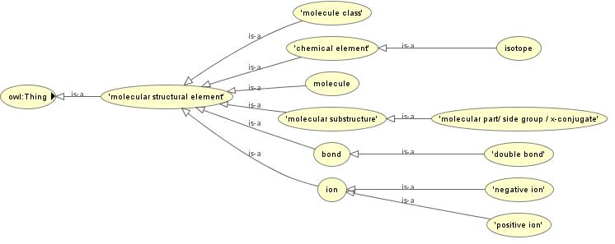
Molecular Structures
http://phenomenal-h2020.eu/home/workpackages/wp8-data-provenance-compliance-and-integrity/

Slide 8
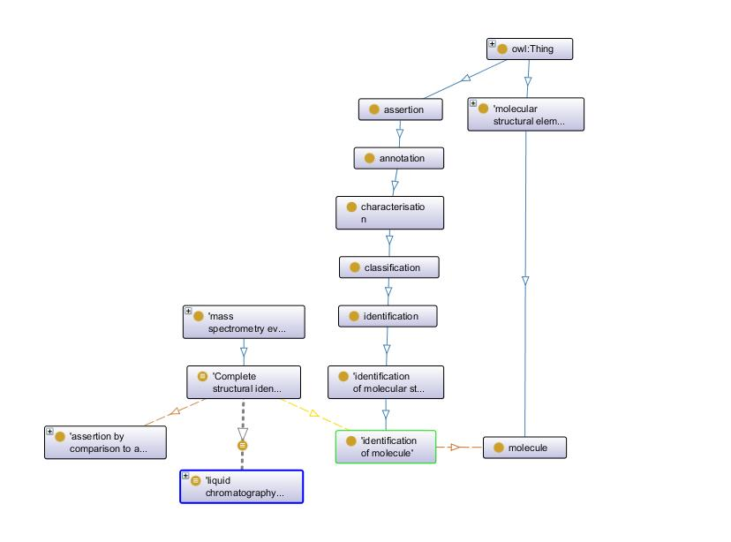

Slide 9
Data Quality
Data Quality is an important provenance data
Audit trail allows to judge data reliability
based on source data & transformation indicators
Foundation for Trust and Evaluation
Drives decisions to re-use Data

Slide 10
Confidence in Identification statements
levels of confidence in identification statements
are varying greatly between studies
difficult to communicate to data users in a concise and accurate fashion

Slide 11
Scopeing
General Constraints
Retain mappings to earlier Schemes for downward compatibility
Simple set-up so non-IT users can use it
Low entry hurdle for bio community
Easy to adopt & use

Slide 12
Existing Standards
EU Directive 96/23/EC concerning performance of analytical methods & the interpretation of results (C(2002) 3044)
Too complex → provide little practical utility

Slide 13




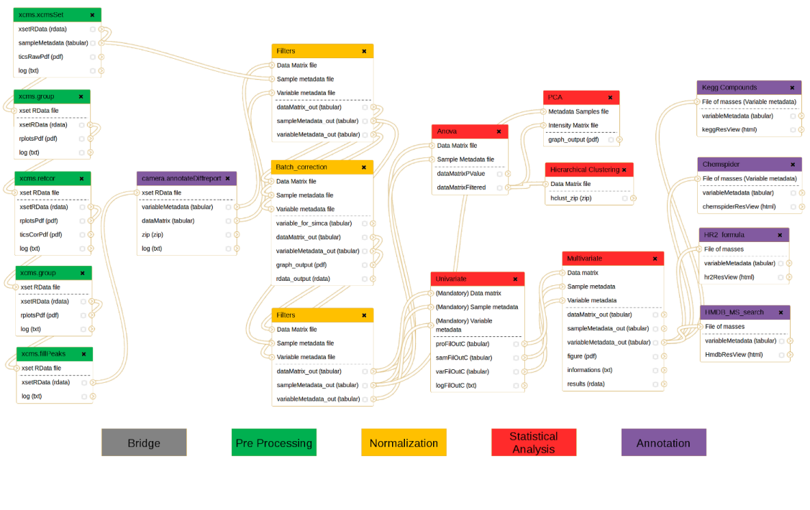



Publication Workflow
Package the data for standards-compliant dissemination and reporting
http://www.isatools.org/
http://workflow4metabolomics.org

Slide 14
Next tasks
Write paper
How to best impose the requirement to use reporting standards for metabolite identification ?
Recommend publishers & repositories to enforce usage
i.e. Springer Metabolomics & Metabolights

Slide 15
Autogenerate Evidence Codes from standardized data ?
Text mining to derive ECOs from paper methods sec
or ideally formal future workflow specifications

Slide 16
Resources
Git
https://github.com/DSchober/MIECO
Gdoc
https://docs.google.com/document/d/1JHw7FntqtntZV0qoWsFmcOLcHlM2wv4jt4-ccLUgZNU/edit#

Slide 17
Acknowledgements
PhenoMeNal is funded by European Commission's Horizon2020 programme, grant agreement number 654241
Metabolomics Society: Metabolite Identification Task Group
Nadine Strehmel

Slide 18
Thank you!
dschober@ipb-halle.de

Slide 19
Overview of Use Cases
Use Case | Partner | Cohort Size | Assays | Workflow | Implementation
MESA | ICL | 4,000 | NMR, LC/MS | NMR: calibration, alignment, normalisation, statistics MS: Data conversion, feature detection, alignment, deconvolution, QC filtering, normalisation, batch correction | Matlab, Octave, R
CoLaus | SIB | 6,733 | NMR, Genotyping | NMR processing, MetaboMatching (Genotype correlation) | Octave
Uppsala | UU | 120 | LC/MS | Data conversion, feature detection, alignment, blank removal, feature selection | OpenMS
MetaboHUB | CEA | 183 | LC/MS | Data conversion, feature detection, alignment, univariate and multivariate statistics | R
¹³C tracer cell line | UB | -- | GC/MS | Data import, Natural Isotope abundance correction, Label enrichment, SBML | R, Python

