Slide 1


MIECO: Metabolite Identification Evidence Codes
Daniel Schober
Steffen Neumann

Slide 2
Contents
Project setting
Metabolite Identification Schemes
Review state of the art
MI Schemes
Terminologies/ontologies
Why yet another ontology?
Efforts we can re-use
ECO
Our Use Case
Basic MI evidence patterns
MIECO overview
MIECO Use Case Example

Slide 3
Project environment
PhenoMeNal H2020 EU Project
Phenome and Metabolome aNalysis
http://phenomenal-h2020.eu/home/
e-Infrastructure
processing, analysis & information-mining of metabolomics phenotyping data
Contribute to WP 8 Data standards
D8.4: Signal processing and analysis data exchange format
D8.4.1: specifications for derived data matrices and terminology for description of analysis & statistical results (M24)

Slide 4
MetSoc Ident Task force
Metabolomics Society: Metabolite Identification Task Group
Objective
update 4 Level reporting standard by adding increased granularity on instruments, data & bioinformatics resources

Slide 5
What are we talking about ?
Metabolite Assignments
assertions on the involvement of a compound under investigation
Metabolite Characterisation
Compoubnd is of a certain backbone structure (Identification on the class level).
Metabolite Identification
totally defined molecular structure (Identification on the individual level)

Slide 6
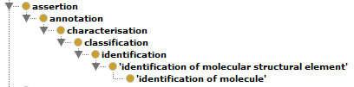
Assertions
A simple is-a taxonomy

Slide 7
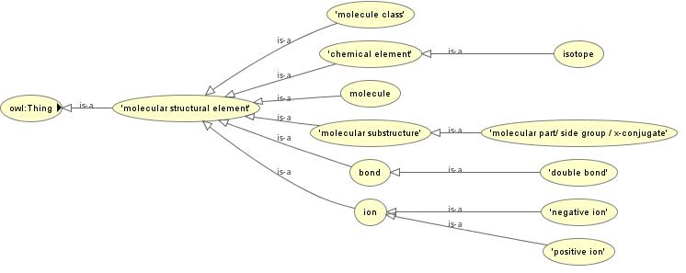
Molecular Structures
http://phenomenal-h2020.eu/home/workpackages/wp8-data-provenance-compliance-and-integrity/

Slide 8
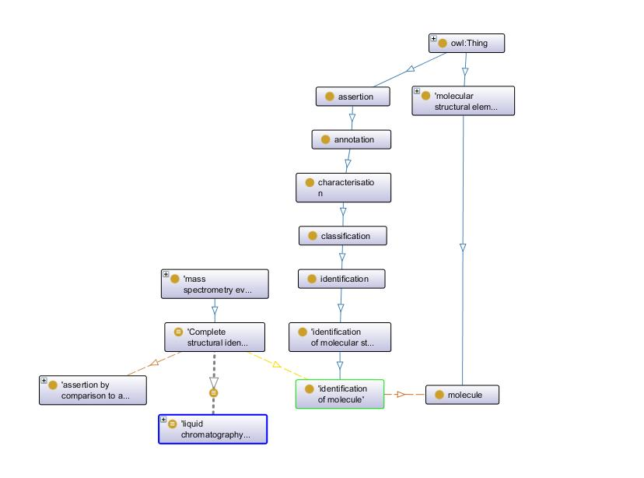

Slide 9
Data Quality
Data Quality is an important provenance data
Audit trail allows to judge data reliability
based on source data & transformation indicators
Foundation for Trust and Evaluation
Drives decisions to re-use Data

Slide 10
Confidence in Identification statements
levels of confidence in identification statements
are varying greatly between studies
difficult to communicate to data users in a concise and accurate fashion

Slide 11
Scopeing
General Constraints
Retain mappings to earlier Schemes for downward compatibility
Simple set-up so non-IT users can use it
Low entry hurdle for bio community
Easy to adopt & use

Slide 12
Import & X-Refs
Multiple Options
MIREOT
Owl:import
http://labs.mondeca.com/protolov/

Slide 13
Existing Standards
EU Directive 96/23/EC concerning performance of analytical methods & the interpretation of results (C(2002) 3044)
Too complex → provide little practical utility

Slide 14

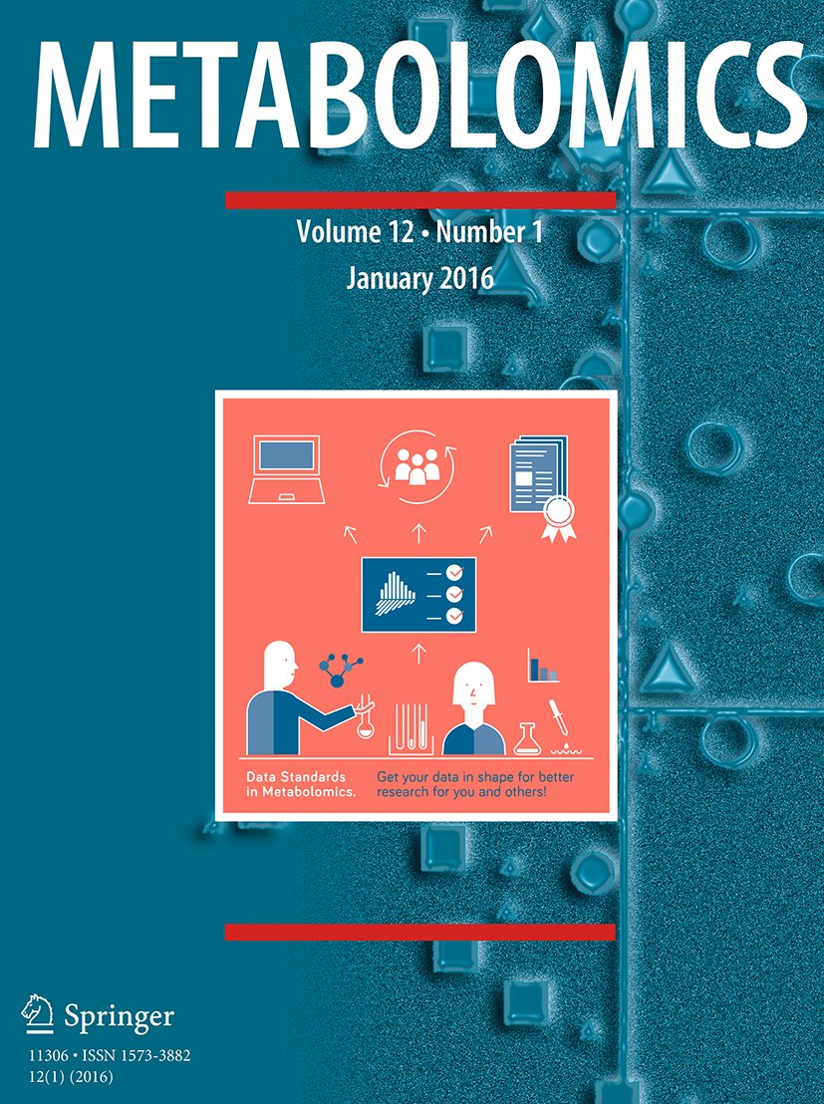


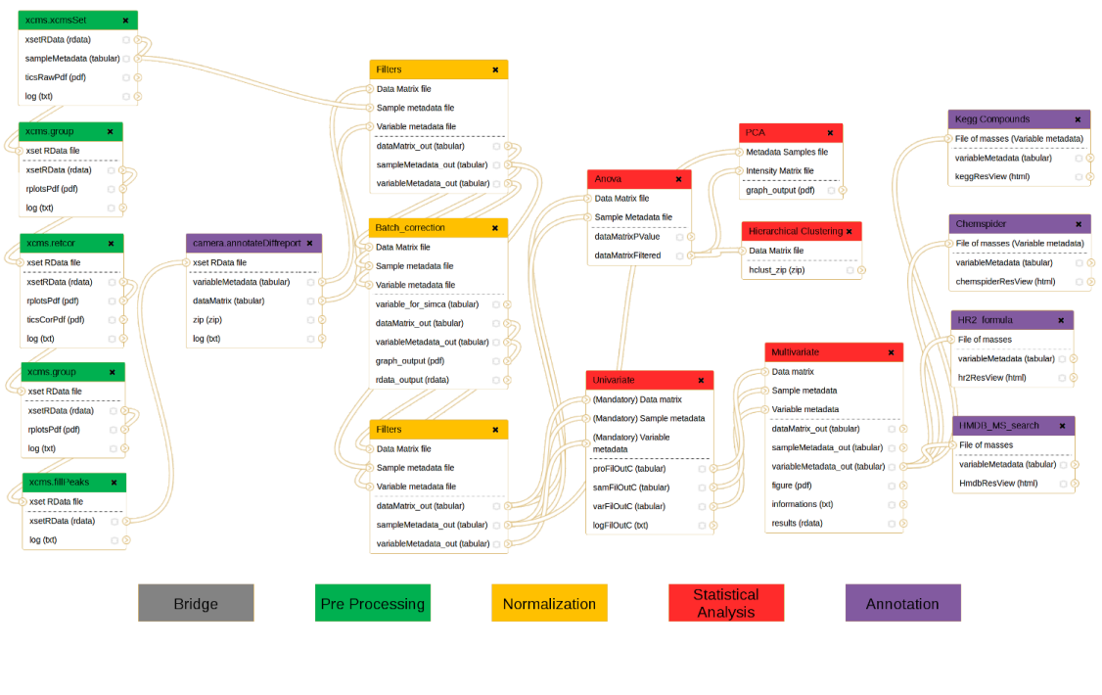



Publication Workflow
Package the data for standards-compliant dissemination and reporting
http://www.isatools.org/
http://workflow4metabolomics.org

Slide 15
Next tasks
Write paper
How to best impose the requirement to use reporting standards for metabolite identification ?
Recommend publishers & repositories to enforce usage
i.e. Springer Metabolomics & Metabolights

Slide 16
Autogenerate Evidence Codes from standardized data ?
Text mining to derive ECOs from paper methods sec
or ideally formal future workflow specifications
Transition into Quantitative background model for numeric evaluation
i.e. setting evidence thresholds for quality analysis

Slide 17
Resources
Git
https://github.com/DSchober/MIECO
Gdoc
https://docs.google.com/document/d/1JHw7FntqtntZV0qoWsFmcOLcHlM2wv4jt4-ccLUgZNU/edit#

Slide 18
Acknowledgements
PhenoMeNal is funded by European Commission's Horizon2020 programme, grant agreement number 654241
Metabolomics Society: Metabolite Identification Task Group
Nadine Strehmel

Slide 19
Thank you!
dschober@ipb-halle.de

Slide 20
Overview of Use Cases
Use Case | Partner | Cohort Size | Assays | Workflow | Implementation
MESA | ICL | 4,000 | NMR, LC/MS | NMR: calibration, alignment, normalisation, statistics MS: Data conversion, feature detection, alignment, deconvolution, QC filtering, normalisation, batch correction | Matlab, Octave, R
CoLaus | SIB | 6,733 | NMR, Genotyping | NMR processing, MetaboMatching (Genotype correlation) | Octave
Uppsala | UU | 120 | LC/MS | Data conversion, feature detection, alignment, blank removal, feature selection | OpenMS
MetaboHUB | CEA | 183 | LC/MS | Data conversion, feature detection, alignment, univariate and multivariate statistics | R
¹³C tracer cell line | UB | -- | GC/MS | Data import, Natural Isotope abundance correction, Label enrichment, SBML | R, Python

