Slide 1
Personal Password Manager in
the Private Cloud

Slide 2
The Issue
Passwords
  Too easy to guess
  Too easy to bruteforce
  Or…
  Too difficult to remember

Slide 3
Use a password manager
Trusting someone else with your data
No synchronization of data

Slide 4
Hosting A Solution Yourself
Private Cloud
Not that expensive anymore
  Small low-powered devices such as Raspberry Pi
Complete control of data

Slide 5
What do we need?
(excerpt from the complete list of requirements)
Distributed password database
Multi-user support
  Albeit solution should be aimed at individuals
Password organization, in multiple levels
Password sharing (for convenience)
Passwords only ever appear in clear text client-side
Auditing
Two-factor authentication

Slide 6
And most importantly…
Something the user wants to use!

Slide 7
So… What already exists?

Slide 8
Reviewed Commercially Available Tools
In-Browser Password Managers
LastPass, and Similar Solutions
KeePass, and Similar Solutions
Rattic
Encryptr
Vault
TeamPasswordManager
Passwordstate
Simple Safe
PassWork
SimpleVault
RoboForm
Vaultier
TeamPass

Slide 9
But none are up to standards

Slide 10
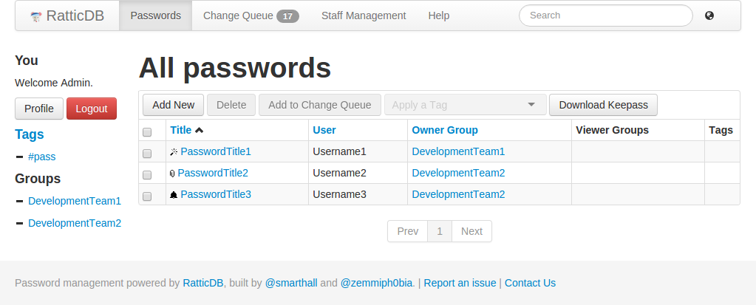
Most are aimed at teams
Notes:
Solution: Rattic DB
Good: Easy understand UI
Bad: Rattic is clearly aimed at teams. If the user wants to have passwords for him or herself, there needs to be a group with ONLY that user in, and those personal passwords then belong to that group.

Slide 11
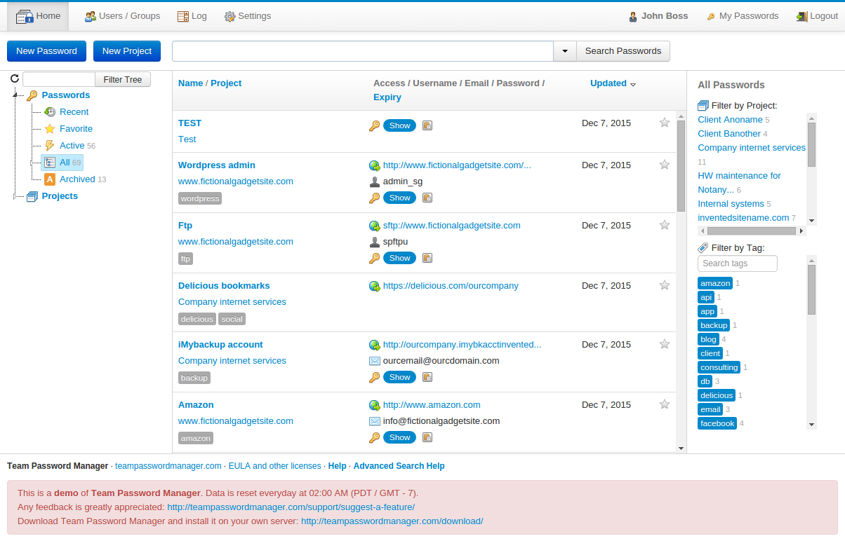
Most are aimed at teams
Notes:
Solution: TeamPasswordManager
Good: Structuring is actually made logically, as a “tree”
Bad: Again, same thing as rattic: Teams. Passwords belong to teams instead of individual users.

Slide 12
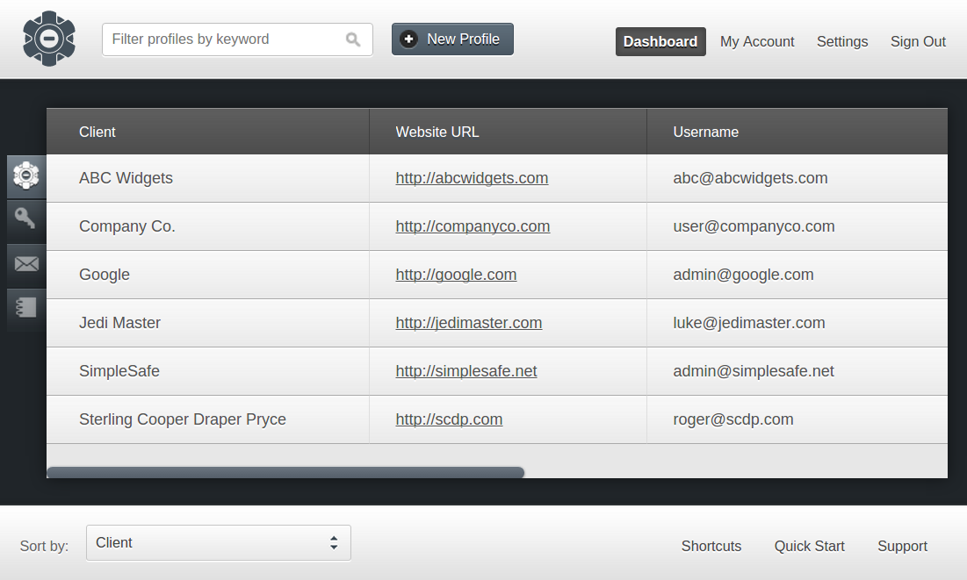
Some have simply been discontinued since
“…, we have made the tough decision to remove SimpleSafe for sale and cease to actively develop the product.”
Notes:
Solution: SimpleSafe
They have simply discontinued sale and development of the solution, during the master project

Slide 13
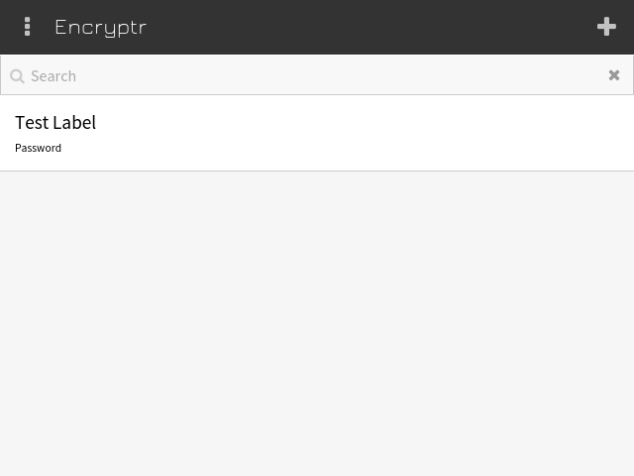
Some lack organization
Notes:
Solution: Encryptr
Good: Extremely sleek UI
Bad: NO organization what so ever. Passwords are stored in a single list.

Slide 14
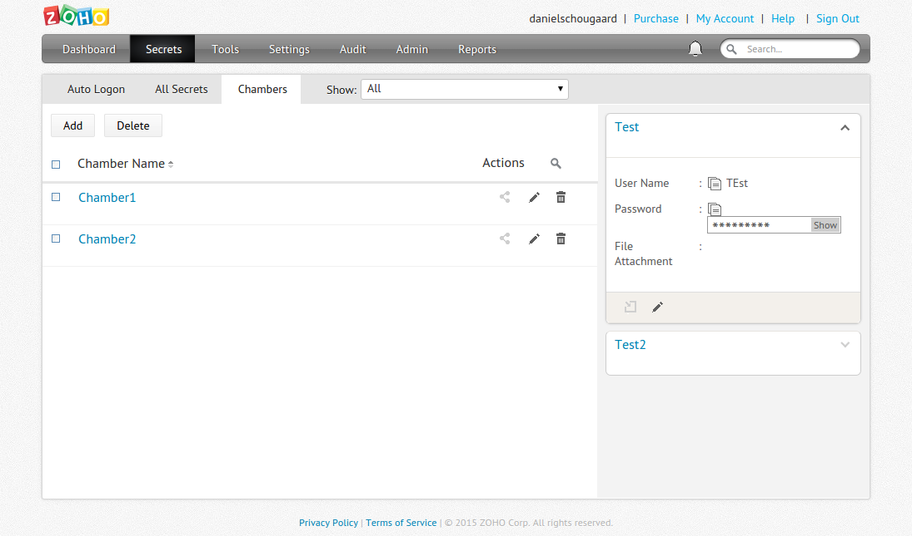
Some invent their own organization
Notes:
Solution: Vault
Bad: Chambers are not intuitive. Clunky, difficult.

Slide 15
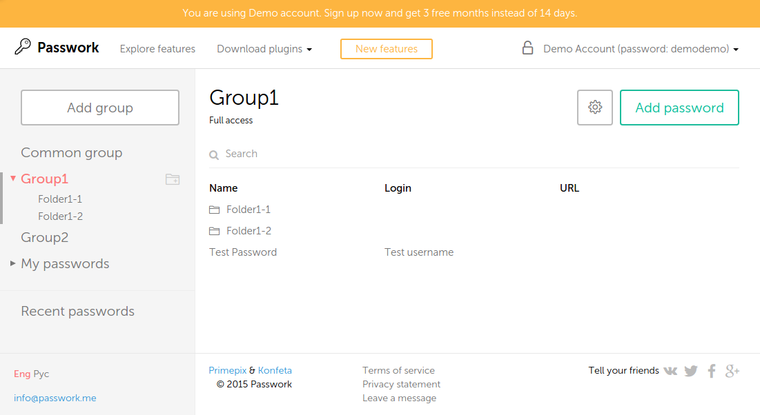
Some doesn't even tell which platform it runs on
Notes:
Solution: Passwork
Bad:
NO information regarding which platform it runs on
Their online demo was broken around half of the time

Slide 16
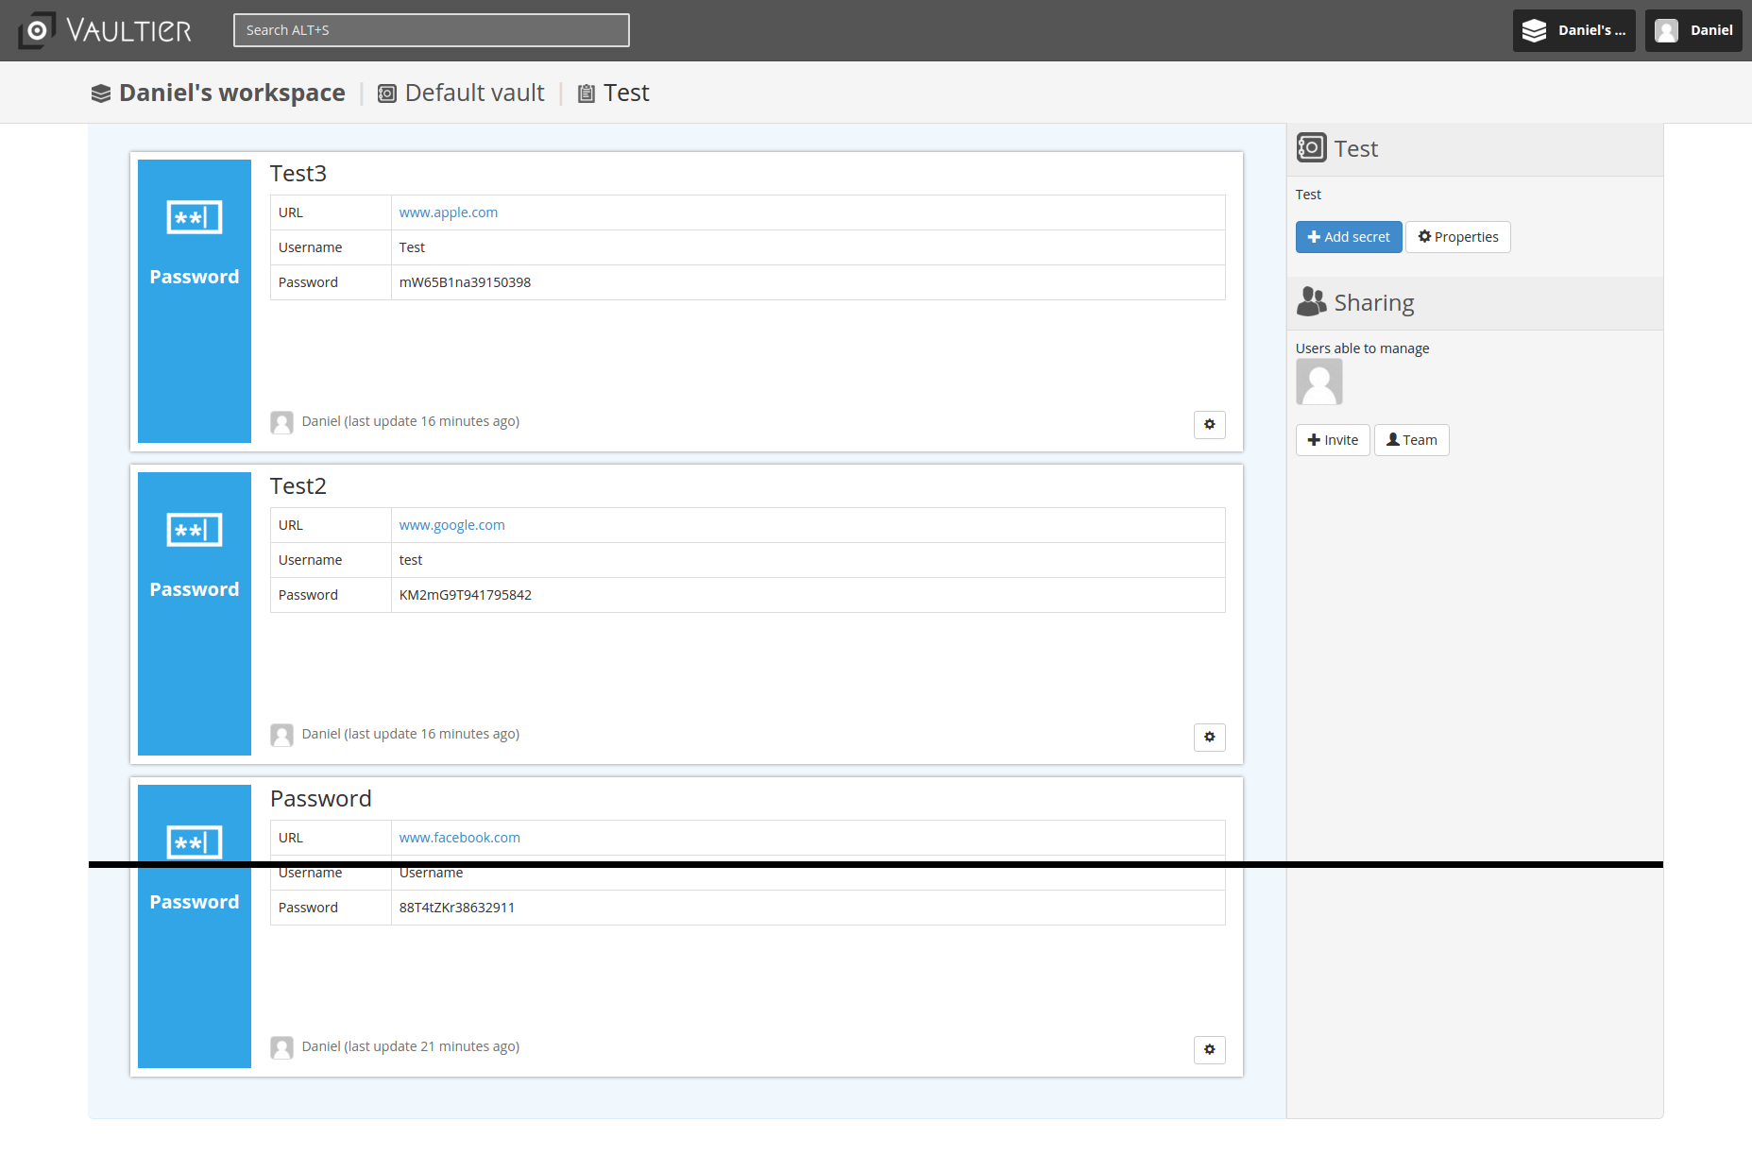
Some have no regards for usability
(black line denotes cutoff on 1080p 24'' monitor)
Notes:
This is vaultier. The black line denotes where the buttom of a 1080p 24'' inch monitor is.
You can see 2-3 passwords at a time….. Imagine scrolling through just 10 passwords.

Slide 17
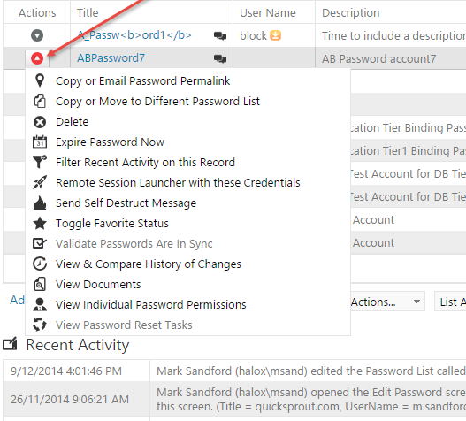
Some are WAY to complex
Notes:
Solution: Passwordstate
Good: Probably a very good solution for enterprise uses.
Bad:
- FAR too complex for most scenarios involving a private-cloud.
- Many enterprise features would simply end up not being used.
- Most users would be deterred from it, seeing that menu.

Slide 18
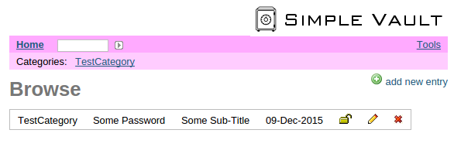
And some are just plain horrible
Notes:
Solution: Simply Vault
Bad: If the implementation LOOKS sketchy, the user will THINK it is sketchy. And then the user simply wont be safe storing sensitive data in the soltion.

Slide 19
Reviewed Academic Solutions
Tapas: Design, Implementation, and Usability Evaluation of a Password Manager
Using CardSpace as a Password Manager & Implementing PassCard - a CardSpace-based Password Manager
Stronger Password Authentication Using Browser Extensions
Sesame: A Secure and Convenient Mobile Solution for Passwords
All Your Browser-saved Passwords Could Belong to Us: A Security Analysis and a Cloud-based New Design
Passpet: Convenient Password Management and Phishing Protection
Cloud Based Manager Using Privacy-Preserved Biometrics
A Password Manager that Doesn't Remember Passwords
Password Management Using Doodles
PALPAS -- PAssword Less PAssword Synchronization
Cloud-based Storage-Free Browser-based Password Manager
CredProxy

Slide 20
And the academics…?
Solution name (or paper name, if no name given) | Reason to dismissal
Tapas | Does not support multiple devices
CardSpace | Restricted to the Windows platform
PwDHash | Password derivation tool. Relies on a single master password to derive logins.
Sesame | Intended for smartphones, tablets, smart watches, and etc.
All your browser-saved passwords could belong to us | Relies on third party servers.
Passpet | Only works for website logins, in the browser.

Slide 21
And the academics…? Cont.
Solution name (or paper name, if no name given) | Reason to dismissal
Cloud password manager using privacy-preserved biometrics. | Not all devices has biometric inputs.
Versipass | Low amount of permutations and im- practical.
Doodles | Does not support multiple devices
PALPAS | Assumed dependency on third party servers and limited to native applica- tions.
Toward a secure and usable cloud-based password manager for web browsers. | Only works for website logins, in the browser.
CredProxy | Ambiguity in implementation details, no support for multiple devices, and de- pendency on third party servers.

Slide 22
Unfortunately….
… None of them fit the bill

Slide 23
So… What then?
We need something new
Something better
Something that actually fulfills the requirements

