Slide 1
Digital Cash: Bitcoins and Cryptology
Daniel Segal

Slide 2
Cryptocurrency

Slide 3
What is cryptocurrency?
A digital currency that derives its value and security from cryptographic principles
Difficult to counterfeit & trace
Utilize public and private keys for transfer

Slide 4
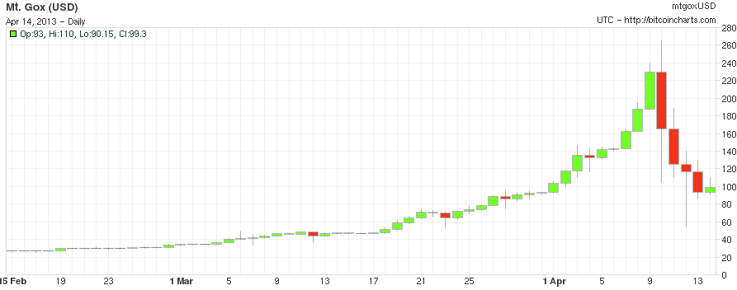
The value in Cryptocurrency
Not regulated by a central bank
Market forces drive value
Chart from bitcoincharts.com

Slide 5
Attempted cryptocurrencies
Many cryptocurrencies have failed
Qubic
TimeKoin
BBQCoin
Coiledcoin
Currencies fail when system is broken or not enough users participate
Bitcoin (BTC) is only current successful cryptocurrency

Slide 6
The bitcoin: Basics

Slide 7
Satoshi Nakamoto
Introduced bitcoins in a paper (2008)
Nakamoto is a presumed pseudonym for a person or group of people
Currently no confirmed identity
Posted to forums from a German IP address
Active times corresponded with somebody in EST
Uses British formatting, but American spelling
Has since stepped down from public eye
Wrote and maintained bitcoin client, “mined” first bitcoins on January 3, 2009

Slide 8
Goals of bitcoin
Eliminate need for a central authority
Enable easy transfer of bitcoins between individuals
Create a secure & private economy

Slide 9
Obstacles to bitcoin
Double Spending Problem
Digital “coins” (character strings) are easy to reproduce, how do you prevent somebody from spending those coins multiple times
Sybil (51%) Attacks
Since no central authority, users need to agree on validity of transaction. If a malicious user controls 51% of the network (via processing power or number of identities), they can overrule honest users

Slide 10
The bitcoin: Implementation

Slide 11
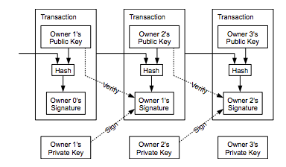
Solution: The block chain
“Block chain” is bitcoin’s answer to these problems
Every user has record of every transaction and helps verify these transactions
Longest chain is assumed to be correct

Slide 12


A bitcoin Transaction
Step 1) Alice decides to pay a sum of bitcoins to Bob
Step 2) Alice signs the transaction with her private key
Step 3) Alice’s client notifies other clients of the transaction
User
User
BOB
User
ALICE
User
User

Slide 13
A bitcoin Transaction
Step 4) Each node competes to solve a computationally hard problem (this problem will be described later)
Step 5) A node broadcasts that it has found a solution
User
User
BOB
User
ALICE
User
User

Slide 14
A bitcoin Transaction
Step 6) Each node verifies the solver node’s solution
Step 7) The transaction authorized and added the the block chain
User
User
BOB
User
ALICE
User
User

Slide 15
THE BITCOIN: MATHEMATICs

Slide 16
THE HASHES
Two different types of hashes used
SHA-256
256 bit SHA-2 (Secure Hash Algorithm, Generation 2)
Designed by National Security Agency (NSA), published by National Institute of Standards and Technology in 2001
RIPEMD-160
160 bit RIPEMD variant (RACE Integrity Primitives Evaluation Message Digest)
Designed academically, published in 1996
Both currently believed to be secure

Slide 17
THE HASHES
SHA-256 used for creating aforementioned difficult problem (stay patient, we will get to this soon)
Always used twice (hashed value is hashed again)
RIPEMD-160 used for bitcoin address
Used after value has already been hashed by SHA
Useful for shorter digest size
Address is user’s bitcoin “wallet
Alice transfers bitcoins to Bob by sending them to his address

Slide 18
The Signature
Alice uses the elliptic curve digital signature algorithm (ECDSA) to sign transactions
Uses secp256k1 curve given in Standards for Efficient Cryptography
128 bits of security
Over a 256 bit field
Comparable in strength to 3072 bit RSA

Slide 19
The Transaction
Signature releases bitcoins from previous transaction (i.e. whenever the bitcoins were transferred to Alice)
Can only be authorized by current owner’s private key
Transaction contains amount and destination address

Slide 20
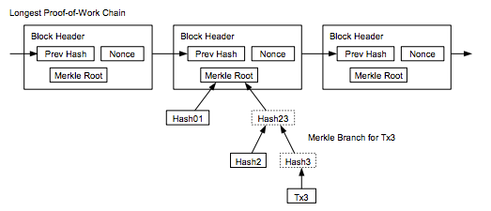
The Block chain
Proofs of work stored as Merkle (Hash) Tree
Allows old leaves to be deleted
Can verify transaction by attempting to insert into place in block chain

Slide 21
The “hard” Problem (Finally)
Find a value which, when double hashed by SHA-256, begins with n zeroes where n is set by the bitcoin network in proportion to amount of processing power available (more power = hard problems)
Keep incrementing a nonce (k in this example) stored in the transaction block until find an appropriate value
k = 1 SHA-256: 6b86b273ff34fce19d6b804eff5a3f5747ada4eaa22f1d49c01e52ddb7875b4b
k = 2 SHA-256: d4735e3a265e16eee03f59718b9b5d03019c07d8b6c51f90da3a666eec13ab35
.
.
.
.
.

Slide 22
The “HARD” Problem (FINALLY)
Entire network can solve a problem every 10 minutes
62.118 x 10¹² hashes per second
Would take an individual several weeks – months (currently)

Slide 23
Bitcoins: Privacy & Security

Slide 24
How private are bitcoin transactions
?

Slide 25
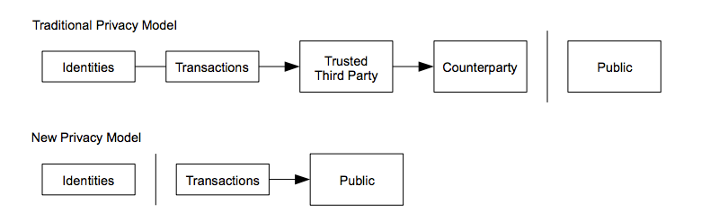
How private are bitcoins
Bitcoin network makes efforts to remove user identifiable information
Never transmit to a person, just to a hashed address
Security is contingent on address not being linked to person
As bitcoins grow in popularity, government agencies might start building databases

Slide 26
How Secure Are Bitcoins
Very
(until you add people into the mix)

Slide 27
How secure are bitcoins
All of bitcoins cryptographic functions are provided by established and vetted algorithms (SHA-256, ECDSA)
Only one vulnerability identified so far:
Bug found in transaction log that did not properly verify transactions which overflowed transaction size
Two users generated 184 billion bitcoins in a day
Protocol was updated, transaction reversed

Slide 28
How Secure are bitcoins
All malicious attacks on bitcoins have been focused on peripheral trading sites and wallets
Users store their bitcoin wallet online to avoid loss, malicious users gain access
Trading websites have been exploited (mass sell offs) to manipulate market value of bitcoins

Slide 29
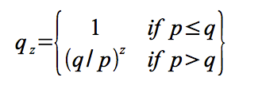
Preventing 51% Attacks
By design, bitcoin network is 1 vote per CPU instead of 1 vote per IP
Malicious user would need to control 51% of processing power, and then could only double-spend own money, can’t create money
Since longest chain accepted as correct chain
p = probability honest node finds next block
q = probability attacker finds next block
q_{z} = probability attacker can catch up from z blocks behind

Slide 30
Digital Cash, Analog market

Slide 31
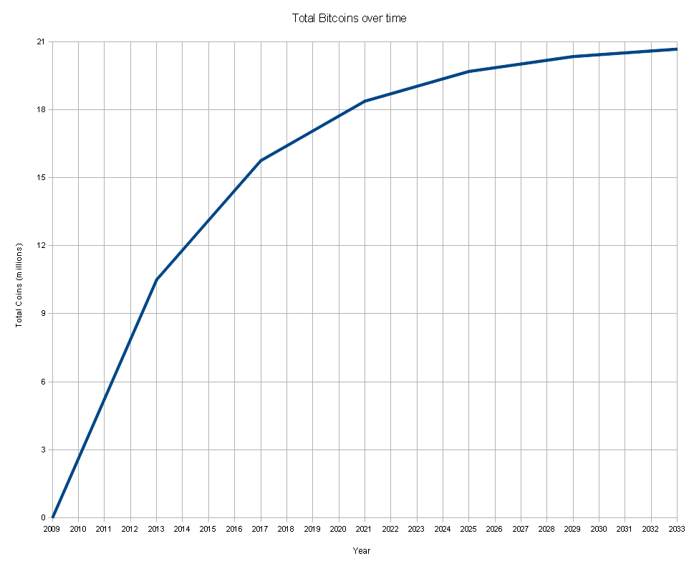
Where do bitcoins come from?
Mining
Every time a transaction is verified, node that verified it gets a predetermined number of bitcoins
Started at 50BTC
In March, dropped to 25BTC
BTC limited to 21 million, intended to last until 2140

Slide 32
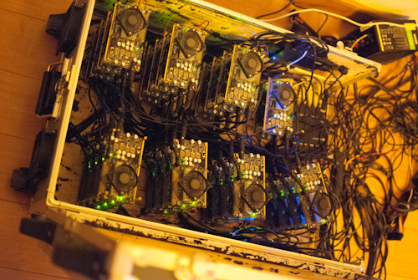
Mining bitcoins
Difficult for individual user to mine bitcoins at this point
People are building machines specifically to mine bitcoins
GPU heavy machines
Top commercial devices can try ~60 billion hashes per second
Balance performance against energy costs (current estimates of $150,000 in power used daily mining bitcoins)
Many users join mining “pools”, contribute computing power for portion of block payout

Slide 33
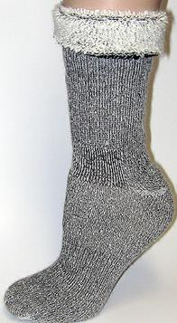
What can you buy with bitcoins
First purchase made with bitcoins was on May 21st 2010. A Florida programmer gave a man in England to order him a pizza from Papa Johns.
Many niche companies are starting to accept bitcoins
Web services (VPN, web hosting)
Gambling
A dental practice in Seattle
Alpaca socks (0.2487 BTC)
Most people are treating bitcoin as an investment
10,000 BTC

Slide 34
Trading bitcoins
Several exchanges have been created
Largest is Mt. Gox (www.mtgox.com)
Handles 70% of bitcoin trading
Over past year has handled $550,704,696.11 of currency

Slide 35
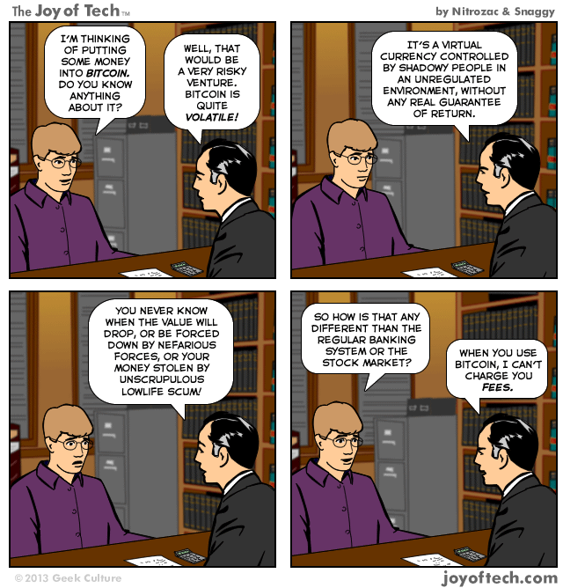

Slide 36
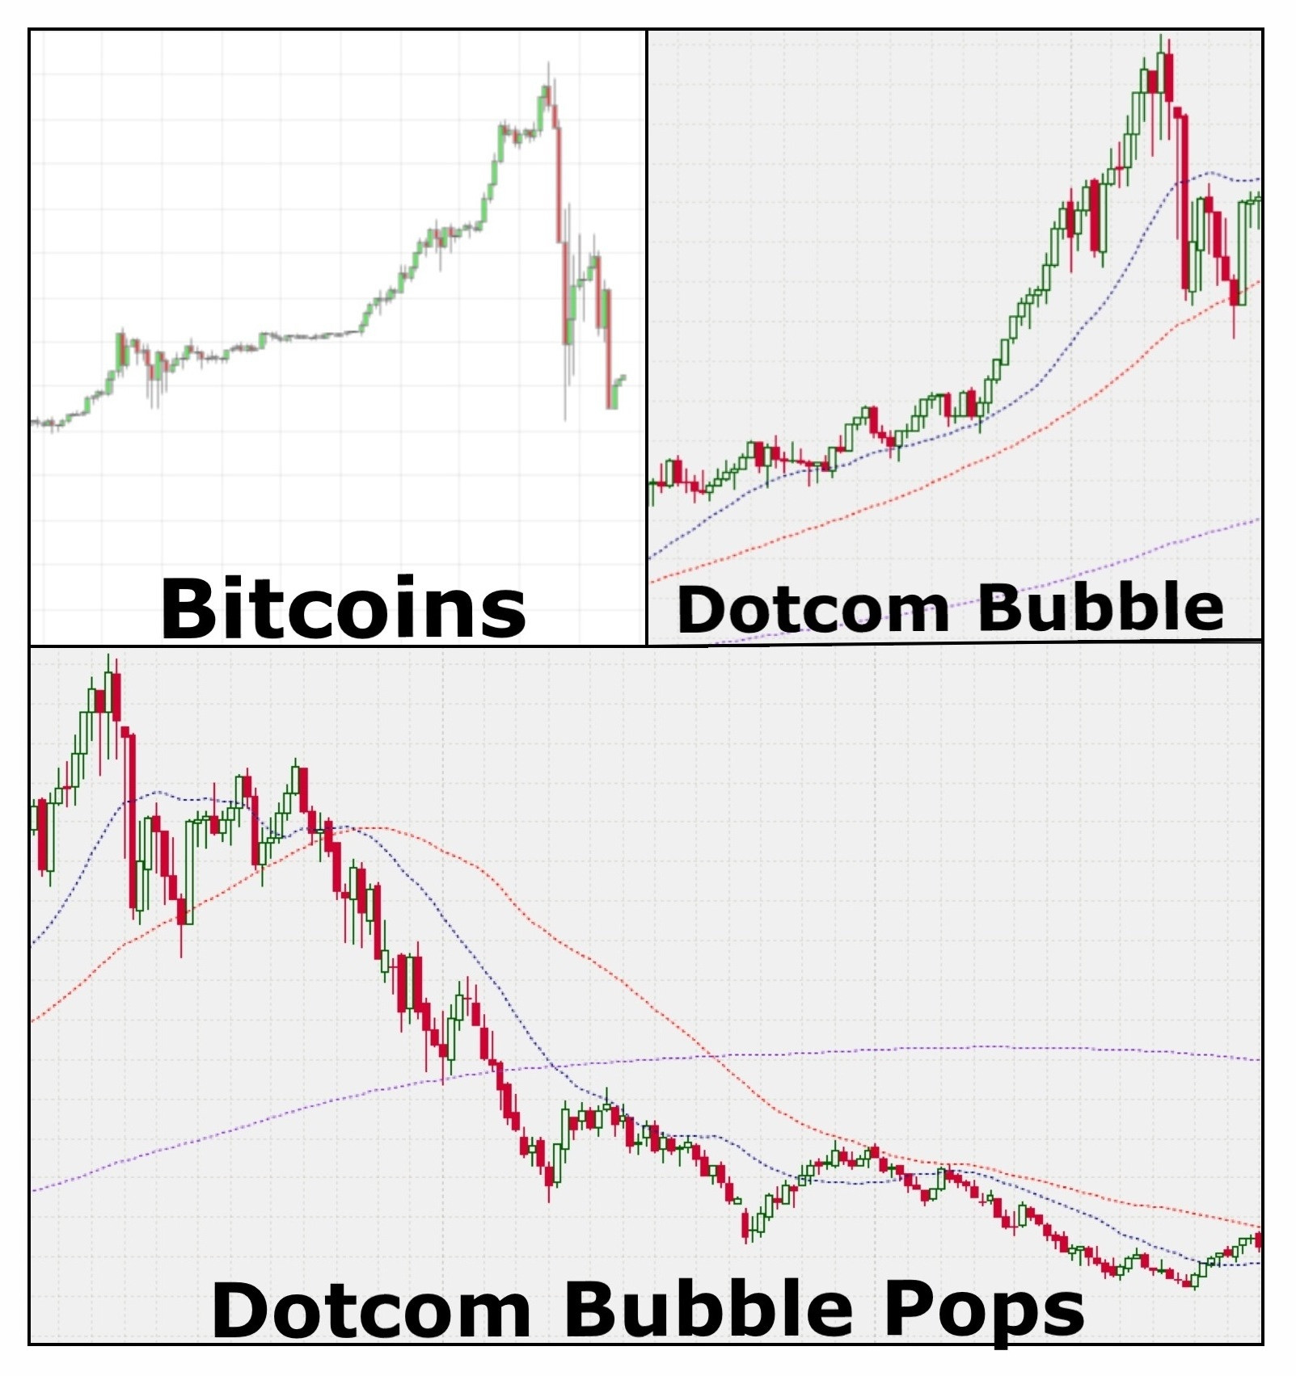

Slide 37
Questions?

