Slide 1
Expense Tracker
A MERN Stack Web Application
Submitted by: Shiva
Course: Full Stack Web Development
Date: April 30, 2026

Slide 2
Project Overview
Problem
People struggle to track their daily spending and stay within a monthly budget. Existing tools are often complex, paid, or require linking bank accounts.
Solution
A simple, self-hosted expense tracking web app that lets users record expenses, categorize them, set a monthly budget, and visualize their spending through interactive charts.
Key Features
Add, edit, and delete expenses with description, amount, category, and date
Eight categories: Food, Transport, Shopping, Entertainment, Bills, Health, Education, Other
Monthly budget tracking with live progress bar and over-budget alerts
Visualizations: 7-day spending area chart and category breakdown donut chart
Search and filter transactions by description or category

Slide 3
Tech Stack
Built using the MERN stack: MongoDB, Express, React, and Node.js.
Layer | Technology | Purpose
Database | MongoDB (Atlas) | Stores expense and budget documents in the cloud
Backend Framework | Express 4 + Node.js | Handles HTTP requests and serves the REST API
ODM | Mongoose | Schema validation and MongoDB query layer
Frontend Library | React 18 | Component-based user interface with hooks
Build Tool | Vite | Fast dev server and production bundling
Styling | Tailwind CSS | Utility-first styling for the responsive UI
Charts | Recharts | Area chart and donut chart for visualization
HTTP Client | Axios | Frontend communication with backend API

Slide 4
System Architecture
The application follows a three-tier architecture. The React frontend communicates with the Express backend through HTTP requests, and the backend persists data in MongoDB Atlas using the Mongoose ODM.
Frontend (Client)
Backend (Server)
Database
React 18 + Vite
Node.js + Express
MongoDB Atlas
Renders UI, handles user input,
sends API requests via Axios.
Runs on localhost:3000
Handles routes, validates input,
performs CRUD operations.
Runs on localhost:5000
Stores expense and budget
documents in the cloud.
Accessed via Mongoose ODM
Data Flow: User action → Axios request → Express route → Mongoose model → MongoDB → JSON response → React state update → UI re-render
Folder Structure
server/ contains config, models, controllers, routes, and server.js. client/ contains src/App.jsx, src/api.js, and Vite config files.

Slide 5
REST API Endpoints
The Express backend exposes six RESTful endpoints across two resources: expenses and budget.
Method | Endpoint | Description
GET | /api/expenses | Fetch all expenses, sorted by most recent
POST | /api/expenses | Create a new expense (description, amount, category, date)
PUT | /api/expenses/:id | Update an existing expense by its ID
DELETE | /api/expenses/:id | Delete an expense by its ID
GET | /api/budget | Fetch the current monthly budget
PUT | /api/budget | Update the monthly budget amount
Sample Request
POST http://localhost:5000/api/expenses
Content-Type: application/json
{ "description": "Lunch", "amount": 12.50, "category": "food", "date": "2026-04-30" }

Slide 6
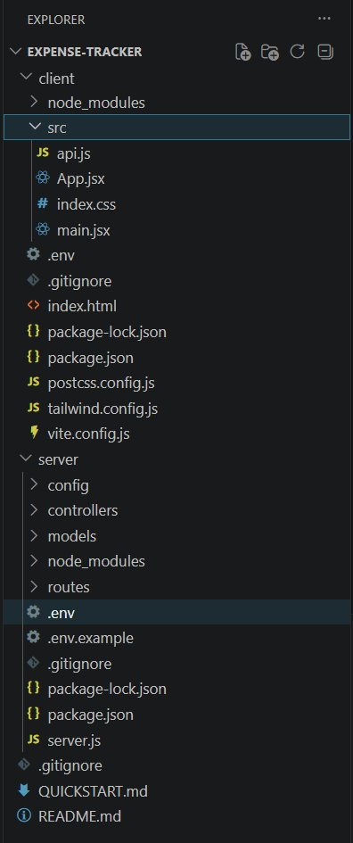
Project Structure in VSCode
The project is organized into two main folders following standard MERN conventions. The server folder contains the backend (config, models, controllers, routes), and the client folder contains the React frontend.
server/
config/db.js — MongoDB connection
models/ — Expense and Budget schemas
controllers/ — CRUD logic
routes/ — API route definitions
server.js — Express entry point
client/
src/App.jsx — Main React component
src/api.js — Axios API helper
src/main.jsx — React entry point

Slide 7
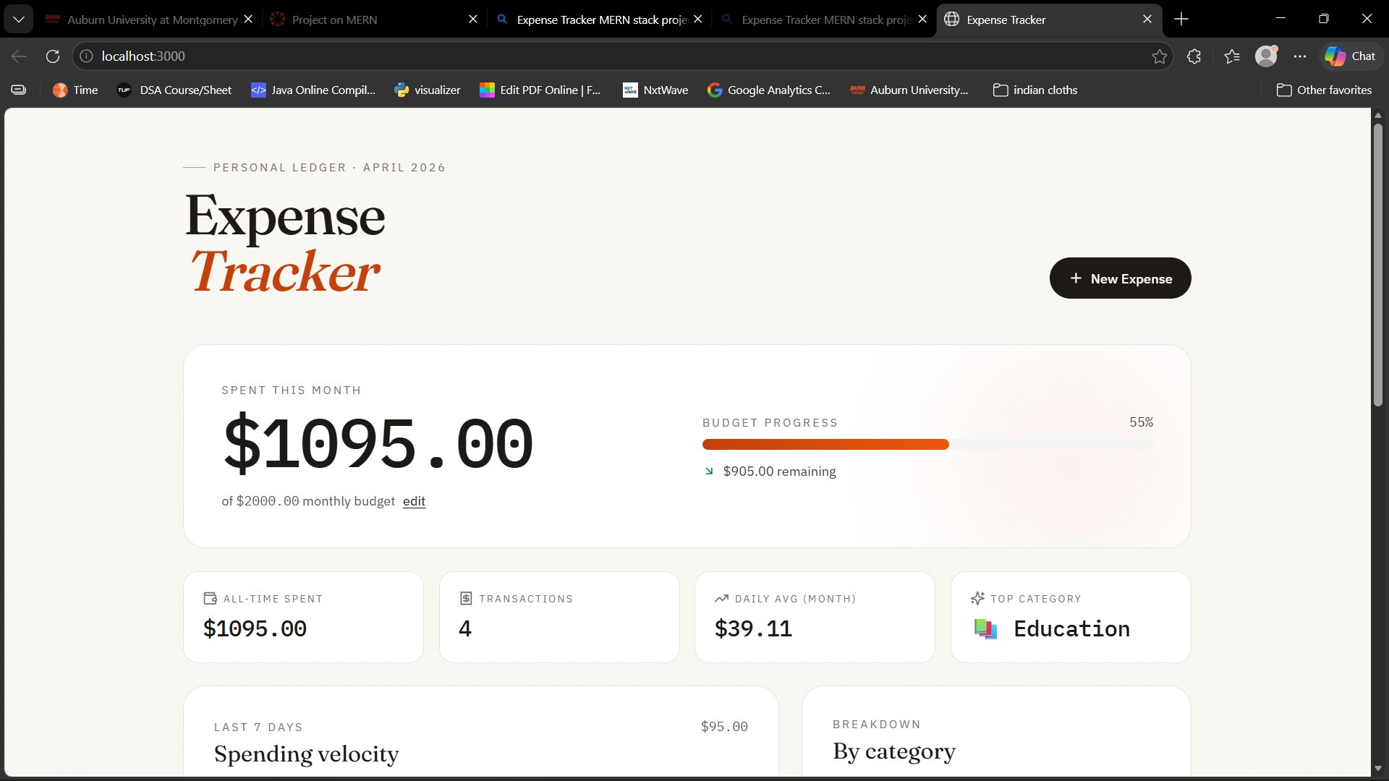
Main Dashboard
The dashboard shows total spent for the month, a live budget progress bar, and four key statistics: all-time spent, total transactions, daily average, and top spending category.

Slide 8
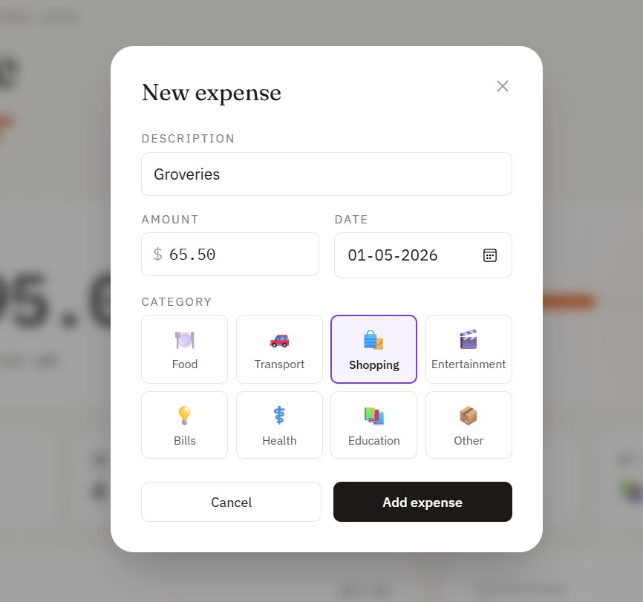
Adding a New Expense (Create)
Clicking the New Expense button opens a modal with fields for description, amount, date, and category. The form sends a POST request to /api/expenses, which creates a new document in MongoDB.
Form Fields
Description: short label for the expense
Amount: numeric value in dollars
Date: defaults to today
Category: choose from eight options
Validation
Mongoose schema enforces required fields, positive amount, and valid category enum on the backend before saving to MongoDB.

Slide 9
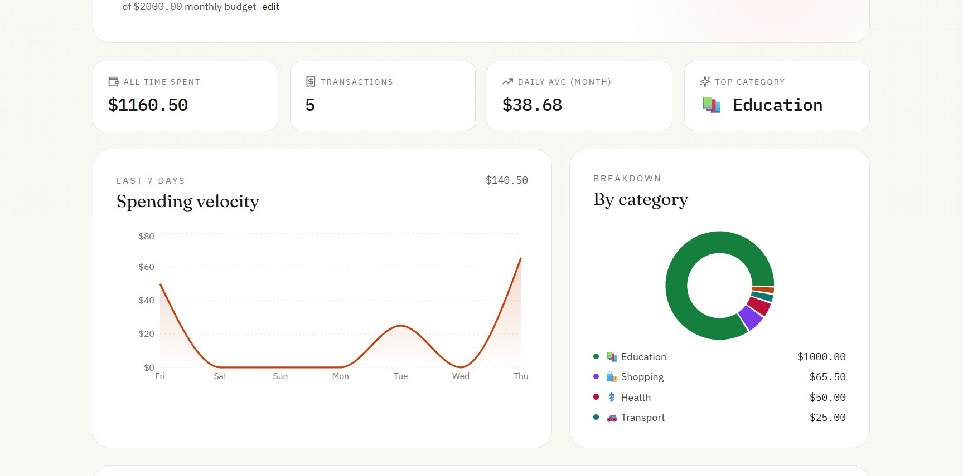
Charts and Statistics
The dashboard includes two interactive charts powered by the Recharts library. The area chart visualizes spending velocity over the last seven days, and the donut chart shows total spending broken down by category.

Slide 10
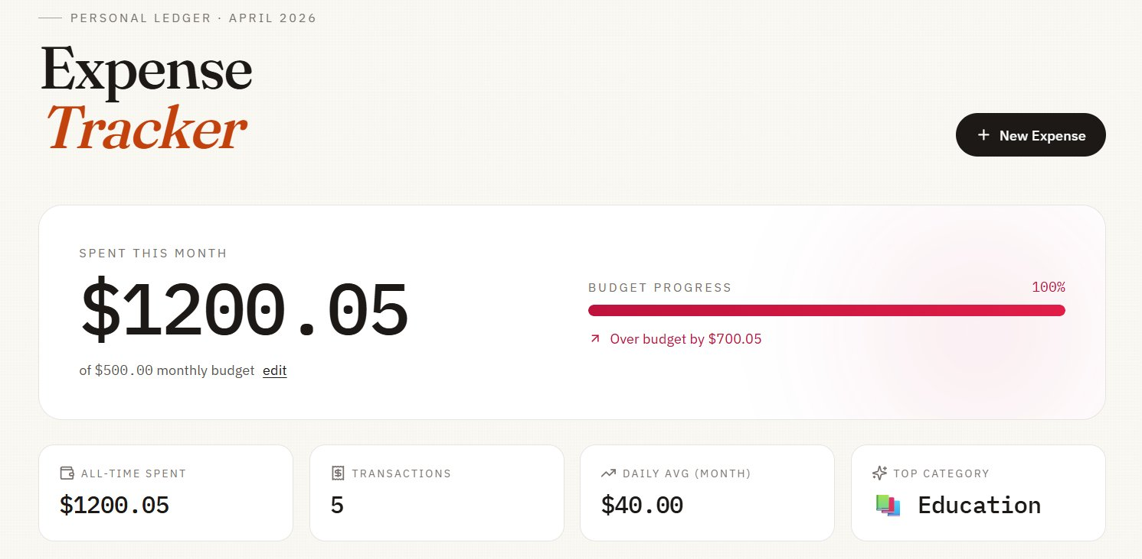
Budget Tracking
When the total spent for the month exceeds the budget, the progress bar turns red and displays the amount over budget. The budget itself is editable and persists in MongoDB.

Slide 11
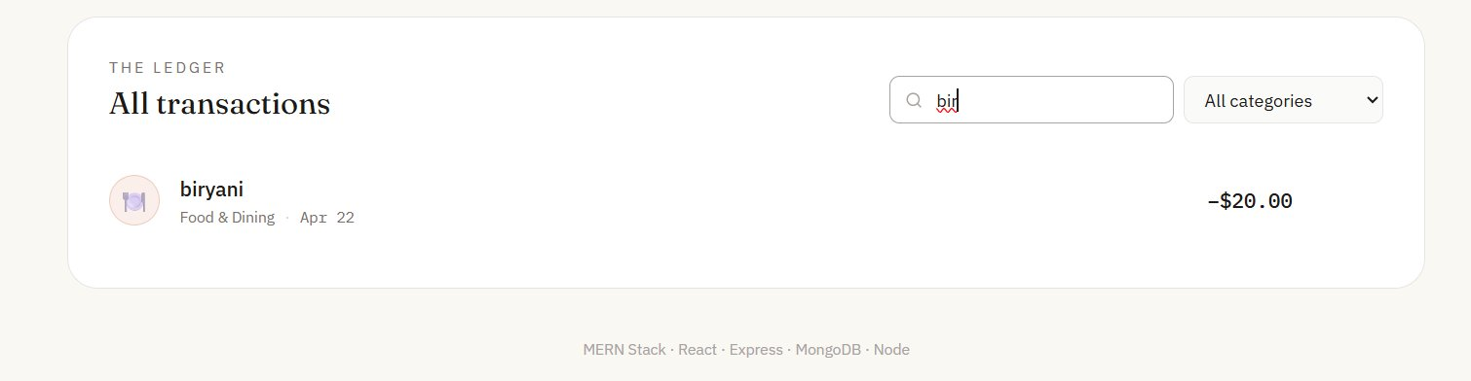
Search and Filter
The transaction list supports real-time search by description and filtering by category. In this example, typing "bir" in the search box filters the list to show only the matching biryani entry.

Slide 12
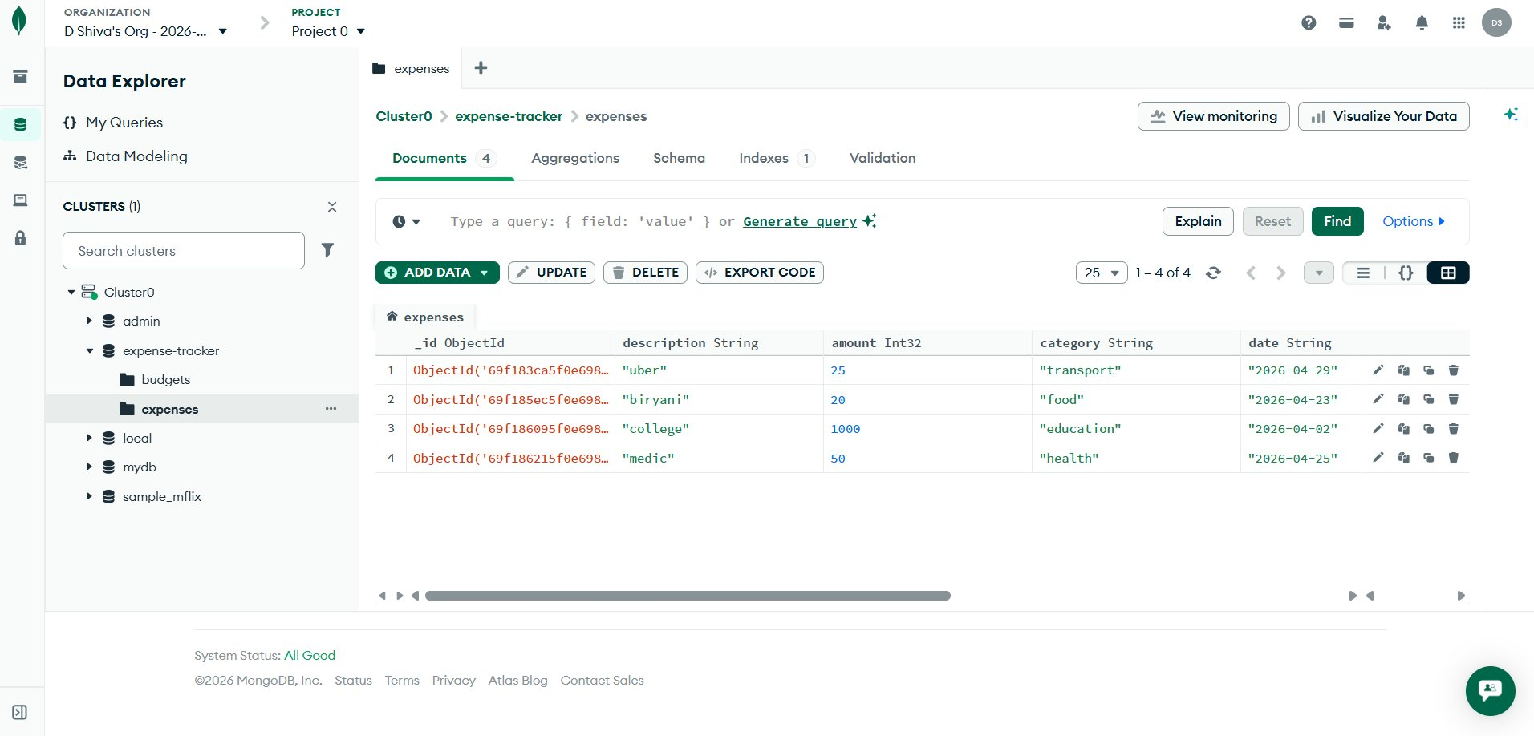
Data Persistence in MongoDB Atlas
All expense data is stored in MongoDB Atlas, a cloud-hosted NoSQL database. The screenshot below shows the expense-tracker database with the expenses collection containing four real documents created through the application.

Slide 13
Testing the Application
The application was tested manually for all functionality and all four CRUD operations.
Frontend Testing
Verified the page loads with no console errors
Confirmed expenses can be added, edited, and deleted from the UI
Tested data persistence by refreshing the browser after each operation
Verified the budget update and over-budget visual state
Confirmed search and category filter work in real time
Backend Testing
Tested all six API endpoints (GET, POST, PUT, DELETE) directly using HTTP requests
Verified Mongoose schema validation rejects invalid data (negative amounts, unknown categories)
Confirmed CORS allows the frontend to communicate with the backend
Verified database documents in MongoDB Atlas match what the UI displayed

Slide 14
Challenges and Learnings
Challenges
Connecting MongoDB Atlas required configuring IP whitelisting and URL-encoding the password in the connection string
Coordinating two separate servers (frontend on port 3000, backend on port 5000) needed CORS configuration
Implementing the edit-expense feature required reusing the modal for both create and update operations
Calculating monthly statistics required handling JavaScript date comparisons correctly across time zones
Key Learnings
Designing a clean REST API with proper separation of routes, controllers, and models
Using Mongoose schemas to enforce data validation at the database layer rather than only in the UI
Managing application state in React with hooks (useState, useEffect, useMemo)
Building a complete full-stack application from scratch and connecting all four MERN components

Slide 15
Future Improvements
Possible enhancements that could be added in future iterations of the project.
User authentication: add login and signup so each user has their own private expenses (using JWT tokens and bcrypt for password hashing)
Recurring expenses: support automatically repeating monthly expenses like rent, subscriptions, and utilities
Export functionality: allow users to download their expense history as CSV or PDF for record-keeping
Multiple budgets: allow setting separate budgets for each category instead of just one overall budget
Receipt uploads: attach receipt images to expenses using cloud storage (AWS S3 or Cloudinary)
Email notifications: alert the user when they cross 75 percent or 100 percent of their monthly budget
Mobile application: build a React Native version that shares the same backend API
Dark mode: add a theme toggle for users who prefer a darker interface

Slide 16
Conclusion
This project successfully demonstrates the core capabilities of the MERN stack. The application performs full CRUD operations on two resources, persists data to a cloud-hosted MongoDB database, exposes a clean REST API, and provides a responsive React frontend with charts and real-time filtering. All assignment requirements have been met.
Summary
Six REST API endpoints across two resources (expenses and budget)
Two Mongoose models with full schema validation
Eight expense categories with color-coded icons
Two interactive Recharts visualizations
Cloud database hosted on MongoDB Atlas
Complete documentation with README and quick-start guide
Thank You

