Slide 1
Structure Learning Algorithms for Chain Graphs
Damian Skrzypiec
19.12.2017

Slide 2
A probablilistic graphical model (Graphical Model) is a probabilistic model for which a graph expresses the conditional dependence structure between random variables.
Probabilistic Graphical Models
Statistics
Graph Theory
Computer Science
PGM

Slide 3
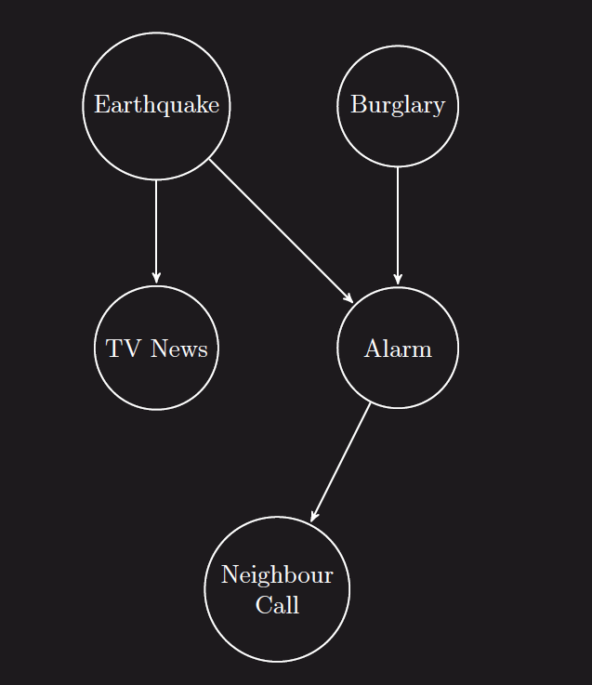
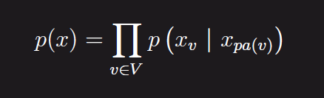
Bayesian network is a probabilistic graphical model which is represented by a directed acyclic graph (DAG). It is the most common class of PGMs. Bayesian networks were formally introduced in 1982 by Pearl.
Bayesian Networks

Slide 4
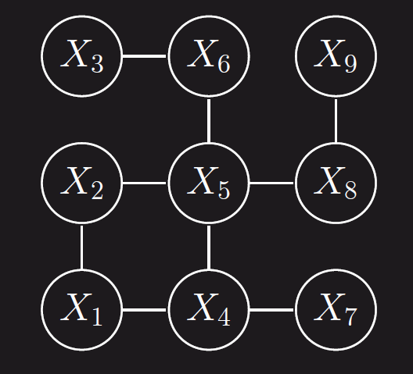
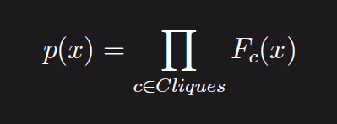
Markov Random Field is a probabilistic graphical model which is represented by an undirected graph. Besides bayesian networks it is one of the most common class of PGMs.
Markov Random Fields

Slide 5
Why PGMs?
Graphical representation is very intuitive and convenient in case of high dimension probability spaces
Graphical representation provides insight about conditional independence structure just by looking at the graph.
Graphical representation makes easier to requires less comuputational to calculate conditional probability (e.g P(Earthquake | Alarm = 1))

Slide 6
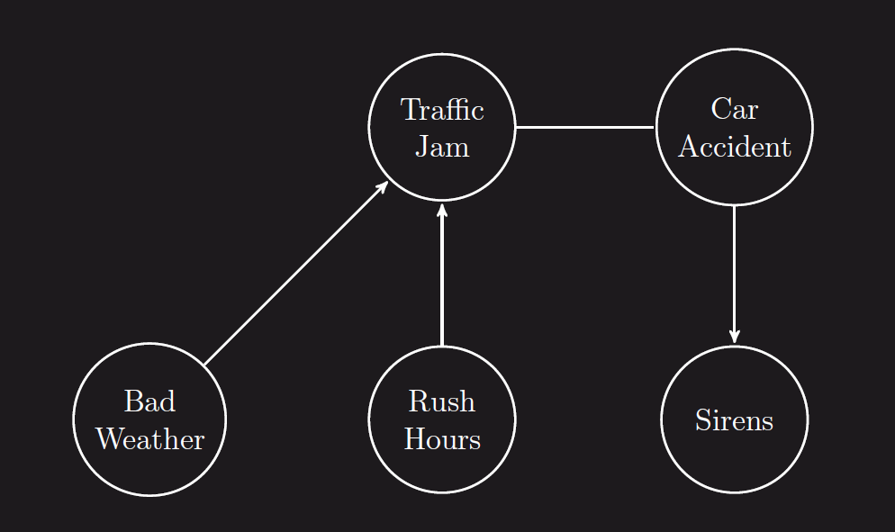
Chain Graphs
Chain graphs is a class of PGMs which is represented by graphs not containing cycles. It can contains both directed and undirected edges. Thus chain graphs can be perceived as generalization of bayesian networks and Markov fields.

Slide 7
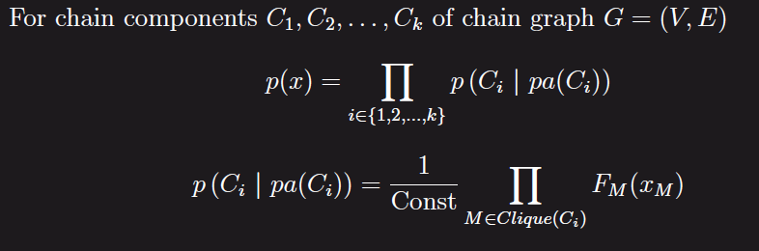
Parametrization of chain graphs
A chain component C of chain graph is a maximal set of vertices such that there is a path between every pair of vertices in C containing only undirected edges. When we treat chain components of chain graph as „nodes” we got DAG. Therefore

Slide 8
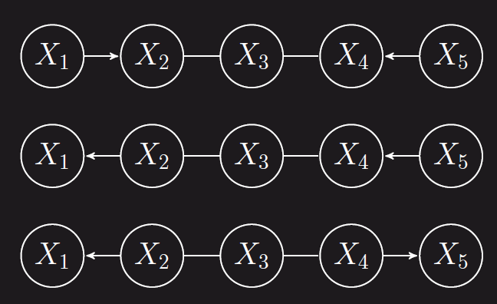
C-Separation
Section
collider section
non collider section
non collider section

Slide 9
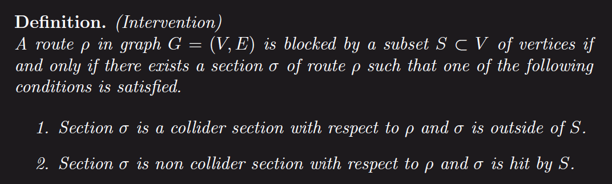
C-Separation

Slide 10
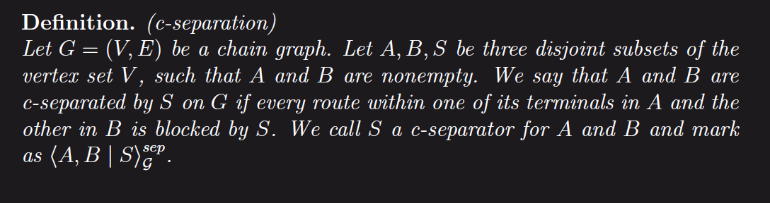
C-Separation

Slide 11
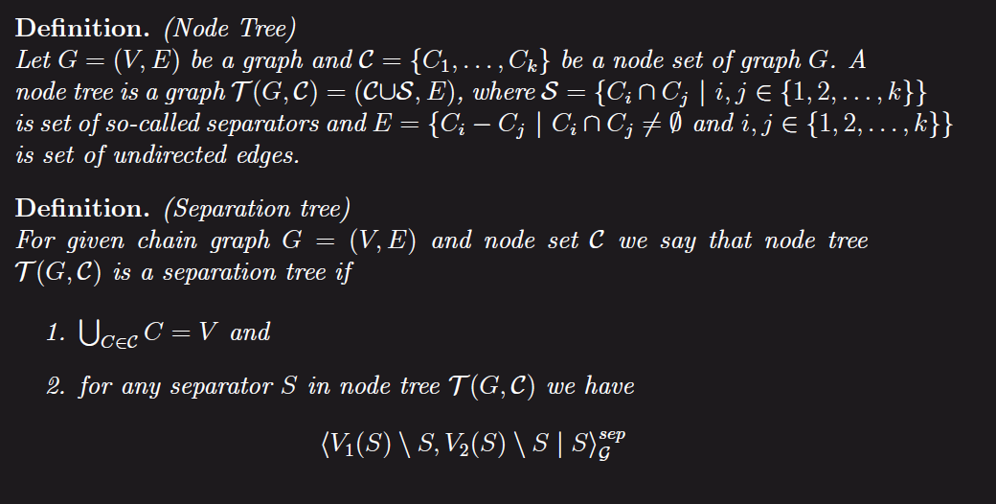
Separation Trees

Slide 12
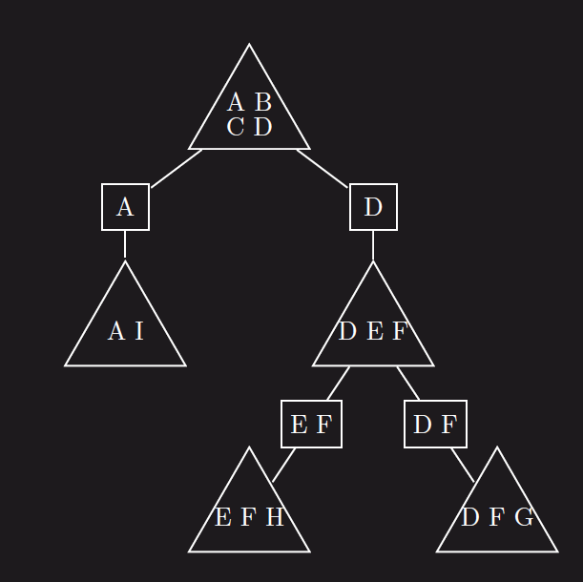
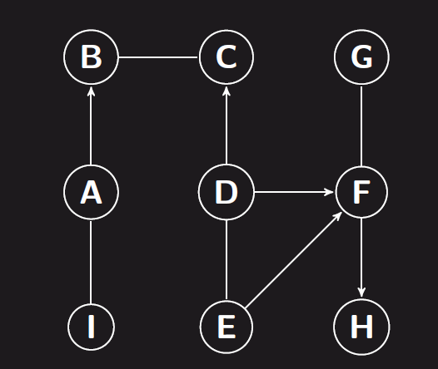
Separation Trees

Slide 13
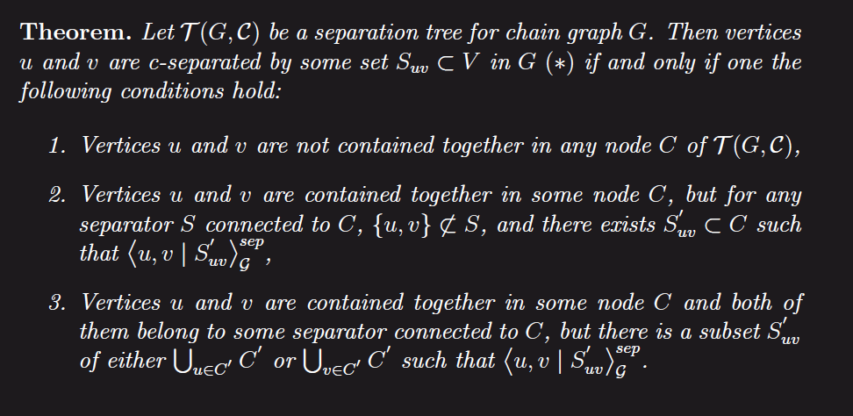
Main Theorem

Slide 14
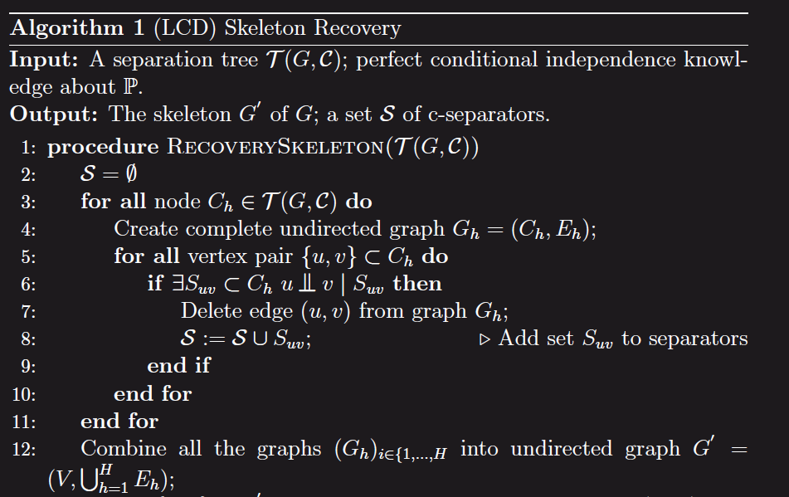
Skeleton Recovery Algorithm

Slide 15
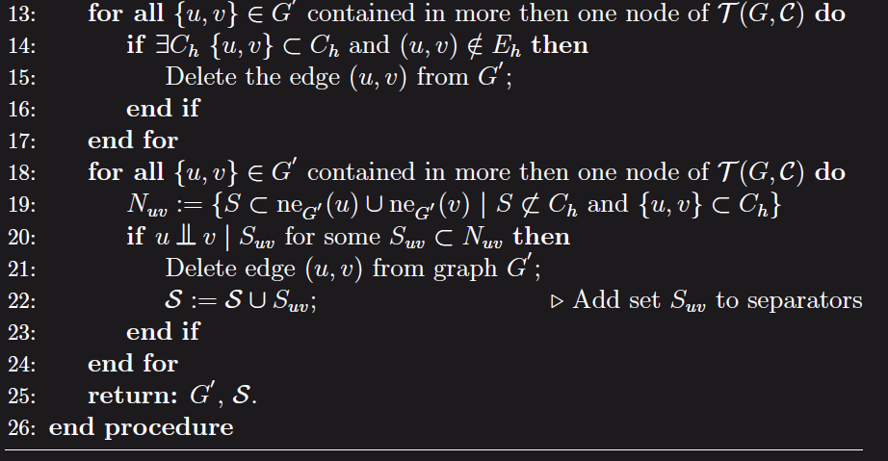
Skeleton Recovery Algorithm

Slide 16
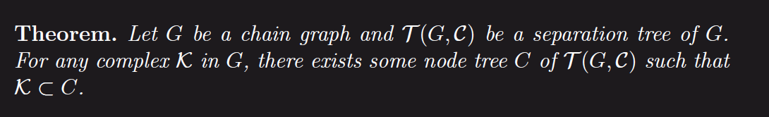
Complex Recovery

Slide 17
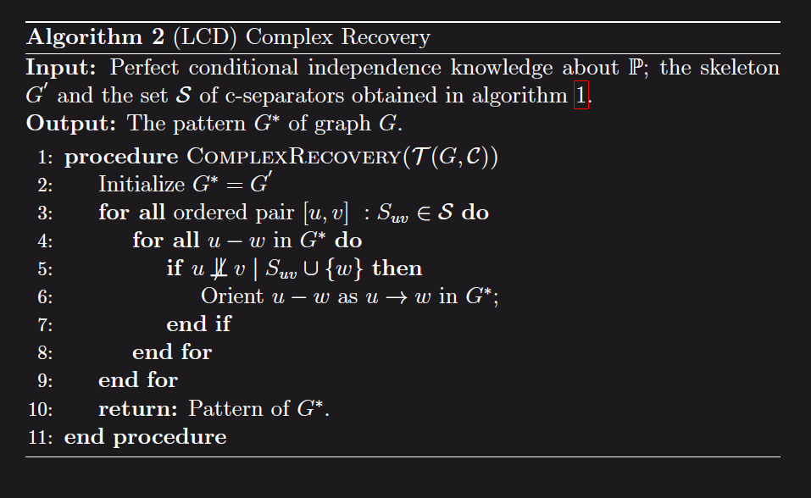
Complex Recovery Algorithm

Slide 18
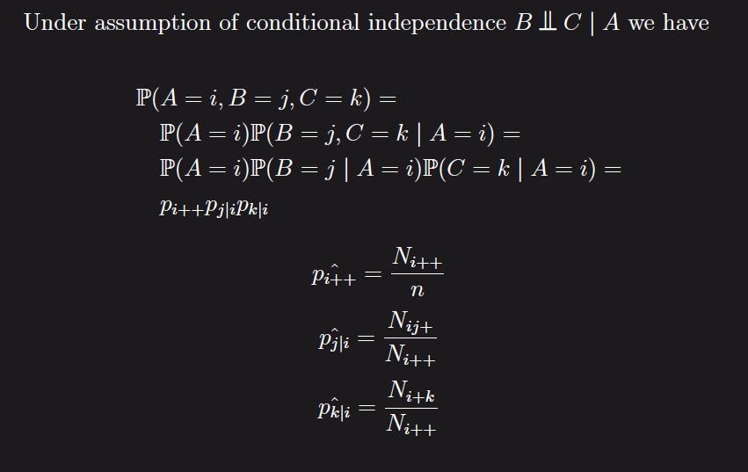
Testing conditional independence

Slide 19
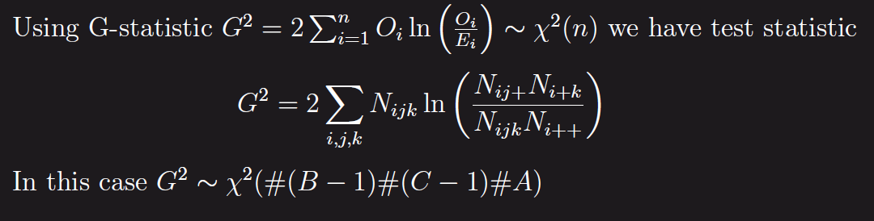
Testing conditional independence

