Slide 1
Passion & Polarization
Using Reddit Data to Examine Trends in Thread Comment Behavior

Slide 2
Hatred, anger, and violence can destroy us: the politics of polarization is dangerous. Rahul Gandhi

Slide 3
Proposed Roadmap to Polarization
Someone shares a charged statement
People see it and interact with it
Social media algorithms show statement to more individuals
Sentiment becomes more widespread

Slide 4

An Example…
How many likes do you think a comment like this would receive?
These criminals belong in prison! LOCK THEM UP!
?
A potentially polarizing sentiment
Limited by its visibility

Slide 5
An Example…
How many likes do you think a comment like this would receive?
Politicians outlaw ice cream in all restaurants nationwide, citing concerns about rising costs. “This will be a major blow to Big Dairy,” the president shared in a press conference last week.
-1,382,438
These criminals belong in prison! LOCK THEM UP!
LOTS

Slide 6
An Example…
How many likes do you think a comment like this would receive?
Last, week thousands of migrants from Ukraine entered the United States seeking refuge from ongoing turmoil in their homes. US services welcomed them to safety. #StandWithUkraine
3,583,294
These criminals belong in prison! LOCK THEM UP!
-LOTS

Slide 7
How can we understand what’s going on here?
Sentiment of ‘parent’ post
Sentiment of ‘child’ post
Popularity of ‘parent’ post
Popularity of ‘child’ post
Where better to look than Reddit?

Slide 8
Our Research Questions
What relationships exist among the content (defined by sentiment and topic) and popularity of a post and the content and popularity of its replies?
We think posts with negative sentiment in response to unpopular posts will receive more likes, and vice versa.
Are these relationships universal, or do they look different in different areas (platform, topic)?
We think they are not universal. Topics like politics, climate change, or abortion might have more polarized comment sections.
Do these relationships tell us anything about online polarization of opinion? What next steps might these findings suggest?

Slide 9
What we did
Phase 3: Broader Implications
Looked for key takeaways and lessons learned
Thought about limitations of our project and how it could be scaled
Phase 2: Wider Search
Looked across Reddit comment sections in a variety of topic areas
Saw how our model did (or didn’t) hold up for different themes
Phase 1: Case Study
Examined the comment section to the most downvoted Reddit post to date
Created a model that can help answer our questions

Slide 10
Phase 1: Case Study
EA’s Blunder

Slide 11
/R/StarWarsBattlefront
About 4 years ago…
Seriously? I paid 80$ to have Vader locked?
This is a joke. I'll be contacting EA support for a refund... I can't even playing f***ing Darth Vader?!?!? Disgusting. This age of "micro-transactions" has gone WAY too far. Leave it to EA though to stretch the boundaries.
202,000
The intent is to provide players with a sense of pride and accomplishment for unlocking different heroes.
As for cost, we selected initial values based upon data from the Open Beta and other adjustments made to milestone rewards before launch. Among other things, we're looking at average per-player credit earn rates on a daily basis, and we'll be making constant adjustments to ensure that players have challenges that are compelling, rewarding, and of course attainable via gameplay.
We appreciate the candid feedback, and the passion the community has put forth around the current topics here on Reddit, our forums and across numerous social media outlets.
-667,700

Slide 12
/R/StarWarsBattlefront
About 4 years ago…
Sentiment: Negative
Popularity: Positive
Sentiment: Positive
Popularity: Negative

Slide 13
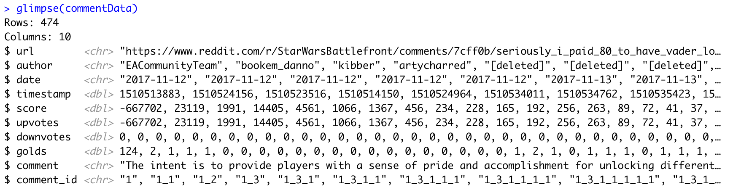
Scraping Reddit data
commentData <- tibble(get_thread_content("https://www.reddit.com/r/StarWarsBattlefront/ comments/7cff0b/seriously_i_paid_80_to_have_vader_locked/dppum98/")$comments)
...
overallSentiment = positive - negative,
parent_ID = substr(comment_id, 1, regexpr("\\_[^\\_]*$", comment_id)-1))
parentSentiment = workingData[match(parent_ID, workingData$comment_id), 14]
parentPopularity = workingData[match(parent_ID, workingData$comment_id), 13]

Slide 14
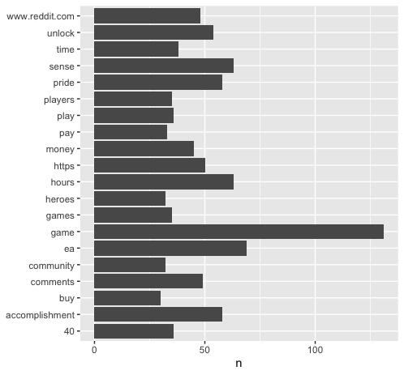
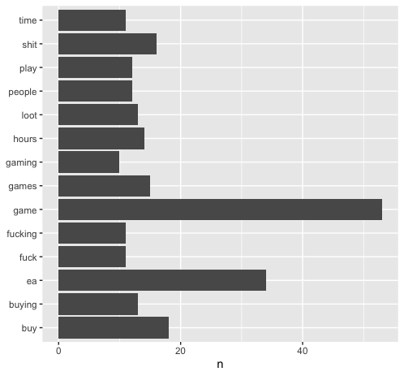
Exploring the Comment Data
Most Common Words in Positive Comments
Most Common Words in Negative Comments
Removed words like “game” with stop words

Slide 15
Exploring the Comment Data
ANOTHER VISUALIZATION?

Slide 16
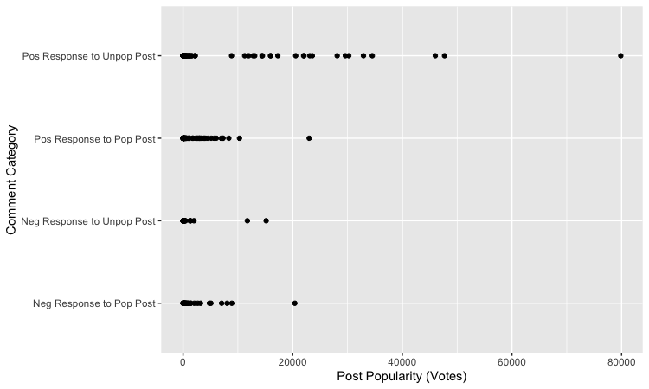
Sampled Comments

Slide 17
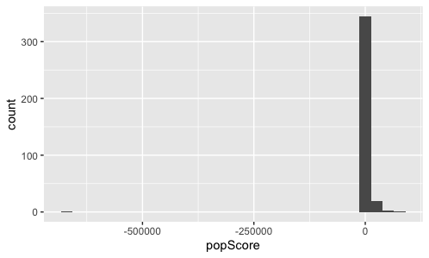
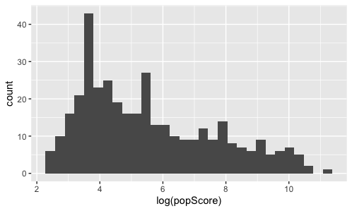
Creating the Model
parentPopularity
parentSentiment
Comment’s Popularity
overallSentiment

Slide 18
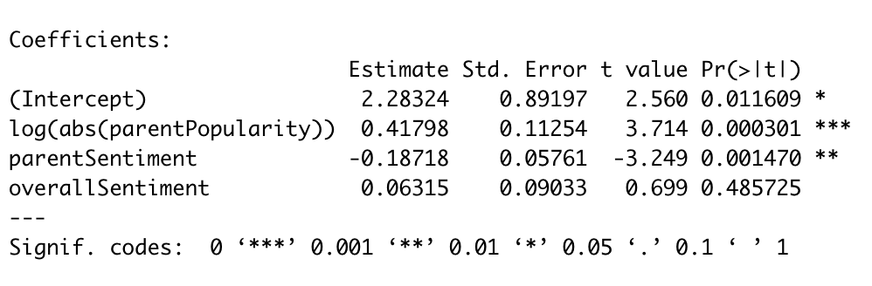
Note: Data used for the model was one where the sentiment of the comment and the popularity of its parent were aligned. This was, in part, because
using the entire pool of comments yielded a useless model, though this choice is also theoretically justified.

Slide 19
Case Study Takeaways
Popularity of parent post is a big indicator of a post’s potential to become popular.
High coefficient for parent popularity in linear model
Makes sense to us – commenting on an unpopular post doesn’t give you traction
- harder to ‘go viral’ from a lower-visibility starting point
Unpopular posts lend themselves to more unpopular comment sections.
Negative coefficient for parent sentiment in linear model
Makes sense to us – more opportunities for a ‘clap back,’ opportunity to defend your belief
- interesting relationship with social media algorithms & negativity bias
The sentiment of a post seems to be less important than the sentiment of the post it responds to.
Minute coefficient for post sentiment in linear model, little significance
More important seems to be the (mis)match in sentiment from parent and response

Slide 20
Case Study Limitations
Length of posts versus words contained in lexicons
roughly 10% of words are classified
most comments are already short
look at sentiment score per word?
Lack of posts with unpopular parents
functionally, only EA’s post filled this role
difficult to distinguish between negative
parent and depth in thread
SARCASM!
look at a score of pos+neg = passion?
“I wonder if Burger King wants to sell me a sense of pride and accomplishment by making me work 10 hours for my f**king fries."

Slide 21
Phase 2: Wider Search
Model Cross-Topic Generalizability

Slide 22

Selecting Other Threads
Topics Selected Using Implications from Case Study:
Looking for longer posts, more ‘charged’ language
Looking for fewer instances of sarcasm
More mix of up and down votes
Reproductive Rights
Politics
Climate Change

Slide 23
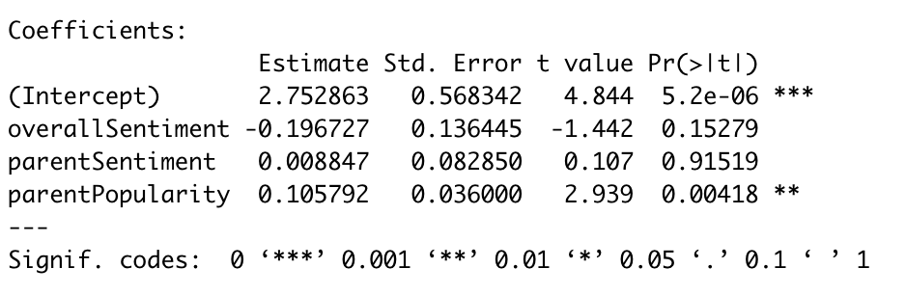
Climate Change

Slide 26
Comparison Across Topics

