Slide 1
Passion & Polarization
Using Reddit Data to Examine Trends in Thread Comment Behavior

Slide 2
Hatred, anger, and violence can destroy us: the politics of polarization is dangerous. Rahul Gandhi

Slide 3
Proposed Roadmap to Polarization
Someone shares a charged statement
People see it and interact with it
Social media algorithms show statement to more individuals
Sentiment becomes more widespread

Slide 4

An Example…
How many likes do you think a comment like this would receive?
These criminals belong in prison! LOCK THEM UP!
?
A potentially polarizing sentiment
Limited by its visibility

Slide 5
An Example…
How many likes do you think a comment like this would receive?
Politicians outlaw ice cream in all restaurants nationwide, citing concerns about rising costs. “This will be a major blow to Big Dairy,” the president shared in a press conference last week.
-1,382,438
These criminals belong in prison! LOCK THEM UP!
LOTS

Slide 6
An Example…
How many likes do you think a comment like this would receive?
Last, week thousands of migrants from Ukraine entered the United States seeking refuge from ongoing turmoil in their homes. US services welcomed them to safety. #StandWithUkraine
3,583,294
These criminals belong in prison! LOCK THEM UP!
-LOTS

Slide 7
How can we understand what’s going on here?
Sentiment of ‘parent’ post
Sentiment of ‘child’ post
Popularity of ‘parent’ post
Popularity of ‘child’ post
Where better to look than Reddit?

Slide 8
Our Research Questions
What relationships exist among the content (defined by sentiment and topic) and popularity of a post and the content and popularity of its replies?
We think posts with negative sentiment in response to unpopular posts will receive more likes, and vice versa.
Are these relationships universal, or do they look different in different areas (platform, topic)?
We think they are not universal. Topics like politics, climate change, or abortion might have more polarized comment sections.
Do these relationships tell us anything about online polarization of opinion? What next steps might these findings suggest?

Slide 9
What we did
Phase 3: Broader Implications
Looked for key takeaways and lessons learned
Thought about limitations of our project and how it could be scaled
Phase 2: Wider Search
Looked across Reddit comment sections in a variety of topic areas
Saw how our model did (or didn’t) hold up for different themes
Phase 1: Case Study
Examined the comment section to the most downvoted Reddit post to date
Created a model that can help answer our questions

Slide 10
Phase 1: Case Study
EA’s Blunder

Slide 11
/R/StarWarsBattlefront
About 4 years ago…
Seriously? I paid 80$ to have Vader locked?
This is a joke. I'll be contacting EA support for a refund... I can't even playing f***ing Darth Vader?!?!? Disgusting. This age of "micro-transactions" has gone WAY too far. Leave it to EA though to stretch the boundaries.
202,000
The intent is to provide players with a sense of pride and accomplishment for unlocking different heroes.
As for cost, we selected initial values based upon data from the Open Beta and other adjustments made to milestone rewards before launch. Among other things, we're looking at average per-player credit earn rates on a daily basis, and we'll be making constant adjustments to ensure that players have challenges that are compelling, rewarding, and of course attainable via gameplay.
We appreciate the candid feedback, and the passion the community has put forth around the current topics here on Reddit, our forums and across numerous social media outlets.
-667,700

Slide 12
/R/StarWarsBattlefront
About 4 years ago…
Sentiment: Negative
Popularity: Positive
Sentiment: Positive
Popularity: Negative

Slide 13
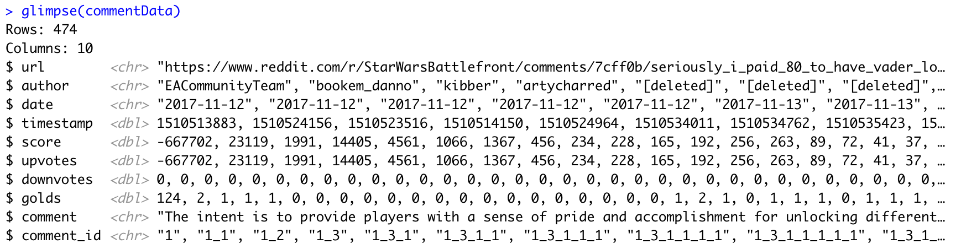
Scraping Reddit data
commentData <- tibble(get_thread_content("https://www.reddit.com/r/StarWarsBattlefront/ comments/7cff0b/seriously_i_paid_80_to_have_vader_locked/dppum98/")$comments)
...
overallSentiment = positive - negative,
parent_ID = substr(comment_id, 1, regexpr("\\_[^\\_]*$", comment_id)-1))
parentSentiment = workingData[match(parent_ID, workingData$comment_id), 14]
parentPopularity = workingData[match(parent_ID, workingData$comment_id), 13]

Slide 14
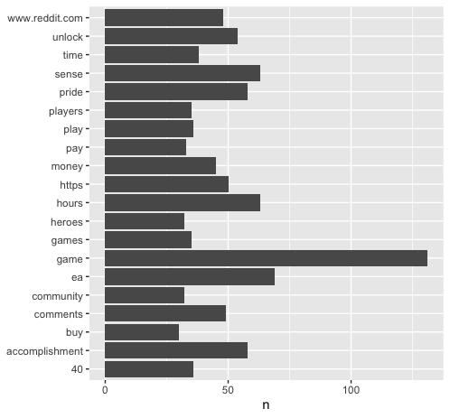
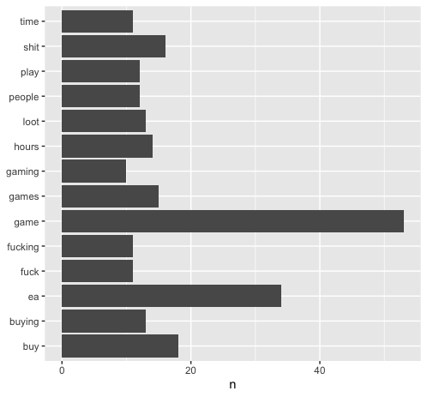
Exploring the Comment Data
Most Common Words in Positive Comments
Most Common Words in Negative Comments

Slide 15
Exploring the Comment Data

Slide 16
Creating the Model
parentPopularity
parentSentiment
Comment’s Popularity
overallSentiment

