Slide 1
Improved Bounds on the Expected Length of Longest Common Subsequences
https://arxiv.org/abs/2407.10925
Submitted to ALENEX
Tufts University, August 8 2024

Slide 2





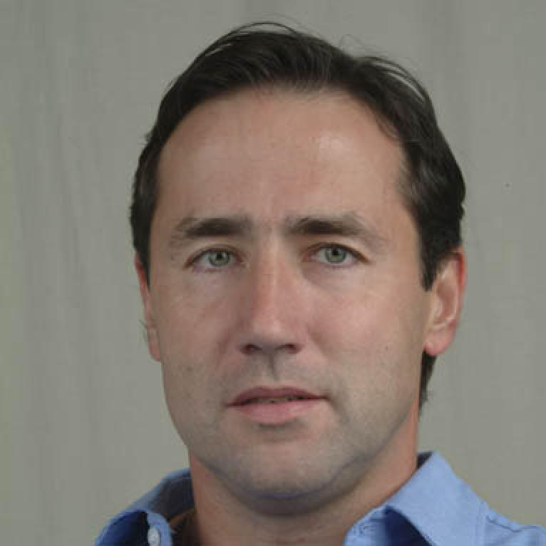
Authors
Chase Miller
Andrew Salls
Duncan Soiffer
George Heineman
Daniel Reichman
Gábor Sárközy

Slide 3
(Longest Common) Subsequences
mathematics
computer science
meats
mteic
music
Longest Common Subsequence
Notes:
Remove symbols while preserving the order of the remaining symbols

Slide 4


Computing an LCS
Elegant dynamic programming algorithm
Taught in thousands of classes across US alone
Running Time

Slide 5
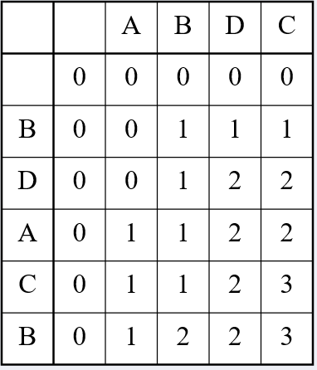
LCS Algorithm
Create m x n table
Fill each cell as follows:

Slide 6
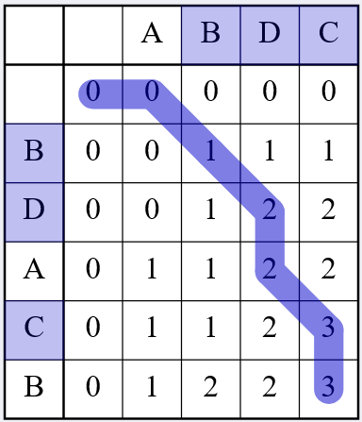
LCS Algorithm
Create m x n table
Fill each cell as follows:
If the character of current row and current column match, fill cell by adding one to the diagonal element, and point to it.
Else take max from cell in previous column and row. Point to cell with max value.

Slide 7
Applications
Computational Biology
Computational Linguistics
Other Fields
Sequence comparison
Phylogenetic tree reconstruction
File comparison
Plagiarism detection
Pattern matching
Anomaly detection
(Biological) data compression
Stratigraphy

Slide 8
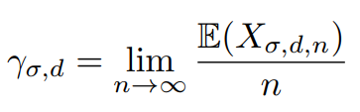

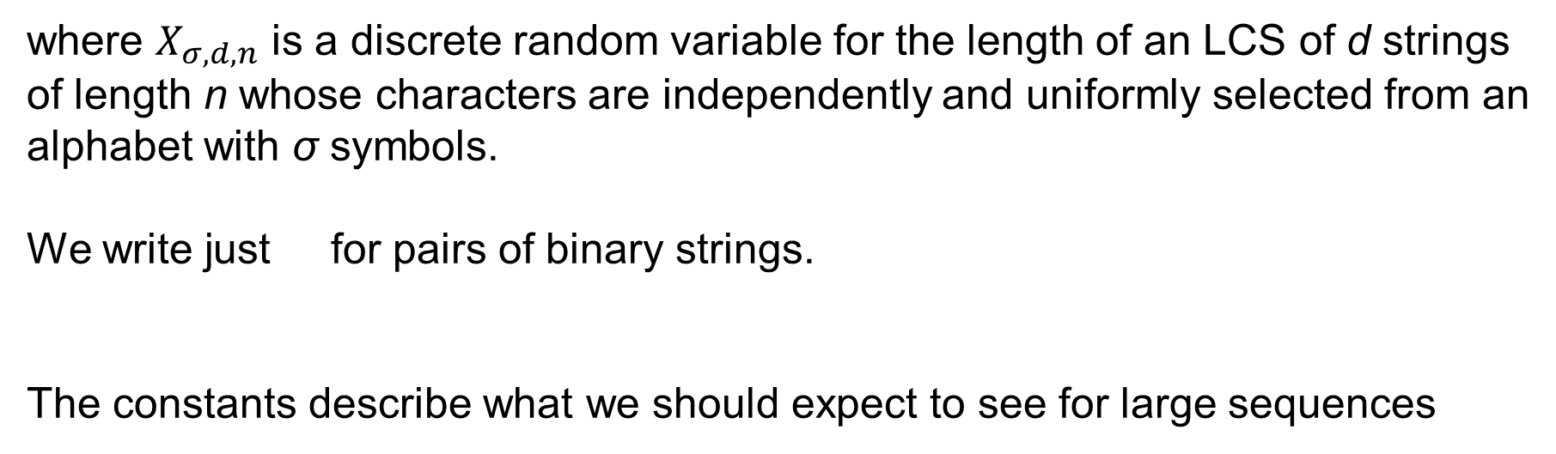
The Chvátal-Sankoff Constants
where $X_{σ,d,n}$ is a discrete random variable for the length of an LCS of d strings of length n whose characters are independently and uniformly selected from an alphabet with σ symbols.
We write just for pairs of binary strings.
The constants describe what we should expect to see for large sequences
Notes:
We denote the chvatal-sankoff constant for the case of two binary strings as just gamma, as it is by far the most studied case in the literature

Slide 9

The Chvátal-Sankoff Constants
Mean LCS length is superadditive:
So converges to a constant.
Lower and upper bounds are known, but exact values are not.
Notes:
despite the simplicity of the random variable involved it is not clear how to compute the expectation exactly. This is atypical.

Slide 10
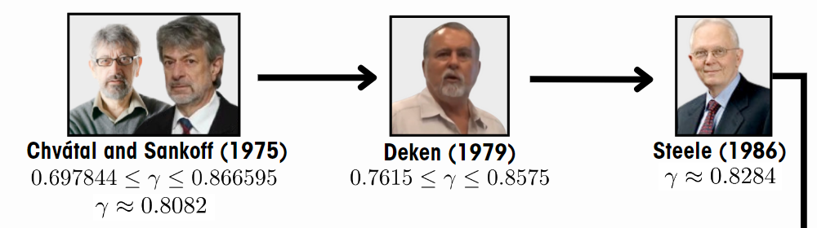
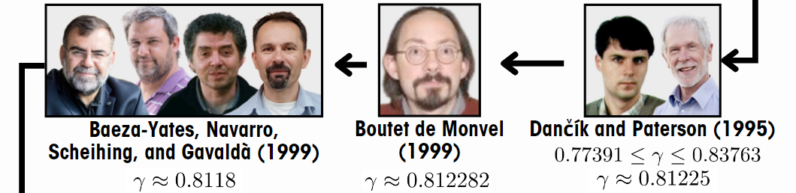
History of the Chvátal-Sankoff Constants

Slide 11

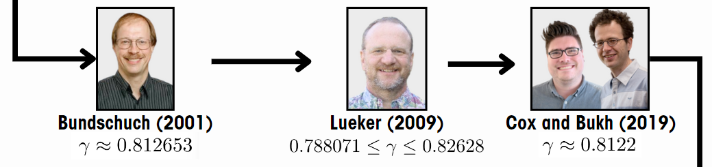
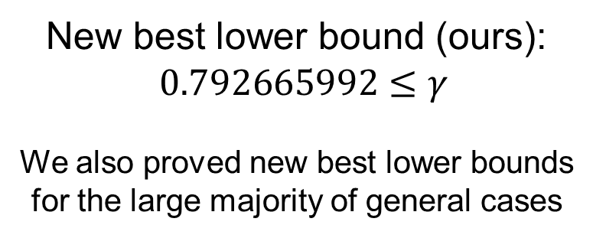
History (Cont.)
New best lower bound (ours): $$0.792665992≤γ$$
We also proved new best lower bounds for the large majority of general cases
Notes:
Presenter: Duncan

Slide 12


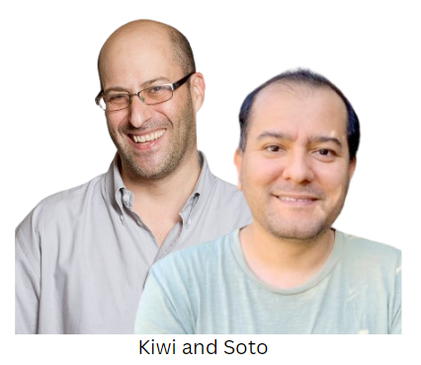
Our Methods
Improve on algorithms by Lueker, Kiwi and Soto
Computes recurrences on giant vectors
Require immense compute, memory use:
For l = 20, 4 bytes per entry means
Overcome through:
Parallelization
Recursive sub-chunking
Use of LCS properties
$$4∙4^{20}=4,398,046,511,104 bytes≈4.4TB$$
Notes:
Before I move on to the actual algorithm, I’m first going to cover the theory behind it and why it works. This theory is originally presented by Lueker and Kiwi and Soto, and I’m going to summarize it here while leaving out some of the more cumbersome proofs.

Slide 13
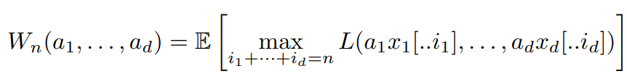

Central Idea: W_{n}
Why not deal with LCS directly?
Notes:
This quantity is the expected length of an LCS of d strings with prefixes a1, . . . , ad, respectively, and d suffixes whose lengths sum to n and whose characters are independently and uniformly chosen from Σ [16]. It is increasing, so by lower bounding it we can also lower bound its associated chvatal sankoff constant.

Slide 14
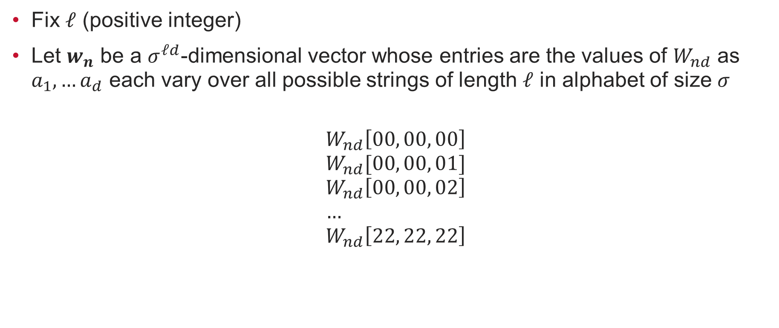

Recurrence Vectors w_{n}
Fix $ℓ$ (positive integer)
Let $w_{n}$ be a $σ^{ℓd}$-dimensional vector whose entries are the values of $W_{nd}$ as $a_{1},…a_{d}$ each vary over all possible strings of length $ℓ$ in alphabet of size $σ$
$$W_{nd}\left[00, 00, 00\right] \\ W_{nd}[00, 00, 01]$$
$$W_{nd}\left[00, 00, 02\right] \\ … \\ W_{nd}\left[22, 22, 22\right]$$
$$w_{n}=$$
Notes:
This inequality states that if all the strings start with the same character, then the expected length of the LCS of all of them, permitting n random extra characters, is at least 1 (the first character) plus the average of the expected length of the LCS of the strings obtained by removing the first character and adding d of the n random characters [16]. w_n, and in fact all vectors mentioned for the rest of this presentation, all contain real numbers and are of length σ^d·ℓ , corresponding to the number of possible d-tuple of strings where each string has ℓ characters taken from an alphabet of size σ

Slide 15
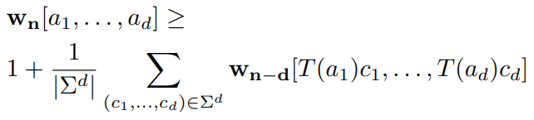

First Inequality
If all strings $a_{1},…,a_{d}$ start with same character,
Notes:
This inequality states that if all the strings start with the same character, then the expected length of the LCS of all of them, permitting n random extra characters, is at least 1 (the first character) plus the average of the expected length of the LCS of the strings obtained by removing the first character and ‘borrowing’ (adding) d of the n random characters [16].

Slide 16
Wn-d
wn

Slide 17

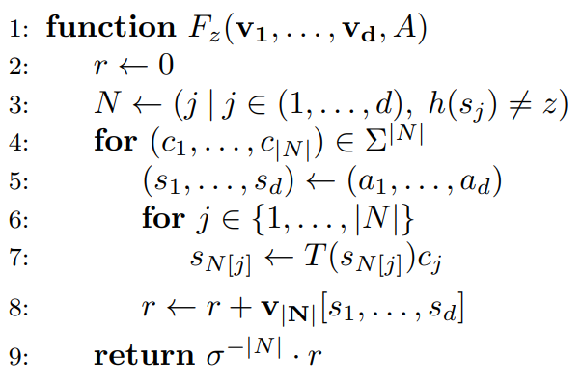
Second Inequality (Calculating F_{z})
Notes:
However, it becomes more complicated if all the strings do not start with the same character. For this purpose, we define a function Fz which computes the expected length of an LCS of the strings A = (a1, . . . , ad) when discarding the first character of all strings not beginning with z and adding to their end a random character from Σ (independently chosen for each string). Here, N is an ordered set containing the positions of strings in the tuple (a1, . . . , ad) that do not start with some character z. Fz removes the first character from all strings that do not start with z and adds some new character to their ends, doing this for all possible combinations of new characters at the end of the strings. Fz then calculates the mean value of v|N| at the indices corresponding to all σ |N| of the d-tuples created this way.
Informally, each term over which the maximum is taken corresponds to the expected length of the LCS of the strings one would obtain by disregarding all first characters of sequences not starting with z, and concatenating to the tail of these strings an element randomly chosen over the alphabet Σ. A is the d-tuple of strings a_1 through a_d

Slide 18


Combined Inequalities
We can combine inequalities ($b=1$ if first characters of $A=\left(a_{1},…,a_{d}\right)$’s all same, 0 otherwise)

Slide 19
Algorithm Intuition Overview
If we could simply do LCS, that would be better
But limited by memory and compute to an extreme degree
Instead, have set of starting strings
Match and discard leftmost character when possible. Else, discard one specific character from left of all strings.
Add random new character to the ends of each impacted string.
Keep iterating this (for all possible sets of starting strings).
Grow total suffix size each iteration
But keeps actual buffer size constant
Notes:
At first iteration, it really is identical to treating as just subsequences, no prefixes.
But then, with this relation, you can take a character off the front, add one at the end, and still retain some information. Each iteration is increasing the total combined size of the prefixes. The length of the base strings increase how strong of a bound that info store is basically.
Sort of like doing memoization of the lower bounds with an incomplete (but still correct) table?
Good luck computing LCS for all pairs of strings from an alphabet of size 4 with 100 characters…

Slide 20
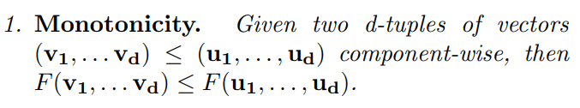
Feasible Triplet Lemma: Monotonicity
Notes:
(make sure to mention what F is)

Slide 21

Feasible Triplet Lemma: Translation Invariance

Slide 22
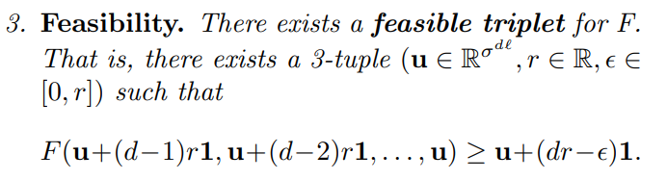
Feasible Triplet Lemma: Feasibility

Slide 23
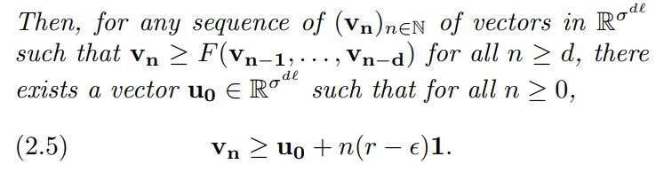

Feasible Triplet Lemma
Thus, if we find feasible triplet for F, sequence of w_{n} generated by applying F repeatedly also obeys this
Follows that
Need only find good feasible triplet

Slide 24

Empirical Observation
For any initial set of vectors, set v_{n+d} to
Eventually, will converge so that all vectors differ by very close to constant amount
Meaning,

Slide 25


Finding a Feasible Triplet
Iterate F on vectors v₁, v₂, … until convergence
Set $u=v_{n+1}$
Define $r$ as max value where holds
Define $ε$ as min value such that $\left(u, r, ε\right)$ is a feasible triplet

Slide 26
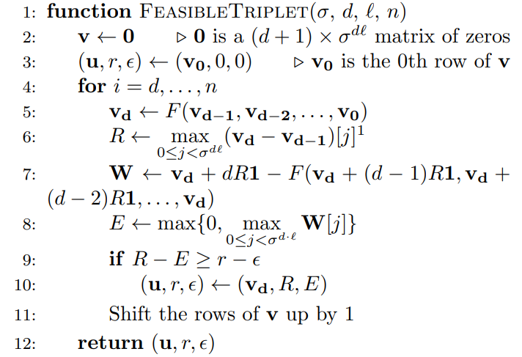
Feasible Triplet Algorithm
[Calculate values based on v]
Notes:
Once Algorithm 2.2 has terminated, values r and ϵ can be used to calculate a lower bound on γ_σ,d according to (2.6). Eventually, the v vectors appear to converge where the difference between consecutive vectors appears to be constant

Slide 27
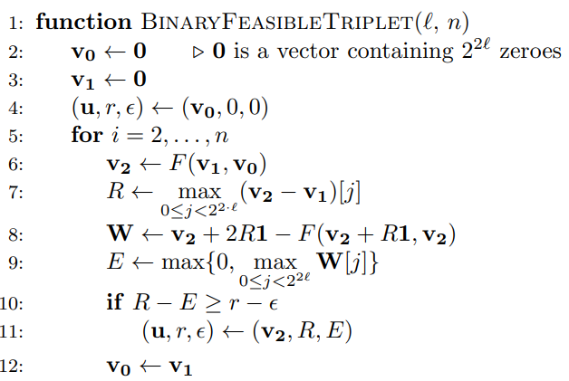

Binary Algorithm
[Calculate values based on v₂, v₁]

Slide 28
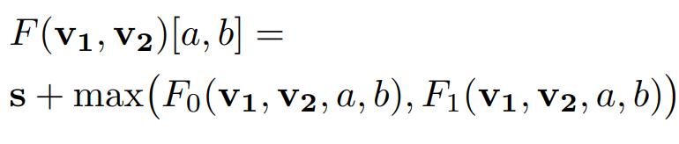
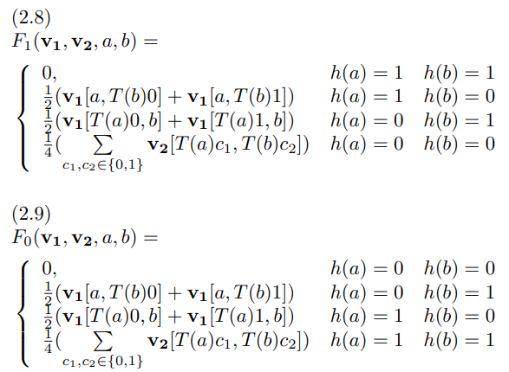
The Binary F
Notes:
ssentially, when one or more of the strings starts with 0, F1 returns the average of all permutations of those strings where we remove the first character and append some new character (0 or 1). When all strings start with 1, the average is 0, since there are no strings to permute. F0 does the same but for strings that start with a 1.
s is the same as b earlier (1 if a, b start with same character, 0 otherwise)

Slide 29

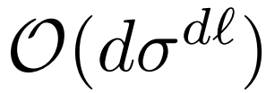
Limitations
Time complexity:
Space complexity:
In order to achieve better bounds, need to find ways to speed up algorithm and reduce memory usage.
Notes:
ince a value must be computed for every possible d-tuple of strings over an alphabet of size σ, the Feasible Triplet Algorithm (Algorithm 2.2) has a time complexity of O(nσdℓ), and since it must store d + 1 vectors of size σ dℓ, it has a space complexity of O(dσdℓ).

Slide 30

Parallelization
Each coordinate of v_{d} can be computed independently of every other coordinate of v_{d}

Slide 31

Parallelization
Each coordinate of v_{d} can be computed independently of every other coordinate of v_{d}
Beyond here, we optimize only binary case.

Slide 32
Indexing
Represent (‘index’) pair of binary strings as 64-bit integer
We index them by interleaving the strings:
a = 1011, b = 0010 = 0…10001110

Slide 33
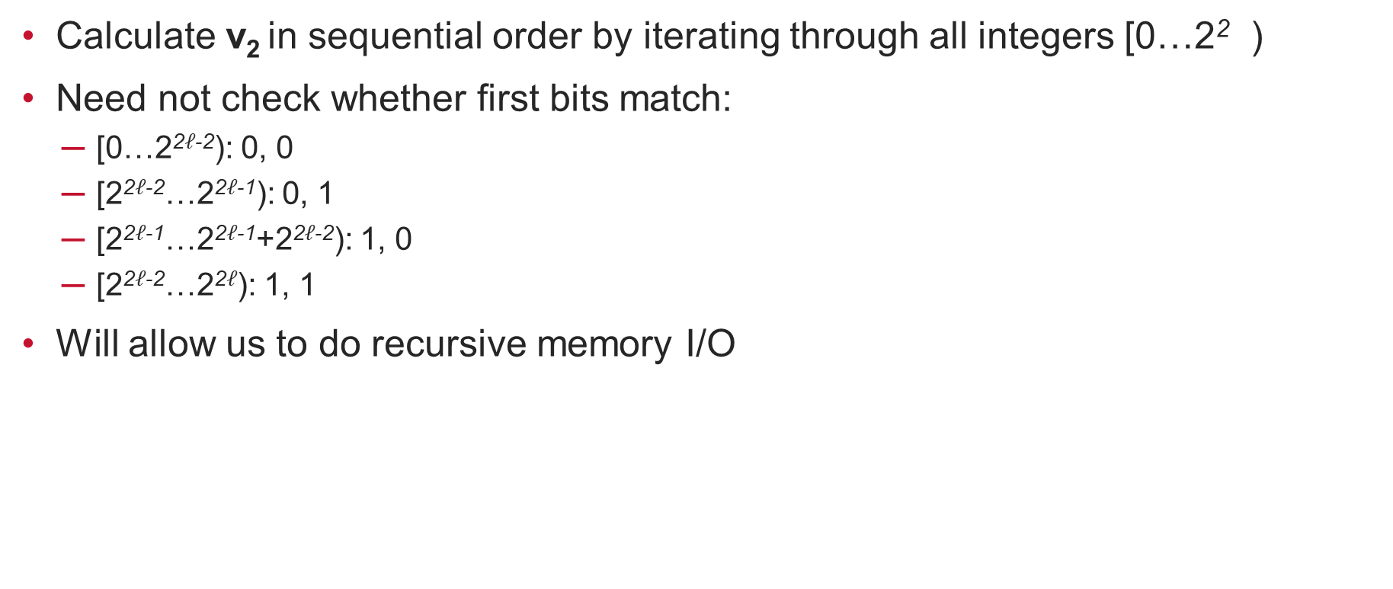
Advantages of Interleaving
Calculate v₂ in sequential order by iterating through all integers [0…2² )
Need not check whether first bits match:
[0…2²$ℓ$⁻²): 0, 0
[2²$ℓ$⁻²…2²$ℓ$⁻¹): 0, 1
[2²$ℓ$⁻¹…2²$ℓ$⁻¹+2²$ℓ$⁻²): 1, 0
[2²$ℓ$⁻²…2²$ℓ$): 1, 1
Will allow us to do recursive memory I/O

Slide 34

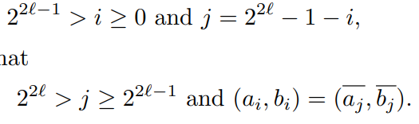
Array Reductions, Symmetries
Lueker notes how to store only store and iterate on two arrays
Complementation does not impact LCS length:
With interleaving, if
then
So, need only iterate until 2^{2l-1}

Slide 35
Sequential Memory Access
Memory is a huge limiting factor
Vector sizes quickly outscale RAM capacity
Non-sequential memory I/O results in >100x slow down
File I/O dominates actual compute time!
Must find way to do sequential memory I/O

Slide 36
Sequential Memory Access
Implement via three loops
L_{0,0}: h(a) = 0, h(b) = 0 for F₁
L_{0,1}: h(a) = 0, h(b) = 1 for F₀
L_{1, 0}: h(a) = 0, h(b) = 1 for F₁

Slide 37
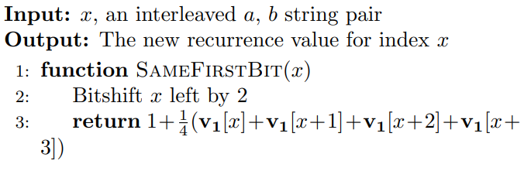

L_{0,0}
Loops from [0…2²$ℓ$⁻²)
For x >= 2²$ℓ$⁻³, after shifting use symmetry to transform back below 2²$ℓ$⁻¹
First 2 bits always 0
Bitshift left by 2 is multiplication by 4
Notes:
Adding 0 is like appending 0 to a and b, adding 1 is like appending 0 to a and 1 to b, adding 2 is like appending 1 to a 0 to b, adding 3 is like appending 1 to a and b

Slide 38
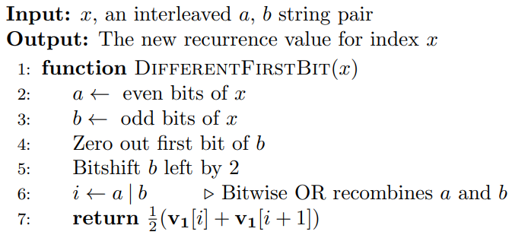

L_{0,1}
Iterated only within [2²$ℓ$⁻²…2²$ℓ$⁻¹)
Notes:
L1,0 calculates the third case (h(a) = 0, h(b) = 1) from F1 (see (2.8)). A similar function as for L0,1 can be defined for L1,0. However, when the second bit of a is 1, the string pair will access values above 2^2ℓ−1 − 1. In this case, we use (3.10) to transform the value accesses to their symmetric position within the vector

Slide 39
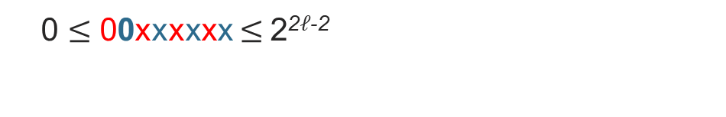
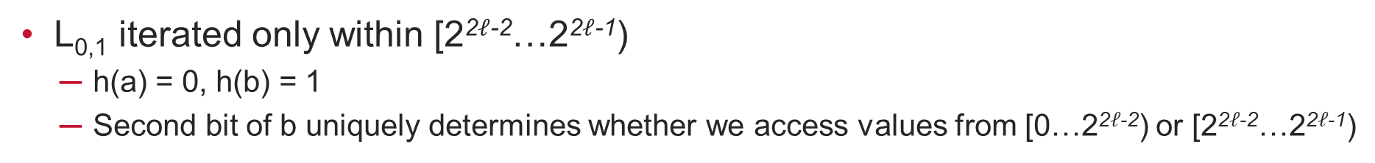
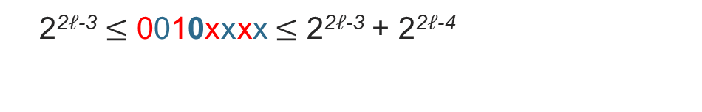
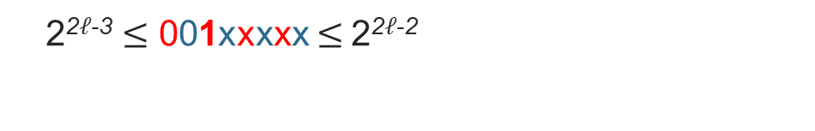
L_{0,1} Recursion
L_{0,1} iterated only within [2²$ℓ$⁻²…2²$ℓ$⁻¹)
h(a) = 0, h(b) = 1
Second bit of b uniquely determines whether we access values from [0…2²$ℓ$⁻²) or [2²$ℓ$⁻²…2²$ℓ$⁻¹)
01100011 v₁[00100110] + v₁[00100111]
0 $≤$ 00xxxxxx $≤$2²$ℓ$⁻²
2²$ℓ$⁻³ $≤$ 001xxxxx $≤$2²$ℓ$⁻²
2²$ℓ$⁻³ $≤$ 0010xxxx $≤$ 2²$ℓ$⁻³ + 2²$ℓ$⁻⁴
…

Slide 40
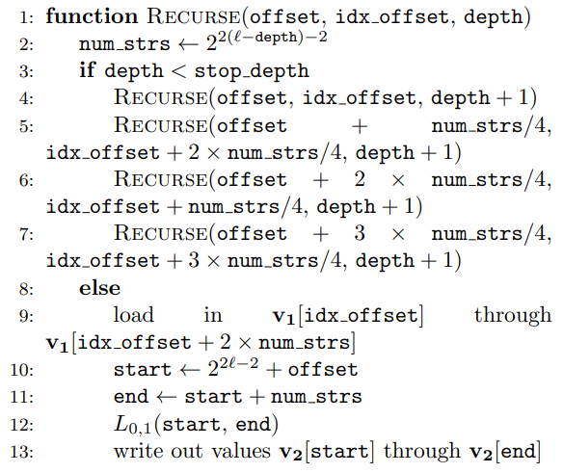
L_{0,1} Memory I/O Recursion
next bit a = 0, next bit b = 0
next bit a = 0, next bit b = 1
next bit a = 1, next bit b = 0
next bit a = 1, next bit b = 1
sequentially reading in
sequentially writing out
Notes:
Set up recursion that is going to tell us where to start the loop (offset) and what values need to be loaded in (idx_offset) Notice here how the multiplications by 2 (lines 5 and 6) aren’t on the same line, that’s precisely because of the bitshifting. And that’s exactly why we need to have a recursion instead of just doing it in the straightforward way.
ssentially, these recursions serve as wrappers for the algorithm, dictating the portions of v2 to calculate and the values from v1 that must be loaded in to facilitate those calculations. By dividing the calculations into specific contiguous chunks, the recursions guarantee that disk memory is read from sequentially, with no unnecessary values read in, while maintaining the property that disk memory is written to in sequential chunks.

Slide 41
L_{1,0}
Can be defined very similarly as L_{0,1}
Same for its recursion
In practice, combine with L_{0,1} to perform max locally
Reduces overhead
Memory I/O recursion becomes messier but even more efficient

Slide 42
Recursive I/O Recap
Interleaved indexing leads to recursive subdivision
Wrap algorithm in driver that dictates slices to calculate and what must be read in for them
Can divide chunks until they fit in RAM
Guarantees no wasted I/O

Slide 43
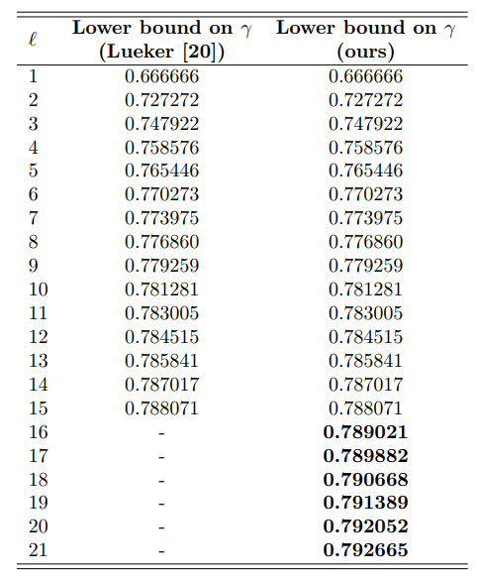
Results
4⁶ = 4,096x ‘harder’ to compute than previous best
New best lower bounds
Notes:
Switch to external memory brings overhead down to less than 18x

Slide 44
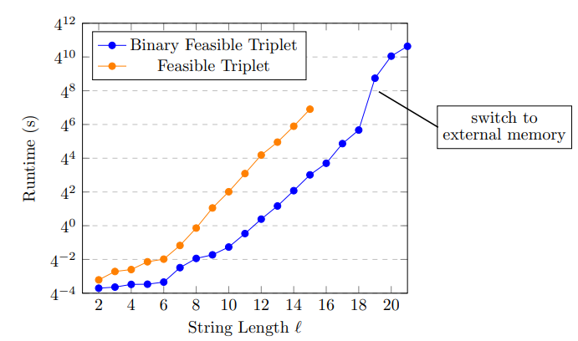
Runtime for $γ$
Less than 18x overhead, compared to >100x previously
Other speedups allow for new best
bounds even without external memory

Slide 45
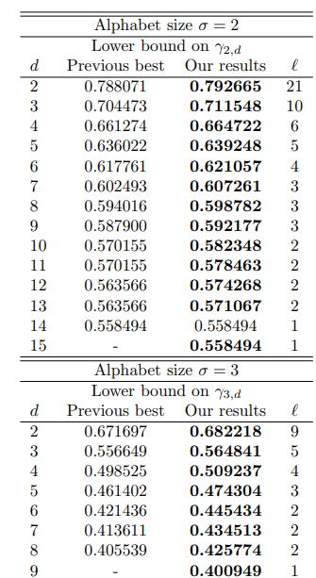
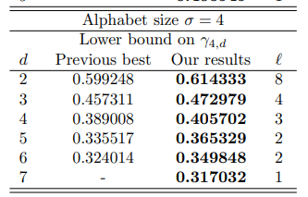
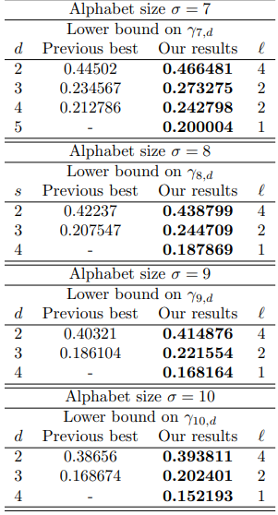
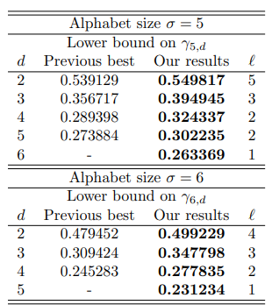
Results (General case)
New best lower bounds for almost all alphabets, numbers of strings
Notes:
Don’t forget to mention new research paper which improved on some of our bounds

Slide 46
Recent Developments
Recent Arxiv paper released 10 days after ours improved on some of our lower bounds
Our bounds for the most important cases remain unbeaten
Improved only on bounds for two strings when alphabet is not of size 2 or 4
https://arxiv.org/abs/2407.18113
Notes:
We were completely unaware of this other paper

Slide 47
Conclusion
New best lower bounds on the Chvátal-Sankoff constants
Optimizations vastly improve performance
Parallelization
Interleaved string indexing
Recursive chunking for sequential memory I/O
Future work
Applying optimizations to upper bound algorithms
Approximating values for general cases
Notes:
Don’t forget to mention the paper published 10 days after ours

Slide 48
Acknowledgements & References
This research was performed using computational resources supported by the Academic & Research Computing group at Worcester Polytechnic Institute.
We would also like to thank James Kingsley, Director of High Performance Computing and Faculty Support, for his advice and assistance in utilizing WPI’s Turing cluster.
References
V. Chvátal and D. Sankoff. “Longest common subsequences of two random sequences”. In: J. App. Prob. (1975).
M. Kiwi and J. Soto. “On a speculated relation between Chvátal-Sankoff constants of several sequences”. In: Comb. Prob. Comp. (2009).
G. S. Lueker. “Improved bounds on the average length of longest common subsequences”. In: J. ACM (2009).
M. J. Steele. Probability Theory and Combinatorial Optimization. Soc. for Ind. & App. Math, 1997.
M. S. Waterman. Introduction to computational biology. Chapman & Hall/CRC, 1995.
Notes:
“As we were exploring the LCS problem…”

Slide 49
Thank you for listening!
Questions?

Slide 50
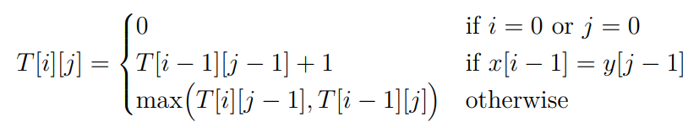

Slide 51

Notation
Let C[j..k] denote the substring C[j]C[j+1] … C[k] for by all the characters between the jth and kth position of C.
Given strings A₁,…,A_{d} of length at least n, we say that B is an n-diagonal common subsequence of A₁,…,A_{d} if B is a common subsequence of a set of prefixes of A₁,…, whose lengths sum to n.
Let D_{n}(A₁,…,A_{d}) denote length of a longest n-diagonal common subsequence of the strings A₁,…, A_{d}. D_{n,sigma,d}

Slide 52
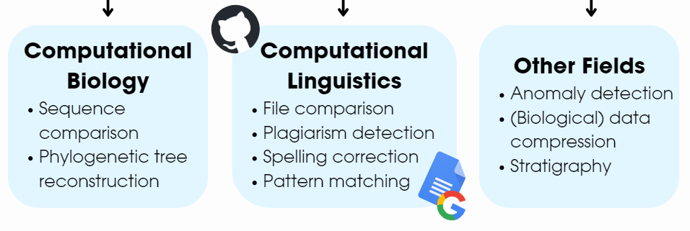
Applications

