Slide 1


뇌종양 치료 및 예후예측을 위한 인공지능기반 영상분석 기술개발
Korea University, Biomedical Engineering
BREIN Lab.
Doo Hwan Son

Slide 2
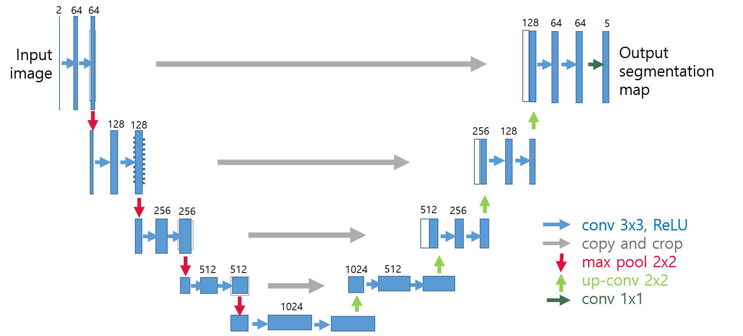

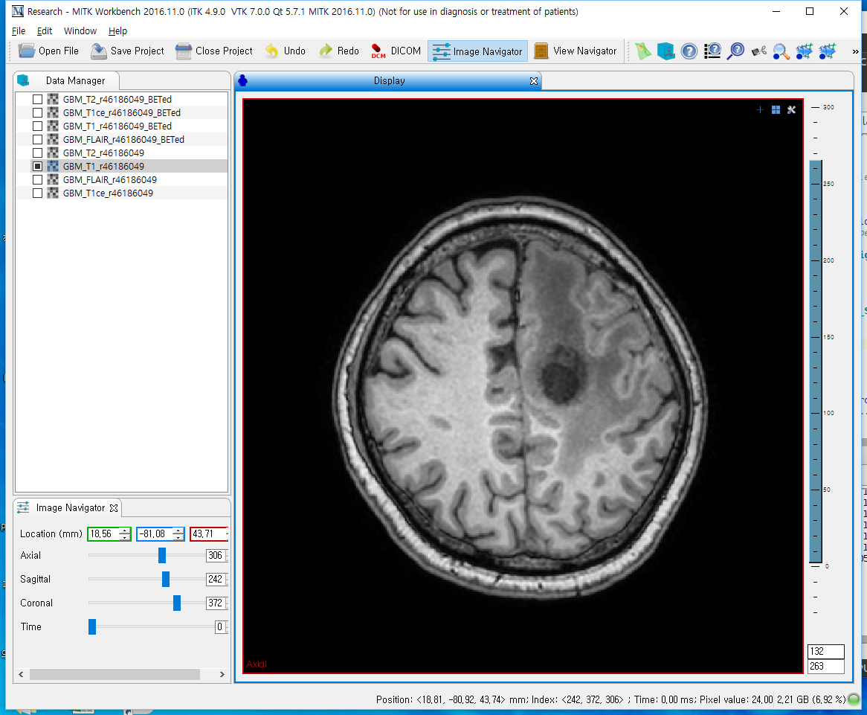
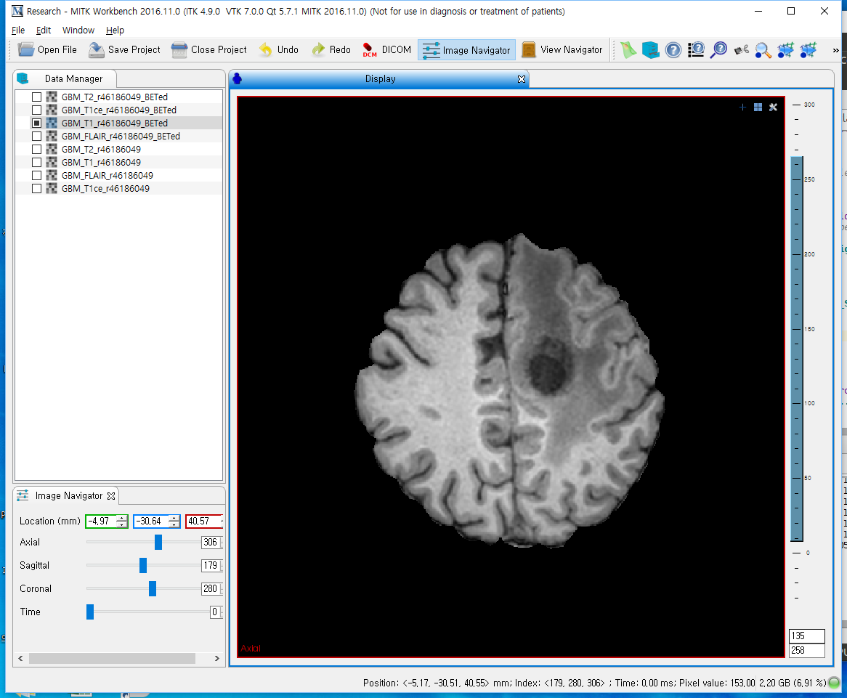

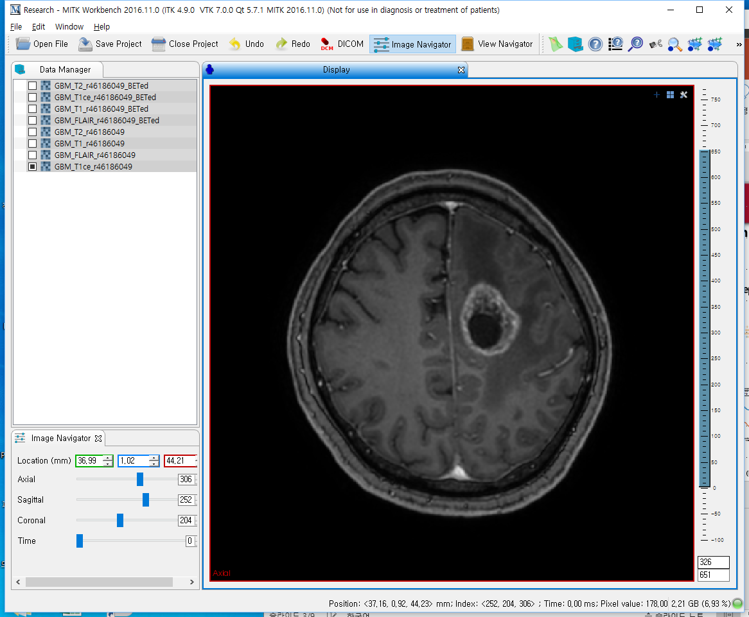
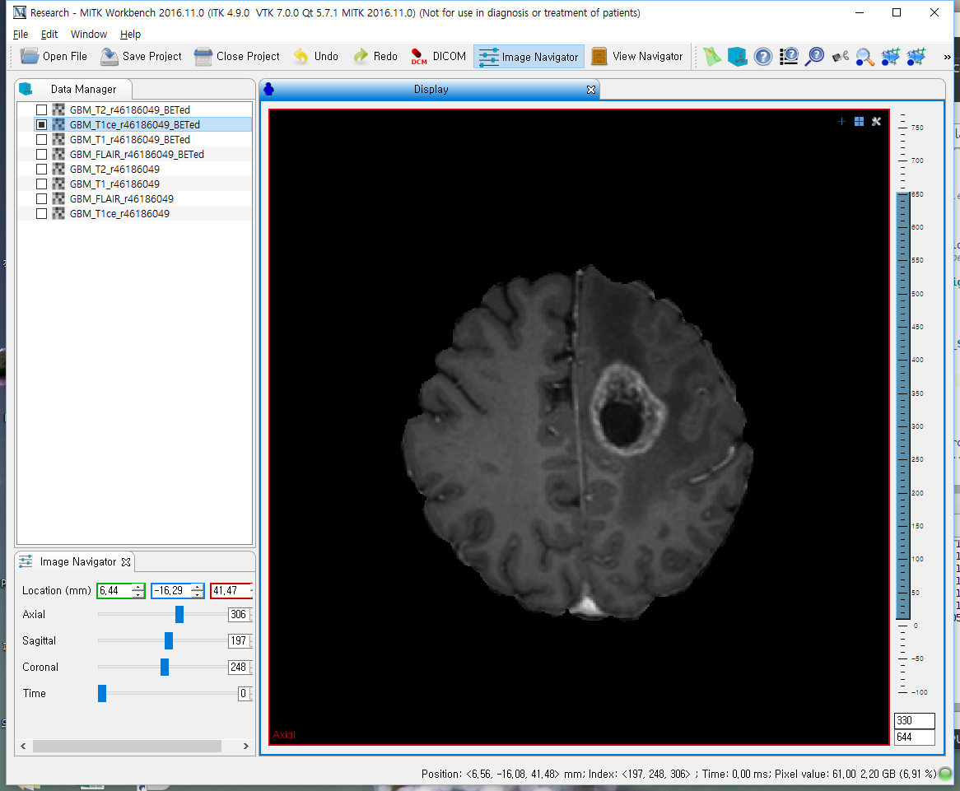
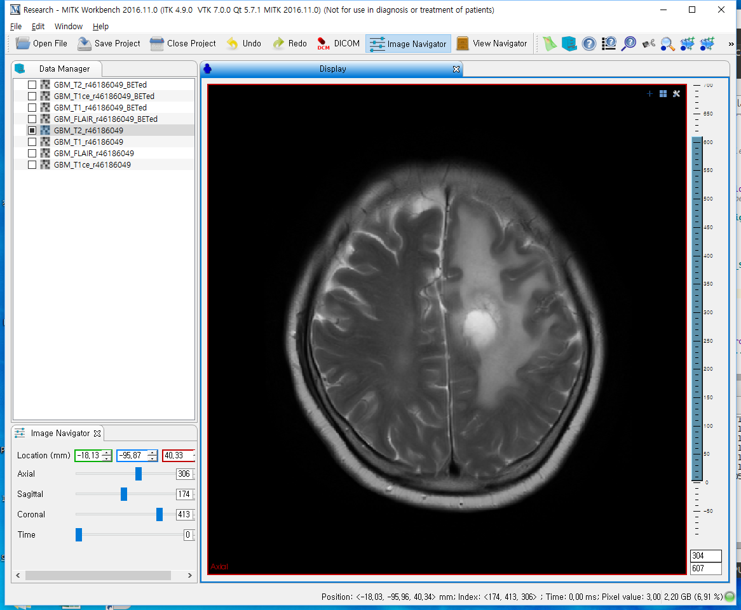
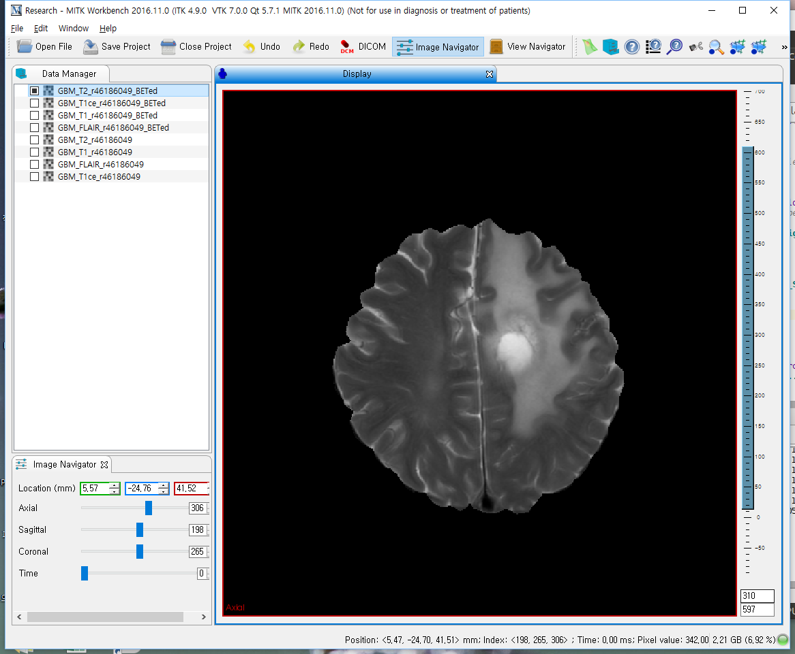
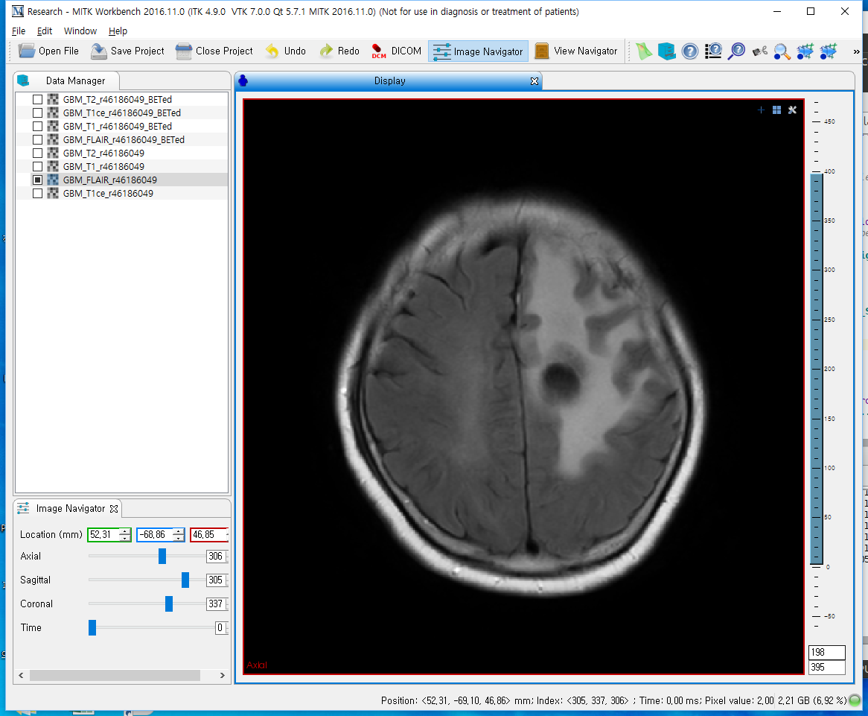
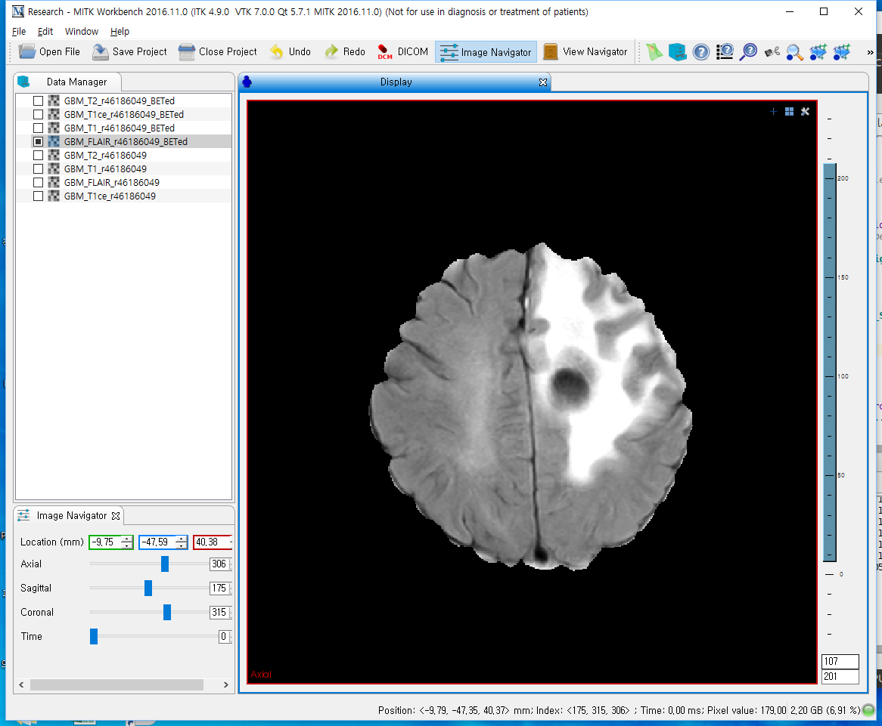
Brain tumor segmentation
연구 목표
Brain glioma patient segmentation with multi-modal MR images
Pre-processing
Deep Learning Segmentation
Co-registration
T1
Flair
T1ce
MRI(4ch)
T2
4channel image
Skull stripping

Slide 3
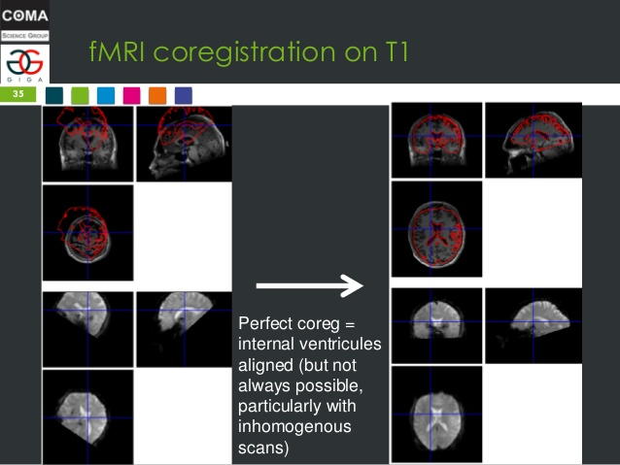
Brain tumor segmentation Co-registration
Co-registration to T1 image
Register T1ce, T2 and FLIAR images to the T1 image of same subject
co-registration reference
co-registration target

Slide 4
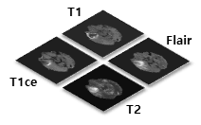
Brain tumor segmentation
Data pre-processing
Seoul National University Hospital data for test
Skull stripping is needed for the noise reduction and segmentation accuracy
Coregister T1ce, T2, FLAIR to T1
MRI(4ch)
T1, T1ce, T2, FLAIR
From test data set, extract 4 channel image
Skull stripping of all modalities

Slide 5
Brain tumor segmentation
Data
BRATS 2015 for training
SNUH for Test and analysis
Survival time, gender, IDH mutation
BRATS 2015 data
BRATS 2015 | LGG | HGG
Subjects | 54 | 220
Slices | 2454 | 6005
SNUH data 처리현황
SNUH original | Astro | AA | GBM
Total Subjects | 56 | 105 | 271
skull stripped | 51 | 103 | 263

Slide 6
Brain tumor segmentation
Subject ID
T1
T1ce
T2
Flair
Segmentation
Image
Segmentation result
Seoul National University Hospital data for test
Everything else
14579620
Necrosis
Edema
17402255
Non-enhancing tumor
Enhancing tumor
25191013
25483976
26922133

Slide 7
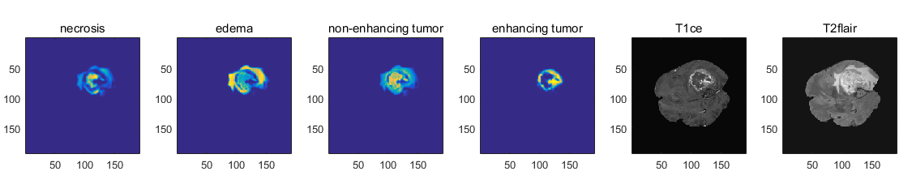
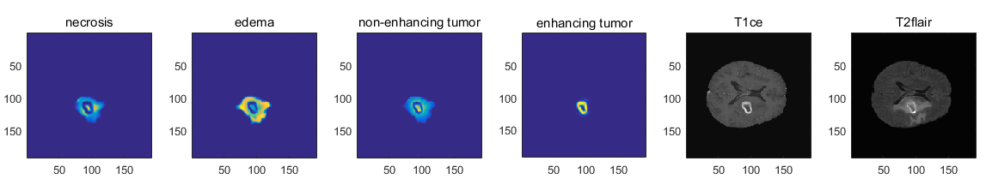
Brain tumor segmentation
Segmentation result
Seoul National University Hospital data for test
Segmentation probability for each four tumor types

