Slide 1
Stanford University Guided Tour
AA272C
Mike Ackermann
Tom Chouinard
Dave Stauffer

Slide 2
Outline
Introduction
Experimental Setup
Software Functionality
Accuracy Discussion
Playback Demonstration
Accomplishments
Conclusions

Slide 3
Introduction
Stanford GPS Guided Tour
  Outdoor tour of Stanford Campus
  Locations based on GPS
    Updated on map in real-time
    Guidance algorithm
  Preprogrammed landmarks
    Audio playback
    Visual aids
  MATLAB GUI displays information to user

Slide 4
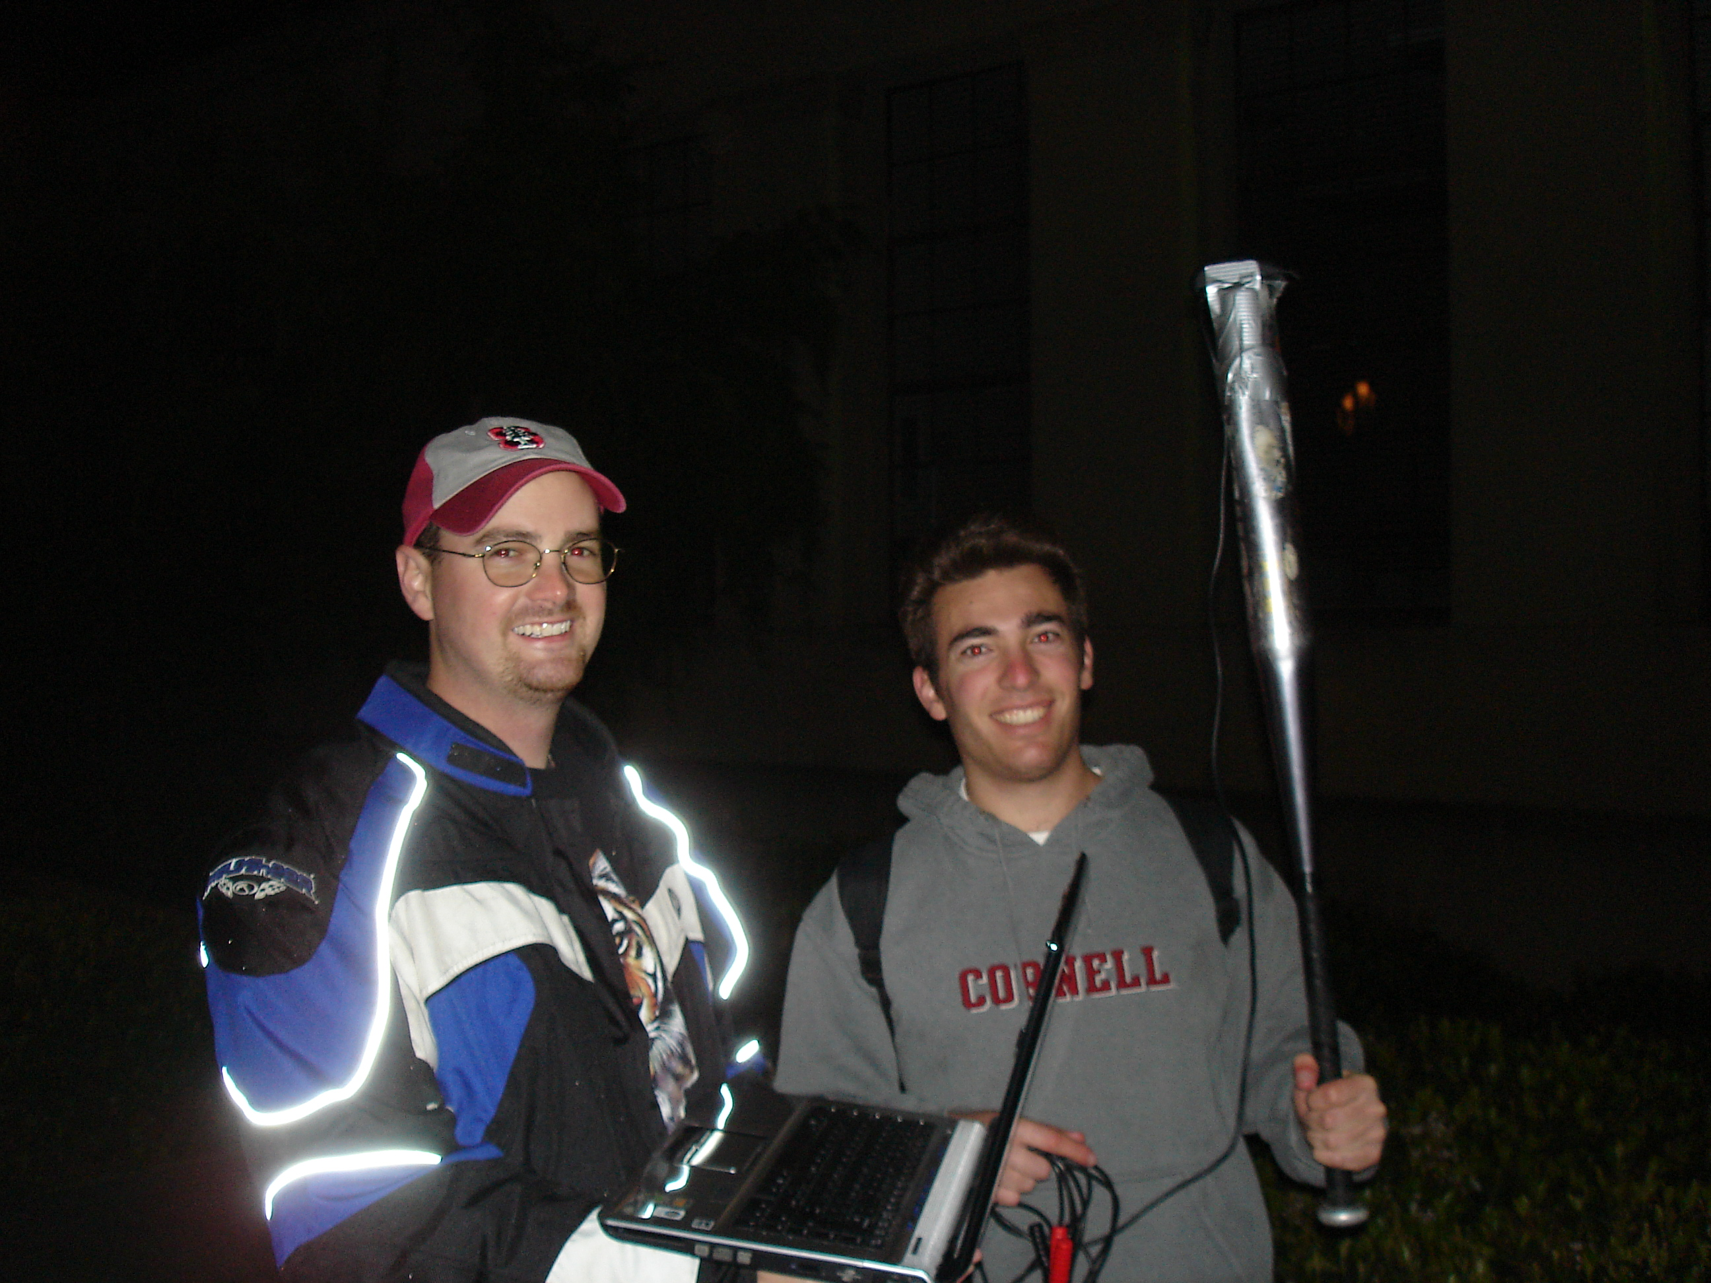
Experimental Setup
Receiver
  Mounted on baseball bat
  9V battery
Laptop
  Running MATLAB
  Hooked to GPS receiver through serial to USB converter
Highly reflective motorcycle jacket
Cornell sweatshirt, Stanford grad student
Tom not shown

Slide 5
Software Functionality
GPS GUI
Main Loop
Position Finder
Stored Travel History
Update GUI
Guidance Algorithm
Display Landmark Information

Slide 6
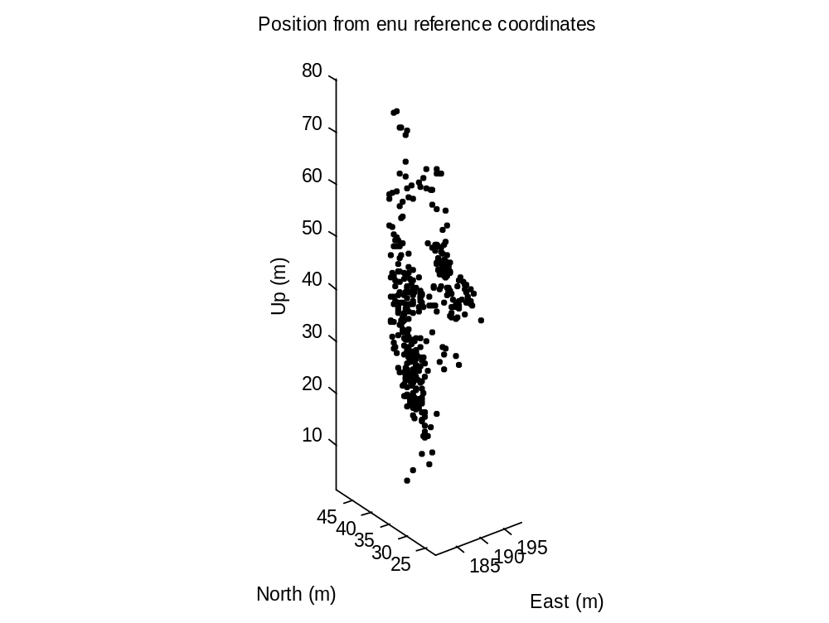
Accuracy Discussion
Measurement | Value
EDOP | 0.65
NDOP | 0.90
VDOP | 2.17
TDOP | 1.28
GDOP | 2.77
Mean Num. Sats. | 7.57
σ_{E} | 3.63 m
σ_{N} | 4.17 m
σ_{U} | 14.72 m
Immobile Position Solution
  15 minute duration
  East and North standard deviations are important

Slide 7
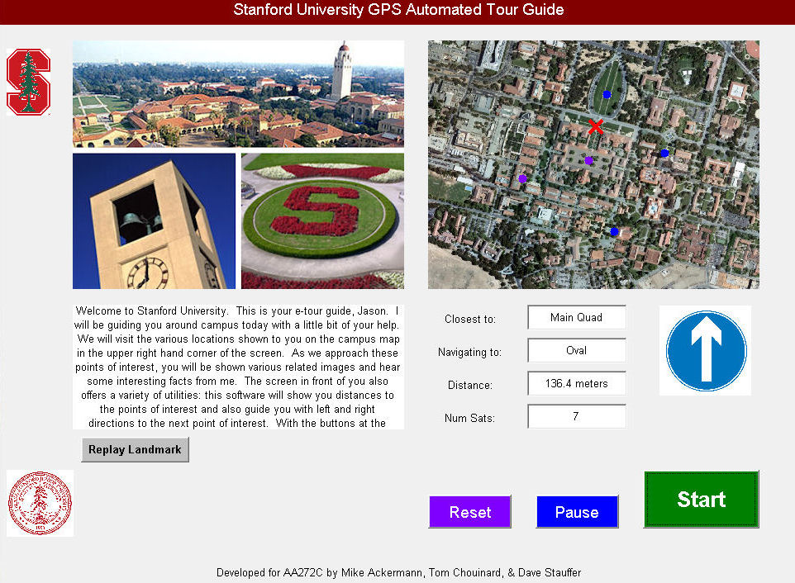
Playback Demonstration

Slide 8
Accomplishments
Reading data in real-time
  Matching receiver and ephemeris data
    Checked for at least four satellites and matched subsets between files
  Updating the GUI as new data emerged
    Each function updated the corresponding GUI field as new values were obtained
Guidance algorithm
  Data too noisy for instantaneous heading
    Implemented average history over some minimum threshold distance traveled
Testing
  Data collection is time consuming and requires walking around in real-time
    Implemented MATLAB function to recreate streaming data
    Modular code allowed testing at other locales

Slide 9
Conclusions
It Works!
  Concept was successfully demonstrated
Recommendations
  Real-time DGPS
    Add a broadcast receiver somewhere on campus to eliminate iono, tropo, and clock biases
  Dual Frequency Receiver
    Eliminates largest error source, the Ionospheric delay
  Cell Phone App
    The laptop, receiver and battery can be condensed into a cell phone
    Application would be downloadable content

